Slide 1
HUNGARY
19 & 20 March 2024

Slide 2
Reduction in antibiotic use in Spain
Hungary, 19th-20th March 2024

Slide 3


WHY DID SPAIN NEED A PLAN ON AMR?
35,8
362,4
ANTIBIOTIC CONSUMPTION: SPAIN vs. European UNION 2014
24
124,6
Human
(DHD)
Animal
(mg/PCU)
Human
(DHD)
Animal
(mg/PCU)

Slide 4







STRATEGIC LINES
2
4
6
PREVENTION
EDUCATION
1
CONTROL
3
COMMUNICATION
5
RESEARCH

Slide 5


REDUCTION ANTIBIOTIC CONSUMPTION BETWEEN 2014 AND 2021
69.5%
69,5%
Sanidad animal
17%
Salud humana

Slide 6












REDUCE PROGRAMS
WG PIGS
WG POULTRY
WG RABBIT
WG DAIRY RUMINANS
WG CATTLE
WG SMALL ANIMALS
WG SHIP AND GOATS
WG AUICULTURE
WG EQUIDAE

Slide 7



ANTIBIOTICS REDUCTION PROGRAMS
ANTIBIOTICS REDUCTION PROGRAMS
Voluntary Programs
Management, biosecurity and hygiene guidelines
Implement management and treatment guidelines
Reduce use of critical antibiotics

Slide 8

PORCINE SECTOR
AGREEMENT FOR VOLUNTARY REDUCTION OF COLISTINE
National veterinary associations
Professionals of the sector
Reduce
Colistin Program
8

Slide 9
PORCINE SECTOR
GOALS:
Reduce the consumption of the COLISTIN:
Control the alternative consumption of the antibiotics:
Objective: 5 mg/PCU in 3 years
Neomycin y Apramycin
Reduce
Colistin Program

Slide 10
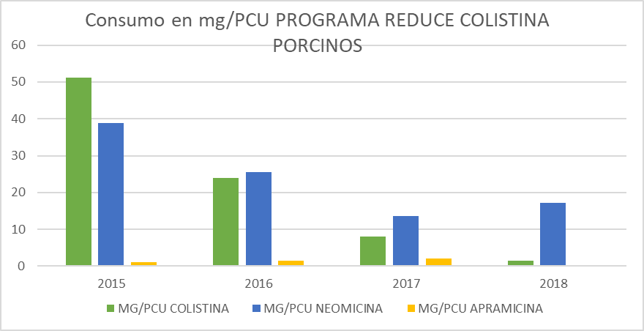
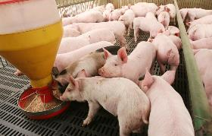
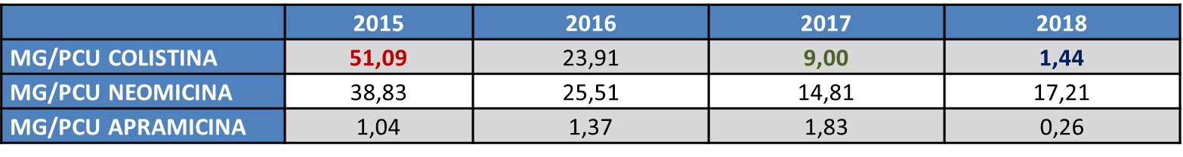
CONSUMPTION IN MG/PCU - REDUCE COLISTIN PROGRAM
106 companies
97,18%
+ 85% production

Slide 11
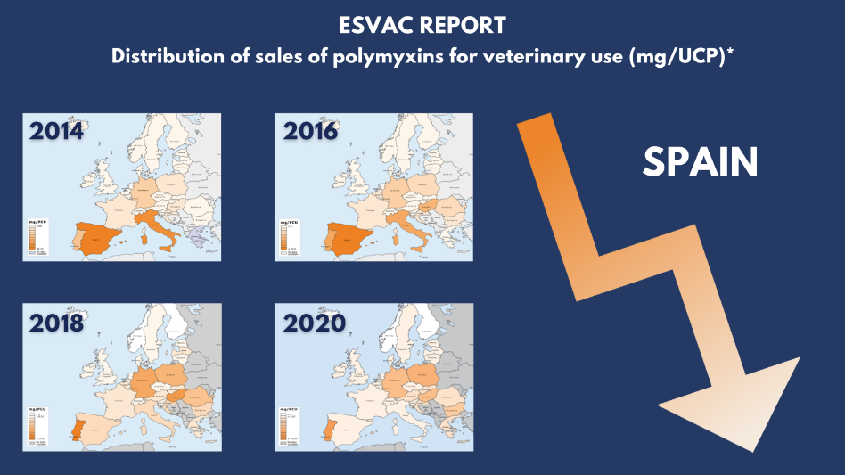
CONSUMPTION IN MG/PCU - REDUCE COLISTIN PROGRAM

Slide 12

Reduce Antibiotics Program
Reduce
Colistin Program
GENERAL REVIEW OF THE USE OF ANTIBIOTICS
Reduce
Antibiotics Program

Slide 13
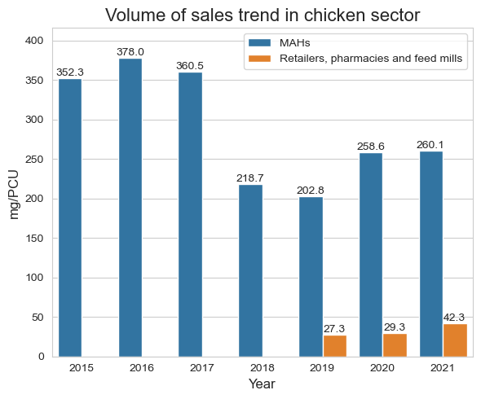

Reduce Antibiotics Program
Reduce
Antibiotics Program

Slide 14
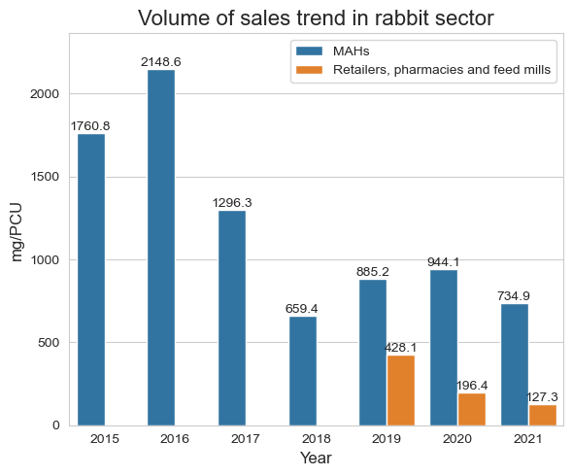

Reduce Antibiotics Program
Reduce
Antibiotics Program

Slide 15
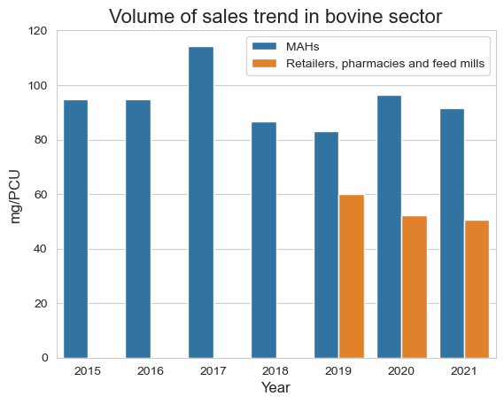


Reduce Antibiotics Program
Reduce
Antibiotics Program

Slide 16
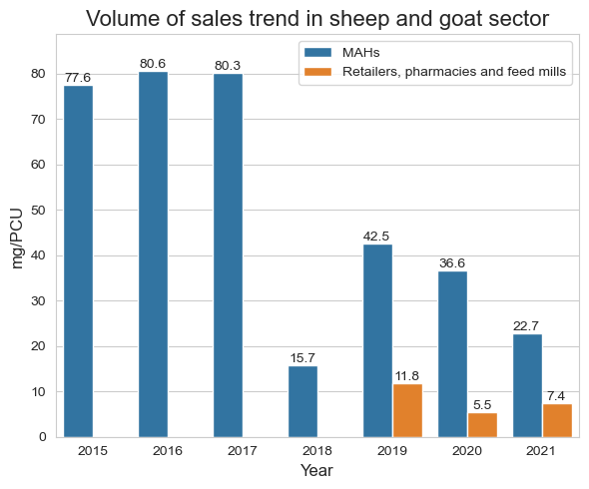

Reduce Antibiotics Program
Reduce
Antibiotics Program

Slide 17
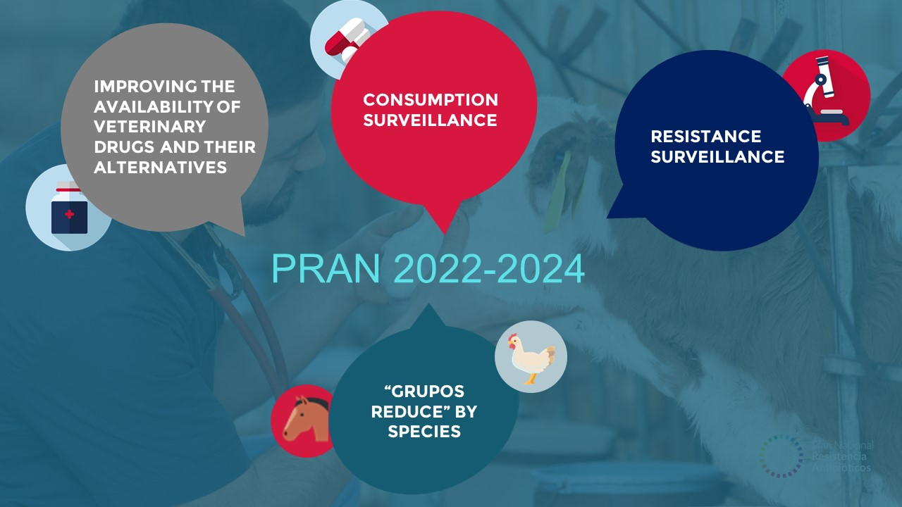
Notes:
three satellite ( satelaid) groups

Slide 18





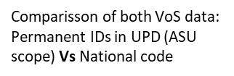







NATIONAL SURVEILLANCE: SALES AND USE DATA COLLECTION
ANTIBIOTICS VOLUME OF SALES BY MAHs
SALES AND USE OF ANTIBIOTICS
MAHs: AB SALES DATA
ANTIBIOTICS USED IN FARMS
VET PRESCRIPTIONS
RETAILERS, VET PHARMACIES AND FEED MILLS: AB USE DATA
ANTIBITOTICS PRESCRIBED BY VETERINARIANS
VET PRESCRIPTIONS
DISCUSSIONS ON DATA AVAILABILITY
18

Slide 19
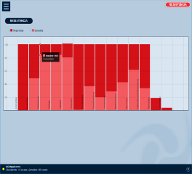
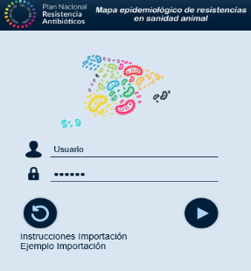
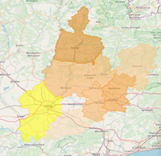
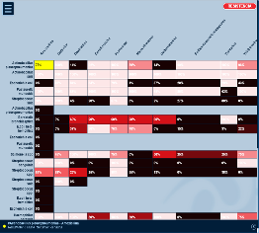
Resistance surveillance
1
GRAFICA
Microrganismo
Resistencia
MIC - 90
MAPA
3
MATRIZ
2
Microrganismo
Resistencia
MIC - 90
Resistencia
MIC - 90

Slide 20
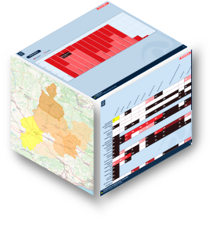




Laboratory results
1
GRAPHIC
2
MAP
3
MATRIX
Database
Options
Time period
Location
Specie
Microorganism
Antibiotic
Report

Slide 21






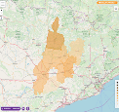
NATIONAL SURVEILLANCE: EPIDEMIOLOGYCAL PATHOGENS DATA
Aggregate information of antibiotic resistance at the national level that allows to analyze:
-Trends
-Relationships with antibiotic consumption
-Specific measures
GOALS
      EARS-VET
Network of voluntary laboratories with the same methodology or equivalent methodologies for the identification of pathogenic bacteria and their resistance profile
Volunteer pilot project
Prescription tool for the clinicians with useful epidemiological information for other clinical cases produced by the same pathogen
21
Notes:
In terms of surveillance of resistance in animal health, the Clinical Pathogenic Bacteria Surveillance Project in animal health is underway.
This ambitious project is a pioneer at a national level and one of the first at a European level.
With the creation of this project, the PRAN wants to expand knowledge about resistance in animal health, necessary to identify trends in the evolution of resistance and implement specific actions against them.
The main objectives of this project are:
Identify trends in the resistance of clinical pathogenic bacteria in animal health.
Promote the taking of samples to determine diagnosis and susceptibility and unify criteria and methodology by creating a network of laboratories.

Slide 22
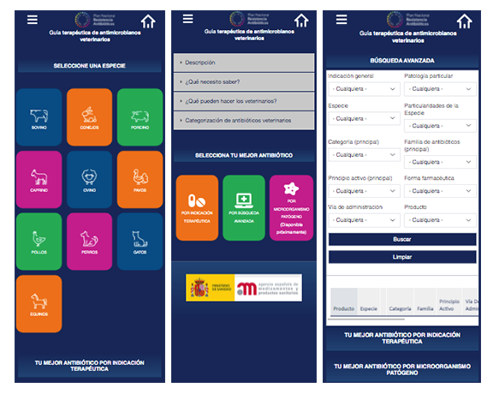
Prescribing guidelines
https://www.resistenciaantibioticos.es/es/lineas-de-accion/control

Slide 23
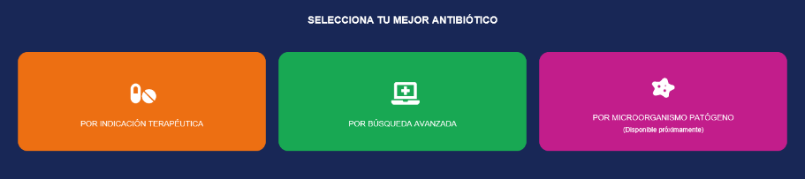
Prescribing guidelines
Orderly selection of the various criteria.
Facilitates in case of cascade prescribing.
Quick search by selection of a few criteria.
Treatment recommendation according to the most relevant epidemiological information.
Fed by the EPIDEMIOLOGICAL MAP

Slide 24







WORKING GROUP ON AVAILABILITY
Working Group on Availability of AM Medicinal Products and Alternatives to their Use
MINISTRY OF AGRICULTURE
INDUSTRY
FUNDACIÓN VET + I
CODI-VET
CCAA
24
COORDINATION UNIT

Slide 25



WORKING GROUP ON AVAILABILITY
Working Group on Availability of AM Medicinal Products and Alternatives to their Use
Working Group on Availability of AM Medicinal Products and Alternatives to their Use
25

Slide 26
WORKING GROUP ON AVAILABILITY
Identification of therapeutic gaps
Listing of the field therapeutic gaps for each sector
Reasons of the Gaps
A list (prioritisation) of therapeutic gaps
Possible ways of collaboration between the three countries

Slide 27














COMMUNICATION
III Edition
PRAN running race
EAAD and WAAW
III Edición PRAN Awards
General public campaigns
CGCOF campaign
CONTINUITY
2022-2024
European campaigns dissemination
World Hand Hygiene Day campaign
Debate kit for schools
Conferences and events
27

Slide 28
¡Thanks for your interest!

