Slide 1
ESTONIA
10th-11th April 2024

Slide 2
General introduction to the AMR impact. Focus on country’s AMU & AMR figures
Estonia, 10th-11th April 2024

Slide 3
Objective
Setting the scene with general data and figures on resistance, economic impact, actions taken until now, and from now on. Main figures on AMU in animal food-producing species and AMR of the country in which the session is organised will be provided

Slide 4
Content
What is Antimicrobial Resistance?
Main figures on AMU and AMR in animal food-producing species
Actions taken until now, and from now on

Slide 5
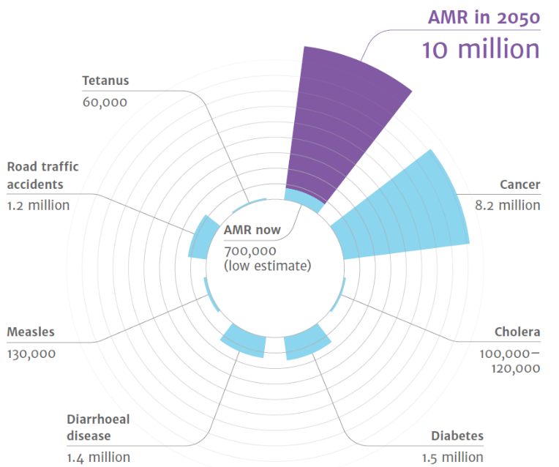
Antimicrobial Resistance
A Global threat
Economical impact
Estimated number of deaths caused by AMR in 2050 in comparison with current common causes of deaths
The estimated cost of AMR for healthcare systems in Europe is
€1.1 billion
per year
Notes:
‘Tackling drug-resistant infections globally: Final report and recommendations’ - THE REVIEW ON ANTIMICROBIAL RESISTANCE
CHAIRED BY JIM O’NEILL – May 2016 - https://amr-review.org/sites/default/files/160525_Final%20paper_with%20cover.pdf
Over the last two decades, the total consumption of antibiotics in humans increased modestly in OECD and EU/EEA and substantially across non-
OECD G20 countries.
The animal sector has been actively participating in the development and implementation of nearly all action plans developed by OECD, EU/EEA and G20 countries
Enhanced food handling practices and improving biosecurity in farms promise reductions in resistant infections.
The benefits of enhancing farm biosecurity entirely offset implementation costs.
By 2050, the United Nations, based on the Jim O’Neil’s report, estimates that up to 10 million deaths per year could be caused by superbugs and associated forms of antimicrobial resistance.
The graphic shows the predicted mortality from AMR compared with common causes of current deaths, and its estimates in deaths in the year 2050.
The data of the different causes of current deaths are taken from the different sources:
Diabetes: www.whi.int/mediacentre/factsheets/fs312/en/ Cancer: www.whi.int/mediacentre/factsheets/fs297/en/
Cholera: www.whi.int/mediacentre/factsheets/fs107/en/ Diarrhoeal disease: www.sciencedirect.com/science/article/pii/So140673612617280
Measles: www.sciencedirect.com/science/article/pii/So140673612617280 Road traffic accidents: www.whi.int/mediacentre/factsheets/fs358/en/
Tetanus: www.sciencedirect.com/science/article/pii/So140673612617280
Actually, Antimicrobial Resistance is having a huge impact on the healthcare systems in Europe, around 1.1 € billion per year, according to data from the Organisation for Economic Co-operation and Development (OECD).
When an infection does not respond to a first-line antimicrobial treatment ("First-line treatment is the first recommended treatment option"), healthcare professionals turn to more expensive alternatives, such as second-and third-line drugs (the last treatment options available). Complications or the longer duration of a disease or treatment sometimes require longer hospital stays, with the corresponding costs.
Source: OECD (2018), Stemming the Superbug Tide: Just A Few Dollars More, OECD Health Policy Studies, OECD Publishing, Paris, https://doi.org/10.1787/9789264307599-en.

Slide 6


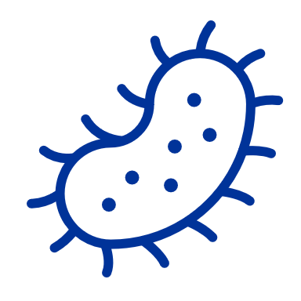




How does AMR occur?
Use of antimicrobials,
overuse and misuse
Microbes develop resistance
Diseases spread more easily, persist or kill
Antimicrobials become less effective
Notes:
Antimicrobial resistance (AMR) is the ability of micro-organisms to survive or grow despite antimicrobial agent that normally inhibits or kills that micro-organism.
It is the consequence of a natural selection and genetics. Antibiotic resistance occurs too when bacteria change to protect themselves from an antibiotic.
And additional human drivers promote resistance development such as:
Inappropriate use:
Overuse:
sharing antibiotics
using antibiotics without the need for that
using antibiotics for viral infections and inflammation
Misuse:
using antimicrobials as animal growth promoters on farms or in aquaculture
not completing the course or taking an insufficient dose
taking antibiotics for the wrong indications such as viral infection and inflammation
Over time, this makes antimicrobials less effective and ultimately useless in human and veterinary medicine.
All bacteria spread through air, water, soil, food or living vectors.
Next slide illustrates the various directions of spread.

Slide 7
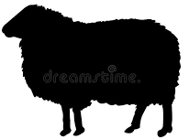
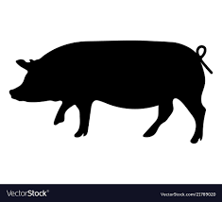








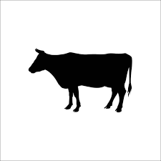













Illustration of directions in which resistance can be spread
Antibiotics are given to humans, in hospitals, in the community and are also given to pets.
Gut bacteria of humans and animals can develop resistance and may be transferred among them. The development of resistance could be accelerated due to overuse and misuse of antimicrobials.
Livestock
Food-producing animals
Antibiotics are used in farming
Aquaculture
Drug resistant bacteria spread to other patients / through poor hygiene and unclean facilities
Ingestion of contaminated feed, water, dust, soil
Plant based food
Antibiotic residues from untreated human waste, sewage/water supply
In hospitals
Environment
Ingestion of contaminated water
Pets
Birds, insects, other animals that act as vectors
Air, dust, soil
In animals, gut bacteria may develop resistance which can spread to other animals via contact, untreated waste, lack of hygiene
In community
Water
Humans
Antibiotic residues from untreated livestock waste
Drug-resistant bacteria reach humans through food and environment
Ingestion of food containing bacteria with resistance genеs
food
Arrows represent transfer of antibiotic- resistant genes or bacteria
Notes:
The resistance can be spread in many different ways through the environment, food or via close contact with animals and other humans:
Antimicrobials are given to animals and humans.
Bacteria in their guts can develop resistance.
From animals to humans, via food or environment:
- Drug-resistant bacteria can remain on meat from animals. When not handled or cooked properly (hygiene measures), the bacteria can spread to humans.
Animal faeces with drug-resistant bacteria may be spread by the fertilizers and/or water, used in food crops.
Drug-resistant bacteria in animal faeces can remain in crops and be eaten. These bacteria can remain in the human gut.
Drug-resistant bacteria in animals may be spread to other animals in the farm, via water, faecal contamination, close contact.
From humans to humans, via hospitals, close contact with pets, in the community and via environment:
Humans may develop resistance to drugs in the gut, and can also develop resistance from overuse or misuse of antimicrobials.
At hospitals patients can develop resistance to drugs, that spreads when going home. It can also spread to other patients indirectly via unclean hands through surfaces within the healthcare facility.
The drug-resistant bacteria can then be spread into the community.

Slide 8
Resistant bacteria infect 800.000 people every year
Source: ECDC European Centre for Disease Prevention and Control)
Notes:
In 2020, over 800 000 people were infected by antibiotic-resistant bacteria in Europe. The resultant diseases included pneumonia and bloodstream and intra-abdominal infections. (Source: ECDC European Centre for Disease Prevention and Control).
Overall in the EU/EEA, AMR percentages for the bacterial species–antimicrobial group combinations under surveillance continue to be high:
carbapenem resistance in Escherichia coli and Klebsiella pneumoniae (K. pneumoniae),
vancomycin resistance in Enterococcus faecium showing a significant increase during 2016–2020.
High percentages of resistance to third-generation cephalosporins and carbapenems in K. Pneumoniae
high percentages of carbapenem-resistant Acinetobacter species and Pseudomonas aeruginosa
(Source: Antimicrobial resistance surveillance in Europe 2022)
in several countries in the European Region are of concern.

Slide 9
This slide is hired - not to be seen!!!
Malta: 7 x 5,15* = 36,05 deaths in 2020
Data to update the next slide in each HOT session depending on the country
Hungary: 6 x 98* = 586 deaths in 2020
Countries | Population in 2020 | Deaths by AMR in 2020 | Population / 100.000 | Total deaths
Austria | 8.901.064 | 3 | 89 | 267
Belgium | 11.522.440 | 5 | 115 | 576
Bulgaria | 6.951.482 | 4 | 70 | 278
Croatia | 4.058.165 | 7 | 41 | 284
Cyprus | 888.005 | 10 | 9 | 89
Czechia | 10.693.939 | 5 | 107 | 535
Denmark | 5.822.763 | 3 | 58 | 175
Estonia | 1.328.976 | 3 | 13 | 40
Finland | 5.525.292 | 3 | 55 | 166
France | 67.485.531 | 5 | 675 | 3.374
Germany | 83.166.711 | 7 | 832 | 5.822
Greece | 10.718.565 | 20 | 107 | 2.144
Hungary | 9.769.526 | 6 | 98 | 586
Ireland | 4.964.440 | 4 | 50 | 199
Italy | 59.641.488 | 19 | 596 | 11.332
Latvia | 1.907.675 | 5 | 19 | 95
Lithuania | 2.794.090 | 7 | 28 | 196
Luxembourg | 626.108 | 4 | 6 | 25
Malta | 514.564 | 7 | 5 | 36
Netherlands | 17.407.585 | 2 | 174 | 348
Poland | 37.958.138 | 9 | 380 | 3.416
Portugal | 10.295.909 | 10 | 103 | 1.030
Romania | 19.328.838 | 13 | 193 | 2.513
Slovakia | 5.457.873 | 7 | 55 | 382
Slovenia | 2.095.861 | 5 | 21 | 105
Spain | 47.332.614 | 4 | 473 | 1.893
Sweden | 10.327.589 | 3 | 103 | 310
TOTAL | 447.485.231 |  |  | 36.214
Estonia: 3 x 13* = 40 deaths in 2020
Romania: 13 x 193* = 2.513 deaths in 2020
Slovakia: 7 x 55* = 382 deaths in 2020
Croatia: 7 x 41* = 284 deaths in 2020
Portugal: 10 x 103* = 1.030 deaths in 2020
Luxembourg: 4 x 6* = 25 deaths in 2020
Cyprus: 10 x 9* = 89 deaths in 2020
Source population in 2020: Eurostat data
Notes:
Source data to next slide. To be changed adapted to the country where the session is being held.

Slide 10
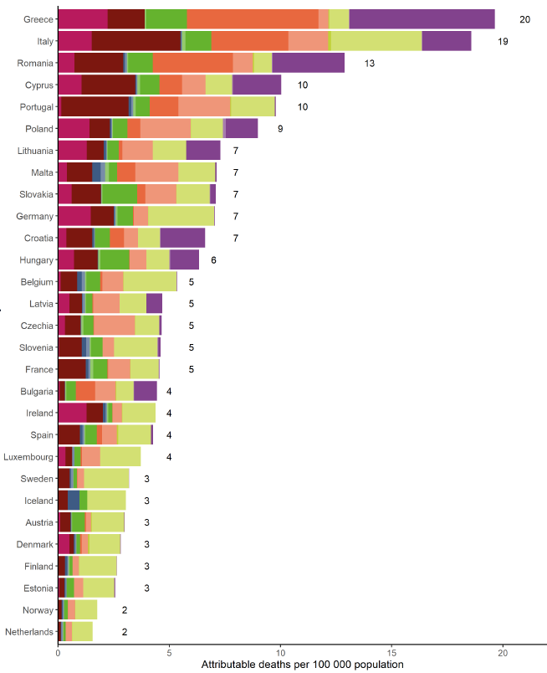
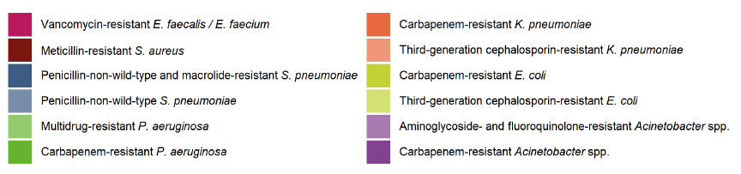
Estimation of the burden of infections with antibiotic resistance bacteria presented as attributable deaths per 100.000 population by country, EU/EEA, 2020
100 people died from AMR each day in Europe in 2020.
2.100 died from AMR in EU in 2020.
Estonia
40 deaths in 2020
Malta’s population in 2020 515.000 (7 x 5,15 = 36 deaths)
Assessing the health burden of infections with antibiotic-resistant bacteria in the EU/EEA, 2016-2020 TECHNICAL REPORT
Notes:
Antimicrobial resistance affects real people
Source Eurostat - Population of Estonia in 2020: 1.328.976
Estonia’s population in 2020: 1.328.976 (3 x 13*) = 40 deaths in 2020

Slide 11
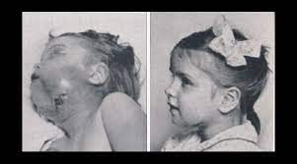
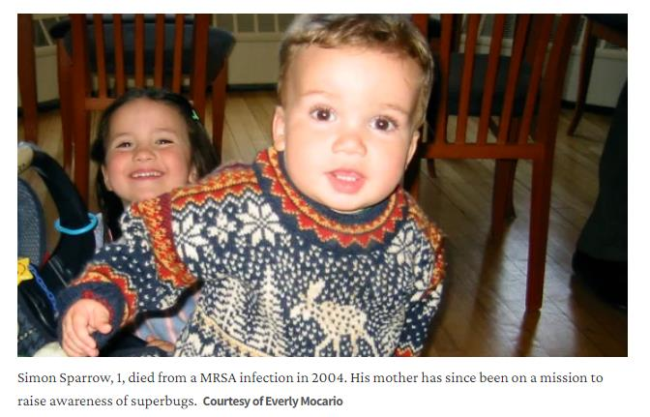

1942 Sara
2004 Simon
Notes:
Antimicrobial resistance affects real people. The child in 1942 had blood poisoning, and following the logic of the time, she should have died. But they tested penicilin on her, and safed her life.
A child in 2000 era, died because of an MRSA-resistant bacteria, antimicrobials had no effect on him. His mom said “He was born full term. He had all his vaccinations. I breast-fed him exclusively for his full year-and-a-half of life. He didn't have any underlying diseases”
This is a reality. This is really happening.

Slide 12
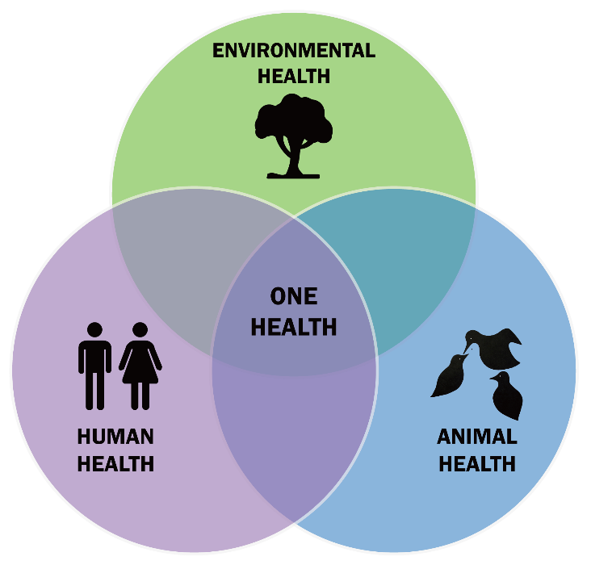
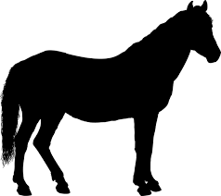

AMR is present in animals, food, plants and the environment
Antimicrobial consumption in animals
Antimicrobial consumption in humans
A
H
Notes:
The One Health concept recognises that human health is tightly connected to the health of animals and the environment, i.e. that animal feed, human food, animal and
human health, and environmental contamination are closely linked.
This reflects the European Commission's 'One Health' approach to AMR, by addressing the human and veterinary sectors together in a holistic and coordinated approach
Increased antibiotic use is a matter of concern as antibiotic resistance is considered to be a serious threat to human and animal health and welfare in the future, and growing levels of antibiotics or antibiotic-resistant bacteria in the environment could increase the numbers of drug-resistant infections in both.
The wording of the graphic focuses on antimicrobial consumption in food-producing animals. But in principle, it is not limited to food-producing animals only despite the fact we're talking to farmers and food-producing animal vets.

Slide 13
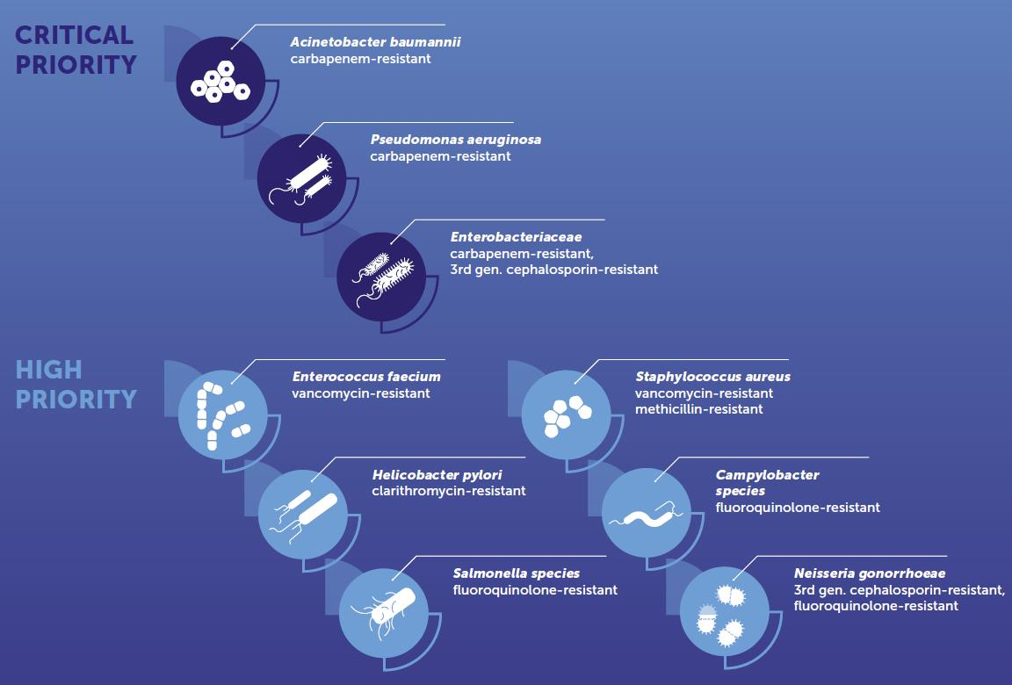
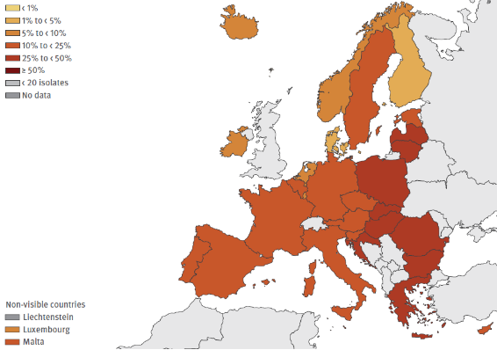
Urgent need for new antibiotics: pathogens classified as critical, high and medium priority, based on the limited available treatment
67.638 infections
3.210 deaths
Map produced by ECDC on 23 February 2023 percentage of invasive isolates with resistance to carbapenems (imipenem/meropenem),
Data Source: ECDC EU 2020
Notes:
Many pathogens do not respond to treatment already.
Pathogens, common for human and animals, can acquire multiple resistance mechanisms and hence become resistant to several antimicrobial agents. This is particularly problematic as it may severely limit the treatment alternatives available for the infection
Critical priority pathogens identified as those in the image, are resistant to many antibiotics, including Carbapenem-resistant. Pose a significant threat to patients, healthcare systems, and animal health in all EU/EEA countries.
Acinetobacter baumannii:
Causes serious infections in healthcare settings.
The epidemiological situation in Europe has worsened in the past years, with a higher number of countries reporting interregional spread or endemicity of carbapenem-resistant A. baumannii.
A. baumannii is adapted to persistence in healthcare settings and is difficult to eradicate once it has become established there (this is, once it is introduced in a healthcare setting, it is very difficult to eradicate).
Increased efforts are therefore needed for the detection of cases and the control of outbreaks in order to prevent carbapenem-resistant A. baumannii from becoming common in further European regions and health facilities.
Pseudomonas aeruginosa: map of Europe (2021)
in 2020 there were 67 638 infections with carbapenem-resistant P. aeruginosa and 3 210 deaths attributable to the same bacterial species antimicrobial group combination
Enterobacteriaceae:
High transmissibility. Urgent to early detect Carbapenem-resistant Enterobacterales (CRE) infections
Associated with high mortality, due to delays in the administration of effective treatment and the limited availability of treatment options.
Image of Critical and High priority bacteria for which effective treatment is in danger → Source: WHO Prioritization of pathogens to guide discovery, research and development of new antibiotics for drug-resistant bacterial infections 2017
Examples information → Source ECDC Antimicrobial resistance surveillance in Europe 2023 report, data from 2021.

Slide 14
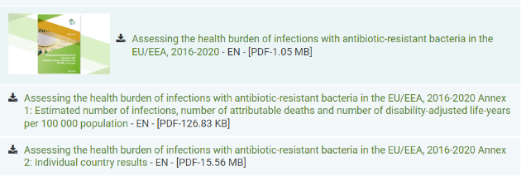
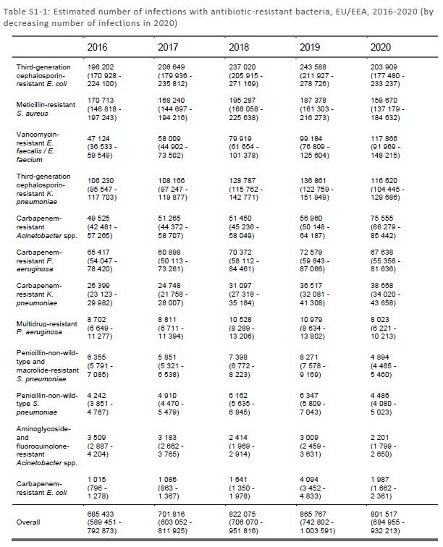
https://www.ecdc.europa.eu/sites/default/files/documents/Annex_1_burden_estimate_by_antibiotic_resistance_bacterium.pdf
Notes:
Hidden slide: Data source of previous slide on infections of Carbapenem-resistant P.aeruginosa

Slide 15
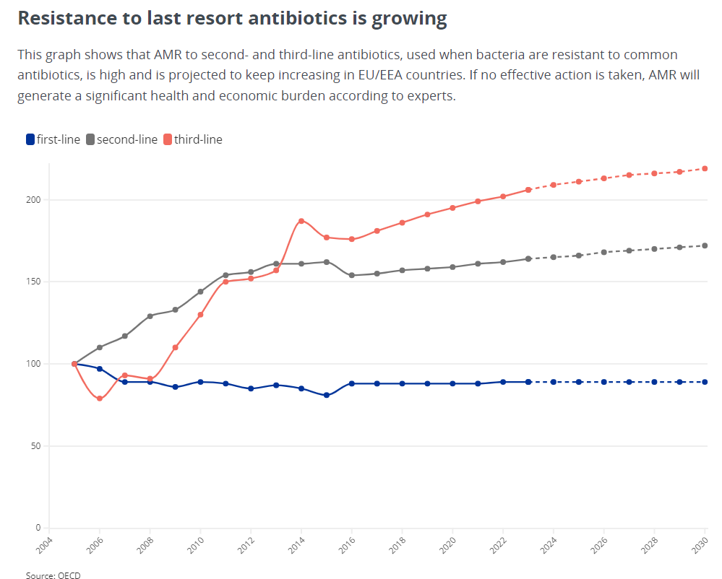
Notes:
There is a categorization of antibiotics according to OCDE, of first line, second line and third line, that corresponds to WHO classification of Access, Watch and Reserve (AWaRe)
First line (line in blue): those antibiotics with a reliable antibiotic activity, broad-spectrum agents. These antibiotics can be used in animals in a prudent manner. Example – Beta-lactams, including penicillins and cephalosporins, i.e., tetracycline
They correspond to the World Health Organisation (WHO) classification of “A” = Access – antibiotics that offer the best therapeutic value, while minimising the potential for AMR.
Second line: only few alternatives are available in certain veterinary indications. Example –mycrolise
They correspond to the World Health Organisation (WHO) classification of Wa = Watch - antibiotics with higher AMR potential and should be prioritised in stewardship and monitoring efforts. ‘Watch’ antibiotics include most of the highest priority agents in the WHO Critically Important Antimicrobials for Human Medicine
Third line: Antibiotics in this category are critically important in human medicine and their use in animals should be restricted to mitigate the risk to public health.example – colistine
They correspond to the World Health Organisation (WHO) classification of Re = Reserve: antibiotics include antibiotics of last resort and should be saved for treatment of confirmed or suspected infections due to multidrug-resistant organisms. Agents included in this analysis: antibacterials for systemic use, neomycin, streptomycin, polymyxin B, kanamycin, vancomycin, colistin, rifamixin, fidaxomicin, rifamycin, rifampicin, rifamycin, rifabutin, metronidazole, tinidazole, ornidazole and secnidazole.

Slide 16
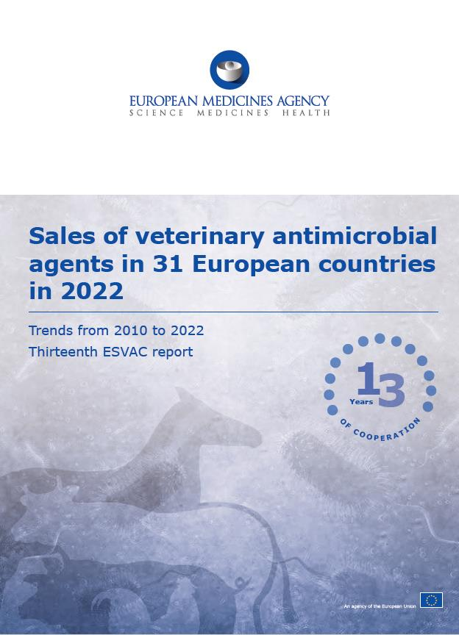
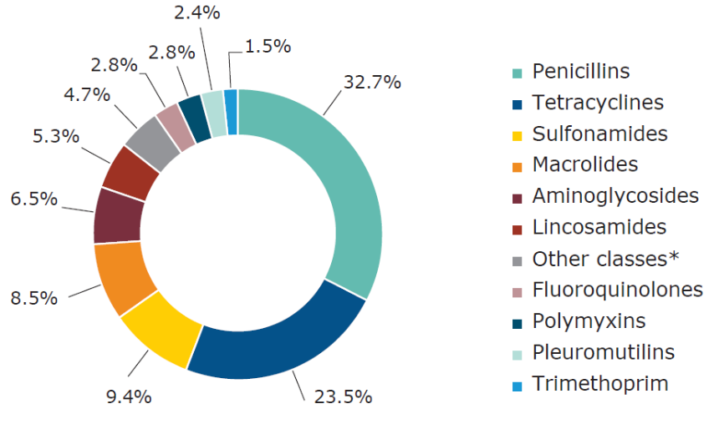
European Medicines Agency (EMA) - Thirteen European Surveillance of Veterinary Antimicrobial Consumption – ESVAC report 2022
How antimicrobials medicines are used in animals across the European Union
Notes:
The European Medicines Agency (EMA) started the ESVAC project in 2009.
The European Surveillance of Veterinary Antimicrobial Consumption (ESVAC) project collected information from 2009 to 2023 on how antimicrobial medicines are used in animals across the European Union (EU). This type of information is essential to identifying possible risk factors that could lead to the development and spread of antimicrobial resistance.
Provides harmonised approach for the collection and reporting of data on the use of antimicrobial agents in animals from EU and European Economic Area (EEA) Member States.
Voluntary participation in the ESVAC project increased from 9 to 31 reporting countries over the years.
The ESVAC project formally came to an end in November 2023 with the publication of its final report.
From January 2024, all EU / EEA Member States must report their data on the volume of sales and use of antimicrobial medicinal products in animals, in line with the Veterinary Medicinal Products Regulation.
EU / EEA Member States must use EMA's Antimicrobial Sales and Use Platform to report their data to EMA.
Round figure: shows the proportion of aggregated sales, in mg/PCU on antibiotic VMPs for food producing animals by antibiotic class in 31 European countries in 2022
Other classes” includes amphenicols, cephalosporins, other quinolones and “Others”

Slide 17
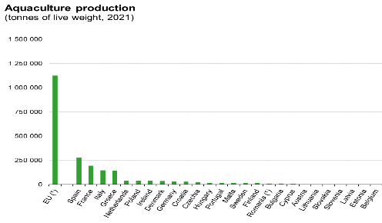
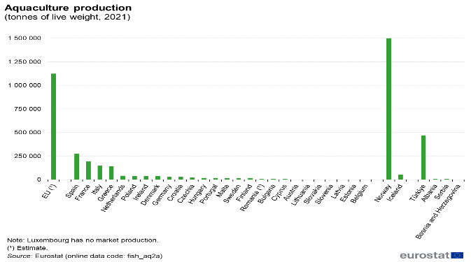
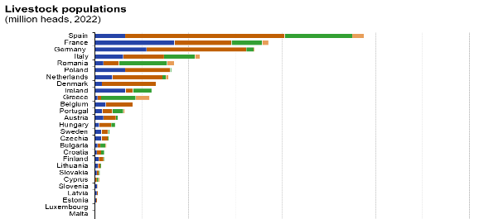
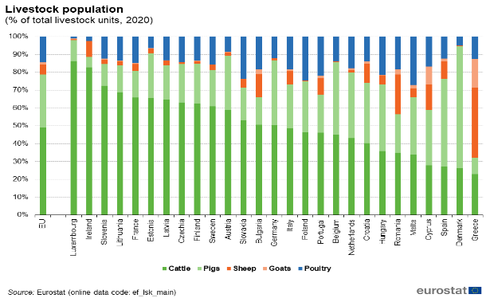

ESTONIA Animal food-producers data
* Aquaculture data in Tonnes
** 2016. No data for 2020, nor accummulate data
Notes:
Livestock population statistics: Statistics | Eurostat (europa.eu)
Livestock densities Agri-environmental indicator - livestock patterns - Statistics Explained (europa.eu)
Aquaculture statistics: Aquaculture statistics - Statistics Explained (europa.eu)

Slide 18
“Farm to fork” Objective
50% reduction of overall EU
sales of antimicrobials for
farmed animals and
in aquaculture by
2030
Notes:
https://ec.europa.eu/eurostat/statistics-explained/images/f/f2/Developments_of_livestock_populations_%28index_2002%3D100_based_on_heads_of_animals%2C_EU%2C_2002-2022%29_16-10-2023_v2.png
Farm to fork objective is part of the Green Deal
The starting point is 2018.
Objective is for all EU countries, not individual

Slide 19
Objective
-33,5mg/PCU
More than half has already been reached in 4 years!!
Total objective: 50% reduction from 2018 to 2030 = ↓59,2mg/PCU
118,3 mg/PCU
84,8 mg/PCU
59,2 mg/PCU
↓33,5mg/PCU =
56% of reduction is already reached
81,1 mg/PCU
77,5 mg/PCU
74,1 mg/PCU
70,8 mg/PCU
67,7 mg/PCU
64,7 mg/PCU
61,9 mg/PCU
2023
2024
2025
2026
2027
2028
2029
2018
2022
2030
Notes:
EU overall objective: Reduce from 50% of 118,3mg/PCU. This is a reduction of 59,15mg/PCU.
Baseline year: 2018
Target year: 2030
Number of years to reduce 50%: 12 years
In 2018 the sales were 118,3mg/PCU
In 2022 the sales were 88,72mg/PCU
→From 2018 to 2022 (4 years), the reduction has been of 33,5mg/PCU (=56% of the target amount)

Slide 20
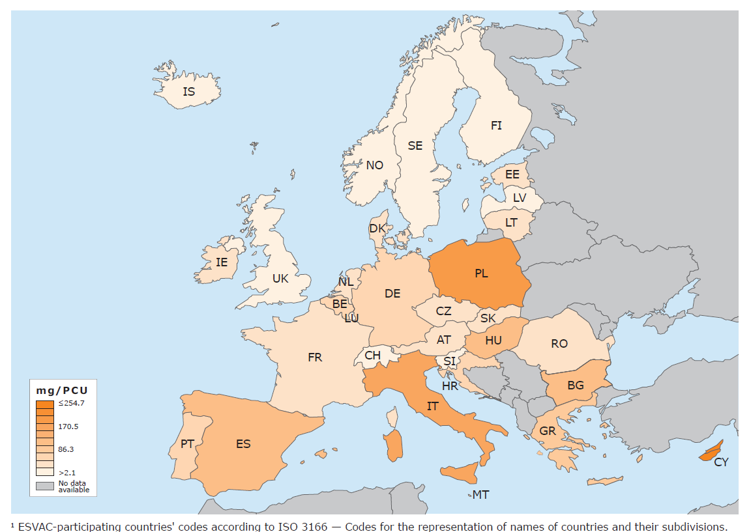
EU overall sales map 2022 for food-producing animals

Slide 21
















How are the data on sales of antimicrobials per country calculated?
Food producing animal population that could be potentially treated with antimicrobials - In Kilogrammes
Per 1.000 Tonnes.
400 kg.
425 kg.
200 kg.
140 kg.
240 kg.
65 kg.
25 kg.
POPULATION CORRECTION UNIT = PCU
75 kg.
20 kg.
20 kg.
6,5 kg.
20 kg.
20 kg.
1 kg.
20 kg.
20 kg.
1,4 kg.
Notes:
Note: Slide not to be shown. To be maintained hidden, for reference if needed to calculation of PCU. Data do not correspond to latest guideline. Responds to ESVAC project data, previous to 2022.
Latest calculations of PCU:
Guideline on the reporting of antimicrobial sales and use in animals at the EU level – denominators and indicators. 13 October 2023. EMA/CVMP/882931/2022. Committee for Veterinary Medicinal Products (CVMP)
Agree on the average weight per specie, in kilos
Calculate the number of animals per specie – Example, Malta
Note: consumption of antimicrobials for fish data is calculated per tonnes
3. Multiply the number of animals x weight => kilos of meat produced at national level
4. Compile the sales of antimicrobials, in milligrams
5. Obtain a unit number of milligrams or antimicrobial per kilo of meat
Average weigh (AW) at treatment, in kilos, used in calculating the population correction unit
Cattle:
Slaughter cows – 425
Slaughter heifers – 200
Slaughter bullocks and bulls – 425
Slaughter calves and young cattle – 140
Imported/exported cattle for slaughter – 425
Imported/exported cattle for fattening – 140
Livestock dairy cows – 425
Pigs
Slaughter pigs – 65
Imported / exported pigs for slaughter – 65
Imported / exported pigs for fattening – 25
Livestock sows – 240
Poultry
- Slaughter broilers – 1
- Slaughter turkeys – 6,5
- Imported / exported poultry for slaughter – 1
Sheep and goats
Slaughter sheep and goats – 20
Imported / exported sheep and goats for slaughter – 20
Livestock sheep – 75
Horses
Living horses – 400
Rabbits
Slaughter rabbits – 1,4
Fish – Eurostat – 1.000 tonnes of slaughtered fish

Slide 22
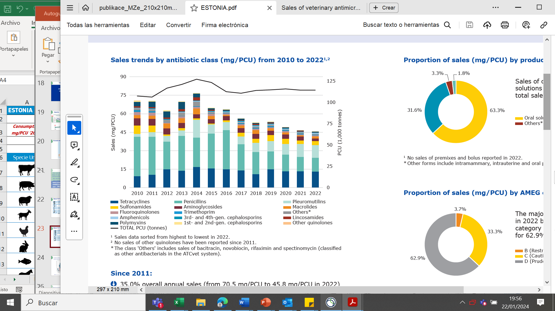
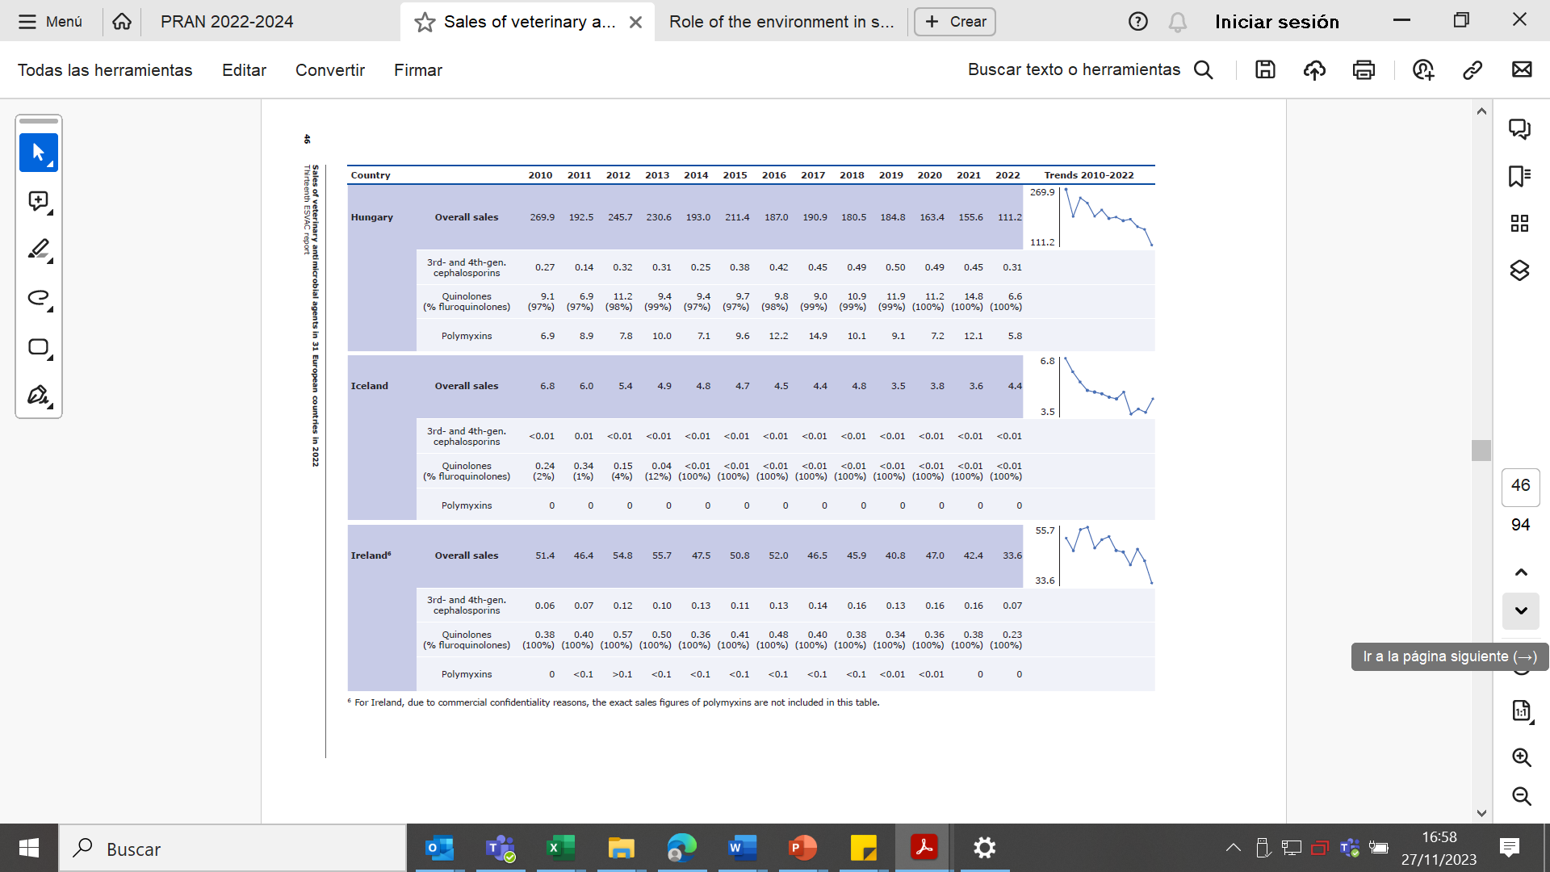
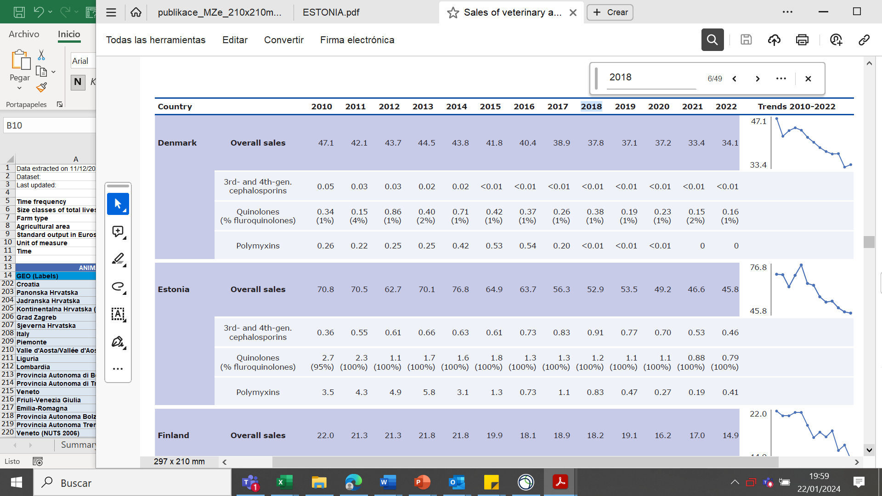
Sales of VMP in ESTONIA
PCU
2022 (1.000 tonnes)
Antimicrobial sales
Sales trends (2010-2022)
2018
52,9 mg/PCU
2022
45,8 mg/PCU
-13%
Notes:
Source: 13th ESVAC report.
The PCU is the Population Correction Unit
Food producing animals have a standard weight in kilos
We calculate the number of food producing animals per year and then multiply this number by the standard weight of each animal category.
The result is the amount of kilograms of meat per year, animal biomass that could potentially be treated with antimicrobials.
The total sales of antimicrobials per country is divided by the total number of kilos of meat.
The result is the theoretical amount of milligrams of consumed antimicrobials per kilo of meat (biomass).
In Estonia: 114 x 1000 tonnes = 144.000 tonnes of meat has been produced (2022).
It is estimated that 45,8 milligrams of antimicrobials correspond to each kilogram of meat produced.
Estonia has reduced the total amount of antimicrobials in 6,1% from 2018 (reference year for all EU countries to start measuring the sales of AM) to 2022.

Slide 23
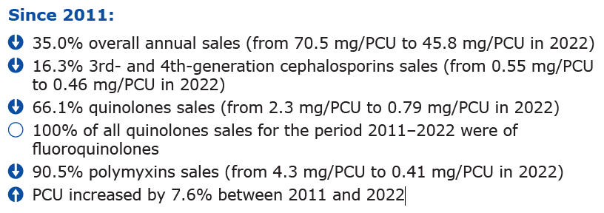
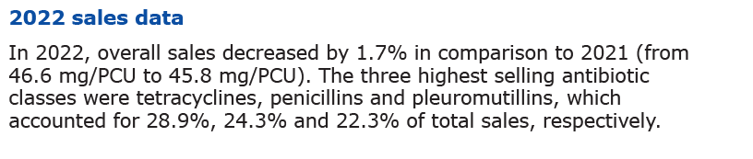
Sales of VMP in ESTONIA
Country information
Summary reports of consumption of antimicrobials and other veterinary
medicines in Estonia:
https://www.ravimiamet.ee/en/statistics/statistics-veterinary-medicines
https://www.ravimiamet.ee/en/statistics/statistical-yearbooks
ESVAC report

Slide 24
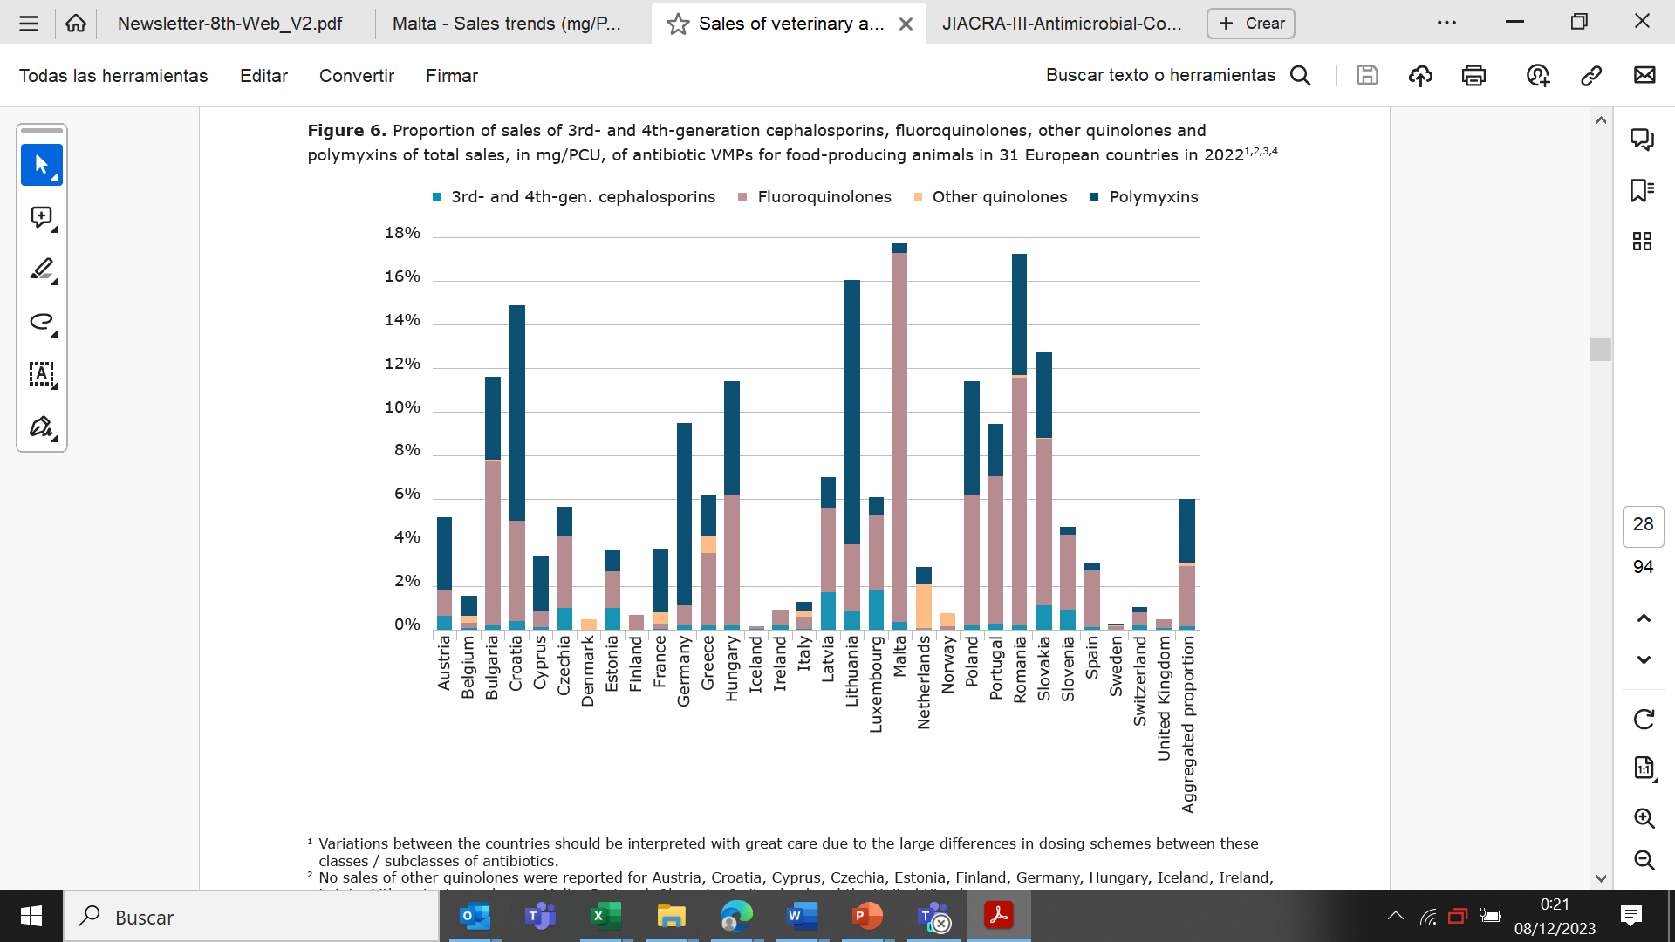
Consumption of 3rd and 4th-generation cephalosporings, fluoroquinolones, other quinolones and polymixins (mg/PCU), food producing animals in 2022
Source: 13th ESVAC report
Notes:
1 Variations between the countries should be interpreted with great care due to the large differences in dosing schemes between these classes / subclasses of antibiotics.
2 No sales of other quinolones were reported for Austria, Croatia, Cyprus, Czechia, Estonia, Finland, Germany, Hungary, Iceland, Ireland, Latvia, Lithuania, Luxembourg, Malta, Portugal, Slovenia, Switzerland and the United Kingdom.
3 No sales of polymyxins were reported for Denmark, Finland, Iceland, Ireland, Norway and the United Kingdom.
4 The aggregated proportion for 31 European countries is based on the aggregated mg/PCU — total quantity of antibiotic active substances sold (mg) divided by total PCU (kg).

Slide 25
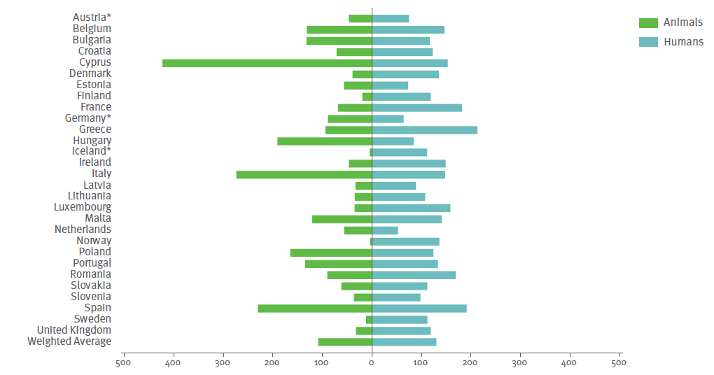
Overall consumption of ANTIMICROBIALS, 2017 (mg/kg of estimated biomass)
Source: JIACRA III - Antimicrobial consumption and resistance in bacteria from humans and animals

Slide 26
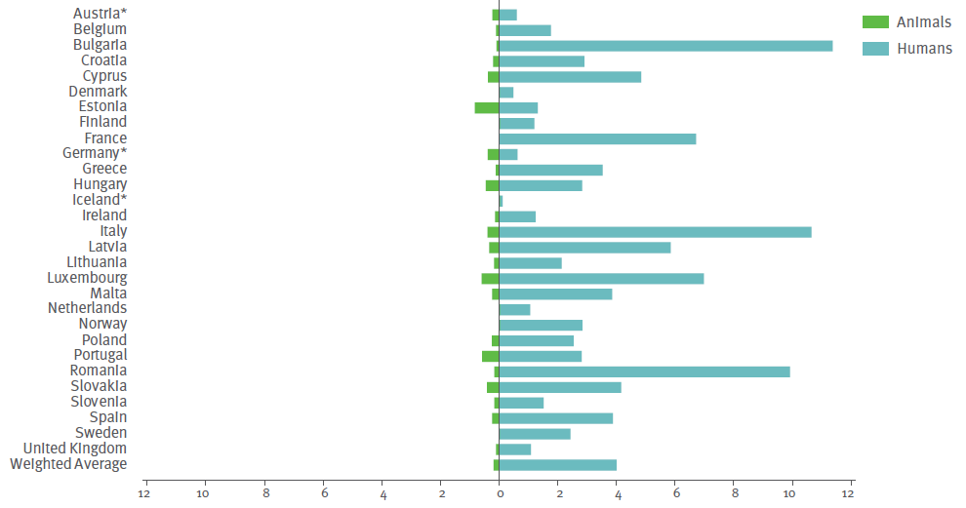
Consumption of 3rd and 4th-generation cephalosporings
Source: JIACRA III - Antimicrobial consumption and resistance in bacteria from humans and animals

Slide 27
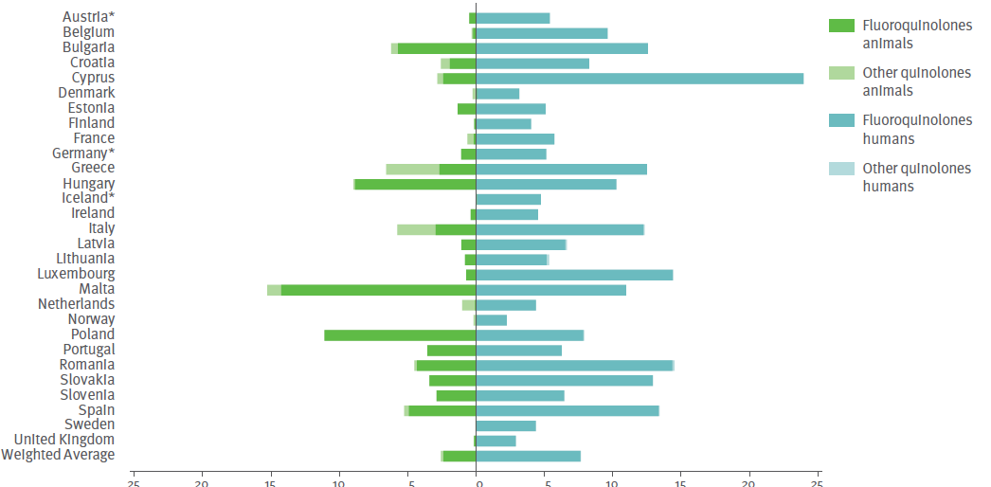
Consumption of fluoroquinolones and other quinolones
Source: JIACRA III - Antimicrobial consumption and resistance in bacteria from humans and animals

Slide 28
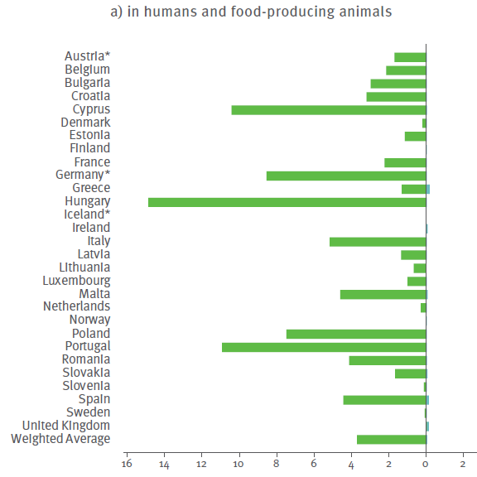
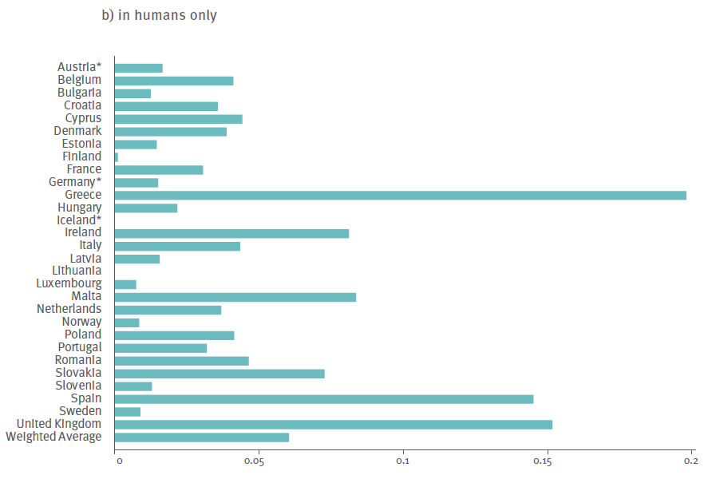
Consumption of polymyxins, 2017 (mg/kg of estimated biomass)
Source: JIACRA III - Antimicrobial consumption and resistance in bacteria from humans and animals

Slide 29
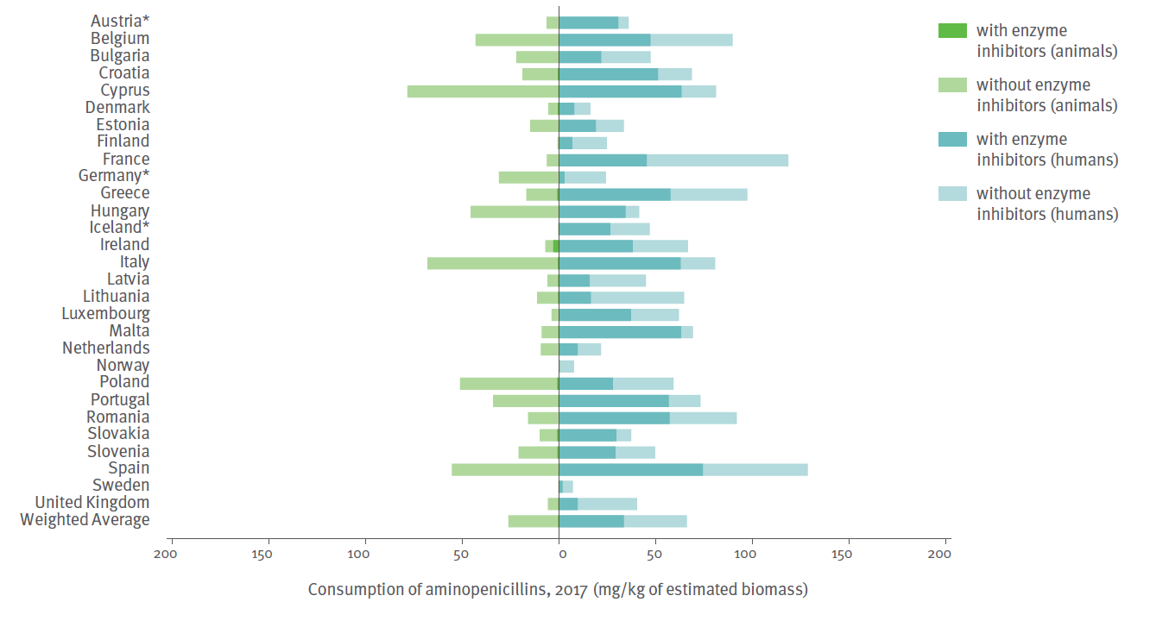
Consumption of aminopenicillins
Source: JIACRA III - Antimicrobial consumption and resistance in bacteria from humans and animals
Notes:
JIACRA III report

Slide 30
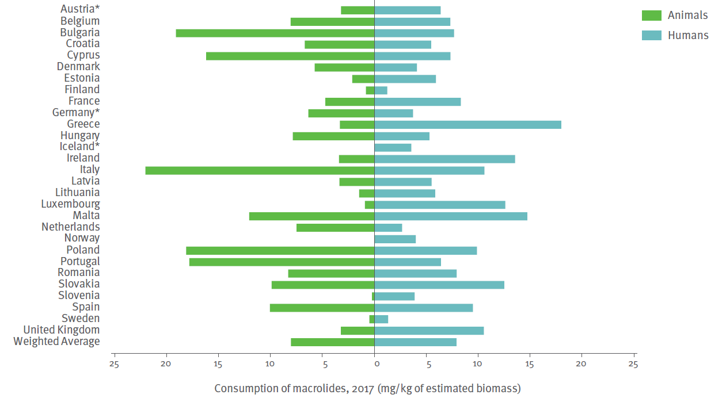
Consumption of macrolides
Source: JIACRA III - Antimicrobial consumption and resistance in bacteria from humans and animals

Slide 31
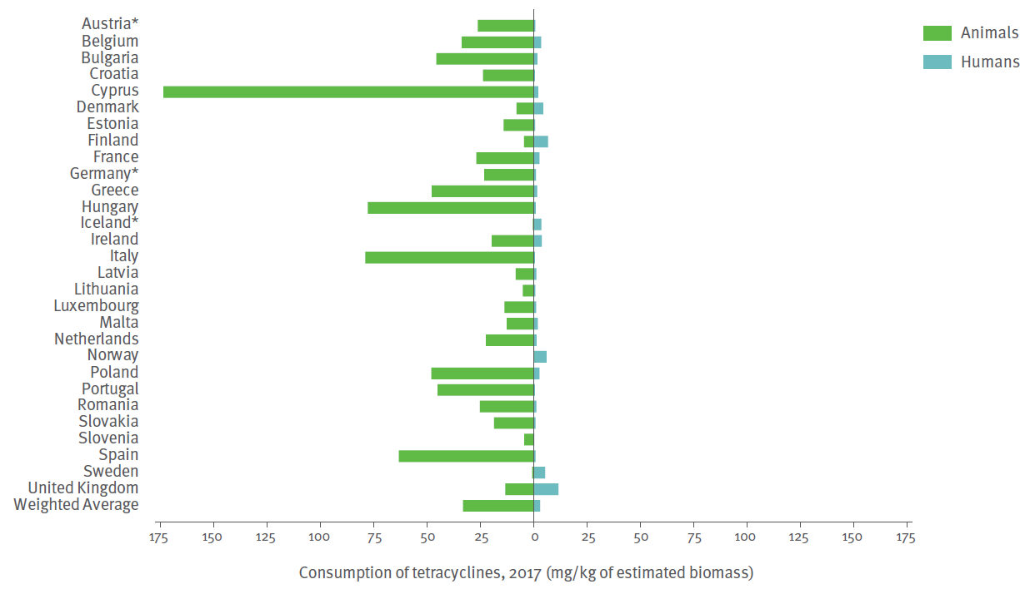
Consumption of tetracyclines
Source: JIACRA III - Antimicrobial consumption and resistance in bacteria from humans and animals

Slide 32
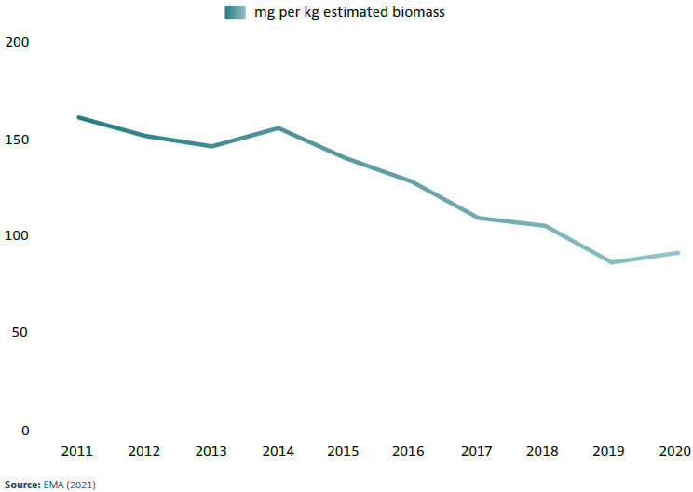


Achievements
The trend over the years shows a reduction of use of antimicrobials
Calculated by measuring the amount of antimicrobials used per kilo of meat produced over the years
Changes in average overall sales
45%
Notes:
Changes in average sales, in mg per kg estimated biomass, for 25 EU/EEA countries, 2011 to 2020
Source: EMA (2021)
These figures would suggest that efforts at both national and EU/EEA level have been successful, resulting in a continuous decrease over time in the use of antibiotics in food-producing animals in of fluoroquinolones registered more mode most participating European countries.
Main indicator: Overall sales - overall reduction in sales
Secondary indicators (substantial progress) : sales in mg per kg of 3rd- and 4th-generation cephalosporins, polymyxins and quinolones
Sales of fluoroquinolones registered more modest aggregated reductions.
Note: synonym for ‘milligrams per PCU’ (PCU = population correction unit), the reporting unit for animal biomass equivalents developed by the
European Surveillance of Veterinary Antimicrobial Consumption (ESVAC) initiative.

Slide 33
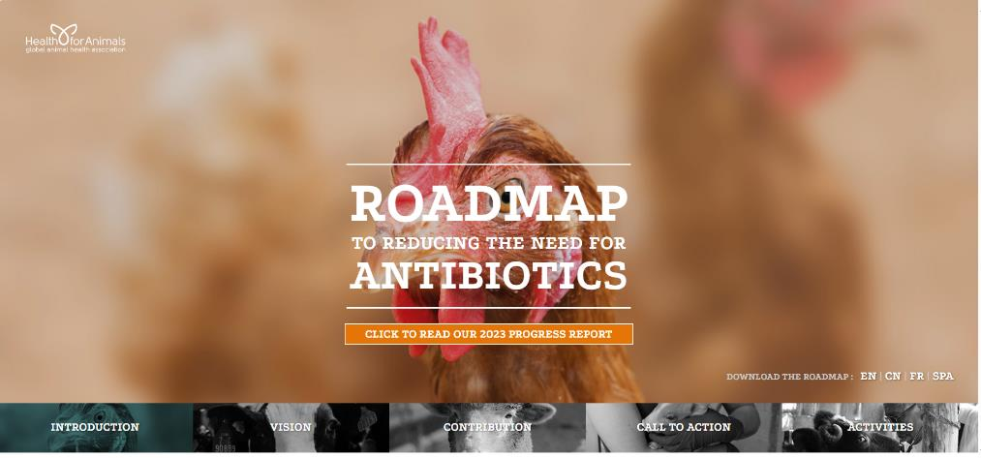
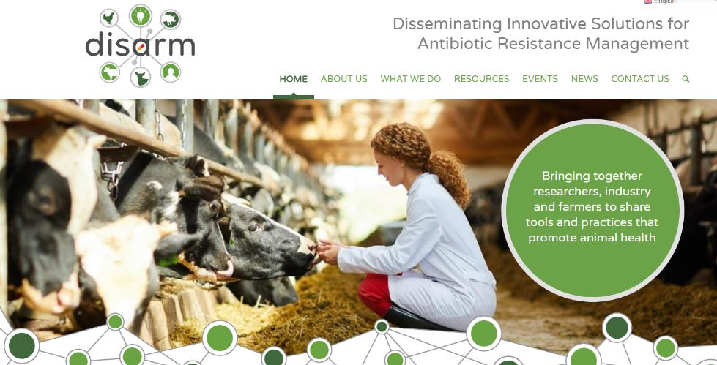
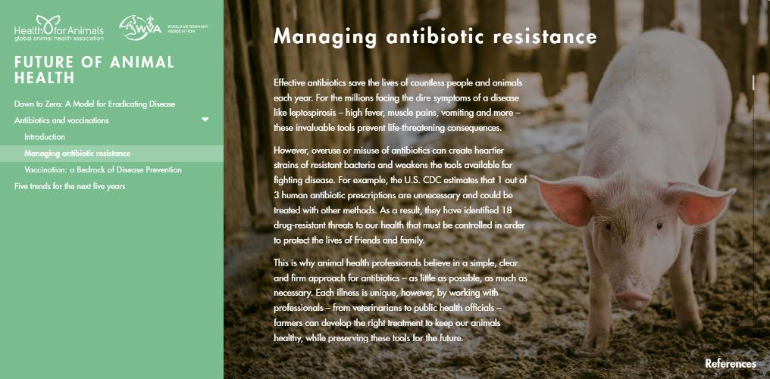
Let’s apply the experience

Slide 34
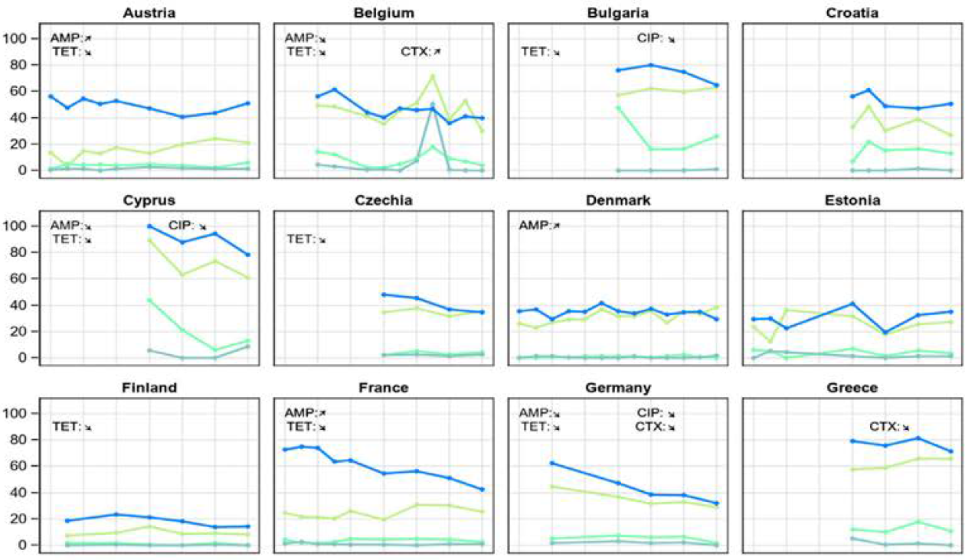
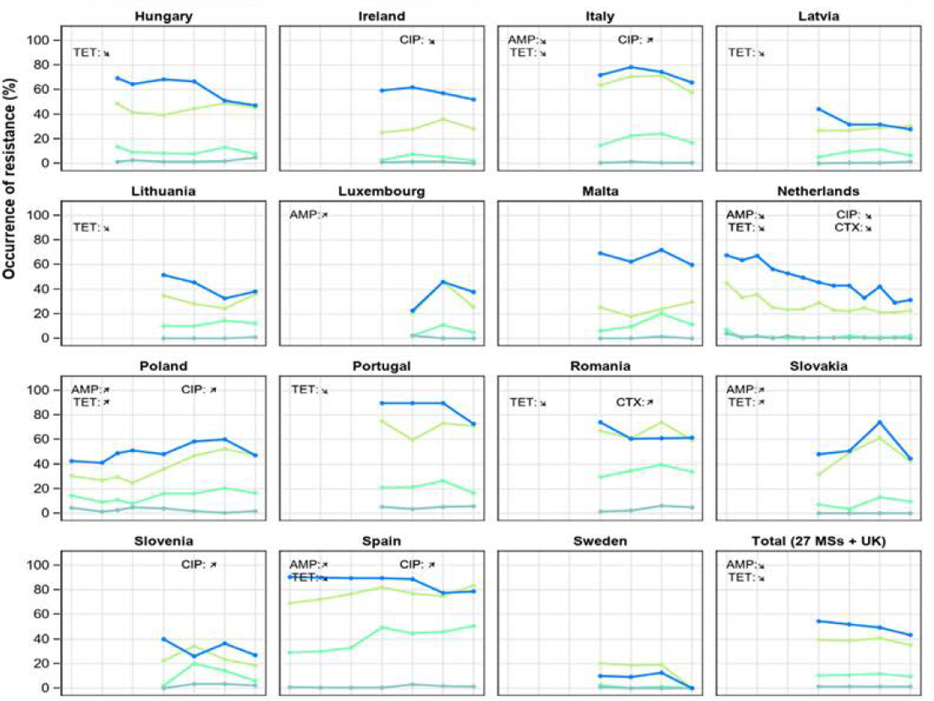
Achievements
Example 1
Trends in resistance to selected antimicrobials in indicator E. coli from pigs, 2009-2021
Resistance to:
ampicillin (AMP)
cefotaxime (CTX)
ciprofloxacin (CIP)
tetracycline (TET)
Notes:
Source: EUSR on AMR in zoonotic and indicator bacteria from humans, animals and food 2020/2021. EFSA Journal 2023;21(3):7867. Page 95
The objective is to reduce resistance.
Trends are able to be seen from samples of bacteria identified as resistant between 2009 and 2021. Not all the countries have reported data in all the years. Even though data are not compiled in a harmonised way, it is possible to see the positive trend of reduction.
There were more decreasing than increasing trends and most noticeable was that a decrease in tetracycline resistance was observed in approximately half of the data sets for pig and calf data (24/43) and poultry data (23/42).
It is of note that in several countries, levels of resistance were stable over time at low levels, and major changes cannot be expected.
Example 1:
Fattening pigs
The figure shows how each of the 27 member states reported resistance of E. coli bacteria in fattening pigs to different antibiotics (ampicillin, cefotaxime, ciprofloxacin and tetracycline), between 2009 and 2021.
The general trend is clearly reducing the resistance to tetracycline and ampicillin. Cefotaxime is slightly reducing and ciprofloxacin keeps constant in time).

Slide 35
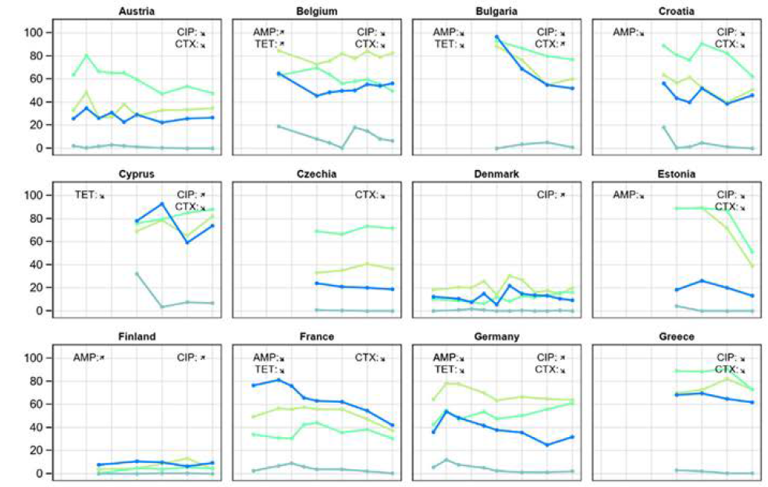

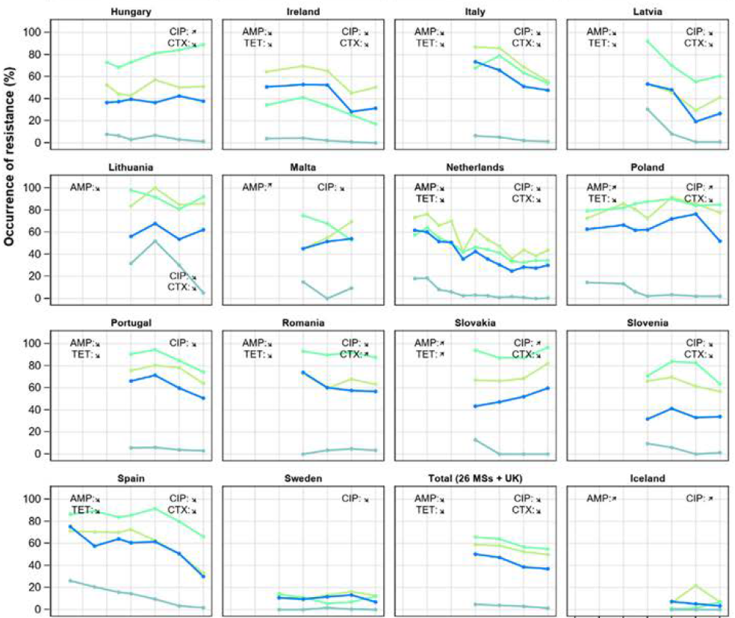

Achievements
Example 2
Trends in resistance to selected antimicrobials in indicator E. coli from broilers, 2009-2021
Resistance to:
ampicillin (AMP)
cefotaxime (CTX)
ciprofloxacin (CIP)
tetracycline (TET)
Notes:
Source: EUSR on AMR in zoonotic and indicator bacteria from humans, animals and food 2020/2021. EFSA Journal 2023;21(3):7867. Page 97.
Example 2:
Broilers Trends in resistance to selected antimicrobials (ampicillin, cefotaxime, ciprofloxacin and tetracycline), in E. coli bacteria from broilers, 2009-2021
In the 30 countries reporting data on bacteria samples from broilers, 68 samples reported decreasing trends and 20 samples reported increasing trends.
- In 16 countries, only decreasing trends were observed. Notably, in Ireland, Italy, Latvia, the Netherlands and Spain, resistance has decreased for all four antimicrobials
and in Croatia, Estonia, France, Lithuania and Portugal for three antimicrobials.
In contrast, in three countries, only increasing trends were observed.
The last square shape shows the summary accumulated trend for all reporting countries (including UK): resistance to all four antimicrobials has decreased with statistical significance.

Slide 36
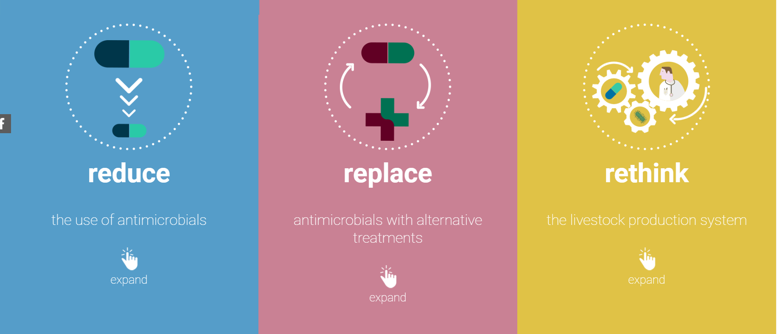
Source: EFSA Multimedia - AMR interactive storytelling (europa.eu)
Notes:
Reduce:
Set targets: Set targets for reducing the use of critically important antimicrobials that are vital for the treatment of serious human diseases.
Increase responsibility of veterinarians; Veterinarians should be accountable for their prescribing decisions. Decisions should be based on regular farm visits, clinical examination of animals and laboratory tests.
Use antimicrobials only when needed: Antimicrobials should not be used to prevent diseases in healthy animals. The preventive use of antimicrobials should be phased out.
Replace: could mean
Consider alternatives to antimicrobials that have been shown to improve animal health and that could reduce the need for antimicrobials. These include probiotics, prebiotics, bacteriophages and organic acids.
Research new alternatives: New scientific studies are needed to investigate alternatives to antimicrobials or to reduce their need.
Develop a EU legal framework: A clear EU legal framework is needed to boost the development and possible authorisation of products that can be used as alternatives to antimicrobials.
Rethink: the livestock production system
Consider alternatives to antimicrobials that have been shown to improve animal health and that could reduce the need for antimicrobials.
Improve prevention and control of diseases in animals; This includes better farming practices to prevent the introduction of diseases to farms, improving the health and welfare of animals, and protecting them from diseases through vaccines or genetic selection.
Consider alternative farming systems: Farming systems where antimicrobials are often used should be evaluated. Alternative systems leading to a reduced use of antimicrobials should be explored.
Offer education: Education and awareness of AMR should be addressed to all levels of society but in particular to veterinarians and farmers.

Slide 37
Thank you!

