Slide 1
ESTONIA
April 10 & 11 2024

Slide 2
Important elements of the new EU VMP & MF regulations, and national related legislation and/or guidelines for veterinarians & farmers (I)
Lecture 3
Estonia, 10th-11th April 2024

Slide 3
Objective
To present the provisions with regards to prescriptions and use of veterinary medicines in the relevant legislation at EU and national level, and obligations and procedure to be followed by veterinarians and farmers.

Slide 4
Content
Common rules
Prescriptions:
Veterinary prescribing and record-keeping for medicines and medicated feed
The use of veterinary medicinal products
What if there are no authorised veterinary medicines or those authorised are not available?
Reporting of adverse events
Data collection on sales and use of antimicrobials
National legislation / national guidelines

Slide 5

Common rules
‘veterinary prescription’ means a document issued by a veterinarian for a veterinary medicinal product or a medicinal product for human use for its use in animals.
‘antimicrobial’ means any substance with a direct action on micro-organisms used for treatment or prevention of infections or infectious diseases, including antibiotics, antivirals, antifungals and anti-protozoals
Antimicrobial veterinary medicinal products must only be available on veterinary prescription.

Slide 6
Common rules – Veterinary prescription
Common rules
RESISTANCE!
ANTIMICROBIAL VERSUS ANTIBIOTICS
Antimicrobials
Antibiotics
Antifungal, Antiprotozoa
Antiviral
Antiparasitic
EU Regulation

Slide 7
Common rules – Veterinary prescription
Some medicines are subject to veterinary prescription for reasons of safety (for animals and people!), efficacy & potential resistance, and possible misuse.
(a) narcotic drugs or psychotropic substances
(b) medicines for food-producing animals
(c) antimicrobials
(d) if a prior diagnosis is needed
(e) euthanasia products
(f) new active substances (< 5 yr)
(g) vaccines
(h) hormones or thyrostatics or beta-agonists

Slide 8
shall NOT be applied routinely
shall NOT be used to compensate for poor hygiene, inadequate animal husbandry, lack of care or poor farm management.
Common rules – Veterinary prescription
Ways of antimicrobial use
Preventive (Prophylaxis)
Group administration (metaphylaxis)
Treatment
Growth promotion
Individual treatment
Group treatment
ONLY for exceptional cases (when risk infection very high/consequences severe)
Antibiotic treatment ONLY to individual animals
Other antimicrobials ONLY to restricted number of animals
ONLY when the risk of spread of an infection or of an infectious disease in the group of animals is high
where no other appropriate alternatives are available
PROHIBITED !
Notes:
Prophylaxis: When used for prophylaxis, antibiotics can be administered to individual animals only while other antimicrobials can be administered to a restricted number of animals

Slide 9
Common rules – Veterinary prescription
Common rules
VETERINARY PRESCRIPTIONS
!Article 105
The veterinarian can issue a veterinary prescription only after he or she has made a clinical examination or any other proper assessment of the health status of the animal or group of animals
The veterinarian can issue a veterinary prescription for an antimicrobial only after he or she has diagnosed an infectious disease
The veterinarian has to be able to provide justification for the prescription of an antimicrobial, especially for preventive (prophylaxis) and group (metaphylaxis) administration
Notes:
DISCUSS last two points

Slide 10
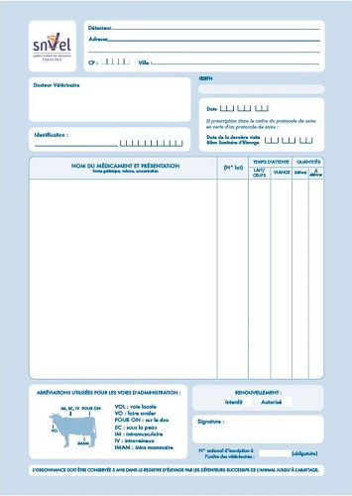
Common rules – Veterinary prescription (example FR template)
Name and address
owner of the animals
Identification animals
Identification Veterinarian (prof nr)
Date
Name of medicine (active ingredient), form and strength.
Quantity prescribed
Dosage regimen
Food producing animals: withdrawal period (even if 0)
Potential warnings or messages on responsible use
A prescription for an antimicrobial is only valid 5 days after the prescription is made.
Note necessary if prescription is Art 107 3-4 or 112-114)
Date and signature vet
Notes:
We can check if a template is available in different countries and if so, include the country template
RE blue box. Explain what is use under art 112-114.

Slide 11
Common rules – Veterinary prescription
Common rules
MEDICATION VIA FEED OR WATER
Different rules apply for
Oral Medication
(on-farm mixing in feed or water by the animal keeper)
Via Feed
Via Water
Medicated Feed
(feed mixed with medicines in feed mill or mobile mixer or via special equipped vehicle by feed business operator )
Reg. (EU) 2019/4
(MF)
Reg. (EU) 2019/6 (VMP)
& delegated act C(2024) 661 final
Notes:
Therefore, the delegated act on oral medication applies to veterinary medicinal products administered orally by means of mixing into or addition onto feed and to the mixing of veterinary medicinal products in drinking water or in liquid feed by the animal keeper. It should not apply to the mixing of a veterinary medicinal product into feed by feed business operators irrespectively of whether they operate in a feed mill, with a mobile mixer or an on-farm mixer, which is covered by Regulation (EU) 2019/4.
(f) ‘mobile mixer’ means a feed business operator with a feed establishment consisting of a specifically equipped vehicle for the manufacture of medicated feed; (g) ‘on-farm mixer’ means a feed business operator manufacturing medicated feed for the exclusive use on its farm;

Slide 12
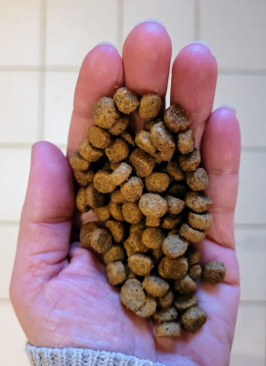
Common rules – Veterinary prescription
Common rules
Veterinary prescriptions in relation to medicated feed (1/2)
Reg.(EU) 2019/4
Article 16
Medicated feed (animal feed mixed with medicines by feed business operator) requires:
a veterinary prescription
can only be issued after clinical examination or any other proper assessment of the health status of the animals
only for diagnosed diseases (except for vaccines and parasitics)
Watch out for interactions with other medications!
Notes:
1. The supply of medicated feed to animal keepers shall be subject to:
(a) the presentation and, in case of manufacturing by on-farm mixers, the possession of a veterinary prescription for medicated feed; and
(b) the conditions laid down in paragraphs 2 to 10.
2. A veterinary prescription for medicated feed shall be issued only after a clinical examination or any other proper assessment of the health status of the animal or group of animals by a veterinarian and only for a diagnosed disease.
3. By way of derogation from paragraph 2, a veterinary prescription for medicated feed containing immunological veterinary medicinal products may be issued also in the absence of a diagnosed disease.
4. By way of derogation from paragraph 2, if it is not possible to confirm the presence of a diagnosed disease, a veterinary prescription for medicated feed containing antiparasitics without antimicrobial effects may be issued based on
the knowledge of the parasite infestation status in the animal or group of animals.

Slide 13
Common rules – Veterinary prescription
Common rules
Veterinary prescriptions in relation to medicated feed (2/2)
Reg.(EU) 2019/4
Article 16
Record keeping: Veterinary prescriptions should be kept by feed mill and the veterinarian prescribing & animal keeper for 5 years
1 prescription = 1 veterinary treatment
Maximum duration of treatment: 2 weeks for antibiotics, 1 month for other medicines
Validity prescription: max 5 days for feed with antimicrobial, max 3 weeks for other medicines for food-producing animals, rest 6 months
Notes:
6. The veterinary prescription for medicated feed shall contain the information set out in Annex V. The original veterinary prescription for medicated feed shall be kept by the manufacturer or, where appropriate, the feed
business operator supplying the medicated feed to the animal keeper. The veterinarian, or the professional person referred to in paragraph 5, issuing the prescription and the keeper of food-producing or fur animal shall keep a copy of the veterinary prescription for medicated feed. The original and copies shall be kept for five years from the date of issuance.
7. With the exception of medicated feed for non-food-producing animals, other than fur animals, medicated feed shall not be used for more than one treatment under the same veterinary prescription for medicated feed.
The duration of a treatment shall comply with the summary of product characteristics of the veterinary medicinal product incorporated in the feed and, where not specified, shall not exceed one month, or two weeks in case of a medicated feed
containing antibiotic veterinary medicinal products.
8. The veterinary prescription for medicated feed shall be valid from the date of its issuance for a maximum period of six months for non-food-producing animals other than fur animals and three weeks for food-producing animals and fur
animals. In the case of medicated feed containing antimicrobial veterinary medicinal products, the prescription shall be valid from the date of its issuance for a maximum period of five days.
9. The veterinarian issuing the veterinary prescription for medicated feed shall verify that that medication is justified for the target animals on veterinary grounds. Furthermore that veterinarian shall ensure that the administration of the
veterinary medicinal product concerned is not incompatible with another treatment or use and that there is no contraindication or interaction where several medicinal products are used. In particular, the veterinarian shall not prescribe
medicated feed with more than one veterinary medicinal product containing antimicrobials.
10. The veterinary prescription for medicated feed shall:
(a) comply with the summary of the product characteristics of the veterinary medicinal product, except for veterinary
medicinal products intended to be used in accordance with Article 112, Article 113 or Article 114 of Regulation (EU)
2019/6;
(b) indicate the daily dose of the veterinary medicinal product which is to be incorporated in a quantity of medicated feed
that ensures the uptake of the dosage by the target animal considering that the feed uptake of diseased animals might
differ from a normal daily ration;
(c) ensure that the medicated feed containing the dosage of the veterinary medicinal product corresponds to at least 50 %
of the daily feed ration on a dry matter basis and that, for ruminants, the daily dose of the veterinary medicinal
product is contained in at least 50 % of the complementary feed except for mineral feed;
(d) indicate the inclusion rate of the active substances, calculated on the basis of the relevant parameters.
11. Veterinary prescriptions for medicated feed issued in accordance with paragraphs 2, 3 and 4 shall be recognized throughout the Union.
12. The Commission may, by means of implementing acts, set a model format for the information set out in
Annex V. That model format shall also be made available in electronic version. Those implementing acts shall be
adopted in accordance with the examination procedure referred to in Article 21(2).

Slide 14

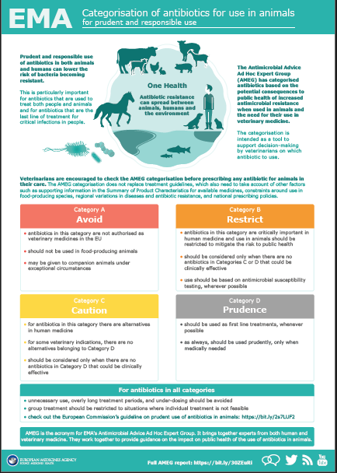
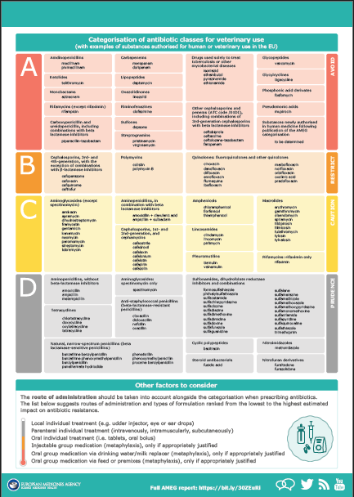
Common rules – Veterinary prescription
Other considerations for prescriptions
Common rules
Categorisation of antimicrobials
Antimicrobials reserved for human use only (Regulation (EU) 2022/1255)
National restrictions
Oral medication (Act to follow) – top dressing
List of essential substances for horses

Slide 15
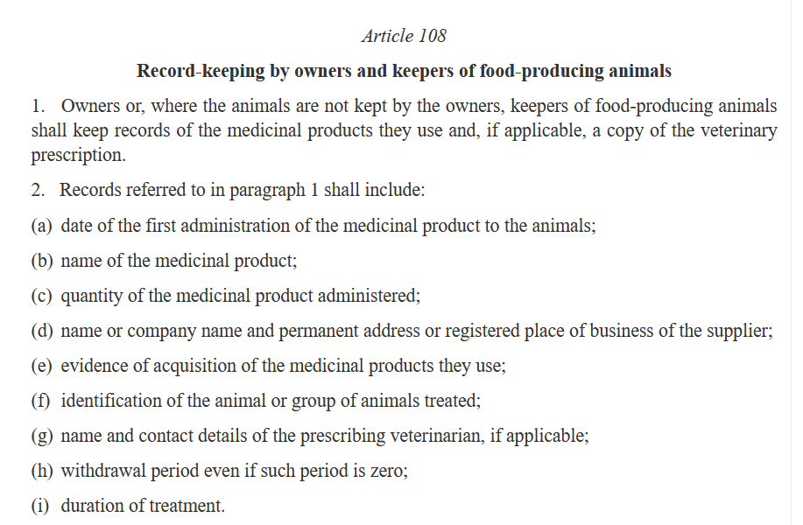

Common rules – Veterinary prescription
Common rules
Record keeping
Reg.(EU) 2019/6 (VPM)
Article 108
OBLIGATIONS

Slide 16
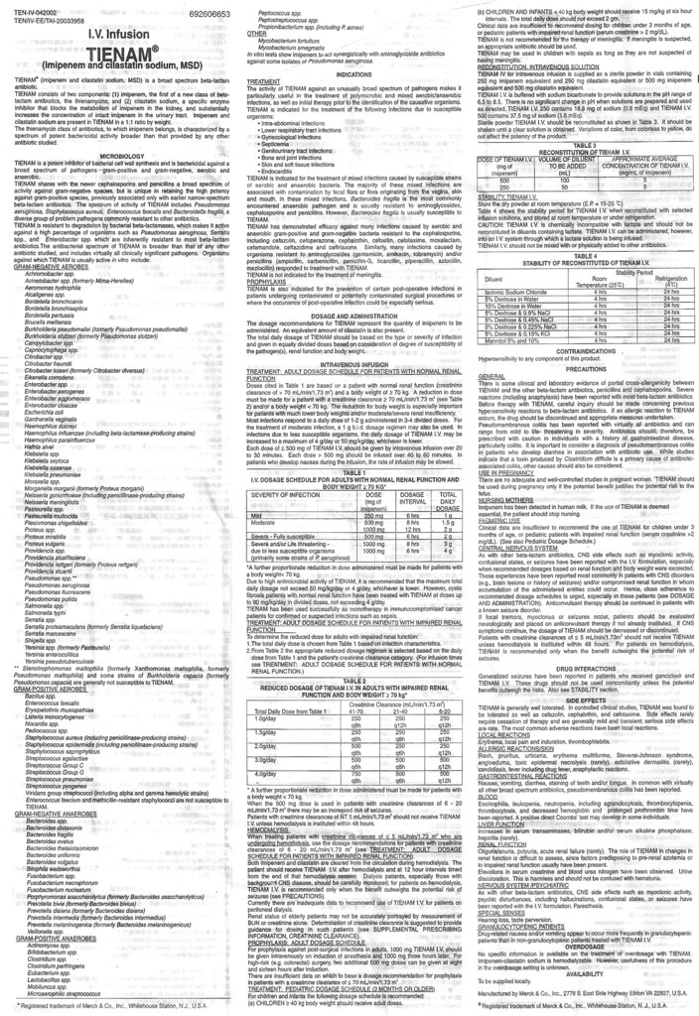
Common rules – Veterinary prescription
Common rules
Marketing Authorisation
Reg.(EU) 2019/6 (VPM)
Principle Rule
Veterinary medicines must be used according to the marketing authorisation (SPC/leaflet)
You need to use a veterinary medicine for the indication, species and dosage regime detailed in the SPC/leaflet. If there is no veterinary product authorized for a certain indication/species or there is a shortage -> you can use the rules of Art. 112-114

Slide 17

Common rules – Use of veterinary medicinal products
outside the terms of the marketing authorisation
When no medicine authorised for food-producing animals or authorized ones are not available
Common rules
Product authorised (Art106(1)) in your country for the species and indication concerned
Must use this product
3rd country products :
In cases where none of the foregoing options are available → use a VMP authorised in a third country for the same animal species and the same indication
If not, under vet responsibility
& to avoid unacceptable suffering
Product authorised for the:
- same/another indication
- in same/another food-producing species
- in the same/another EU country
Select a product
If none, use
Select a product
“use outside marketing authorisation”
Product authorised in the EU for non-food animal for same indication
If none, use
A human medicine authorised in the EU
Select a product
3rd country rules on vaccines. !
If none, use
VMP prepared extemporaneously in accordance with the terms of a veterinary prescription.
Prepare a product
Notes:
Article 113 Use of medicinal products outside the terms of the marketing authorisation in food-producing terrestrial animal species 1. By way of derogation from Article 106(1), where there is no authorised veterinary medicinal product in a Member State for an indication concerning a food-producing terrestrial animal species, the veterinarian responsible may, under his or her direct personal responsibility, and in particular to avoid causing unacceptable suffering, exceptionally treat the animals concerned with the following medicinal product: (a) a veterinary medicinal product authorised under this Regulation in the relevant Member State or in another Member State for use in the s(b) if there is no veterinary medicinal product as referred to in point (a) of this paragraph, a veterinary medicinal product authorised under this Regulation in the relevant Member State for use in a non-food-producing animal species for the same indication; (c) if there is no veterinary medicinal product as referred to in point (a) or (b) of this paragraph, a medicinal product for human use authorised in accordance with Directive 2001/83/EC or Regulation (EC) No 726/2004; or (d) if there is no medicinal product as referred to in point (a), (b) or (c) of this paragraph, a veterinary medicinal product prepared extemporaneously in accordance with the terms of a veterinary prescription. 2. Except as regards immunological veterinary medicinal products, where there is no medicinal product available as referred to in paragraph 1, the veterinarian responsible may under his or her direct personal responsibility, and in particular to avoid causing unacceptable suffering, exceptionally treat food-producing terrestrial animals with a veterinary medicinal product authorised in a third country for the same animal species and same indication. 3. The veterinarian may administer the medicinal product personally or allow another person to do so under the veterinarian’s responsibility, in accordance with national provisions. 4. Pharmacologically active substances included in the medicinal product used in accordance with paragraphs 1 and 2 of this Article shall be allowed in accordance with Regulation (EC) No 470/2009 and any acts adopted on the basis thereof. 5. This Article shall apply also when an authorised veterinary medicinal product is not available in the relevant Member State

Slide 18

Common rules – Use of Veterinary Medicinal Products
When no authorized medicine is available for food-producing aquatic animals or authorized ones are not available
Common rules
Product authorised in your country for the aquatic animal species and indication concerned
Must use this product
3rd country products :
In cases where none of the foregoing options are available → use a VMP authorised in a third country for the same animal species and the same indication
If not, use
Product authorised for the:
- same/another indication
- in same/another food-producing aquatic species
- in the same/another EU country
Select a product
If not, use
“cascade use of AM”
Product authorised in the EU for food-producing terrestrial species (substance list under development)
Select a product
If not, use
3rd country rules on vaccines. !
A human medicine authorised in the EU (substance list under development)
Select a product
If not, use
VMP prepared extemporaneously in accordance with the terms of a veterinary prescription
Prepare a product
Notes:
Article 114 Use of medicinal products for food-producing aquatic species
1. By way of derogation from Article 106(1), where there is no authorised veterinary medicinal product in a Member State for an indication concerning a food-producing aquatic species, the veterinarian responsible may, under his or her direct personal responsibility, and in particular to avoid causing unacceptable suffering, treat the animals concerned with the following medicinal product:
a veterinary medicinal product authorised under this Regulation in the relevant Member State or in another Member State for use in the same or in another food-producing aquatic species and for the same indication or for another indication;
if there is no veterinary medicinal product as referred to in point (a) of this paragraph, a veterinary medicinal product authorised under this Regulation in the relevant Member State or in another Member State for use with a food producing terrestrial species containing a substance present in the list established in accordance with paragraph 3;
if there is no veterinary medicinal product as referred to in point (a) or (b) of this paragraph, a medicinal product for human use authorised in accordance with Directive 2001/83/EC or Regulation (EC) No 726/2004 and containing substances present in the list established in accordance with paragraph 3 of this Article; or
if there is no medicinal product as referred to in point (a), (b) or (c) of this paragraph, a veterinary medicinal product prepared extemporaneously in accordance with the terms of a veterinary prescription.
2. By way of derogation from points (b) and (c) of paragraph 1, and until the list referred to in paragraph 3 is established, the veterinarian responsible may, under his or her direct personal responsibility and in particular to avoid causing unacceptable suffering, exceptionally treat food-producing aquatic species of a particular holding with the following medicinal product:
a veterinary medicinal product authorised under this Regulation in the relevant Member State or in another Member State for use with a food-producing terrestrial animal species; (b) if there is no veterinary medicinal product as referred to in point (a) of this paragraph, a medicinal product for human use authorised in accordance with Directive 2001/83/EC or Regulation (EC) No 726/2004.
3. The Commission shall, by means of implementing acts, at the latest within five years from 28 January 2022, establish a list of substances used in veterinary medicinal products authorised in the Union for use in food-producing terrestrial animal species or substances contained in a medicinal product for human use authorised in the Union in accordance with Directive 2001/83/EC or Regulation (EC) No 726/2004, which may be used in food-producing aquatic species in accordance with paragraph 1 of this Article. Those implementing acts shall be adopted in accordance with the examination procedure referred to in Article 145(2).
4. Except as regards immunological veterinary medicinal products, where there is no medicinal product available as referred to in paragraphs 1 and 2, the veterinarian responsible may, under his or her direct personal responsibility and in particular to avoid causing unacceptable suffering, exceptionally treat food-producing aquatic species with a veterinary medicinal product authorised in a third country for the same species and same indication.

Slide 19
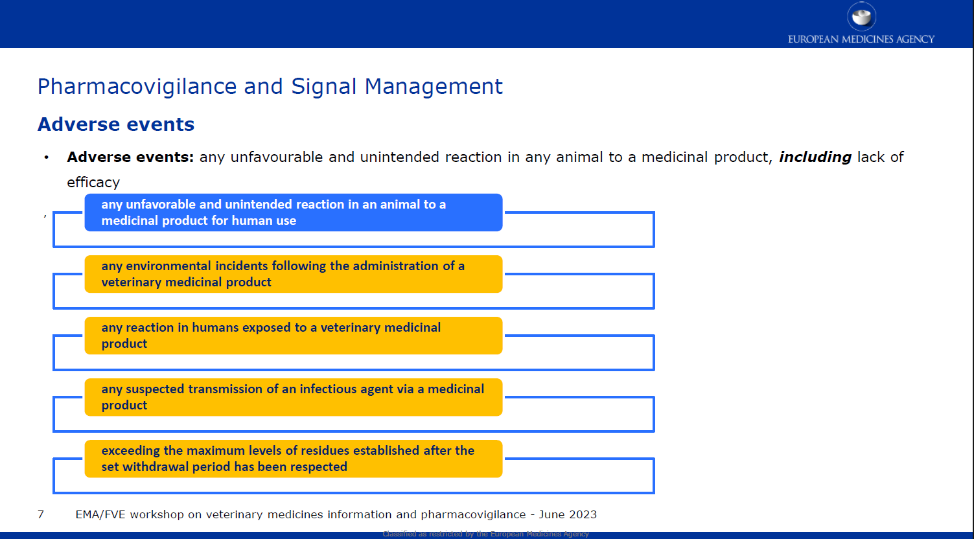
Common rules – Use of Veterinary Medicinal Products
Adverse events
Common rules
Do not forget to report adverse events including lack of efficacy!

Slide 20
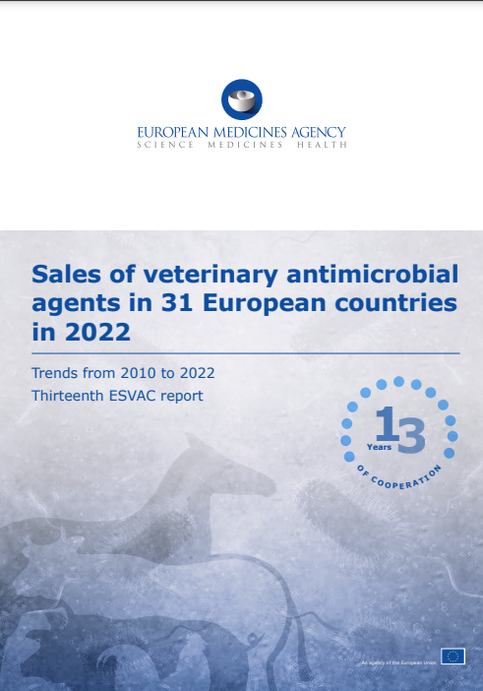
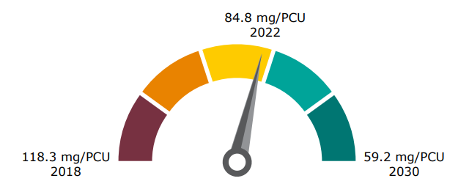
Data Collection on sales and use of antimicrobials
European Surveillance of Veterinary Antimicrobial Consumption (ESVAC)
Common rules
- ESVAC = European Surveillance of Veterinary Antimicrobial Consumption
- Oct 2023: 13th ESVAC report
- Overall sales of veterinary antibiotics in 2022 for 31 countries
- Trends from 2011 to 2022 in 25 ESVAC-participating countries:
- 53.0% total sales
- 49.0% sales of 3rd- and 4th-gen cephalosporins
- 44.0% sales of all quinolones
- 81.0% sales of polymyxins

Slide 21
Data Collection on sales and use of antimicrobials
From January 2024, all EU / EEA Member States must report data of 2023 on the volume of sales and use of antimicrobial medicinal products in animals
Common rules
EU countries must start collecting on use data:
        Cattle, pigs, poultry → from 2023
        All other food-producing animals → from 2026
        Dogs, cats and fur animals → from 2029
      EMA will publish the first report on 31 March 2025, afterwards by 31 December covering the preceding year
      Data will be detailed with relevant animal species, categories or stages
      Data to be collected for
      Antidiarrheals, intestinal anti-inflammatory and antiinfective agents
      2. Gynecological antiinfectives & antiseptics
      3. Anti-infectives & antiseptics for intrauterine use
      4. Antibacterials for systemic use
      5. Antibacterials for intramammary use
      6. Antiprotozoals (with antibacterial effect)
      7. Antimycobacterials for intramammary use
Notes:
Need to change colour graph
Annex of Regulation 2021/578. https://eur-lex.europa.eu/eli/reg_del/2021/578/oj
The first report on the volume of sales of veterinary antimicrobial medicinal products and on the use of antimicrobial medicinal products per animal species shall be published by the Agency by 31 March 2025 and shall include the following: (a) the volume of sales of veterinary antimicrobial medicinal products, covering data from 2023 and submitted by Member States by 30 June 2024; (b) the use of antimicrobial medicinal products for relevant animal species, categories or stages covering data from 2023 and submitted by Member States by 30 September 2024.
2. As from 2025, the following reports after the first report shall be published by the Agency by 31 December and shall include the following: (a) the volume of sales of veterinary antimicrobial medicinal products submitted by Member States by 30 June of each year, covering data from the preceding calendar year; (b) the use of antimicrobial medicinal products for relevant animal species, categories or stages submitted by Member States by 30 June of each year, covering data from the preceding calendar year.
Data collection will start as of the years mentioned. The reporting will start the following years (i.e. for cattle pigs and poultry reporting is due in 2024, other f-p animals in 2027, dogs cats and fur animas in 2030)

Slide 22

Estonian specifications

Slide 23
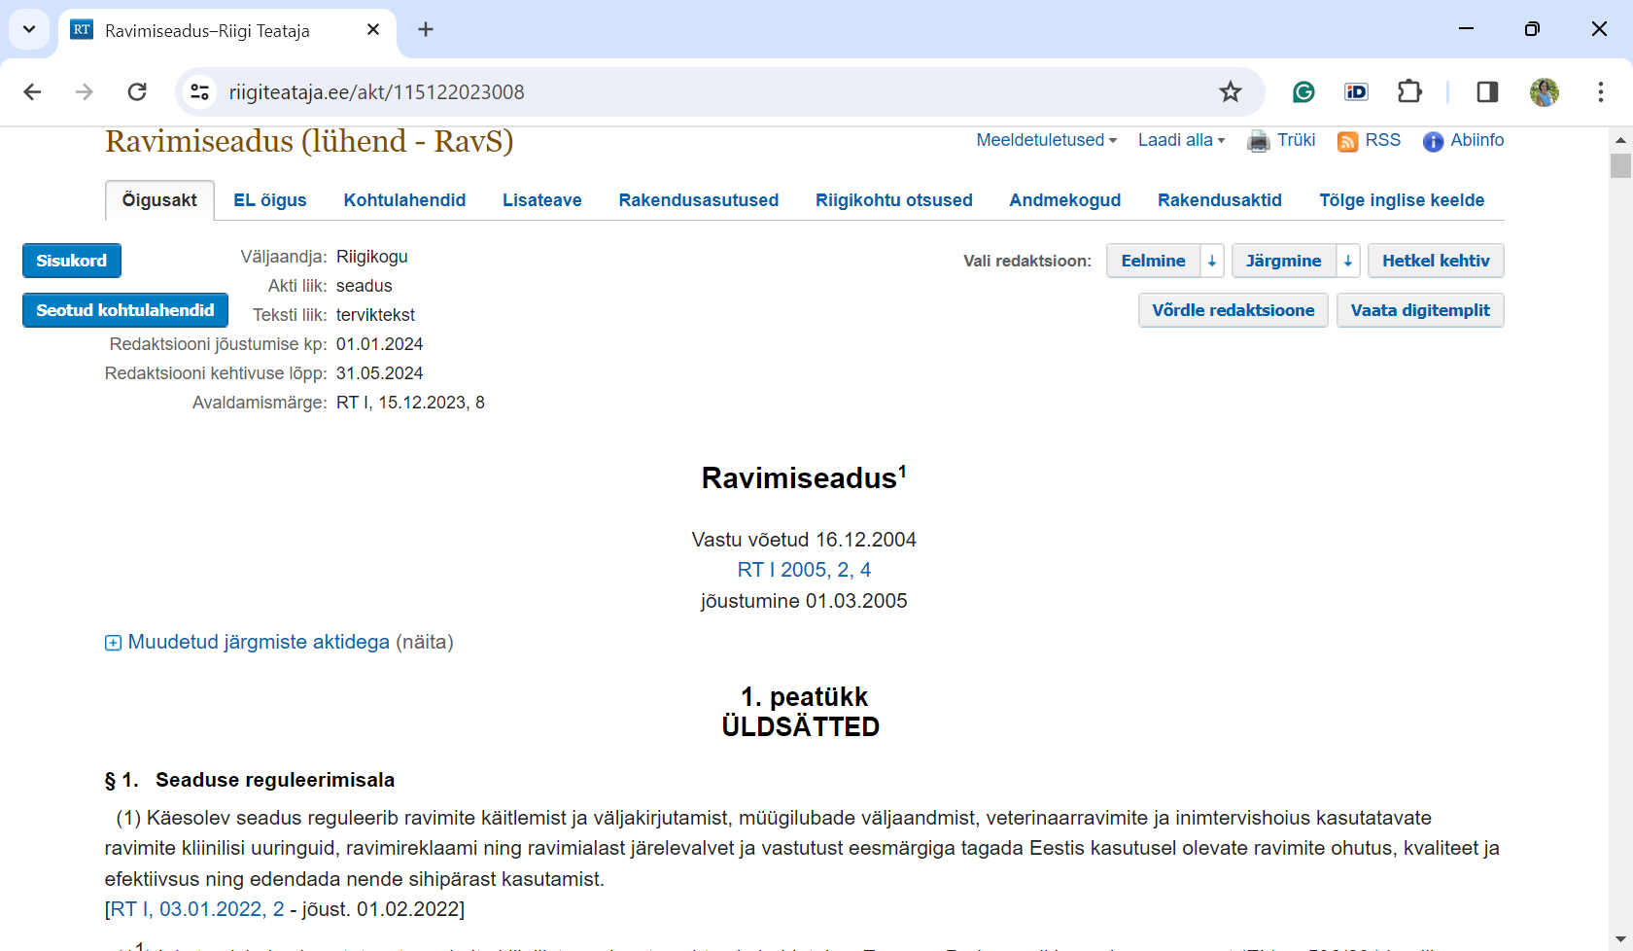
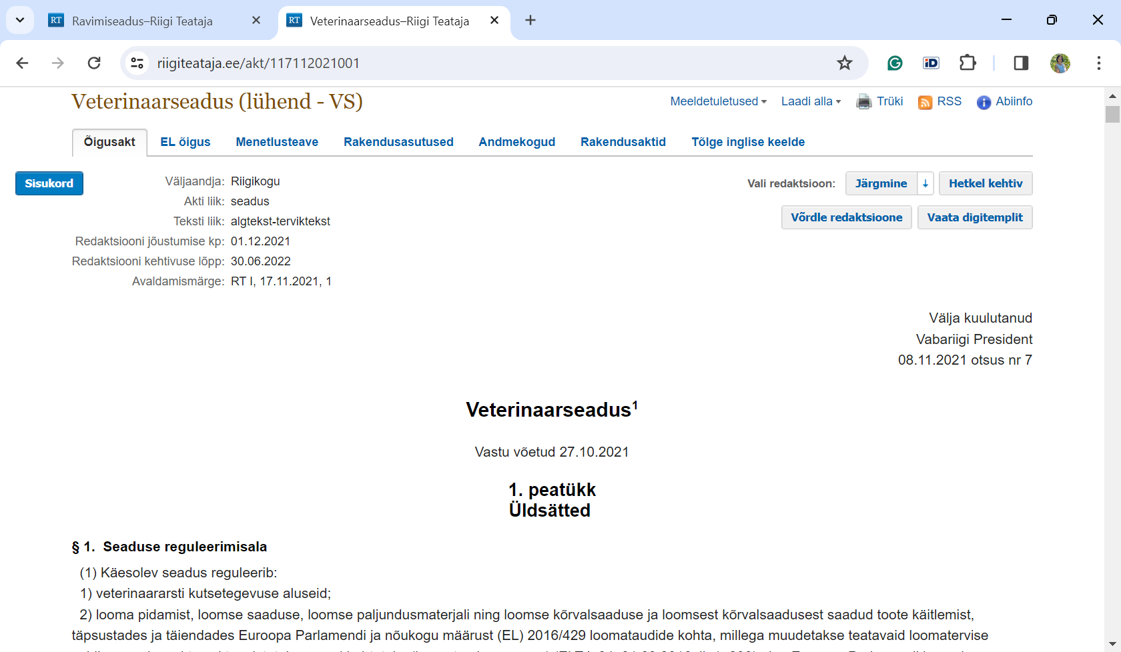
Legislation directly related to antibiotic treatment in veterinary medicine in Estonia.
Regulation (EU) 2019/6 of the European Parliament and of the Council

Slide 24
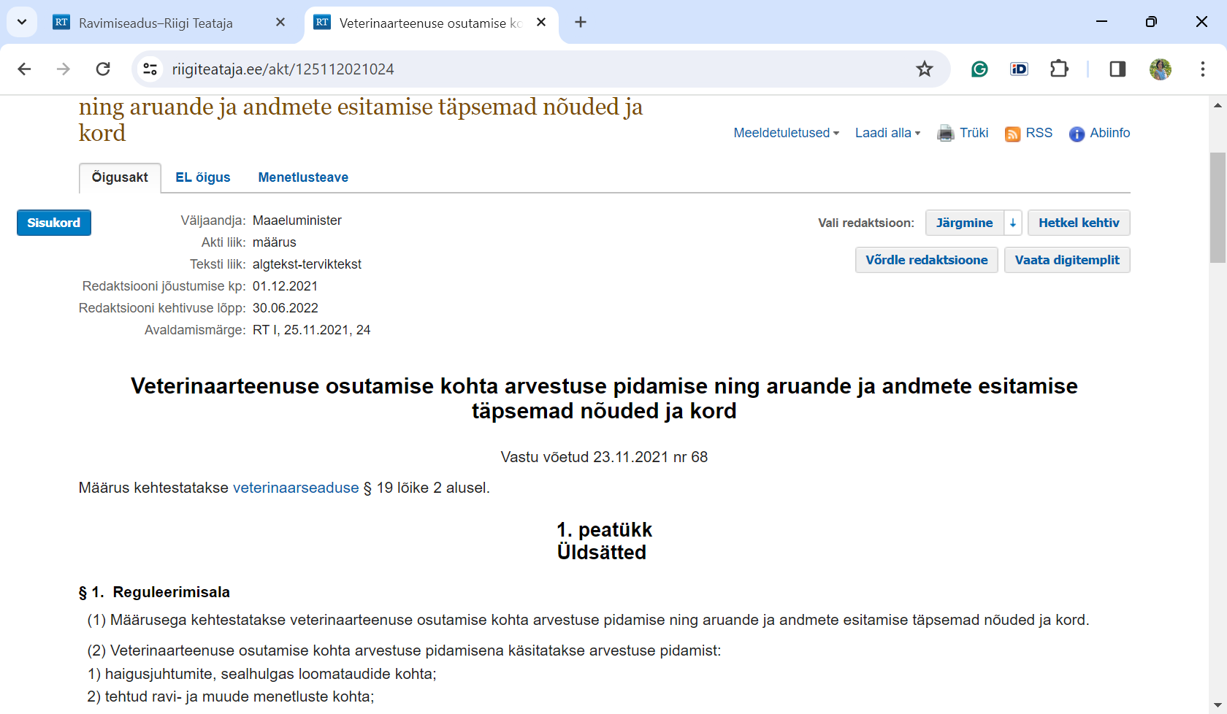
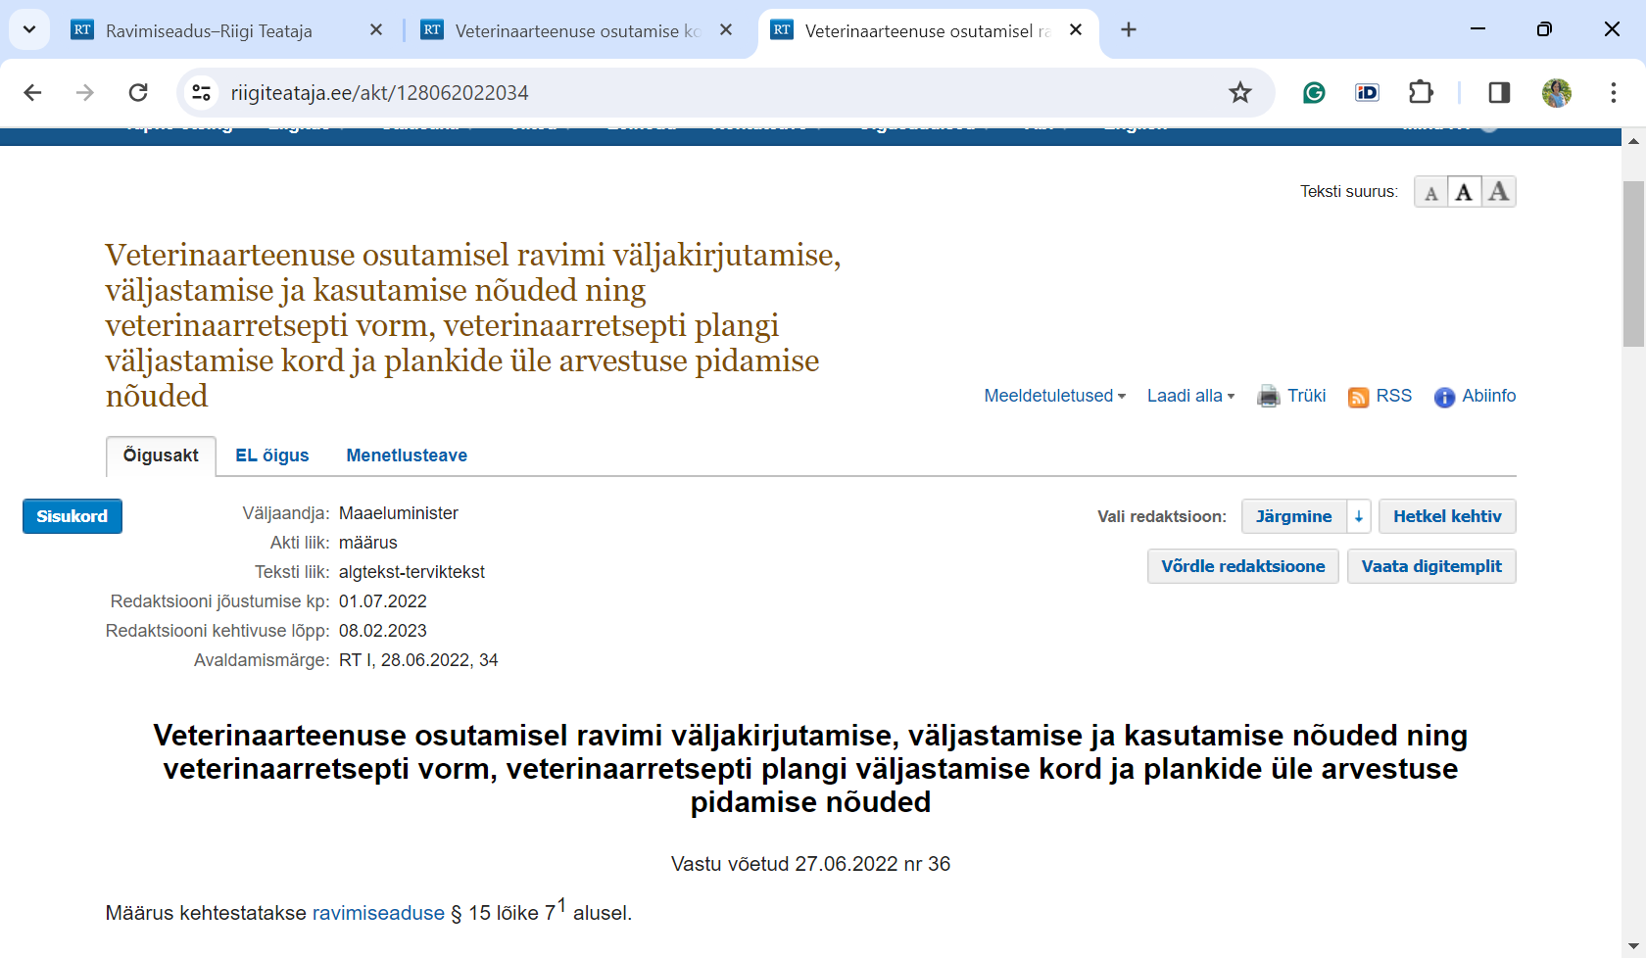

Third and fourth generation cephalosporins and fluoroquinolones may only be used for animal treatment if a sensitivity test has been conducted on the pathogen and it has developed resistance to other antibiotics indicated for treatment of that pathogen.
Commission Delegated Regulation (EU) 2021/578. Registration of antibiotic use data by animal species.

Slide 25
Thank you!

