Slide 1
ROMANIA
09 AND 10 MAY 2024

Slide 2
Additional relevant legislation, provisions and/or guidelines to be considered by veterinarians & farmers (II) Lecture 4
ROMANIA, 9 AND 10 MAY 2024

Slide 3
EU legal framework on veterinary medicinal products/medicated feed
Regulation (EU) 2019/6 on Veterinary Medicinal Products
Regulation (EU) 2019/4 on Medicated Feed
+ Implementing and delegating Acts

Slide 4
Use of Antimicrobial Veterinary Medicinal Products
EU legislative framework: Regulation (EU) 2019/6 on VETERINARY MEDICINAL PRODUCTS (VMP)
Supporting prudent use and preserving efficacy
antimicrobials or groups of antimicrobials reserved for treatment of certain infections in humans.
!Article 37 (5)
“humans reserve list”
List of antimicrobials which:
are not to be used in accordance with Articles 112, 113 and 114; or
(b) are only to be used in accordance with Articles 112, 113 and 114 subject to certain conditions.
!Article 107 (6)
“ use of AM outside the marketing authorisation”

Slide 5
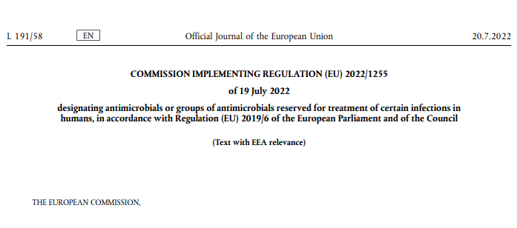
Use of Antimicrobial Medicinal Products
The human reserve list: antimicrobials which are reserved for treatment of certain infections in humans
“reserve list”
The antimicrobials and group of antimicrobials listed in this Regulation cannot be used in veterinary medicinal products.
VMP containing antimicrobials listed in this Regulation cannot be used in medicated feed
The list of antimicrobials or groups of antimicrobials to be reserved for treatment of certain infections in humans should be kept under continual review in the light of new scientific evidence or emerging information
Commission Implementing Regulation (EU) 2022/1255

Slide 6
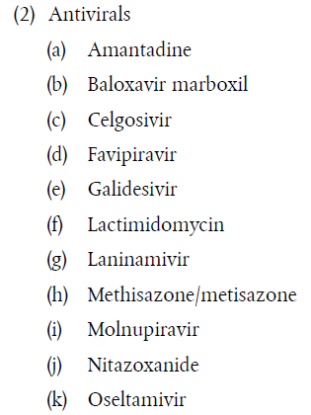
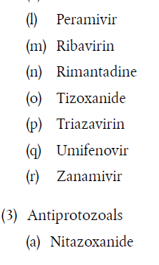
Use of Antimicrobial Medicinal Products
“human reserve list”
Supporting prudent use and preserving efficacy
Commission Implementing Regulation (EU) 2022/1255

Slide 7


Upcoming Delegated and Implementing Legal Acts
List of antimicrobials which shall not be used in accordance with article 112-114 (outside marketing authorisation) or only subject to certain conditions
List of substances authorised for use in food-producing terrestrial animal species or substances contained in a medicinal product for human use authorised in the Union, which may be used in food-producing aquatic species in accordance with Article 114(1)
List of substances which are essential for the treatment of equine species, or which bring added clinical benefit compared to other treatment options available for equine species and for which the withdrawal period for equine species shall be six months.
More info on all delegated and implementing Acts:
https://food.ec.europa.eu/animals/animal-health/vet-meds-med-feed/implementation_en

Slide 8
Use of Antimicrobial Veterinary Medicinal Products
List of antimicrobials which shall not be used outside marketing authorisation
!Article 107(6)
List of antimicrobials which:
  are not to be used in accordance with Articles 112, 113 and 114; or
  are only to be used in accordance with Articles 112, 113 and 114 subject to certain conditions.
“use of AM outside
the marketing authorisation”
Notes:
IF RUNNING OUT OF TIME, THIS SLIDE CAN BE HIDDEN

Slide 9

Upcoming Acts
List of antimicrobials that may be used for food-producing aquatic species
!Article 114
The Commission is to establish, by means of implementing acts, a list of substances used in veterinary medicinal products authorised in the Union for use in food-producing terrestrial animal species or substances contained in a medicinal product for human use authorised in the Union in accordance with Directive 2001/83/EC or Regulation (EC) No 726/2004, which may be used in food-producing aquatic species in accordance with Article 114(1).
Notes:
IF RUNNING OUT OF TIME, THIS SLIDE CAN BE HIDDEN

Slide 10
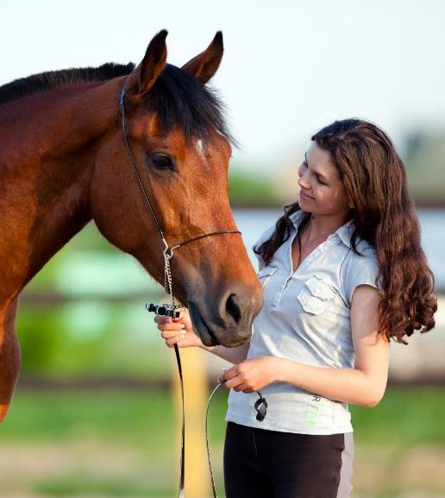
Upcoming Acts
List of antimicrobials for specific species (equine species)
In 2006 and 2013, the Commission published a list of substances essential for the treatment of Equidae ((EC) CR 1950/2006 & R 122/2013 )
The Commission is now updating the list of substances which are essential for the treatment of equine species, or which bring added clinical benefit compared to other treatment options available for equine species and for which the withdrawal period for equine species shall be six months.
On 9 February 2023, the European Medicines Agency received from the European Commission a request to provide scientific advice for the establishment this list of substances and they are currently preparing an answer.
Notes:
IF RUNNING OUT OF TIME, THIS SLIDE CAN BE HIDDEN

Slide 11
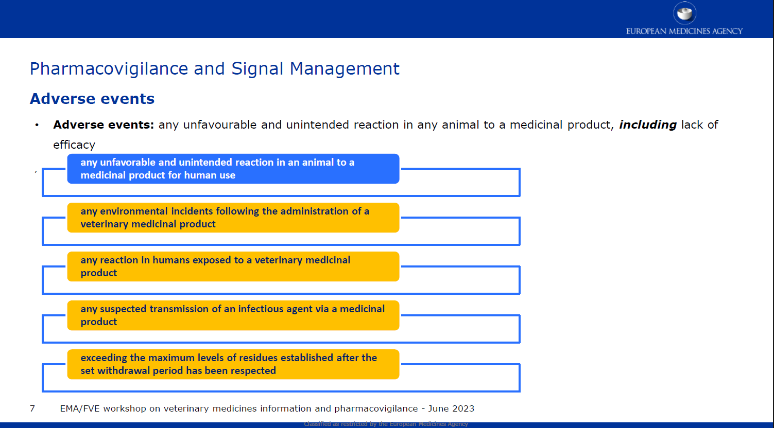
Reporting adverse events (pharmacovigilance)
Do not forget to report adverse events including lack of efficacy!

Slide 12
Disposal of Veterinary Medicine
How and where does pharmaceutical waste occur?
Immediate packaging and the remains of medicines within after use.
VMP or MF that are past their expiry date or that have not been stored in accordance with the instructions.
Prescription of a quantity exceeding the required quantity or uncompleted course of treatment due to either administration difficulties, adverse reactions, change in treatment or because animals died during treatment.
FACTSHEET_PharmaceuticalWasteDisposal.pdf (epruma.eu)

Slide 13
Disposal of Veterinary Medicine
Best practices for disposal
PharmaceuticalWasteDisposal.pdf (epruma.eu)
Everybody (prescribers and users) is responsible for minimising pharmaceutical waste.
Disposal of pharmaceutical waste via waterways should be excluded.
Pharmaceutical waste should be stored in a dedicated container, bin, or facility to ensure adequate protection to animal health, human health, feed, food and the environment and this must be separated from any stocks of veterinary medicines to ensure that the waste cannot be inadvertently used.
Waste must be disposed of in accordance with the Summary of Product Characteristics (SPC) and the waste legislation and national systems developed in consultation with all parties for the collection, transport, and disposal of the waste.
Member States shall ensure that appropriate collection or discard systems are in place for waste veterinary medicinal products (including medicated feed) and to ensure that the location of collection or discard points as well as other relevant information is made available to farmers, animal keepers, veterinarians, and other relevant persons.

Slide 14

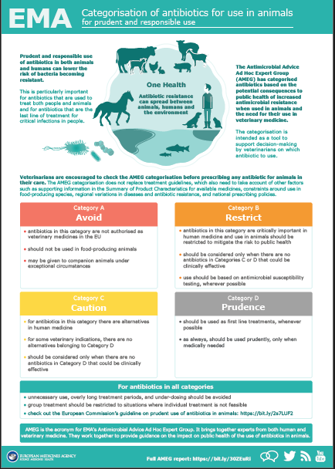
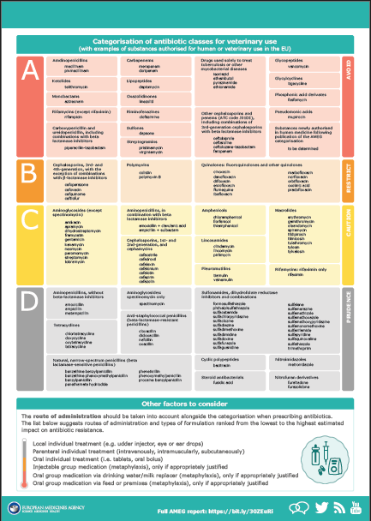
Other considerations for prescriptions

Slide 15
Prudent Use Guidelines
Not legally binding as the previous acts/provisions!
Guideline for the prudent use of
antimicrobials in veterinary medicine 2015/C 299/04​
https://health.ec.europa.eu/system/files/2016-11/2015_prudent_use_guidelines_en_0.pdf
Best-practice framework for the use of antimicrobials in food-producing animals in the EU - Reaching for the next level.
https://epruma.eu/home/best-practice-guides/best-practice-framework-for-the-use-of-antimicrobials-in-food-producing-animals-in-the-eu-reaching-for-the-next-level/

Slide 16
Animal Health Law (Regulation (EU) 2016/429 on transmissible animal disease)
“Prevention is better than cure”
Preventive driven approach:
improvement of animal health and biosecurity measures, good farming practices
Clear responsibility for all players for animal health
  Operators → ensure a high level of animal health and welfare, and biosecurity
  Vets → raise awareness and help in the prevention and spread of pathogens
  CA → protect animal health, human
  health and environment
Prioritising EU intervention
Regulatory tools/interventions for resistant pathogens: "disease agents“
Disease preventive and control measures may apply (surveillance, eradication etc.)
Legal basis monitoring AMR in animal pathogens

Slide 17

Romanian specifications

Slide 18
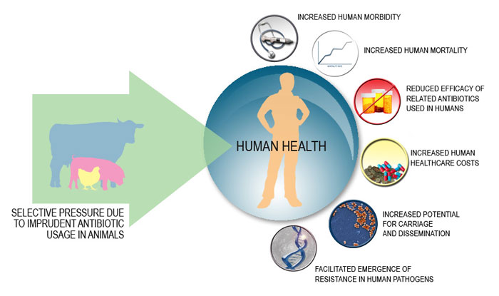
Source: http://amrls.cvm.msu.edu/images/vph/HUMAN-HEALTH-IMPACT_3-copy.jpg

Slide 19
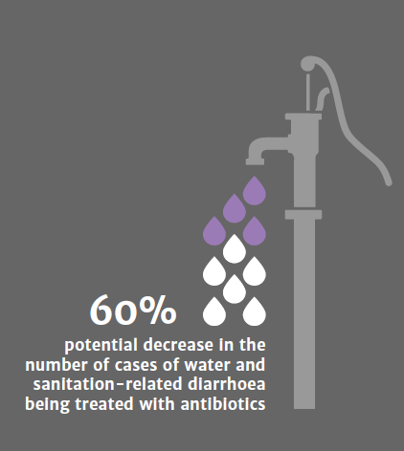
Antibiotics that have been identified in surface waters have often include:
macrolides,
sulfonamides,
tetracyclines,
chloramphenicols,
chlortetracycline,
sulfamethazine,
lincomycin,
trimethoprim,
sulfadimethoxine,
sulfamethazine.
Fact
Source: https://amr-review.org/sites/default/files/160518_Final%20paper_with%20cover.pdf

Slide 20
Fact
Antibiotics administered to animals are not completely absorbed by them!
Depending on the antibiotic, between 30 and 90% of the antibiotic can be excreted through urine or faeces in a bioactive state, even intact or in the form of antibiotic metabolites, which can further retain their antimicrobial activity.
Antibiotics given to animals often end up in soil and water through medical waste and improperly disposed drugs or dust from industrial breeding facilities.

Slide 21
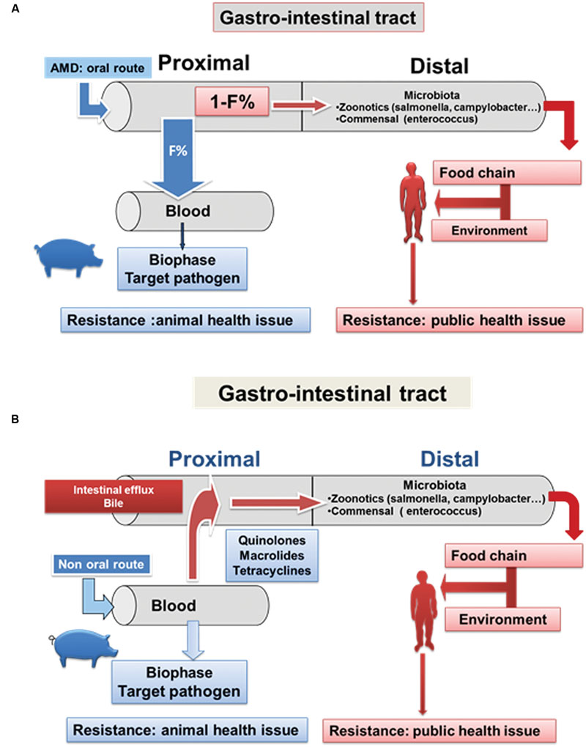
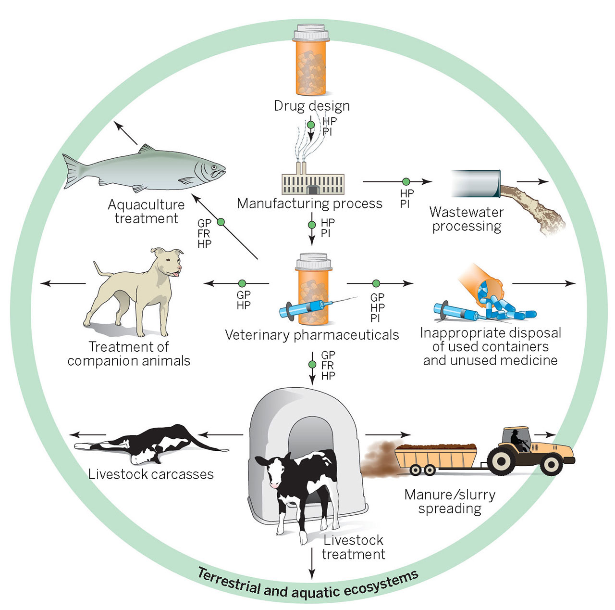
Source: https://www.frontiersin.org/articles/10.3389/fmicb.2016.01196/full
Source: https://science.sciencemag.org/content/346/6215/1296/F2.large.jpg

Slide 22
Some limitations of today's a.u.v. antibiotics:
!
unsatisfactory bioavailability
limited effect
cytotoxicity
long and frequent treatments
In this context, new specific features that can reduce morbidity and mortality are needed!

Slide 23
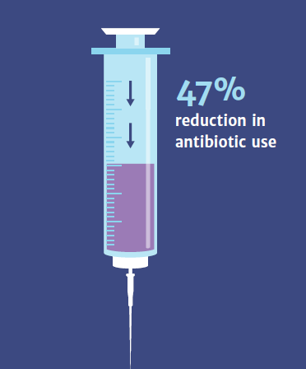
Sally Davies,
Chief Medical Officer for England
“A wide range of approaches and developing alternatives to antibiotics, in humans and animals, is critical to the fight.
Vaccines have a vital role to play in combating drug resistance, by preventing infections in the first place”.
Source: https://amr-review.org/sites/default/files/160518_Final%20paper_with%20cover.pdf

Slide 24
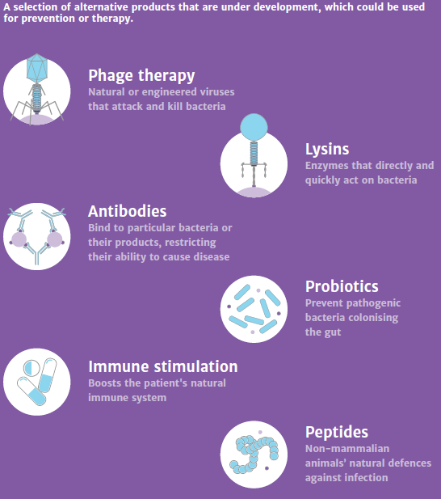
Attractive alternatives could also be:
specific pathogenic antibodies,
Immunomodulatory, agents,bacteriophages,
antimicrobial peptides, and
pro, pre or symbiotic products.

Slide 25
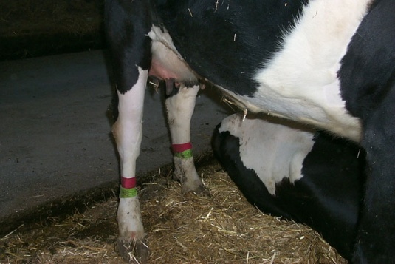
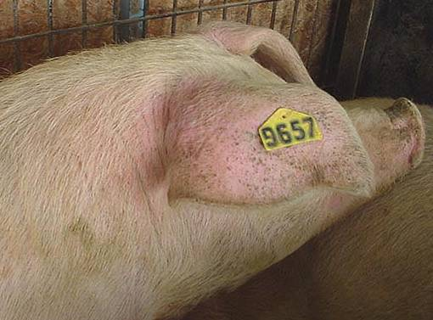
Prevention is the "key" and is achieved by:
Biosecurity
Proper maintenance of animals
Hygiene
Daily observation
Vaccination campaigns
Correct identification of treated animals
Correct record in the consultation register

Slide 26
Source: http://amrls.cvm.msu.edu/images/pharm/prophylaxis-and-metaphylaxis.jpg
Prophylactic & Metaphylactic Use
Antimicrobials should be used in metaphylaxis only when the risk of spreading an infection / infectious disease is high and when no other alternatives are available
Member States will provide guidelines to promote understanding of the risk factors associated with metaphylaxis and include criteria for its implementation.

Slide 27
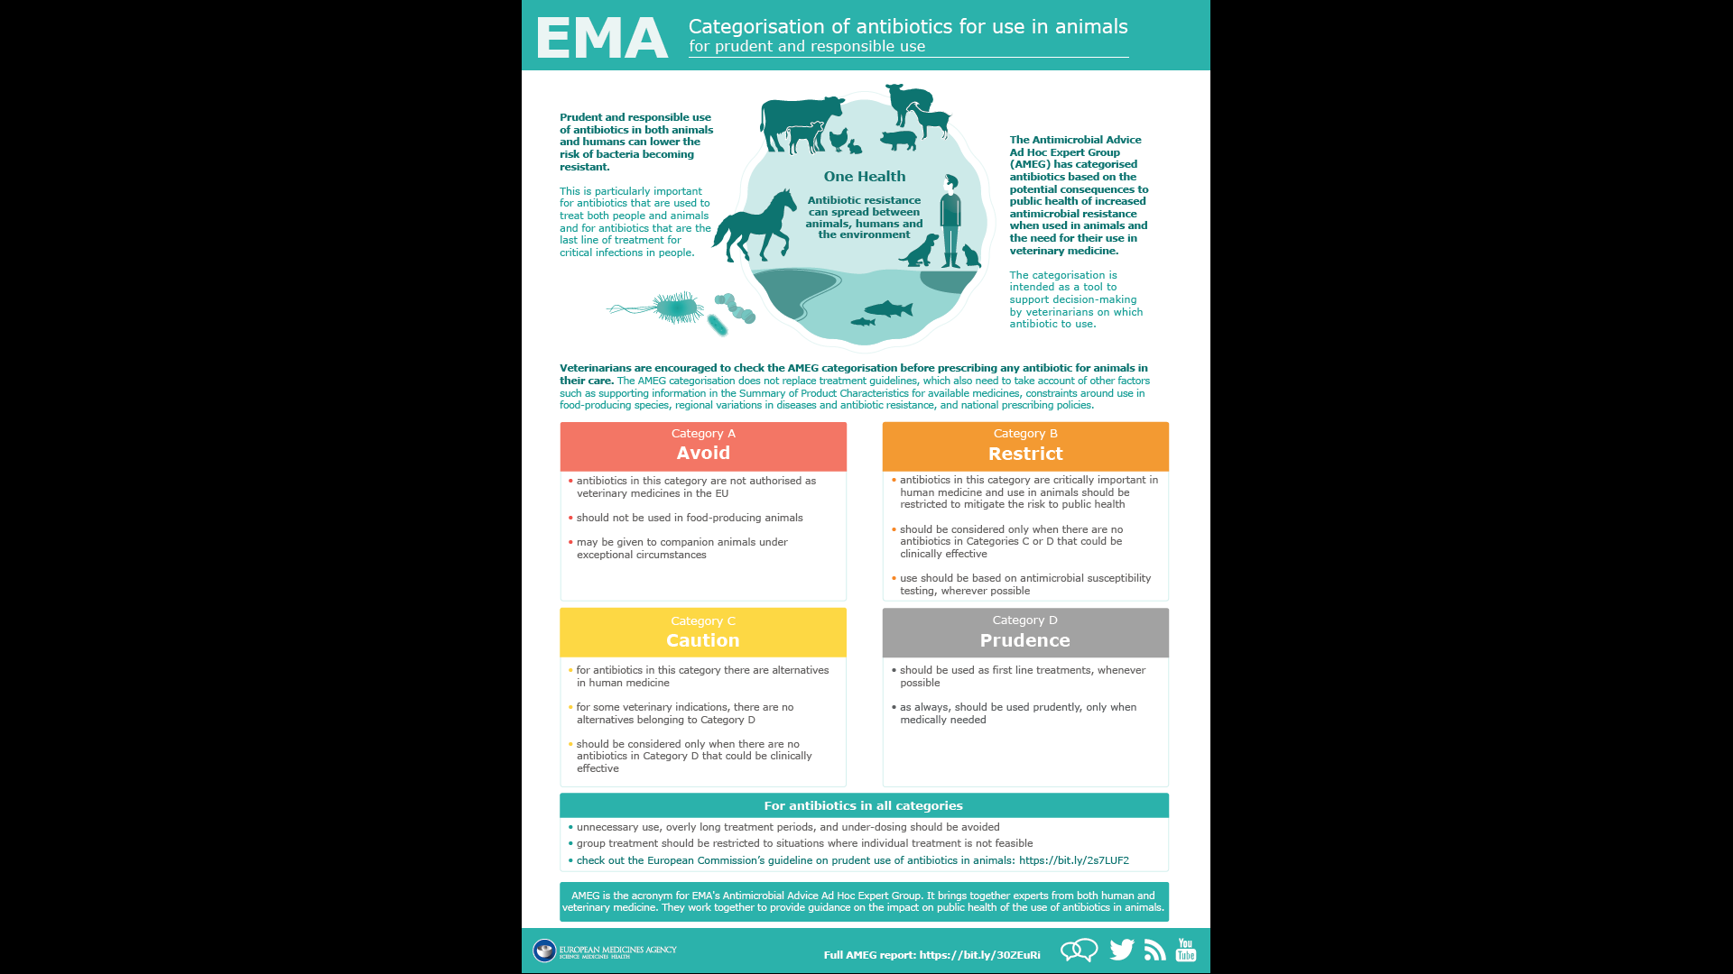
Don't forget the ATCvet codes!
Pay attention to the AMEG classification!
Source: European Commission’s guideline on prudent use of antibiotics in animals: https://bit.ly/2s7LUF2
The most important ATCvet prescription groups are:

Slide 28
The veterinarian will use antibiotics in the treatment of animals only when absolutely necessary!
Administration of antibiotics must be complementary to good management practices;
as many disease states can be avoided by:using management practices that reduce exposure to disease-causing bacteria;
optimizing the environment for the animal, including good hygiene, balanced nutrition and consistent vaccination schedules.

Slide 29
Evaluate!
The therapeutic plan !
anamnesis, symptomatology, results of clinical and paraclinical examinations
pharmacology
A drug with adequate pharmaco-dynamics and pharmacokinetics
specific to the species, disease, and certain regimen of doses
Diagnostic
Medicines intended for
a specific physio-pathological process
elimination of a pathogen
normalization of the body's functioning
the ratio: risk / benefit economic impact

Slide 30
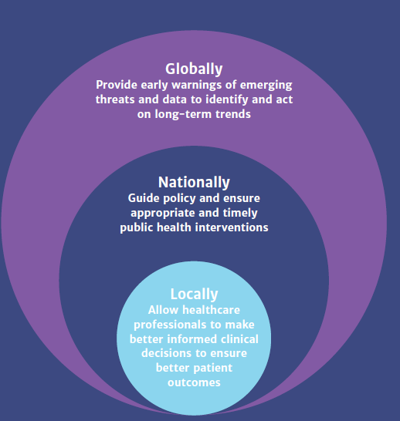
Conclusions:
Sursa: EPRUMA
Source: https://amr-review.org/sites/default/files/160518_Final%20paper_with%20cover.pdf

Slide 31

Thanks for your attention!
Source: http://blog.nouadreapta.org/wp-content/uploads/2011/01/caricatura_zilei-23411-250x300.jpg

