Slide 1
Bucharest, ROMANIA 9th-10th May 2024

Slide 2
Case presentation

Slide 3
A “dimension” of the resistance phenomenon in pig farms in Western Romania
Prof. Romeo T. Cristina
Faculty of Veterinary Medicine Timisoara
www.veterinarypharmacon.com
in a…

Slide 4
Fact
Antimicrobial resistance (AMR) is the capability of microorganisms to adapt to antimicrobials, mainly antibiotics.
Exaggerated and inappropriate use of antimicrobials and inefficient infection management approaches resulted in AMR being a serious global public health menace.
Databases and supervision systems from both human and veterinary sectors are becoming increasingly abundant in data since.
As of today, resistance is registered for almost all antibiotics

Slide 5
Fact
Animals can operate as intermediates, pools, and disseminators of the resistant bacterial strains / genes.
The alarming increase in scientific reports about multidrug-resistant (MDR) bacteria, combined with the decline in new veterinary drugs approval, is indisputable, that this reduces the supply of clinical treatment options.
In these conditions, attempts to manage bacterial infections remain challenging, reducing the efficacy of infectious diseases treatments.
As a result, the need for renewed infection control strategies is becoming crucial!

Slide 6
Fact
Also, studies described that faulty antimicrobial use in slaughterhouse animals is influencing the health of farmworkers and employees from meat processing units or the health of final consumer.
Why is resistance spreading so quickly, and what are their intimate / specific resistance mechanisms?
They are not fully established yet!

Slide 7
Fact
The mortality of pigs in commercial farms represents a significant loss that cannot and will not be completely eliminated, but only reduced to some economically bearable values.

Slide 8
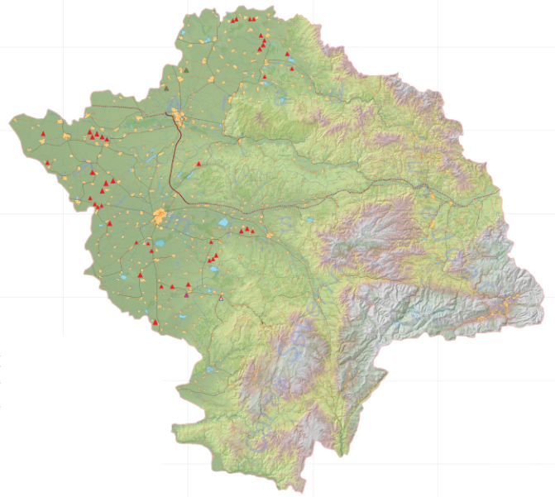
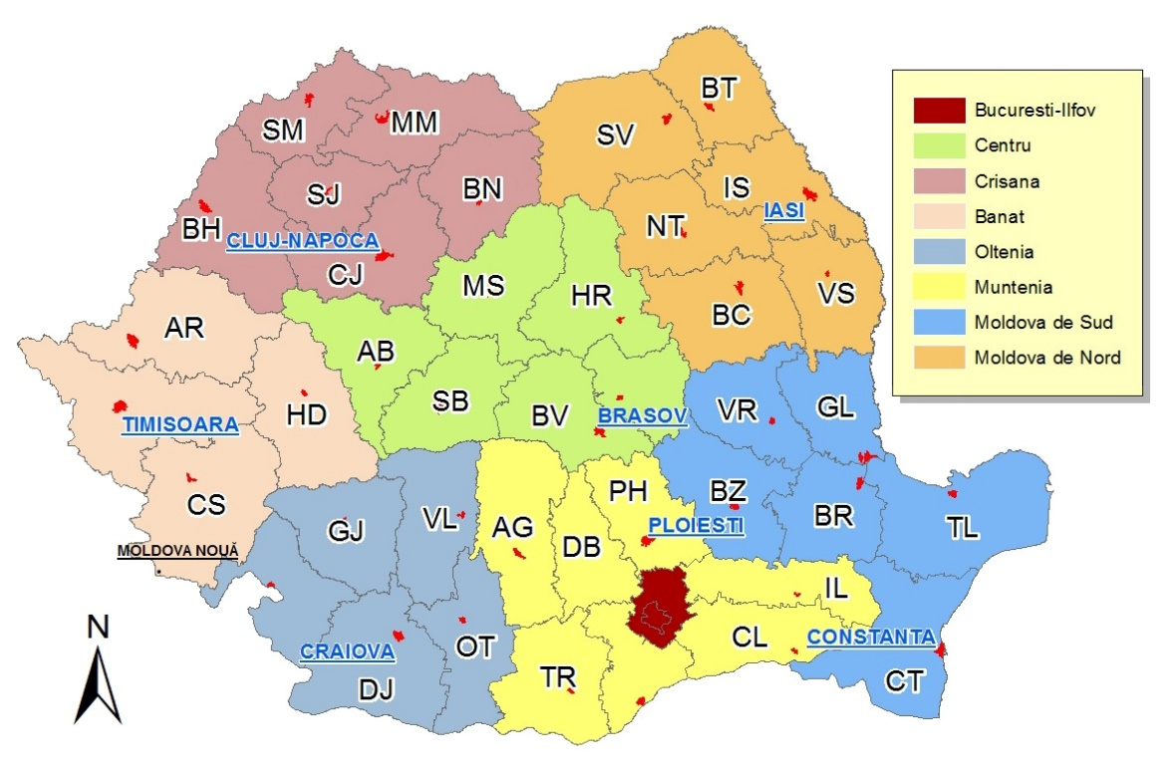
Step 1:
Case identification &
Economic analysis
The total number of pigs / studied county
Category | Boars | Sows | Youth |  |  |  | Fat pigs | Total
 |  |  | Infants | Fattened | Boared | Sows
Arad | - | - | - | 12158 | - | - | 74021 | 86179
Timis | 313 | 45269 | 73237 | 140523 | 26 | 10907 | 224734 | 495009
Caras S. | - | - | - | - | - | - | 6117 | 6117
Total | 313 | 45269 | 73237 | 152681 | 26 | 10907 | 304872 | 587305
Initially, the study was conducted on over half a million pigs, from 49 breeding units located in three counties in Western Romania.

Slide 9
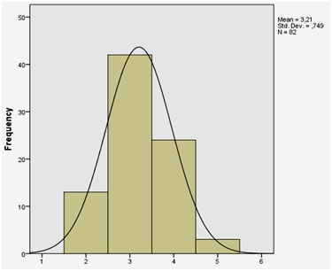
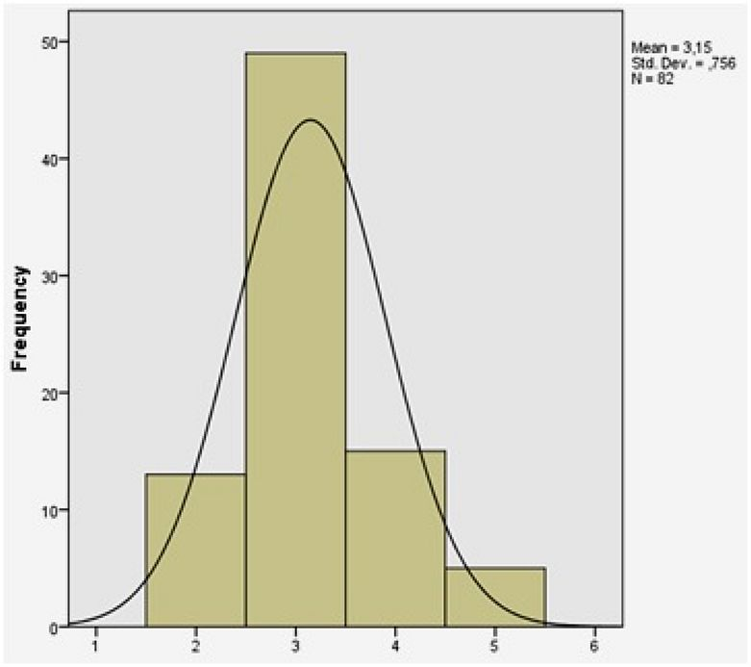
The influence of the season on the main diseases in pigs
Main identified afection | Type A farms % |  | Type B farms %
 | Winter | Summer | Winter | Summer
Bronhopneumonia | 48 | 44 | 49 | 43
HBS* | 42 | 45 | 41 | 46
Digestive disorders | 10 | 11 | 10 | 11
*Hemorrhagic Bowel Syndrome
Classification of farms according to their mortality rate & profitability
Frequency of mortality rate
Category / range | Mortality rate% | Farms % | Profitability
I | 0.00 – 2.75 | 15.85 | ✓
II | 2.76 – 5.51 | 51.22 | ✓
III | 5.52 – 8.27 | 29.27 | ×
IV | 8.28 + | 3.66 | ×
Frequency of medication / animal head
Grouping farms according to the
value of expenses / individual
Group / range | Expenses/ individual | Farms % | Profitability
I | 0 – 6.26 | 15.85 | ✓
II | 6.27 – 12.52 | 51.22 | ✓
III | 12.53 – 18.79 | 29.27 | ✓
IV | 18.80 + | 3.66 | ×

Slide 10
Swine exploiting units from Western Romania, have been included, where clinical cases were diverse, and the identified incidence of colibacillary infections was high.
The examination was completed on biological material from pure E. coli cultures, gathered directly from the fresh intestinal contents of swine

Slide 11
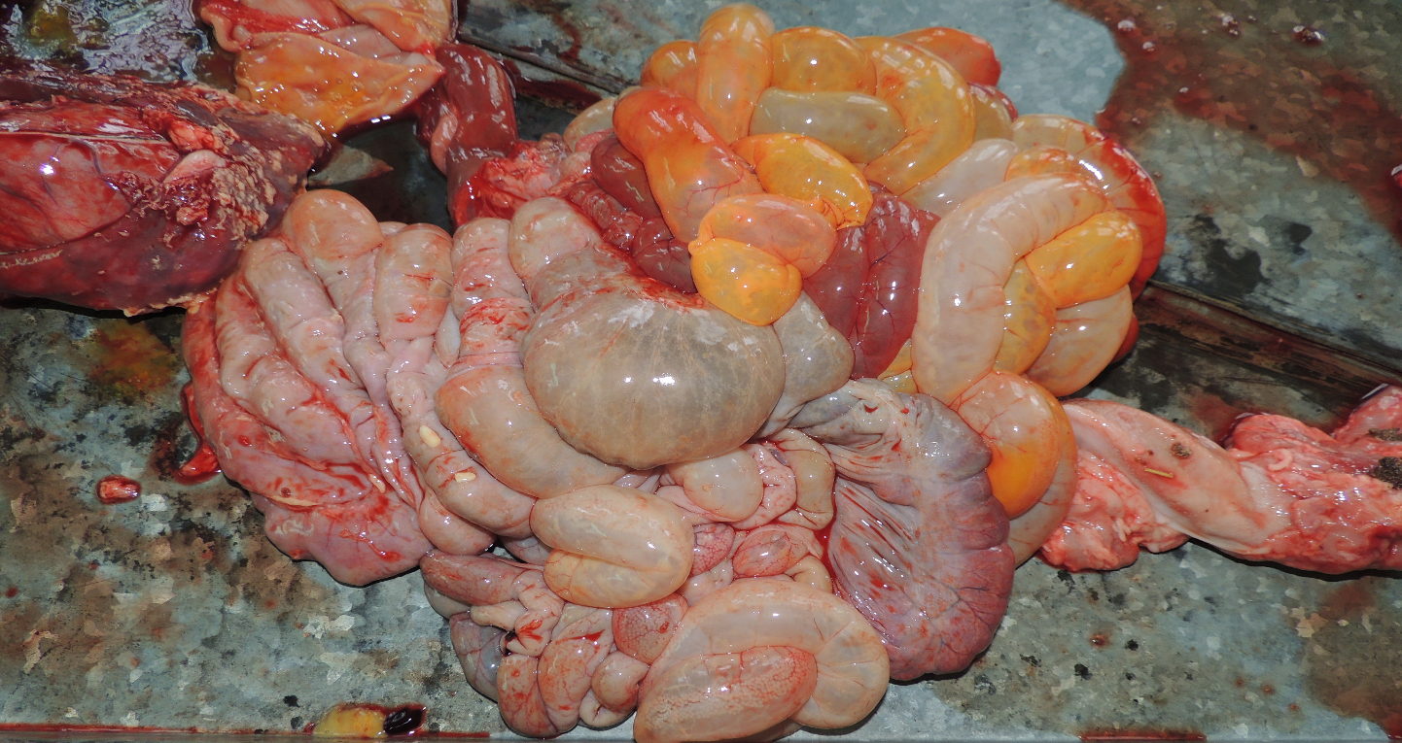
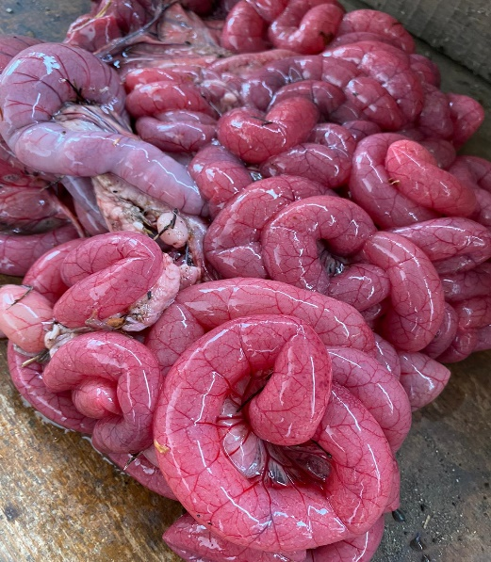
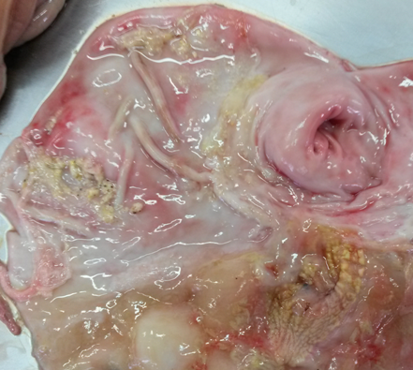
Hemorrhagic enteritis (fibrin hemorrhagic) - a distended gastrointestinal mass, reddish in color,
Jejunoileitis - Enteropathogenic colibacillosis due to strains of EPEC and AEEC strains of E. coli
Fibrin hemorrhagic gastritis - gastric mucosa with red stretched areas covered with rough deposits, some pseudomembranous, greyish-yellowish, adherent

Slide 12
Taking into account similar studies in Europe and Romania carried out on bacterial cultures of E. coli isolated from pigs, 70% were resistant to at least one of the antibiotics tested. On the other hand, 24% of isolates from pigs were sensitive to all antibiotics tested.
The irresponsible use of antimicrobial substances as a means of preventing colibacillary enteritis has led to the emergence of strains resistant to the action of some drugs.
This phenomenon is expanding both locally and globally, so researchers are focusing on implementing alternative disease control measures

Slide 14
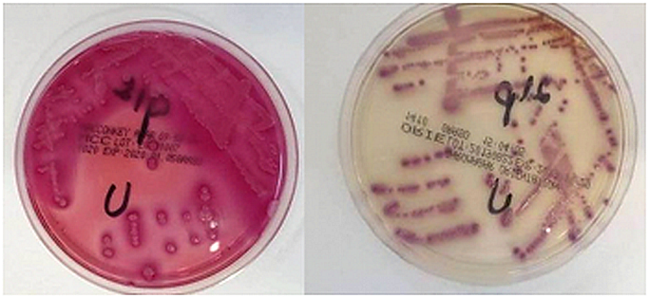
Cultivation of E. coli strains
on McKonkey (Oxoid Ltd., UK) selective media
Isolation of the E. coli strains
sensitivity /
(b, c) resistance to antimicrobials

Slide 15
Step 2:
The Role of Methyl-(Z)-11-tetradecenoate Acid from the Bacterial Membrane Lipid Composition in Escherichia coli and Antibiotic Resistance
The bacterial membrane plays a critical role in the survival of bacteria and the effectiveness of antimicrobial peptides in protecting the host.
The lipid constituents of the bacterial membrane are not evenly distributed, and they could be affected by clustering anionic lipids with cationic peptides with multiple positive charges.
That could be harmful to bacteria because it prevents lipids from interacting with other molecular components of the cell membrane, disrupts existing natural domains, or creates phase boundary defects between the clustered lipids and the bulk of the membrane.

Slide 16
Crt. No. | Sample no./ Antibiotic tested | 1 | 2 | 3 | 4 | 5 | 6 | 7 | 8 | 9 | 10 | 11
1. | Amoxicillin | R | R | R | R | R | R | R | R | R | R | R
2. | Gentamycin | S | S | S | S | S | S | S | S | S | S | S
3. | Florfenicol | R | S | R | S | R | S | R | R | R | R | R
4. | Oxacicyllin | S | R | R | R | R | S | S | S | S | S | S
5. | Cephalothin | R | R | R | R | R | R | R | R | R | R | R
6. | Spectinomycin | R | R | R | R | R | S | R | R | R | R | S
7. | Norfloxacin | R | S | S | S | S | S | R | R | S | R | S
8. | Tiamulin | S | S | S | S | S | S | S | S | R | S | S
9. | Ciprofloxacin | S | S | R | R | R | S | R | S | R | S | R
10. | Penicillin | R | S | R | R | R | S | S | R | R | R | S
11. | Tetracycline | R | R | R | R | R | S | S | R | S | R | R
The antibiotic susceptibility results
(according to CLSI 2018)
Note: R – Resistant, S – Sensitive
The study aimed at assembling a correlation between antibiotic resistance and bacterial lipid composition in E. coli, based on the function and arrangement of the bi-lipidic coating of the bacterial cell, intimately associated with the path of antimicrobials through membranes.

Slide 17
Quantification of results and highlighting of fatty acids in the bacterial membrane
Retention time (min.) | Identified compound | No. of collection dial (chromatogram)
 |  | 1 | 2 | 3 | 4 | 5 | 6 | 7 | 8 | 9 | 10 | 11
8.2 | decanoic acid (methyl-ester) | - | + | - | - | + | - | - | - | - | - | -
10.3 | 4-octadecenal | - | - | - | - | - | + | - | - | - | - | -
10.6 | methyl-10-methyl undecanoate | - | + | + | + | + | + | + | + | + | + | +
13.8 | methyl-(Z)-11-tetradecenoate | - | - | - | - | - | + | - | - | - | - | -
14.3 | methyl-iso-miristate | + | + | + | + | + | + | + | + | + | - | +
15.7 | methyl-(Z)-11-tetradecenoate | - | - | - | - | - | - | - | - | - | + | +
17.2 | i-propyl-tetradecanoate | + | + | + | + | + | + | + | + | + | + | +
20.1 | methyl-palmitoleate | + | + | + | + | + | - | - | - | + | + | -
20.2 | methyl-hexadec- 9-enoate | - | + | - | - | - | + | + | - | - | - | +
21.3 | methyl-14-methyl-pentadecanoate | - | - | - | + | - | + | + | + | - | - | +
21.4 | methyl-3-(3.5-di-tert-butil-4-hidroxy-phenyl) propionate | + | - | - | - | - | - | - | - | - | - | -
26.0 | Methyl-8-heptadecenoate | - | + | - | - | - | - | - | - | + | - | -
26.1 | methyl-9,10-metylene-hexadecanoate | - | - | + | - | - | + | + | - | - | + | +
26.1 | cis-10-heptadecenoic-acid (methyl-ester) | + | - | - | + | + | - | - | - | - | - | -
29.0 | methyl-(10E)-10-octadecenoate | - | - | - | + | - | - | - | - | - | - | -
29.0 | methyl -11-octadecenoate | + | - | - | - | + | + | - | - | - | - | -
29.0 | methyl-trans-8-octadecenoate | - | + | - | - | - | - | - | - | - | - | -
29.1 | methyl-13-octadecenoate | - | - | - | - | - | - | - | - | - | - | +
29.5 | methyl-16-methyl-heptadecanoate | - | - | + | + | + | - | + | - | + | - | -
29.5 | methyl-14-methyl-heptadecanoate | - | + | - | - | - | + | - | - | - | + | +
30.4 | decanoic acid (decylestere) | + | + | - | - | - | + | - | + | - | + | +
31.2 | methyl-dihydrosterculate | - | - | - | - | - | - | - | - | - | + | -
31.2 | methyl-9,10-metilene-octadecanoate | - | - | - | - | - | - | - | - | - | - | +

Slide 18
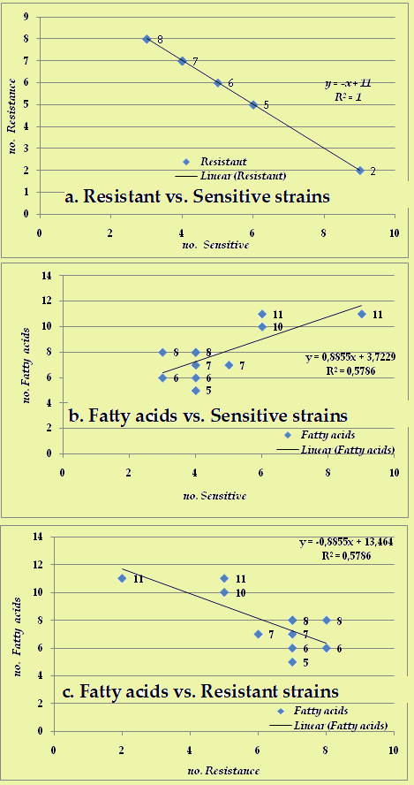
The matrix of statistical correlation
Category | Sensitive | Resistant | Fatty acids
Sensitive | 1 | -1 | 0.760627515
Resistant | -1 | 1 | -0.760627515
Fatty acids | 0.760627515 | -0.760627515 | 1
The presence of methyl-(Z)-11-tetradecenoate acid ascertained was in a positive connection with the susceptibility of E coli.
This fatty acid was not found in the resistant E. coli strains identified!
This allows to affirm that the bacterial fatty acid amount & composition could reflect the differences in antimicrobial susceptibility.

Slide 19
Step 3.
The extent to which ciprofloxacin resistance genes are present,
and their relation in pigs and human samples
from our region.
Since we were concerned on the quinolone group resistance emergent in Western Romania to humans and animals, the study tried to identify CIP-resistant cases and monitored the qnrA, qnrB, and qnrS plasmids in E. coli, using the molecular technique.

Slide 20
According to the European Commission (EC), the influence of the imprudent use of anti-infectives is substantial. Thus, more than 70% of bacteria, accountable for intra-hospital infectivity, were found to be resistant to at least one antibiotic structure.
We studied the expression of qnrA, qnrB, and qnrS plasmids in ciprofloxacin (CIP)-resistant strains of Escherichia coli in swine and humans from Romania, using the Polymerase Chain Reaction (PCR) technique.
1) Antibiotic Susceptibility Testing (AST) for human subjects on 147 samples (H) and 53 swine (S) was ascertained.
2) As well as the isolation of bacterial DNA (E. coli) as follows:
Bacteriolysis,
DNA-binding,
Rinsing & elution,
Amplification & nucleic acids’ migration, and
U.V. visualization stages.

Slide 21
Quinolones group have been used for prophylaxis against Gram negative infections both in humans and animals, but the impact on the resistance mechanisms of this important group nonetheless requires deep exploration!
The qnr genes give generally, low-level resistance, levels of quinolones in Enterobacteriaceae, but the multi-resistance dimension is of great importance, studies about the resistance of E. coli to ciprofloxacin (CIP).

Slide 22
1). Antibiotic Susceptibility Testing (AST)
The results obtained from AST and the evolution of the resistance tendency showed the considerable presence of the multi-resistant strains in swine isolates where, from 53 samples analyzed, 15 isolates were presenting resistance to CIP and also multi-resistance to other antibiotics, including other quinolone representatives like, enrofloxacin, in the majority of cases, and norfloxacin
Swine samples find with multiple resistances to CIP from a total of 53 samples
Sample no. | S2 | S6 | S7 | S13 | S14 | S16 | S22 | S29 | S35 | S36 | S37 | S38 | S46 | S47 | S49 | S50
Resistant strains no. | 7 | 7 | 6 | 8 | 5 | 6 | 2 | 6 | 7 | 7 | 5 | 9 | 8 | 9 | 11 | 10

Slide 23
Sample no. | Resistant strains | Sample no. | Resistant strains
S6 | 4 | S78 | 9
S13 | 3 | S79 | 2
S15 | 3 | S80 | 3
S16 | 4 | S85 | 4
S19 | 1 | S88 | 5
S20 | 2 | S90 | 4
S21 | 3 | S94 | 6
S22 | 6 | S97 | 4
S24 | 4 | S102 | 3
S26 | 2 | S104 | 7
S32 | 5 | S106 | 2
S35 | 4 | S110 | 3
S49 | 5 | S116 | 5
S50 | 2 | S119 | 4
S60 | 3 | S130 | 9
S65 | 9 | S134 | 2
S68 | 2 | S142 | 2
S70 | 5 | S144 | 2
S71 | 5 | S147 | 4
Conclusion | From 38 isolates - 17 were with multiple resistance to four or more antibiotics
The AST results obtained from 147 human samples also presented CIP resistance levels, but proportionally lower compared to swine, 38 isolates presenting resistance, and among these, 17 were found with multiple resistance (e.g. piperacillin, trimetoprim, cefuroxime and levofloxacin).

Slide 24
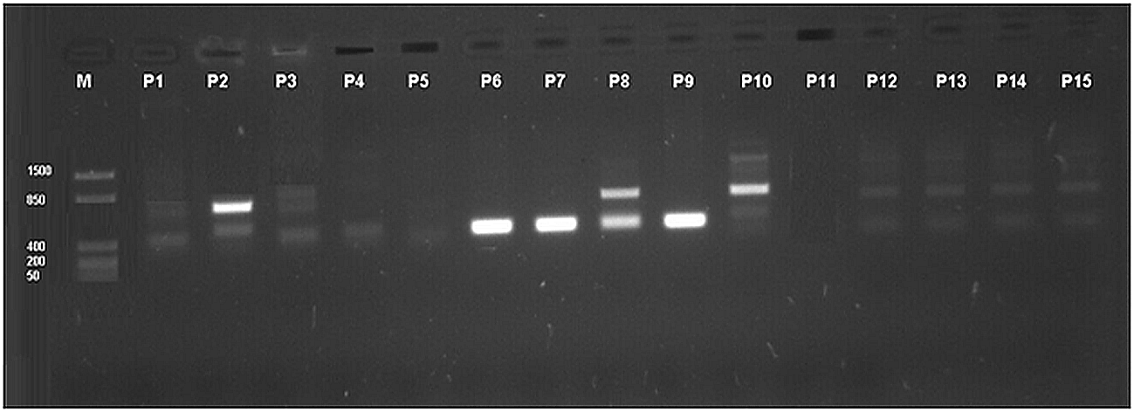
Gene | Primer used | Fragment size
qnrS | F: ACGACATTCGTCAACTGGAA R: TTAATTGGCACCCTGTAGGC | 417 bp
qnrA | F: ATTTCTCACGCCAGGATTTG R:GATCGGCAAAGGTTAGGTCA | 516 bp
qnrB | F: GTTGGCGAAAAAATTGACAGAA R: ACTCCGAATTGGTCAGATCG | 526 bp
Humans (H) | Genes | Swine (S) | Genes
H1 | qnrS + qnrB + qnrA | S1 | qnrS + qnrB
H2 | qnrS + qnrB | S2 | qnrS + qnrB
H3 | qnrS + qnrB + qnrA | S3 | qnrS + qnrB
H4 | qnrS | S4 | qnrS + qnrB
H5 | -- | S5 | qnrS + qnrB
H6 | qnrS | S6 | qnrS + qnrB
H7 | qnrS | S7 | qnrS + qnrB
H8 | qnrS + qnrB | S8 | qnrS + qnrB
H9 | qnrS | S9 | qnrS + qnrB
H10 | qnrS + qnrB +qnrA | S10 | qnrS + qnrB
H11 | -- | S11 | qnrS + qnrB
H12 | qnrS + qnrB | S12 | qnrS + qnrB
H13 | qnrS + qnrB | --
H14 | qnrS + qnrB | --
H15 | qnrS + qnrB | --
2). Presentation of studied CIP-resistant genes

Slide 25
The quick identification and antimicrobial susceptibility testing have considerable effect on the clinical outcome of severe infections in humans and animals.
The frequent emergence of resistance to quinolones occurring in common infections with Campylobacter spp. and E. coli in humans, as a result of their massive use in animal feed, as well as the transmission of human resistant bacteria, through meat and animal products rises great awareness, since quinolones are first line antibiotics !

Slide 26
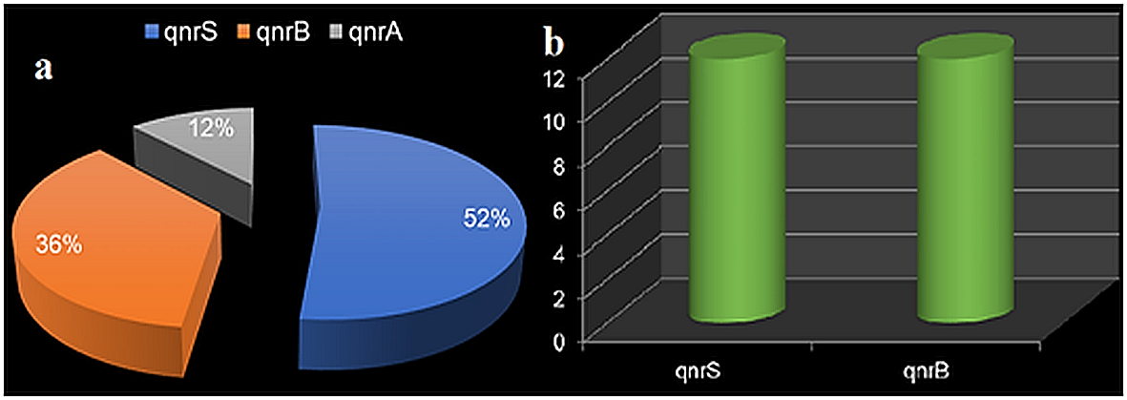
The statistics (with Crosstabs function IBM SPSS Statistics-Ver. 2.1.), revealed:
qnrS (417-bp) gene in 13 human subjects (52.0%), as well as in all swine samples studied.
qnrB (526-bp) gene exposed in 9 of human patients (36.0%) and in all swine isolates, and
qnrA (516-bp), gene, it was observed only in 3 of the isolates obtained from human subjects (12.0%), but not discovered in pigs (p >0.05).
The presence of plasmids qnrA, qnrB and qnrS in the human samples and of qnrB and qnrS in swine, facilitates the survival of pathogens despite the CIP action! The long-term use of CIP could cause a boost in the prevalence of qnr resistance genes, and resistance in the pigs destined for slaughter, a perturbing fact for public health and the human consumer.

Slide 27
Step 4.
Use medicines responsibly!
Medicines cannot replace good management!
Prevention is the key:
Biosafety plan
Proper maintenance of animals
Hygiene
Daily observation
Vaccination campaigns
Identify treated animals correctly
Correct evidence in the consultation and feeding register

Slide 28
Conclusive remarks

Slide 29
007 useful tips!
00sfaturi utile!
Collaboration: research entities - farmers - authorities in order to establish some on the use and marketing of medicines of new veterinary use legislation in Romania is essential!
Whenever possible use only one antibiotic and do not use antimicrobials from the same family.
Veterinarians should not prescribe antibiotics without careful analysis of cases and a well-established diagnosis.
Study the new medicines launched, in order to maintain a pool of effective medicines in the region you are serving.
Close and active collaboration with a microbiology laboratory is recommended, because the antibiogram helps to avoid choosing ineffective antibiotics.
If in vitro, the germ taken from a disease outbreak is sensitive to a drug then it can definitely be used in that outbreak.
If the first choice of an antibiotic is not followed by the effect, another antibiotic or combination of antibiotics should be used after the antibiogram.

Slide 30
The data record shall include information on:
the quantities of the medicinal product used for each animal species;
b. a list of all medicinal products supplied to each livestock holding from which food is obtained;
c. treatment protocols, including animal identification and waiting time/medication;
d. data about the identified antimicrobial sensitivity;
e. observations on the therapeutic response;
f. investigation of adverse reactions to treatment, including the lack of response of a possible antimicrobial resistance. Suspicions of adverse reactions must be reported to the regulatory authorities.

Slide 31
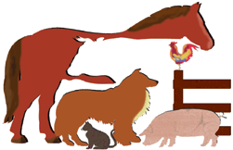
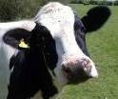
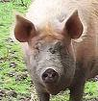
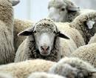
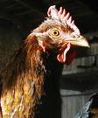
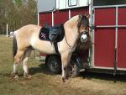
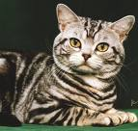
Major Species | Minor Species
Cattle | Goat
pigs | Dairy sheeps
sheeps | Chickens
Chickens | Rabbits
equine | fishs
dogs | Bees
cats
Example of a
treatment registry:
Date of treatment | ID Animal | Administered medicinal product | Dosage | Path | Withdrawal period
10 / 03 2024 | Pig 100 kg order: 35220 | Synulox | 5 ml / 100 kg | Injectionj (IM) | 14 days (25/03/2024)

Slide 32
Do not forget!
Most medications, with few exceptions, require 30-40 days to completely disappear from the body!
The withdrawal period applies to all categories of animals intended for human consumption!
The cascading use of a product is permitted for one animal or for a small number of animals within a farm.
Non-compliance with the legislation can lead to troubles!

Slide 33
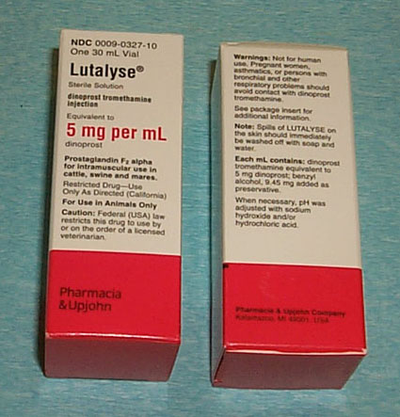
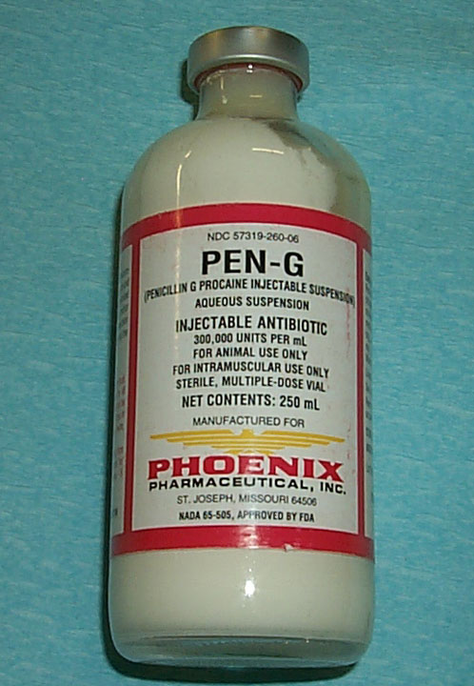
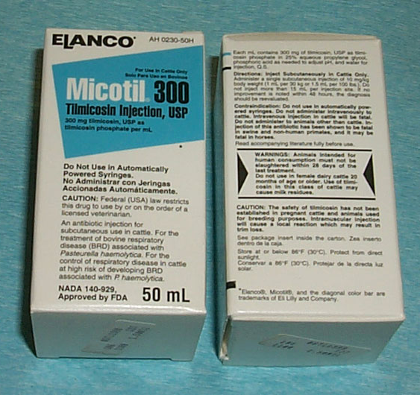
Rx - Prescription Required
The medications in this group are prescribed and used only by a veterinarian.
Images tribute to: Block & Smith / 2008

Slide 34
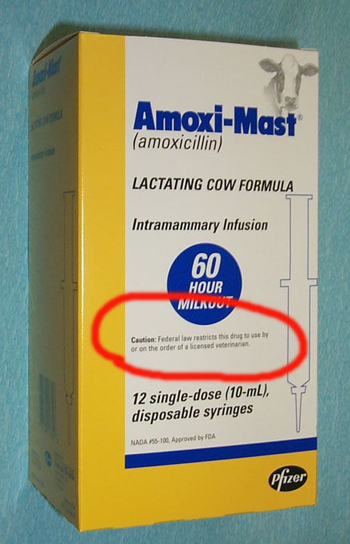
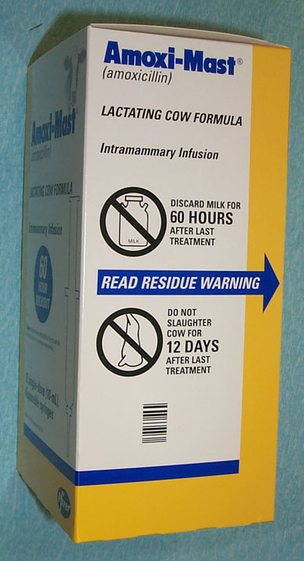
Images tribute to: Block & Smith / 2008

Slide 35
RVCP
Develop a relationship between: Veterinarian / Client / Patient!
Vet: Assumes responsibility for medical judgments.
The owner agrees to follow the advice.
This means that the veterinarian:
has all the necessary knowledge to establish the diagnosis,
has examined the animal or makes regular visits promptly,
is available to monitor and treat any adverse or secondary reactions that occur.

Slide 36
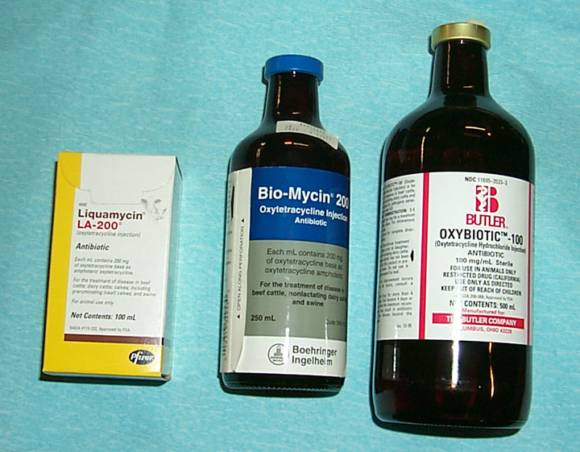
During a treatment, do not change the medicine with another similar product from another company!
Images tribute to: Block & Smith / 2008

Slide 37
In the rearing units, you now have the possibility to perform rapid tests for the presence of residues.
Examples:
Milk tests Urine tests
Delvo MeatSafe 1
Charm Premi® test urine
Snap
For: penicillins, sulfonamides, oxytetracyclines, ceftiofur, tylan, etc.

Slide 38
Prohibited for farm animals.
Chloramphenicol
Nitrofurans,
Diethylstilbestrol = DES
Metronidazole,
Dimetridazole,
Ipronidazole,
Clenbuterol, Thorazine
Enrofloxacin and danofloxacin Extra-label
Excenel® I.M.
Naxcel® in septicemic or metritis calves prohibited, or I.V.
Naxcel® prohibited after operations (in goats with pneumonia)

Slide 39
Not recommended (by the FDA)
Fluoroquinolones (such as Baytril®) Exception: pneumonia in beef cattle, dairy cows, pigs, and heifers under 20 months.
Gentamicin (except for oral administration in pigs).
Phenylbutazone banned in dairy cows over 20 months.
Sulfonamides (only sulfadimethoxine (Albon®) permitted, others not)!
Avoid intramuscular antibiotic administration as much as possible.
Avoid intravenous injections in the throat whenever possible.
Hormonal implants in the ears.

Slide 40
What you need to pay attention to:
Denumire
Substanță activă
Timp de retragere
Atenționări
Stocare
Volum ambalaj
Distribuitor
Expirare

Slide 41
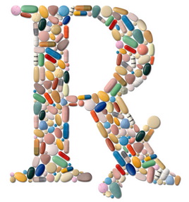
Thank you for your attention!

Slide 42
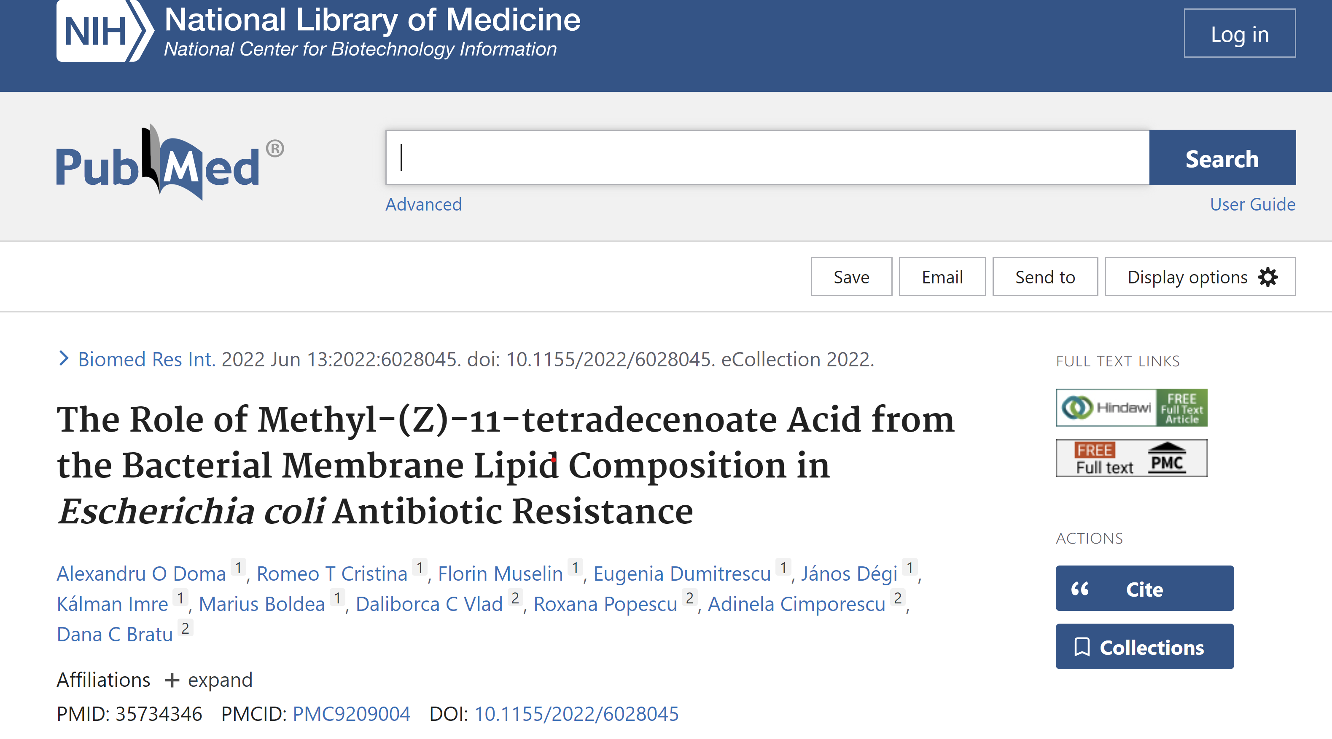
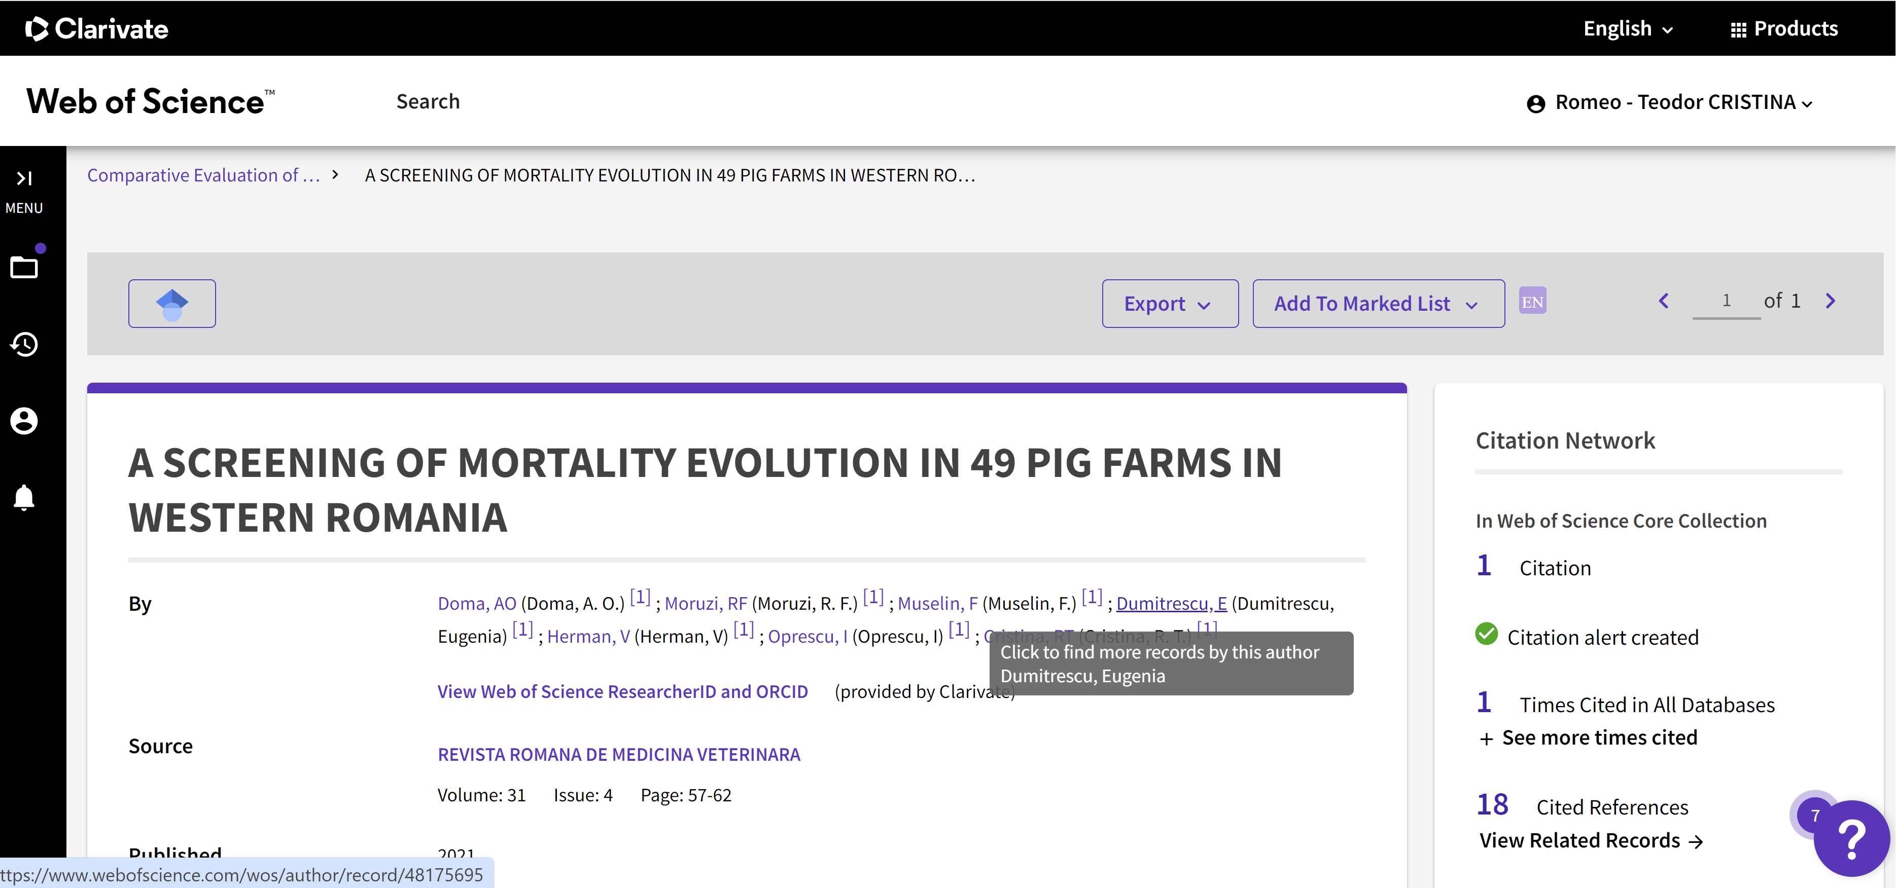
Works published…

Slide 43
Other works published…
Cristina RT. (2006). Introducere în farmacologia și terapia veterinară. Ed. Solness Timișoara.
Cristina RT, Chiurciu V. (2010). Elemente de farmacolovigilenta si toxicovigilenta in medicina veterinară, Brumar, Timişoara. pp 234-276.
Cristina RT, Doma AO, Moșneang CL. (2012). Uzul antibioticelor și despre chinolone în terapia veterinară. Med Vet/Vet Drug, 6(2):4-64.
Cristina RT, Doma, AO, Dumitrescu E, Muselin F, Chirila AB (2018). Despre evolutia si implicatiile fenomenului rezistentei la medicamentele antiinfectioase si antiparazitare de uz veterinar si evolutia acestui fenomen in Romania. Med Vet/Vet Drug. 12(1): 4-49.
Cristina RT, Moruzi RF, Dumitrescu E, Muselin F, Doma AO (2020). Consumul de antimicrobiene, impactul economic și social al rezistenței. Med Vet / Vet Drug. 14(1): 56-65.
Cristina RT, Moruzi RF, Dumitrescu E, Muselin F, Doma AO (2020). Utilizarea responsabilă a antimicrobienelor, noi mijloace și strategii împotriva fenomenului RAM. Med Vet / Vet Drug. 14(1): 67-76.
Cristina RT, Moruzi RF, Dumitrescu E, Muselin F, Doma AO (2020). Introducere în rezistența la antimicrobienele utilizate în medicina veterinară Med Vet/Vet Drug 14(1): 10-28.
Cristina RT, Moruzi RF, Dumitrescu E, Muselin F, Doma AO (2020). Răspunsul microorganismelor la tratamentele antimicrobiene. Med Vet /Vet Drug. 14(1): 42-54.
Cristina RT, Moruzi RF, Dumitrescu E, Muselin F, Doma AO (2020). Modalități de instalare a rezistenței la antimicrobiene și studierea eficacităţii antimicrobienelor. Med Vet / Vet Drug 14(1): 30-40.
Cristina RT, Villa R, Lupu O, Doma AO (2010). Activitatea comparativa unor conditionari farmaceutice de uz veterinar în dizenteria suina. Med Vet /Vet Drug, 4(2): 72-90.
Doma AO, Dumitrescu E, Muselin F, Cristina RT (2015). Elemente de structura bacteriana si mecanismele transmiterii rezistentei la antibiotice. Med Vet / Vet Drug, 9(2): 4-27.
Doma AO, Dumitrescu E, Muselin F, Tirziu E, Dégi J, Cristina RT (2019). Resistance profile screening in pig farms in western Romania. Lucr St Med Vet. Timisoara, LII(3): 37-44.
Doma AO, Popescu R, Mituletu M, Muntean D, Dégi J, Boldea MV, Radulov I, Dumitrescu E, Muselin F, Puvaca N, Cristina RT (2020). Comparative Evaluation of qnra, qnrb, and qnrs genes in Enterobacteriaceae ciprofloxacin-resistant cases, in swine units and a hospital from western Romania. Antibiotics. 9(10): 698.
Doma AO, Cristina RT, Muselin F, Dumitrescu E, Dégi J, Imre K, Boldea M, Vlad DC, Popescu P, Cimporescu A, Bratu DC (2022). The Role of Methyl-(Z)-11-Tetradecenoate Acid from the Bacterial Membrane Lipid Composition in Escherichia coli Antibiotic Resistance. BioMed Research International 2022/6/13.

