Slide 1
PORTUGAL
6 AND 7 JUNE 2024

Slide 2
General introduction to the AMR impact. Focus on country’s AMU & AMR figures
PORTUGAL, 6 AND 7 JUNE 2024
Notes:
This presentation will set the scene with general data and figures on resistance, economic impact, actions taken until now, and from now on. We will look at what is AMR, why should we care and what can we do about it.

Slide 3
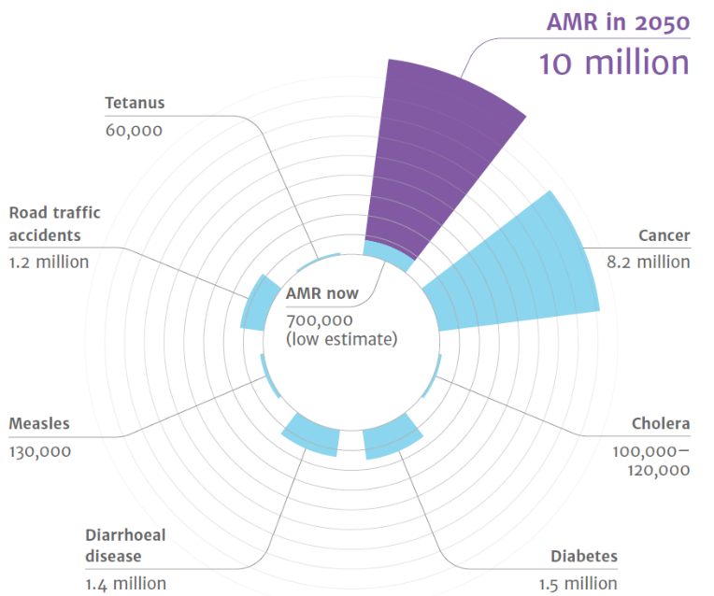
Antimicrobial Resistance
A Global threat
Economical impact
Estimated number of deaths caused by AMR in 2050 in comparison with current common causes of deaths
The estimated cost of AMR for healthcare systems in Europe is
€1.1 billion
per year
Notes:
‘Tackling drug-resistant infections globally: Final report and recommendations’ - THE REVIEW ON ANTIMICROBIAL RESISTANCE
CHAIRED BY JIM O’NEILL – May 2016 - https://amr-review.org/sites/default/files/160525_Final%20paper_with%20cover.pdf
Over the last two decades, the total consumption of antibiotics in humans increased modestly in OECD and EU/EEA and substantially across non-
OECD G20 countries.
The animal sector has been actively participating in the development and implementation of nearly all action plans developed by OECD, EU/EEA and G20 countries
Enhanced food handling practices and improving biosecurity in farms promise reductions in resistant infections.
The benefits of enhancing farm biosecurity entirely offset implementation costs.
By 2050, the United Nations, based on the Jim O’Neil’s report, estimates that up to 10 million deaths per year could be caused by superbugs and associated forms of antimicrobial resistance.
The graphic shows the predicted mortality from AMR compared with common causes of current deaths, and its estimates in deaths in the year 2050.
The data of the different causes of current deaths are taken from the different sources:
Diabetes: www.whi.int/mediacentre/factsheets/fs312/en/ Cancer: www.whi.int/mediacentre/factsheets/fs297/en/
Cholera: www.whi.int/mediacentre/factsheets/fs107/en/ Diarrhoeal disease: www.sciencedirect.com/science/article/pii/So140673612617280
Measles: www.sciencedirect.com/science/article/pii/So140673612617280 Road traffic accidents: www.whi.int/mediacentre/factsheets/fs358/en/
Tetanus: www.sciencedirect.com/science/article/pii/So140673612617280
Actually, Antimicrobial Resistance is having a huge impact on the healthcare systems in Europe, around 1.1 € billion per year, according to data from the Organisation for Economic Co-operation and Development (OECD).
When an infection does not respond to a first-line antimicrobial treatment ("First-line treatment is the first recommended treatment option"), healthcare professionals turn to more expensive alternatives, such as second-and third-line drugs (the last treatment options available). Complications or the longer duration of a disease or treatment sometimes require longer hospital stays, with the corresponding costs.
Source: OECD (2018), Stemming the Superbug Tide: Just A Few Dollars More, OECD Health Policy Studies, OECD Publishing, Paris, https://doi.org/10.1787/9789264307599-en.

Slide 4


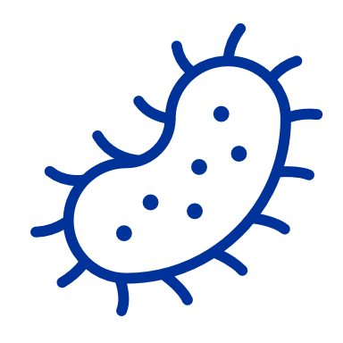




What is AMR and how does AMR occur?
Antimicrobial resistance (AMR) occurs when germs (bacteria, virus, or fungus) that cause infections resist the effects of the medicines used to treat them.
Use, overuse and misuse of antimicrobials
Microbes develop resistance
Diseases spread more easily, persist or kill
Antimicrobials become less effective
Notes:
Antimicrobial resistance (AMR) is the ability of micro-organisms to survive or grow despite antimicrobial agent that normally inhibits or kills that micro-organism.
It is the consequence of a natural selection and genetics. Antibiotic resistance occurs too when bacteria change to protect themselves from an antibiotic.
And additional human drivers promote resistance development such as:
Inappropriate use:
Overuse:
sharing antibiotics
using antibiotics without the need for that
using antibiotics for viral infections and inflammation
Misuse:
using antimicrobials as animal growth promoters on farms or in aquaculture
not completing the course or taking an insufficient dose
taking antibiotics for the wrong indications such as viral infection and inflammation
Over time, this makes antimicrobials less effective and ultimately useless in human and veterinary medicine.
All bacteria spread through air, water, soil, food or living vectors.
Next slide illustrates the various directions of spread.

Slide 5
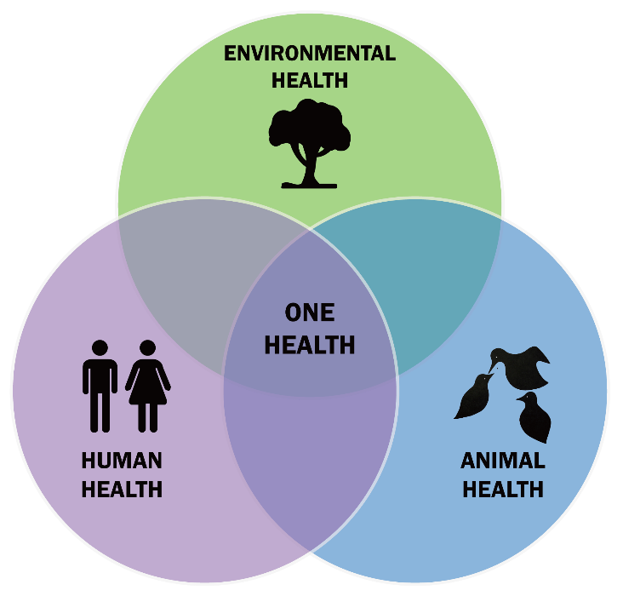
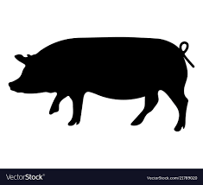
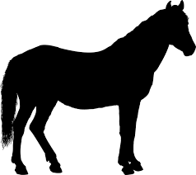


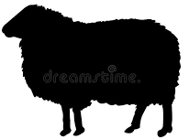
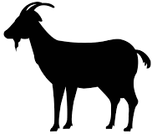
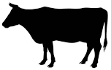
AMR is present in humans, animals, food, plants and the environment
Antimicrobial consumption in animals
Antimicrobial consumption in humans
A
H
Notes:
The One Health concept recognises that human health is tightly connected to the health of animals and the environment, i.e. that animal feed, human food, animal and
human health, and environmental contamination are closely linked.
This reflects the European Commission's 'One Health' approach to AMR, by addressing the human and veterinary sectors together in a holistic and coordinated approach
Increased antibiotic use is a matter of concern as antibiotic resistance is considered to be a serious threat to human and animal health and welfare in the future, and growing levels of antibiotics or antibiotic-resistant bacteria in the environment could increase the numbers of drug-resistant infections in both.
The wording of the graphic focuses on antimicrobial consumption in food-producing animals. But in principle, it is not limited to food-producing animals only despite the fact we're talking to farmers and food-producing animal vets.

Slide 6
Resistant bacteria infect 800.000 people in EU/EFTA every year
(ECDC data 2022)
Source: ECDC (European Centre for Disease Prevention and Control)
Notes:
In 2020, over 800 000 people were infected by antibiotic-resistant bacteria in Europe. The resultant diseases included pneumonia and bloodstream and intra-abdominal infections. (Source: ECDC European Centre for Disease Prevention and Control).
Overall in the EU/EEA, AMR percentages for the bacterial species–antimicrobial group combinations under surveillance continue to be high:
carbapenem resistance in Escherichia coli and Klebsiella pneumoniae (K. pneumoniae),
vancomycin resistance in Enterococcus faecium showing a significant increase during 2016–2020.
High percentages of resistance to third-generation cephalosporins and carbapenems in K. Pneumoniae
high percentages of carbapenem-resistant Acinetobacter species and Pseudomonas aeruginosa
(Source: Antimicrobial resistance surveillance in Europe 2022)
in several countries in the European Region are of concern.

Slide 7
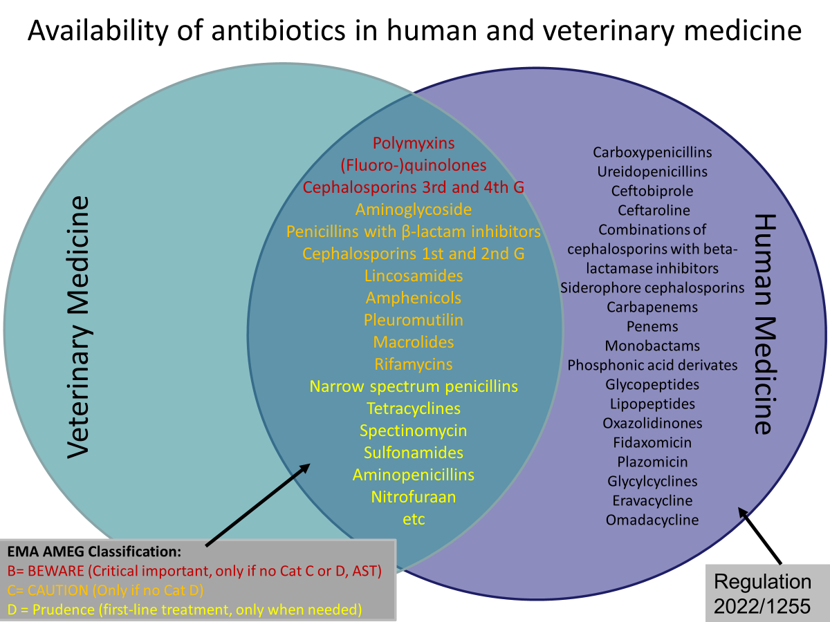
Different classes of antimicrobials
Notes:
Based on AMEG listing and Regulation 2022/1255
The aim is to explain many antimicrobials are the same classes we use in human and veterinary medicines and the difference between the different sorts of antimicrobials

Slide 8
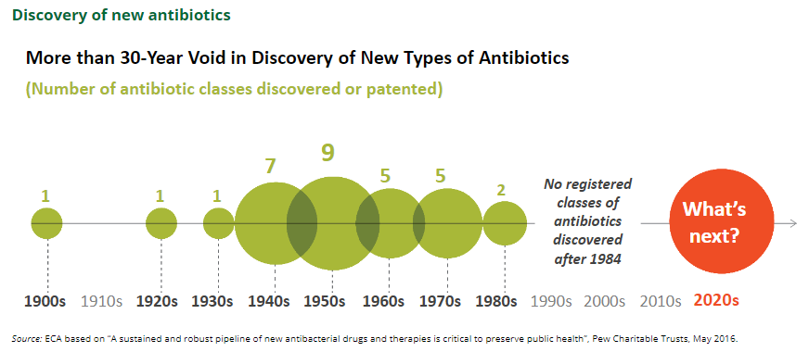
We need to keep the current antimicrobials effective!

Slide 9
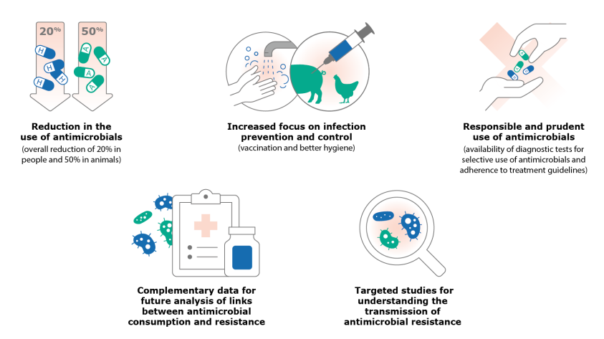
What can we do?
EFSA Journal 2024;22(2):8589
Notes:
From simplified summary JIACRA report: https://www.ecdc.europa.eu/sites/default/files/documents/simplified-summary-antimicrobial-consumption-resistance-bacteria-2019-2021.pdf

Slide 10
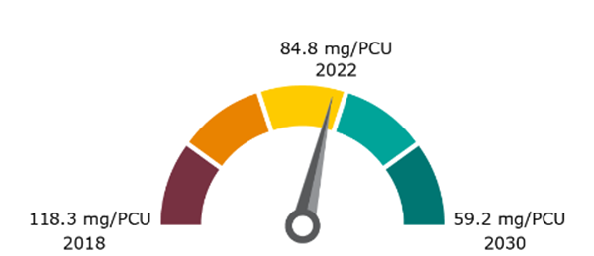
“Farm to fork” Objective
50% reduction of overall EU
sales of antimicrobials for
farmed animals and
in aquaculture by 2030
Notes:
https://ec.europa.eu/eurostat/statistics-explained/images/f/f2/Developments_of_livestock_populations_%28index_2002%3D100_based_on_heads_of_animals%2C_EU%2C_2002-2022%29_16-10-2023_v2.png
Farm to fork objective is part of the Green Deal
The starting point is 2018.
Objective is for all EU countries, not individual

Slide 11
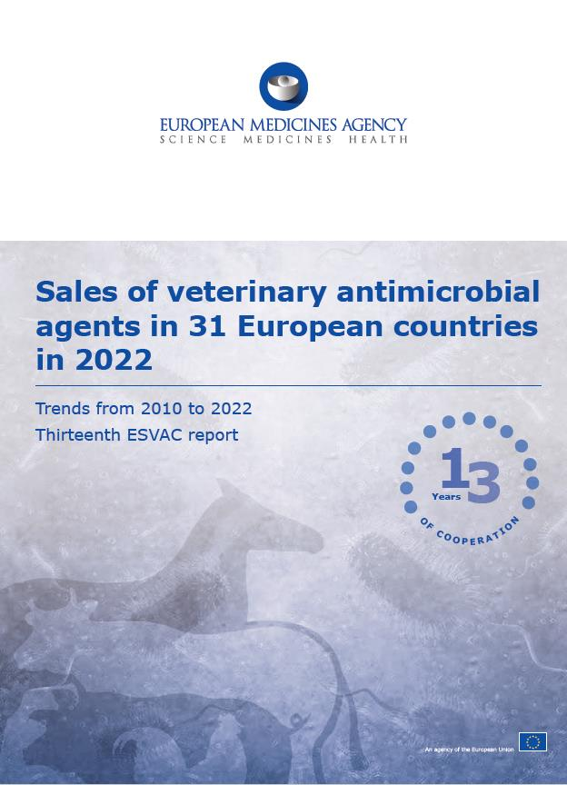
European Medicines Agency (EMA) - Thirteen European Surveillance of Veterinary Antimicrobial Consumption – ESVAC report 2022
ESVAC = European Surveillance of Veterinary Antimicrobial Consumption
- Overall sales of veterinary antibiotics in 2022 for 31 countries
- Trends from 2011 to 2022 in 25 ESVAC-participating countries:
- 53.0% total sales
- 49.0% sales of 3rd- and 4th-gen cephalosporins
- 44.0% sales of all quinolones
- 81.0% sales of polymyxins
Notes:
The European Medicines Agency (EMA) started the ESVAC project in 2009.
The European Surveillance of Veterinary Antimicrobial Consumption (ESVAC) project collected information from 2009 to 2023 on how antimicrobial medicines are used in animals across the European Union (EU). This type of information is essential to identifying possible risk factors that could lead to the development and spread of antimicrobial resistance.
Provides harmonised approach for the collection and reporting of data on the use of antimicrobial agents in animals from EU and European Economic Area (EEA) Member States.
Voluntary participation in the ESVAC project increased from 9 to 31 reporting countries over the years.
The ESVAC project formally came to an end in November 2023 with the publication of its final report.
From January 2024, all EU / EEA Member States must report their data on the volume of sales and use of antimicrobial medicinal products in animals, in line with the Veterinary Medicinal Products Regulation.
EU / EEA Member States must use EMA's Antimicrobial Sales and Use Platform to report their data to EMA.
Round figure: shows the proportion of aggregated sales, in mg/PCU on antibiotic VMPs for food producing animals by antibiotic class in 31 European countries in 2022
Other classes” includes amphenicols, cephalosporins, other quinolones and “Others”

Slide 12
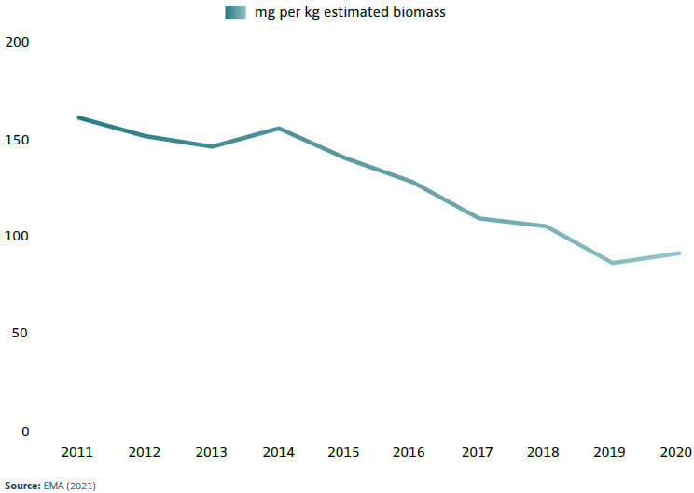


In 2022, just over half the reduction target was reached
The trend over the years shows a reduction of use of antimicrobials
Calculated by measuring the amount of antimicrobials used per kilo of meat produced over the years
Changes in average overall sales
53%
Notes:
Changes in average sales, in mg per kg estimated biomass, for 25 EU/EEA countries, 2011 to 2020
Source: EMA (2021)
These figures would suggest that efforts at both national and EU/EEA level have been successful, resulting in a continuous decrease over time in the use of antibiotics in food-producing animals in of fluoroquinolones registered more mode most participating European countries.
Main indicator: Overall sales - overall reduction in sales
Secondary indicators (substantial progress) : sales in mg per kg of 3rd- and 4th-generation cephalosporins, polymyxins and quinolones
Sales of fluoroquinolones registered more modest aggregated reductions.
Note: synonym for ‘milligrams per PCU’ (PCU = population correction unit), the reporting unit for animal biomass equivalents developed by the
European Surveillance of Veterinary Antimicrobial Consumption (ESVAC) initiative.

Slide 13
Data Collection on sales and use of antimicrobials
As of 2024, EU Member States must report annual data on the volume of sales and use of antimicrobial medicinal products in animals for the preceding year
Common rules
EU countries must start collecting on use data:
        Cattle, pigs, poultry → as of 2023
        All other food-producing animals → from 2026
        Dogs, cats and fur animals → from 2029
      EMA will publish the first report on 31 March 2025, afterwards by 31 December covering the preceding year
      Data will be detailed with relevant animal species, categories or stages
      Data to be collected for
      Antidiarrheals, intestinal anti-inflammatory and antiinfective agents
      2. Gynecological antiinfectives & antiseptics
      3. Anti-infectives & antiseptics for intrauterine use
      4. Antibacterials for systemic use
      5. Antibacterials for intramammary use
      6. Antiprotozoals (with antibacterial effect)
      7. Antimycobacterials for intramammary use
Notes:
Annex of Regulation 2021/578. https://eur-lex.europa.eu/eli/reg_del/2021/578/oj
The first report on the volume of sales of veterinary antimicrobial medicinal products and on the use of antimicrobial medicinal products per animal species shall be published by the Agency by 31 March 2025 and shall include the following: (a) the volume of sales of veterinary antimicrobial medicinal products, covering data from 2023 and submitted by Member States by 30 June 2024; (b) the use of antimicrobial medicinal products for relevant animal species, categories or stages covering data from 2023 and submitted by Member States by 30 September 2024.
2. As from 2025, the following reports after the first report shall be published by the Agency by 31 December and shall include the following: (a) the volume of sales of veterinary antimicrobial medicinal products submitted by Member States by 30 June of each year, covering data from the preceding calendar year; (b) the use of antimicrobial medicinal products for relevant animal species, categories or stages submitted by Member States by 30 June of each year, covering data from the preceding calendar year.
Data collection will start as of the years mentioned. The reporting will start the following years (i.e. for cattle pigs and poultry reporting is due in 2024, other f-p animals in 2027, dogs cats and fur animas in 2030)

Slide 14

NATIONAL FIGURES

Slide 15
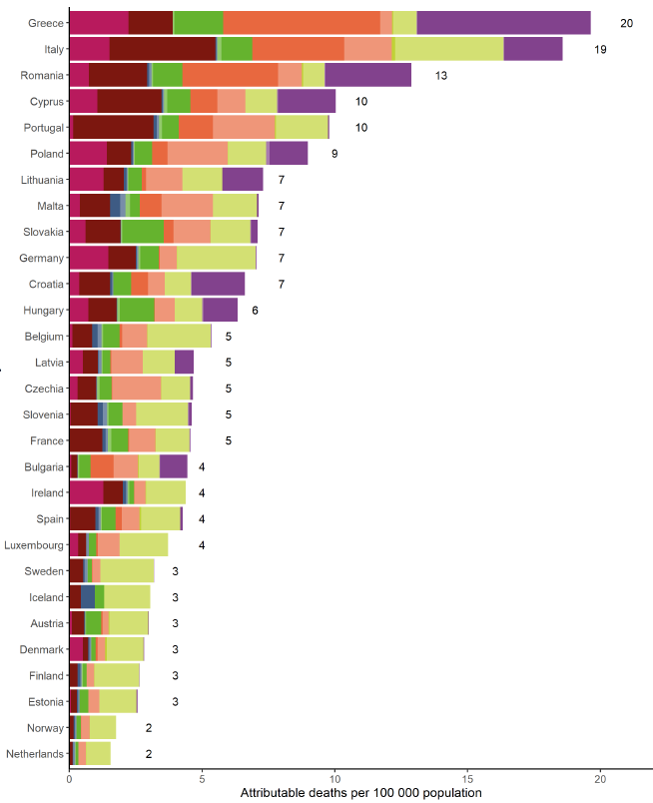
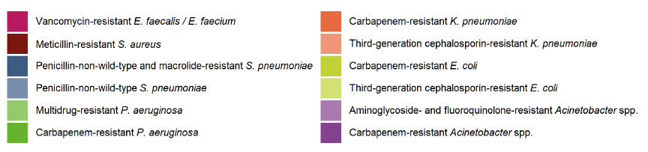
Estimation of the burden of infections with antibiotic resistance bacteria presented as attributable deaths per 100.000 population by country, EU/EEA, 2020
Portugal
1.030 deaths in 2020
Malta’s population in 2020 515.000 (7 x 5,15 = 36 deaths)
Assessing the health burden of infections with antibiotic-resistant bacteria in the EU/EEA, 2016-2020 TECHNICAL REPORT
Notes:
Antimicrobial resistance affects real people
Source Eurostat - Population of Portugal in 2020: 10.295.909
Portugal’s population in 2020: 10.295.909 (10 x 103) = 1.030 deaths in 2020

Slide 16
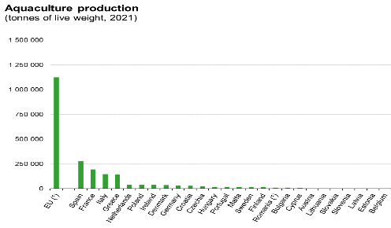
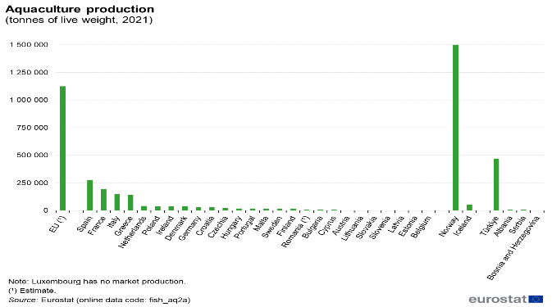

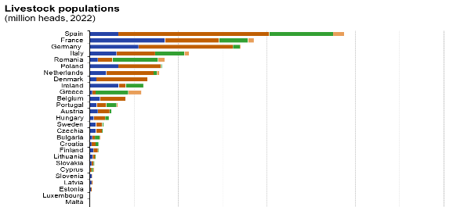
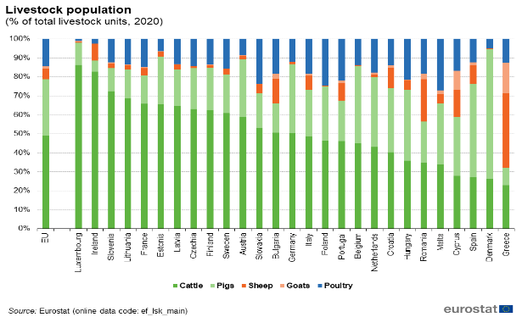

PORTUGAL
Animal food-producers data
Notes:
Livestock population statistics: Statistics | Eurostat (europa.eu) (2020)
Aquaculture statistics: Aquaculture statistics - Statistics Explained (europa.eu)
Data per EU country and specific proportion per specie per country.

Slide 17
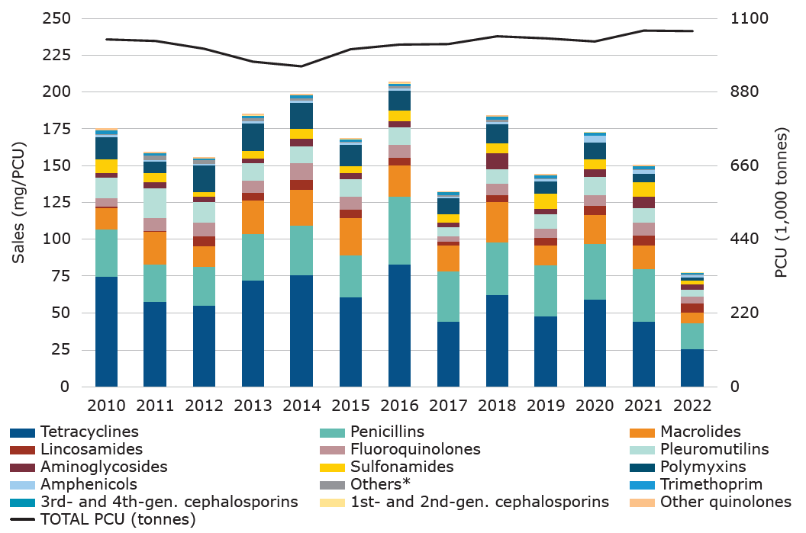
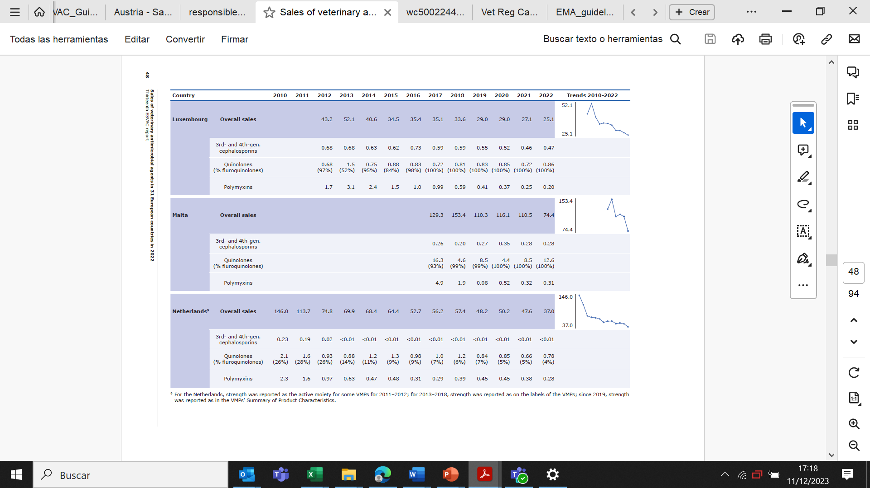
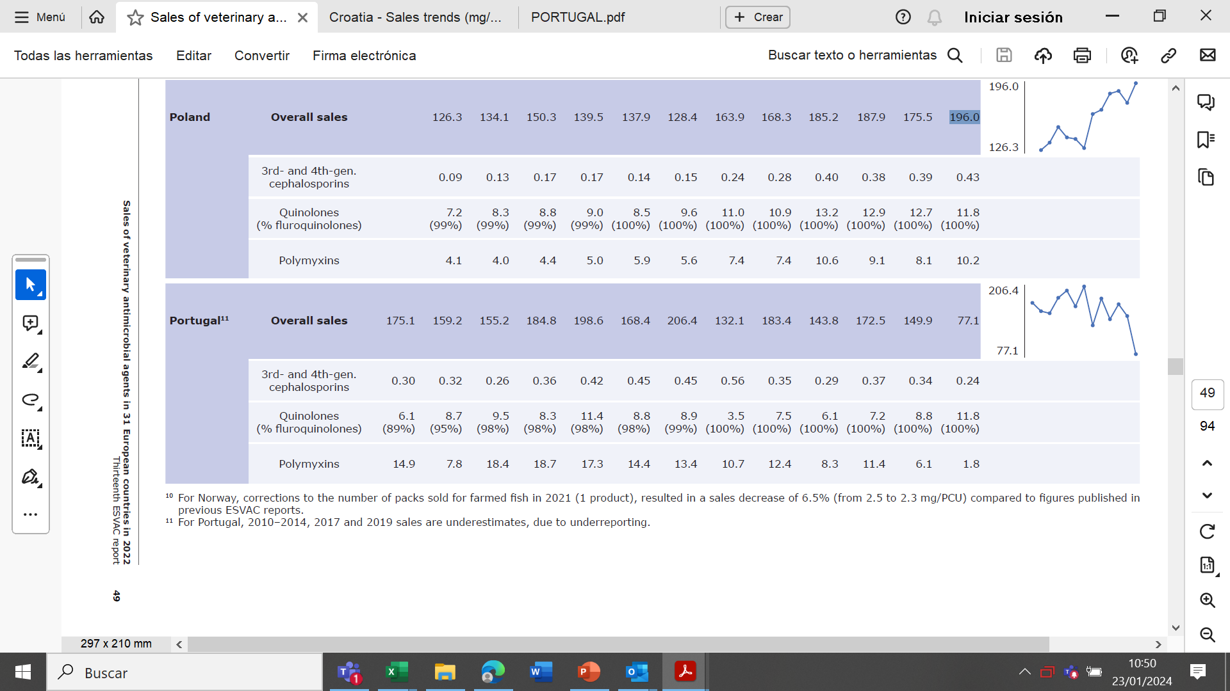
Sales of VMP in PORTUGAL
PCU
2022 (1.000 tonnes)
Antimicrobial sales
Sales trends (2010-2022)
2018
183,4 mg/PCU
2022
77,1 mg/PCU
-58%
Notes:
Source: 13th ESVAC report.
The PCU is the Population Correction Unit
Food producing animals have a standard weight in kilos
We calculate the number of food producing animals per year and then multiply this number by the standard weight of each animal category.
The result is the amount of kilograms of meat per year, animal biomass that could potentially be treated with antimicrobials.
The total sales of antimicrobials per country is divided by the total number of kilos of meat.
The result is the theoretical amount of milligrams of consumed antimicrobials per kilo of meat (biomass).
In Portugal: 1.062 x 1000 tonnes = 1.062.000 tonnes of meat has been produced (2022).
It is estimated that 77,1 milligrams of antimicrobials correspond to each kilogram of meat produced. However 2010-2014, 2017 and 2019 sales are underestimated due to under reporting.
Portugal, given the data available, has reduced the total amount of antimicrobials in 58,% from 2018 to 2022.

Slide 18
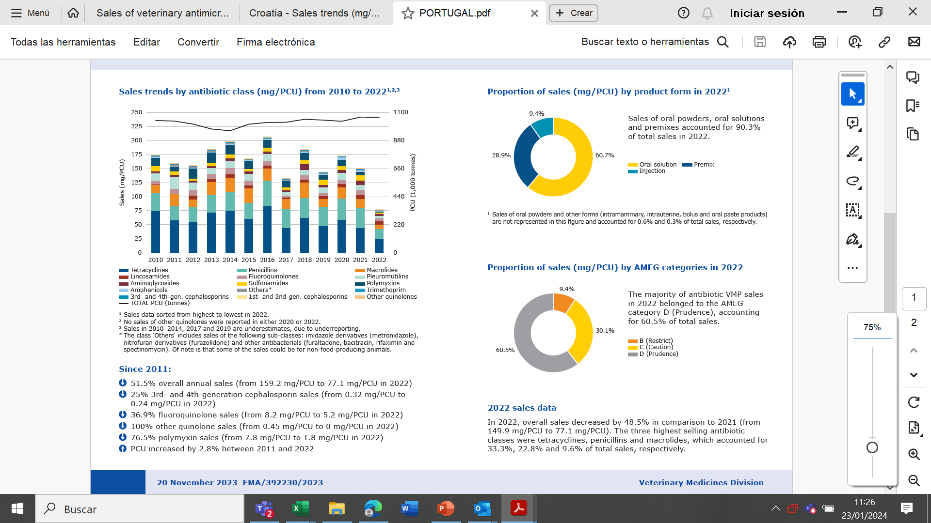
Sales of VMP in PORGUGAL
Country information
Since 2010, the national annual reports monitoring the antimicrobial consumption of VMPs approved for use in food-producing and companion animals are publicly available on the Directorate-General for Food and Veterinary website2.
https://www.dgs.pt/documentos-e-publicacoes/plano-nacional-de-combate-a-resistencia-aos-antimicrobianos-2019-2023-pdf.aspx
https://www.dgav.pt/medicamentos/conteudo/medicamentos-veterinarios/planos-de-controlo-oficial-e-relatorios/esvac/
ESVAC report

Slide 19
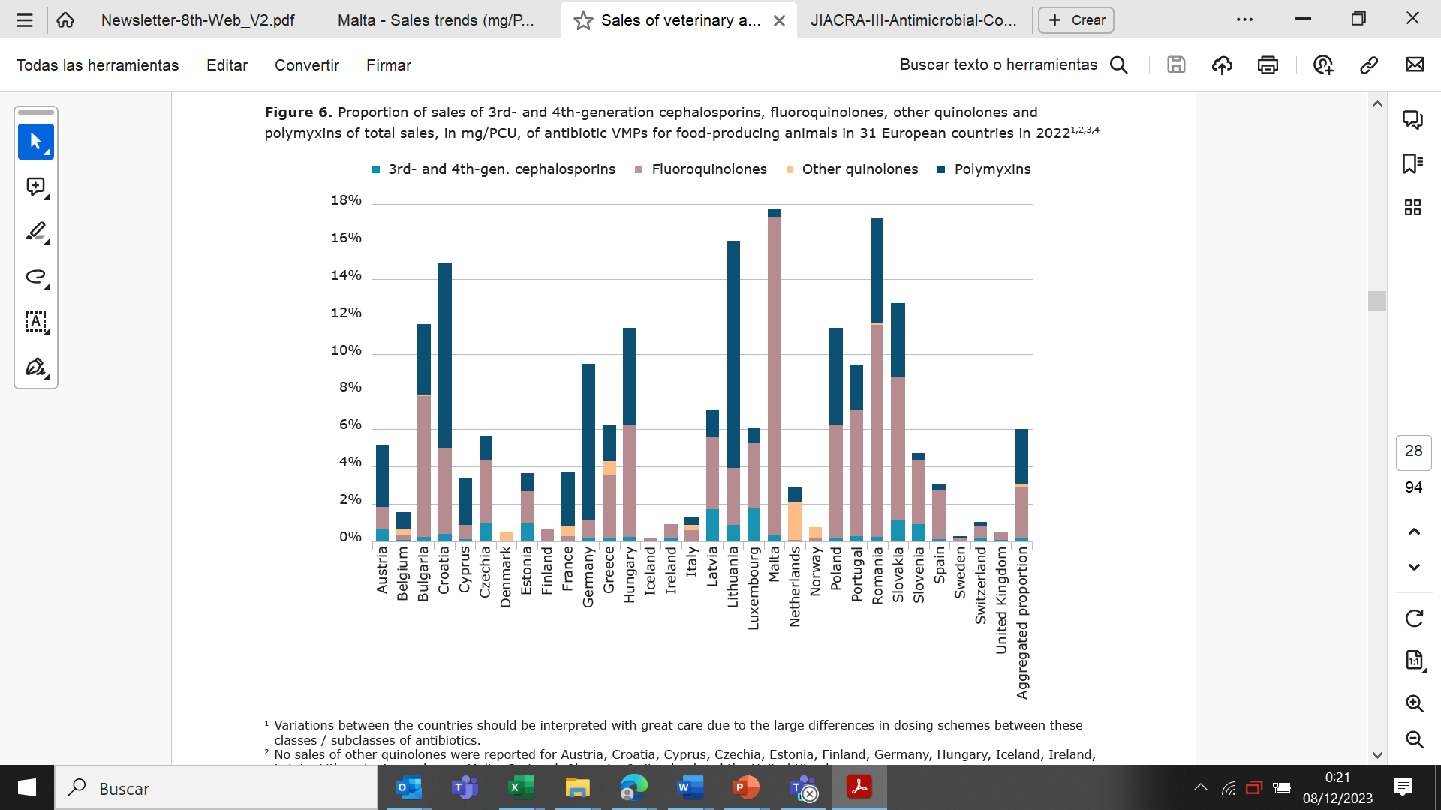
Consumption of 3rd and 4th-generation cephalosporings, fluoroquinolones, other quinolones and polymixins (mg/PCU), food producing animals in 2022
Source: 13th ESVAC report
Notes:
1 Variations between the countries should be interpreted with great care due to the large differences in dosing schemes between these classes / subclasses of antibiotics.
2 No sales of other quinolones were reported for Austria, Croatia, Cyprus, Czechia, Estonia, Finland, Germany, Hungary, Iceland, Ireland, Latvia, Lithuania, Luxembourg, Malta, Portugal, Slovenia, Switzerland and the United Kingdom.
3 No sales of polymyxins were reported for Denmark, Finland, Iceland, Ireland, Norway and the United Kingdom.
4 The aggregated proportion for 31 European countries is based on the aggregated mg/PCU — total quantity of antibiotic active substances sold (mg) divided by total PCU (kg).

Slide 20
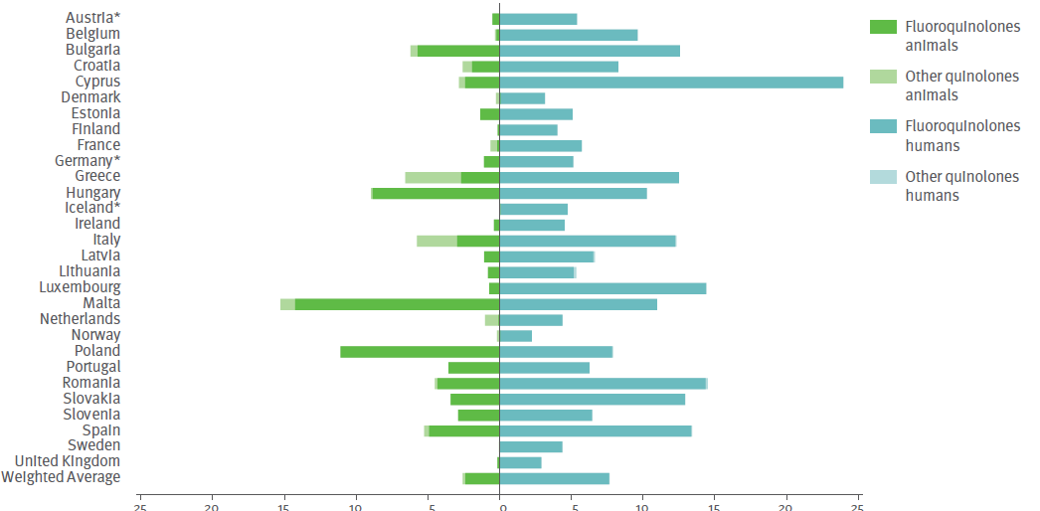
Consumption of fluoroquinolones and other quinolones
Source: JIACRA III - Antimicrobial consumption and resistance in bacteria from humans and animals

Slide 21
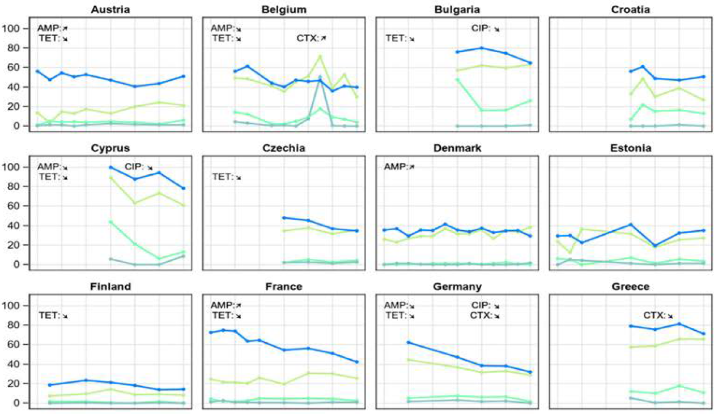
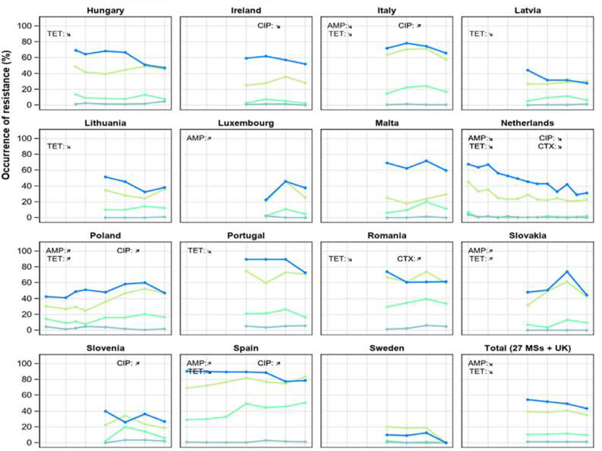
Achievements
Example 1
Trends in resistance to selected antimicrobials in indicator E. coli from pigs, 2009-2021
Resistance to:
ampicillin (AMP)
cefotaxime (CTX)
ciprofloxacin (CIP)
tetracycline (TET)
Notes:
Source: EUSR on AMR in zoonotic and indicator bacteria from humans, animals and food 2020/2021. EFSA Journal 2023;21(3):7867. Page 95
The objective is to reduce resistance.
Trends are able to be seen from samples of bacteria identified as resistant between 2009 and 2021. Not all the countries have reported data in all the years. Even though data are not compiled in a harmonised way, it is possible to see the positive trend of reduction.
There were more decreasing than increasing trends and most noticeable was that a decrease in tetracycline resistance was observed in approximately half of the data sets for pig and calf data (24/43) and poultry data (23/42).
It is of note that in several countries, levels of resistance were stable over time at low levels, and major changes cannot be expected.
Example 1:
Fattening pigs
The figure shows how each of the 27 member states reported resistance of E. coli bacteria in fattening pigs to different antibiotics (ampicillin, cefotaxime, ciprofloxacin and tetracycline), between 2009 and 2021.
The general trend is clearly reducing the resistance to tetracycline and ampicillin. Cefotaxime is slightly reducing and ciprofloxacin keeps constant in time).

Slide 22
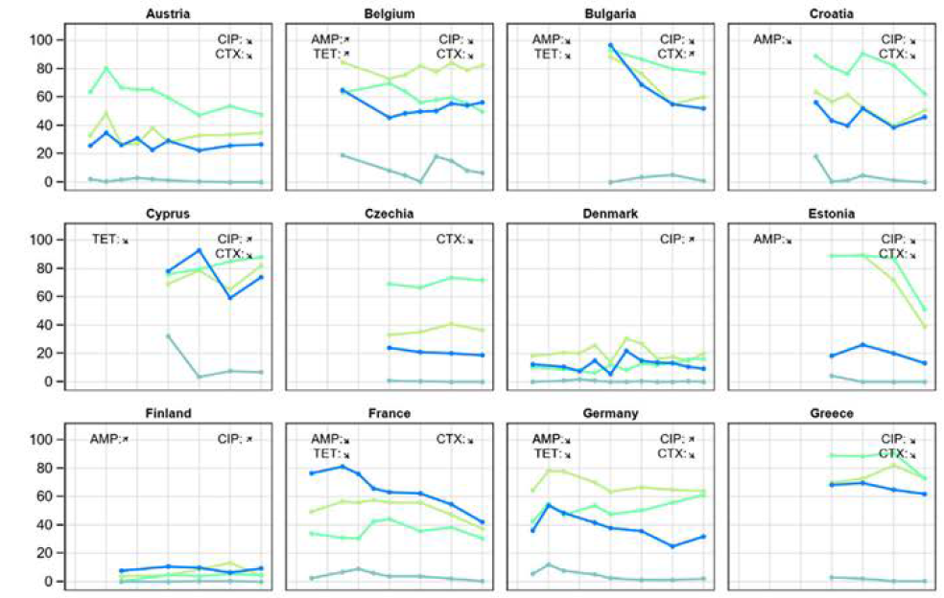

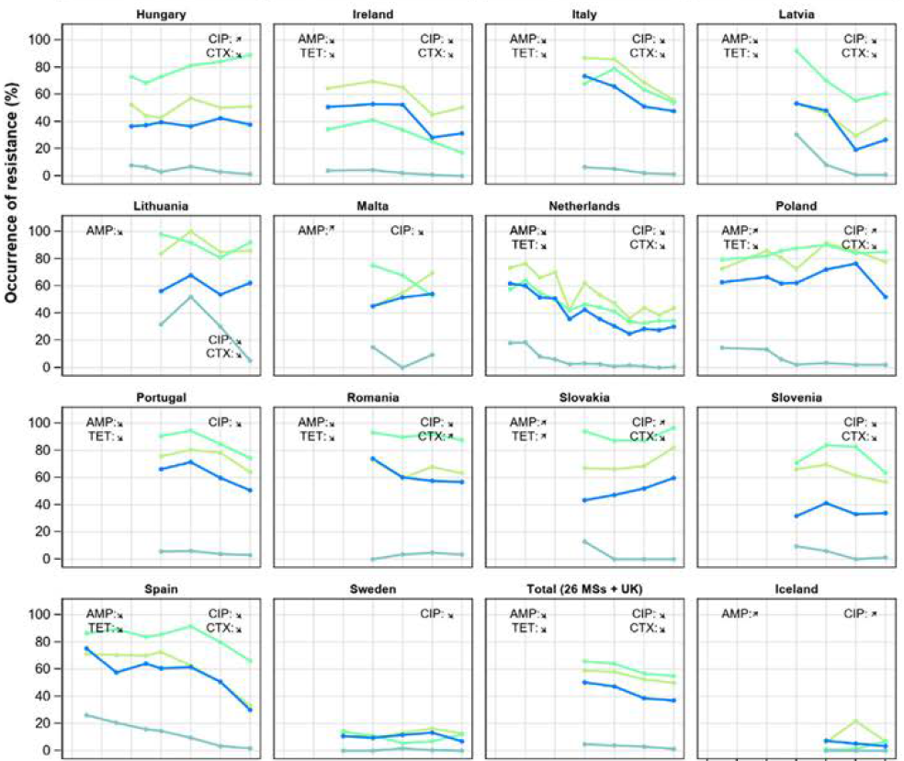

Achievements
Example 2
Trends in resistance to selected antimicrobials in indicator E. coli from broilers, 2009-2021
Resistance to:
ampicillin (AMP)
cefotaxime (CTX)
ciprofloxacin (CIP)
tetracycline (TET)
Notes:
Source: EUSR on AMR in zoonotic and indicator bacteria from humans, animals and food 2020/2021. EFSA Journal 2023;21(3):7867. Page 97.
Example 2:
Broilers Trends in resistance to selected antimicrobials (ampicillin, cefotaxime, ciprofloxacin and tetracycline), in E. coli bacteria from broilers, 2009-2021
In the 30 countries reporting data on bacteria samples from broilers, 68 samples reported decreasing trends and 20 samples reported increasing trends.
- In 16 countries, only decreasing trends were observed. Notably, in Ireland, Italy, Latvia, the Netherlands and Spain, resistance has decreased for all four antimicrobials
and in Croatia, Estonia, France, Lithuania and Portugal for three antimicrobials.
In contrast, in three countries, only increasing trends were observed.
The last square shape shows the summary accumulated trend for all reporting countries (including UK): resistance to all four antimicrobials has decreased with statistical significance.

Slide 23
Thank you!

