Slide 1
SLOVAKIA
21 JUNE 2024

Slide 2
Important elements of the new EU Medicated Feed Regulations
Lecture 3
SLOVAKIA, 21 JUNE 2024

Slide 3
EU legal framework on veterinary medicinal products/medicated feed
Regulation (EU) 2019/6 on Veterinary Medicinal Products
Regulation (EU) 2019/4 on Medicated Feed

Slide 4
EU legal framework on veterinary medicinal products/medicated feed
Regulation (EU) 2019/6 on Veterinary Medicinal Products
Regulation (EU) 2019/4 on Medicated Feed

Slide 5
Common rules – Veterinary prescription
Common rules
MEDICATION VIA FEED OR WATER
Different rules apply for
Oral Medication
(on-farm mixing in feed or water by the animal keeper)
Via Feed
Via Water
Medicated Feed
(feed mixed with medicines in feed mill or mobile mixer or via special equipped vehicle by feed business operator )
Reg. (EU) 2019/4
(MF)
Reg. (EU) 2019/6 (VMP)
& Commission Delegated Reg. (EU) 2024/1159
Notes:
Therefore, the delegated act on oral medication applies to veterinary medicinal products administered orally by means of mixing into or addition onto feed and to the mixing of veterinary medicinal products in drinking water or in liquid feed by the animal keeper. It should not apply to the mixing of a veterinary medicinal product into feed by feed business operators irrespectively of whether they operate in a feed mill, with a mobile mixer or an on-farm mixer, which is covered by Regulation (EU) 2019/4.
(f) ‘mobile mixer’ means a feed business operator with a feed establishment consisting of a specifically equipped vehicle for the manufacture of medicated feed; (g) ‘on-farm mixer’ means a feed business operator manufacturing medicated feed for the exclusive use on its farm;

Slide 6
Use of Antimicrobial Veterinary Medicinal Products
EU legislative framework: Regulation (EU) 2019/4 on MEDICATED FEED (MF)
Principles for the use of medicated feed
  Ban on the use of MF with antimicrobials for prophylaxis.
  Requirement for diagnosis of disease prior to the mandatory prescription for MF.
  Limitation on the duration of a treatment and validity of prescription.
  Reduce any potential synergy between feed medication carry-over residues and occurrence of antimicrobial resistance.
  Measures to increase the quality of medicated feed production (more precise dosage) to avoid subtherapeutic exposure.
  Maximum levels of cross-contamination for 24 antimicrobial active substances in non-target feed.
Ban Systematic Prophylaxis

Slide 7
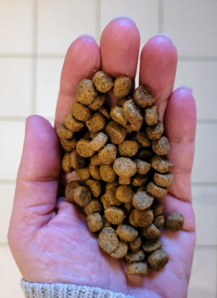
Common rules – Veterinary prescription
Common rules
Veterinary prescriptions in relation to medicated feed (1/2)
Reg.(EU) 2019/4
Article 16
Medicated feed (animal feed mixed with medicines by feed business operator) requires:
a veterinary prescription
can only be issued after clinical examination or any other proper assessment of the health status of the animals
only for diagnosed diseases (except for vaccines and parasitics)
Watch out for interactions with other medications!
Notes:
1. The supply of medicated feed to animal keepers shall be subject to:
(a) the presentation and, in case of manufacturing by on-farm mixers, the possession of a veterinary prescription for medicated feed; and
(b) the conditions laid down in paragraphs 2 to 10.
2. A veterinary prescription for medicated feed shall be issued only after a clinical examination or any other proper assessment of the health status of the animal or group of animals by a veterinarian and only for a diagnosed disease.
3. By way of derogation from paragraph 2, a veterinary prescription for medicated feed containing immunological veterinary medicinal products may be issued also in the absence of a diagnosed disease.
4. By way of derogation from paragraph 2, if it is not possible to confirm the presence of a diagnosed disease, a veterinary prescription for medicated feed containing antiparasitics without antimicrobial effects may be issued based on
the knowledge of the parasite infestation status in the animal or group of animals.

Slide 8
Common rules – Veterinary prescription
Common rules
Veterinary prescriptions in relation to medicated feed (2/2)
Reg.(EU) 2019/4
Article 16
Record keeping: Veterinary prescriptions should be kept by feed mill and the veterinarian prescribing & animal keeper for 5 years
1 prescription = 1 veterinary treatment
Maximum duration of treatment: 2 weeks for antibiotics, 1 month for other medicines
Validity prescription: max 5 days for feed with antimicrobial, max 3 weeks for other medicines for food-producing animals, rest 6 months
Notes:
6. The veterinary prescription for medicated feed shall contain the information set out in Annex V. The original veterinary prescription for medicated feed shall be kept by the manufacturer or, where appropriate, the feed
business operator supplying the medicated feed to the animal keeper. The veterinarian, or the professional person referred to in paragraph 5, issuing the prescription and the keeper of food-producing or fur animal shall keep a copy of the veterinary prescription for medicated feed. The original and copies shall be kept for five years from the date of issuance.
7. With the exception of medicated feed for non-food-producing animals, other than fur animals, medicated feed shall not be used for more than one treatment under the same veterinary prescription for medicated feed.
The duration of a treatment shall comply with the summary of product characteristics of the veterinary medicinal product incorporated in the feed and, where not specified, shall not exceed one month, or two weeks in case of a medicated feed
containing antibiotic veterinary medicinal products.
8. The veterinary prescription for medicated feed shall be valid from the date of its issuance for a maximum period of six months for non-food-producing animals other than fur animals and three weeks for food-producing animals and fur
animals. In the case of medicated feed containing antimicrobial veterinary medicinal products, the prescription shall be valid from the date of its issuance for a maximum period of five days.
9. The veterinarian issuing the veterinary prescription for medicated feed shall verify that that medication is justified for the target animals on veterinary grounds. Furthermore that veterinarian shall ensure that the administration of the
veterinary medicinal product concerned is not incompatible with another treatment or use and that there is no contraindication or interaction where several medicinal products are used. In particular, the veterinarian shall not prescribe
medicated feed with more than one veterinary medicinal product containing antimicrobials.
10. The veterinary prescription for medicated feed shall:
(a) comply with the summary of the product characteristics of the veterinary medicinal product, except for veterinary
medicinal products intended to be used in accordance with Article 112, Article 113 or Article 114 of Regulation (EU)
2019/6;
(b) indicate the daily dose of the veterinary medicinal product which is to be incorporated in a quantity of medicated feed
that ensures the uptake of the dosage by the target animal considering that the feed uptake of diseased animals might
differ from a normal daily ration;
(c) ensure that the medicated feed containing the dosage of the veterinary medicinal product corresponds to at least 50 %
of the daily feed ration on a dry matter basis and that, for ruminants, the daily dose of the veterinary medicinal
product is contained in at least 50 % of the complementary feed except for mineral feed;
(d) indicate the inclusion rate of the active substances, calculated on the basis of the relevant parameters.
11. Veterinary prescriptions for medicated feed issued in accordance with paragraphs 2, 3 and 4 shall be recognized throughout the Union.
12. The Commission may, by means of implementing acts, set a model format for the information set out in
Annex V. That model format shall also be made available in electronic version. Those implementing acts shall be
adopted in accordance with the examination procedure referred to in Article 21(2).

Slide 9

SLOVAKIA
specifications

Slide 10

Contents
National legislation
Act No 362/2011 on medicinal products and medical devices and amending certain acts, as amended (‘Act No 362/2011’); Pursuant to Regulation (EU) 2019/6 of the European Parliament and of the Council on veterinary medicinal products and repealing Directive 2001/82/EC, Act No 362/2011 on medicinal products and medical devices was amended
Decree of the Ministry of Agriculture and Rural Development of the Slovak Republic No 314/2022 laying down details of the drawing up of forms for a veterinary prescription, specific forms for a veterinary prescription marked with an oblique blue stripe, details of the graphic elements, particulars of those forms and details of the registration of specific forms for a veterinary prescription (‘Decree No 314/2022’);
Act No 39/2007 on veterinary care, as amended (‘Act No 39/2007’);
Regulation No 41/2004 of the Goverment of the Slovak Republic, laying down the requirements for the preparation, placing on the market and use of medicated feed

Slide 11

National legislation
Prescribing a veterinary medicinal products
Obligations of private veterinarians and farmers
Administration of the veterinary medicinal product by private veterinarians and breeders
Reporting of consumption of veterinary medicinal products by private veterinarians
Prescribing a veterinary medicinal product
Only the treating veterinarian may prescribe VMPs
The attending veterinarian prescribes the veterinary medicinal product on a veterinary prescription
A veterinary medicinal product for a food-producing animal may only be prescribed by the treating veterinarian
The treating veterinarian cannot prescribe a veterinary medicinal product for injection for a food-producing animal
Notes:
(Section 122 of the Medicines Act)

Slide 12
National legislation
1. Prescribing a veterinary medicinal product
A veterinary medicinal product with a pharmacologically active substance that is prohibited in accordance with European legislation shall not be prescribed to a food animal.
(Table 2 of Regulation 37/2010)
Pharmacologically active substance | MRL
Aistolochia spp. and preparations thereof | MRLs cannot be set.
Chloramphenicol | MRLs cannot be set.
Chloroform | MRLs cannot be set.
Chlorpromazine | MRLs cannot be set.
Colchicine | MRLs cannot be set.
Dapson | MRLs cannot be set.
Dimetridazole | MRLs cannot be set.
Metronidazole | MRLs cannot be set.
Nitrofurans (including furazolidone) | MRLs cannot be set.
Ronidazole | MRLs cannot be set.

Slide 13
National legislation
1. Prescribing a veterinary medicinal product
For food-producing animal may not be prescribed a veterinary medicinal product containing a substance the holding of which on the farm is prohibited under a special regulation.
Slovak Government Regulation No 609/2008 laying down details on the prohibition of the use in animal husbandry of certain substances having a hormonal or thyrostatic action and of beta-agonists.
Council Directive 96/22/EC of 29 April 1996 concerning the prohibition on the use in animal husbandry of certain substances having a hormonal or thyrostatic action and of beta-agonists, and repealing Directives 81/602/EEC, 88/146/EEC and 88/299/EEC

Slide 14
National legislation
1. Prescribing veterinary
medicine
Veterinary prescription
The template is set out in national
legislation
Decree of the Ministry of Agriculture
and Rural Development of the Slovak Republic
No 314/2022 Coll. establishing
details of the drawing up of veterinary forms
prescription
in paper form
it shall contain the informations that
Requests Article 105(5) of the Regulation
(EU) 2019/6

Slide 15
National legislation
Prescribing veterinary
medicine
Veterinary prescription
It may be drawn up by a person
which has its registered office or residence in the territory of the Slovak Republic
has the technical equipment to print documents
secured against forgery
has a system of production, storage
It protects the production processes.
apply to the SVFA SR for the allocation of the unmistakable
registration number for veterinary forms prescription

Slide 16
National legislation
2. Obligations of private veterinarians and farmers
2.1 Obligations of private veterinarians
The veterinarian shall keep and keep for five years a record of the veterinary medicinal products administered in a book of veterinary treatments.
The template of the book of veterinary treatments is listed in the Act on medicinal products 362/2011 Coll. in Annex 3.
Notes:
(104)
the Medicines Act

Slide 17
National legislation
2. Obligations of private veterinarians and farmers
2.1 Obligations of private veterinarians

Slide 18
National legislation / national guidelines
2. Obligations of private veterinarians and farmers
2.1 Obligations of private veterinarians
No later than 15 July in respect of the first half of the year concerned and no later than 15 January in respect of the second half of the previous year, the private veterinarian shall provide the competent district veterinary and food administration in electronic form with information on the consumption of veterinary medicinal products in food producing animals on the basis of data in the records of veterinary medicinal products administered, which the private veterinarian shall keep in the book of veterinary treatments.
Notes:
(104)

Slide 19
National legislation
2. Obligations of private veterinarians and farmers
2.1 Obligations of private veterinarians
The veterinarian shall keep and keep for five years a record of the prescription and administration of the medicinal product for human use.
a) the name of the medicinal product prescribed or administered for human use;
b) the number of packages of the medicinal product prescribed or administered for human use;
c) posology and method of its administration,
d) justification for the use of the medicinal product for human use, including withdrawal period
e) the date of prescription or administration of the medicinal product to the animal;
f) Duration of treatment
g) the type of animal,
h) diagnosis of the animal;
i) details of the animal's keeper.
Notes:
(104a)

Slide 20
National legislation
2. Obligations of private veterinarians and farmers
2.2 obligations of farmers/breeders
The farmer of a food animal is obliged to
produce, at the request of the district veterinary and food administration, proof of purchase, possession and administration of veterinary medicinal products to food producing animals.
Notes:
(104)

Slide 21
National legislation
2. Obligations of private veterinarians and farmers
2.2 obligations of farmers/breeders
The farmer of a food animal is obliged to
keep and keep for five years a register of veterinary medicinal products which, after being authorised by the attending veterinarian, he has administered to a food animal in the farmer’s register pursuant to Annex 4 to the Act on medicinal products 362/2011;
Notes:
(104)

Slide 22
National legislation / national guidelines
2. Obligations of private veterinarians and farmers
2.2 obligations of farmers/breeders

Slide 23
National legislation
3. Administration of the veterinary medicinal product by private veterinarians and farmers/animal keepers
The veterinary medicinal product is authorised to be administered to the animal by
the attending veterinarian;
the owner of the animal, the keeper of the animal or any other person, under the responsibility of the owner of the animal, if:
has been briefed on the diagnosis, method of administration, indication, dosage, duration of treatment, target animal species, contraindications, adverse effects and withdrawal period of the veterinary medicinal product administered;
Notes:
(102)

Slide 24
National legislation
3. Administration of the veterinary medicinal product by private veterinarians and farmers/animal keepers
The veterinary medicinal product is authorised to be administered to the animal by
2. the owner of the animal, the keeper of the animal or another person, under the responsibility of the owner of the animal if
there is no risk to consumer safety as regards the level of residues in food of animal origin obtained from treated food producing animals,
has been instructed in advance by the attending veterinarian to administer the veterinary medicinal product, which has recorded that authorisation in the book of veterinary treatements
The veterinarian shall instruct the farmer on the administration of the veterinary medicinal product; enters the name and surname of the breeder and confirms the entry with a stamp and signature in the book of veterinary treatements
Notes:
(102)

Slide 25
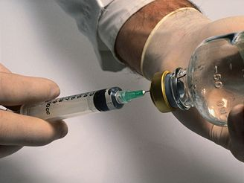
National legislation
3. Administration of the veterinary medicinal product by private veterinarians and farmers/animal keepers
Where a food animal keeper has been appointed by a veterinarian to administer a medicinal product, administers a veterinary medicinal product or performs a veterinary act, he shall record this fact in the farmer's register.
The farmer is responsible for following the instructions of the attending veterinarian
If the administered veterinary medicinal product triggers an adverse event, the food-animal keeper shall notify the treating veterinarian without delay.
The breeder shall certify by his signature that he has been instructed by the attending veterinarian to administer the veterinary medicinal product.
A veterinary medicinal product intended for injection shall only be administered to an animal by the attending veterinarian.

Slide 26
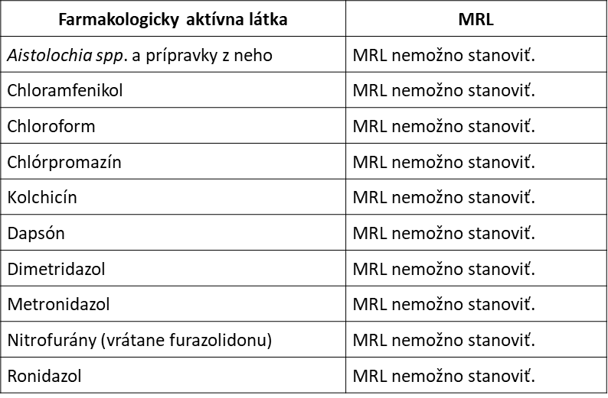
National legislation
3. Administration of the veterinary medicinal product by private veterinarians and farmers/animal keepers
The breeder of a food producing animal must not
possess or use a veterinary medicinal product containing prohibited medicinal products;

Slide 27
National legislation
3. Administration of the veterinary medicinal product by private veterinarians and farmers/animal keepers
The breeder of a food animal must not
use the veterinary medicinal product without the prior consent of the veterinarian;
The use of a premix for medicated feed is not permitted in food producing animal husbandry unless it is part of medicated feedinstuffs

Slide 28
National legislation
4. Reporting of consumption of veterinary medicinal products by private veterinarians
The private veterinarian is obliged to provide information in electronic form to the competent district veterinary and food administration on the consumption of veterinary medicinal products in food producing animals on the basis of the data kept by the private veterinarian in the book of veterinary treatements.
The SVFA SR has developed a web application (predecessor of the electronic book of veterinary treatements)
The SVFA has issued a user manual/manual

Slide 29
National legislation
4. Reporting of consumption of veterinary medicinal products by private veterinarians
The SVFA has issued a user manual/manual

Slide 30
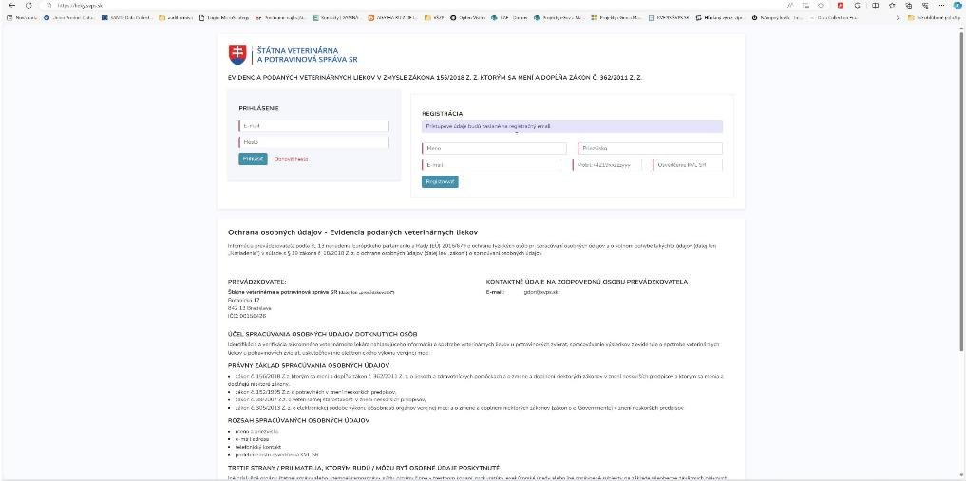
National legislation / national guidelines
4. Reporting of consumption of veterinary medicinal products by private veterinarians
user manual/manual is intended for private veterans doctors

Slide 31
National legislation
4. Reporting of consumption of veterinary medicinal products by private veterinarians
Reporting on antimicrobial consumption by animal species will be sent to the EMA for the first time in 2023
Cattle
Pigs
Poultry
Turkeys
a counting exercise is underway, with first results in September 2024

Slide 32
Thank you

