Slide 1
SLOVAKIA
21 JUNE 2024

Slide 2
Additional relevant legislation, provisions and/or guidelines to be considered by veterinarians & farmers (II) Lecture 4
SLOVAKIA, 21 JUNE 2024

Slide 3
EU legal framework on veterinary medicinal products/medicated feed
Regulation (EU) 2019/6 on Veterinary Medicinal Products
Regulation (EU) 2019/4 on Medicated Feed
+ Implementing and delegating Acts

Slide 4
Use of Antimicrobial Veterinary Medicinal Products
EU legislative framework: Regulation (EU) 2019/6 on VETERINARY MEDICINAL PRODUCTS (VMP)
Supporting prudent use and preserving efficacy
antimicrobials or groups of antimicrobials reserved for treatment of certain infections in humans.
!Article 37 (5)
“humans reserve list”
List of antimicrobials which:
are not to be used in accordance with Articles 112, 113 and 114; or
(b) are only to be used in accordance with Articles 112, 113 and 114 subject to certain conditions.
!Article 107 (6)
“ use of AM outside the marketing authorisation”

Slide 5
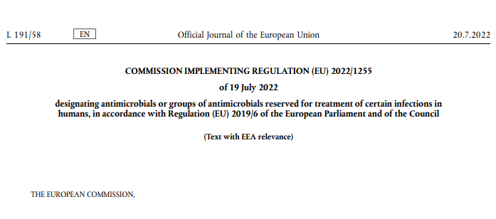
Use of Antimicrobial Medicinal Products
The human reserve list: antimicrobials which are reserved for treatment of certain infections in humans
“reserve list”
The antimicrobials and group of antimicrobials listed in this Regulation cannot be used in veterinary medicinal products.
VMP containing antimicrobials listed in this Regulation cannot be used in medicated feed
The list of antimicrobials or groups of antimicrobials to be reserved for treatment of certain infections in humans should be kept under continual review in the light of new scientific evidence or emerging information
Commission Implementing Regulation (EU) 2022/1255

Slide 6
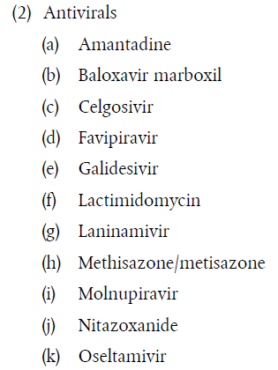
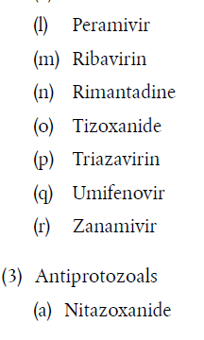
Use of Antimicrobial Medicinal Products
“human reserve list”
Supporting prudent use and preserving efficacy
Commission Implementing Regulation (EU) 2022/1255

Slide 7


Upcoming Delegated and Implementing Legal Acts
List of antimicrobials which shall not be used in accordance with article 112-114 (outside marketing authorisation) or only subject to certain conditions
List of substances authorised for use in food-producing terrestrial animal species or substances contained in a medicinal product for human use authorised in the Union, which may be used in food-producing aquatic species in accordance with Article 114(1)
List of substances which are essential for the treatment of equine species, or which bring added clinical benefit compared to other treatment options available for equine species and for which the withdrawal period for equine species shall be six months.
More info on all delegated and implementing Acts:
https://food.ec.europa.eu/animals/animal-health/vet-meds-med-feed/implementation_en

Slide 8
Use of Antimicrobial Veterinary Medicinal Products
List of antimicrobials which shall not be used outside marketing authorisation
!Article 107(6)
List of antimicrobials which:
  are not to be used in accordance with Articles 112, 113 and 114; or
  are only to be used in accordance with Articles 112, 113 and 114 subject to certain conditions.
“use of AM outside
the marketing authorisation”
Notes:
IF RUNNING OUT OF TIME, THIS SLIDE CAN BE HIDDEN

Slide 9

Upcoming Acts
List of antimicrobials that may be used for food-producing aquatic species
!Article 114
The Commission is to establish, by means of implementing acts, a list of substances used in veterinary medicinal products authorised in the Union for use in food-producing terrestrial animal species or substances contained in a medicinal product for human use authorised in the Union in accordance with Directive 2001/83/EC or Regulation (EC) No 726/2004, which may be used in food-producing aquatic species in accordance with Article 114(1).
Notes:
IF RUNNING OUT OF TIME, THIS SLIDE CAN BE HIDDEN

Slide 10

Upcoming Acts
List of antimicrobials for specific species (equine species)
In 2006 and 2013, the Commission published a list of substances essential for the treatment of Equidae ((EC) CR 1950/2006 & R 122/2013 )
The Commission is now updating the list of substances which are essential for the treatment of equine species, or which bring added clinical benefit compared to other treatment options available for equine species and for which the withdrawal period for equine species shall be six months.
On 9 February 2023, the European Medicines Agency received from the European Commission a request to provide scientific advice for the establishment this list of substances and they are currently preparing an answer.
Notes:
IF RUNNING OUT OF TIME, THIS SLIDE CAN BE HIDDEN

Slide 11
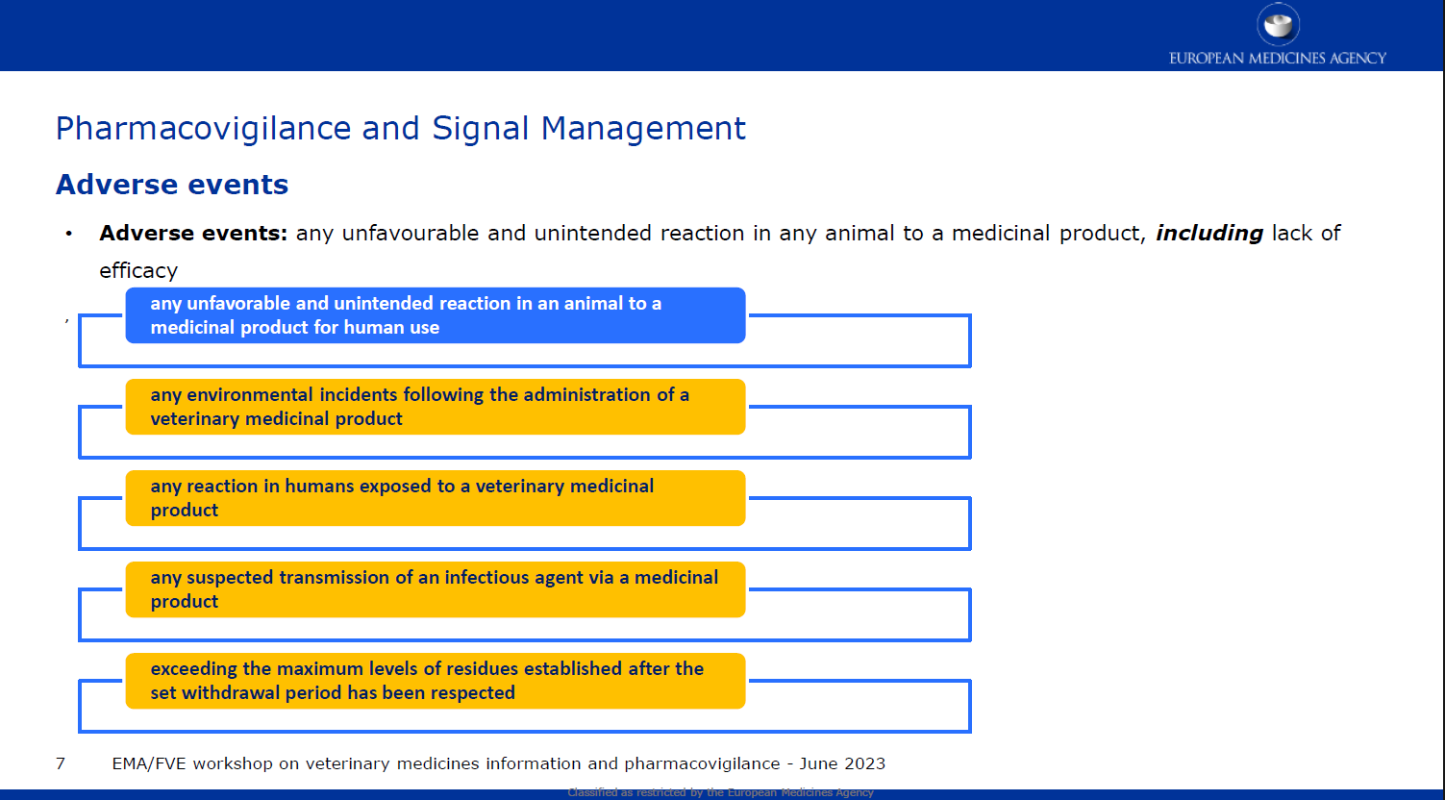
Reporting adverse events (pharmacovigilance)
Do not forget to report adverse events including lack of efficacy!

Slide 12
Disposal of Veterinary Medicine
How and where does pharmaceutical waste occur?
Immediate packaging and the remains of medicines within after use.
VMP or MF that are past their expiry date or that have not been stored in accordance with the instructions.
Prescription of a quantity exceeding the required quantity or uncompleted course of treatment due to either administration difficulties, adverse reactions, change in treatment or because animals died during treatment.
FACTSHEET_PharmaceuticalWasteDisposal.pdf (epruma.eu)

Slide 13
Disposal of Veterinary Medicine
Best practices for disposal
PharmaceuticalWasteDisposal.pdf (epruma.eu)
Everybody (prescribers and users) is responsible for minimising pharmaceutical waste.
Disposal of pharmaceutical waste via waterways should be excluded.
Pharmaceutical waste should be stored in a dedicated container, bin, or facility to ensure adequate protection to animal health, human health, feed, food and the environment and this must be separated from any stocks of veterinary medicines to ensure that the waste cannot be inadvertently used.
Waste must be disposed of in accordance with the Summary of Product Characteristics (SPC) and the waste legislation and national systems developed in consultation with all parties for the collection, transport, and disposal of the waste.
Member States shall ensure that appropriate collection or discard systems are in place for waste veterinary medicinal products (including medicated feed) and to ensure that the location of collection or discard points as well as other relevant information is made available to farmers, animal keepers, veterinarians, and other relevant persons.

Slide 14

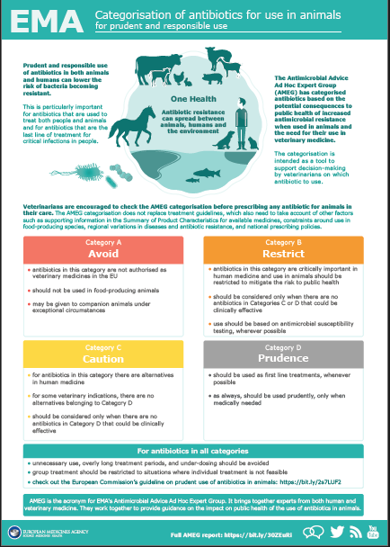
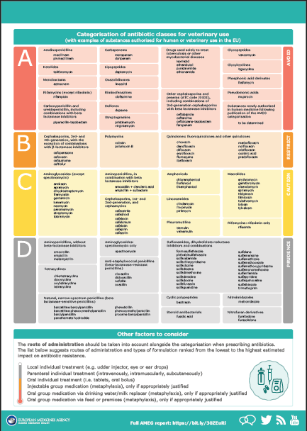
Other considerations for prescriptions

Slide 15
Prudent Use Guidelines
Not legally binding as the previous acts/provisions!
Guideline for the prudent use of
antimicrobials in veterinary medicine 2015/C 299/04​
https://health.ec.europa.eu/system/files/2016-11/2015_prudent_use_guidelines_en_0.pdf
Best-practice framework for the use of antimicrobials in food-producing animals in the EU - Reaching for the next level.
https://epruma.eu/home/best-practice-guides/best-practice-framework-for-the-use-of-antimicrobials-in-food-producing-animals-in-the-eu-reaching-for-the-next-level/

Slide 16
Animal Health Law (Regulation (EU) 2016/429 on transmissible animal disease)
“Prevention is better than cure”
Preventive driven approach:
improvement of animal health and biosecurity measures, good farming practices
Clear responsibility for all players for animal health
  Operators → ensure a high level of animal health and welfare, and biosecurity
  Vets → raise awareness and help in the prevention and spread of pathogens
  CA → protect animal health, human
  health and environment
Prioritising EU intervention
Regulatory tools/interventions for resistant pathogens: "disease agents“
Disease preventive and control measures may apply (surveillance, eradication etc.)
Legal basis monitoring AMR in animal pathogens

Slide 17

SLOVAKIA
specifications

Slide 18
National legislation
Medicated feed
Act No 39/2007 on veterinary care, as amended
Preparation, placing on the market and use of medicated feed
The preparation, placing on the market, storage, prescription and use of medicated feed by veterinarians must be carried out in such a way as to avoid endangering or harming animal health and to ensure the wholesomeness of products of animal origin obtained from animals to which medicated feed has been administered.
Medicated feedingstuffs may be prepared only by manufacturers who have approved premises and conditions and who are subject to veterinary supervision.
Control of the preparation of medicated feed is carried out by the Veterinary Medicines Control Institute in cooperation with the competent regional veterinary and food administration.
The control of the holding, placing on the market and use of medicated feed and the inspection of medicated feed in these operations shall be carried out by the veterinary authorities.
Notes:
(Section 30 of the Veterinary Care Act

Slide 19
National legislation
Medicated feed
Act No 39/2007 on veterinary care, as amended
Preparation, placing on the market and use of medicated feed
The District Veterinary and Food Administration carries out checks on the registration, storage and use of medicated feed in animal holdings.
The owner or keeper of animals shall be obliged to record the use of medicated feed in livestock in a register.
The owner or keeper of the animals is obliged to provide data on the consumption of medicated feed to the competent veterinary authority.

Slide 20
National legislation
Medicated feed
Act No 39/2007 on veterinary care, as amended
Placing on the market of medicated feed and approval of establishments for the preparation of medicated feed
Medicated feed may only be prepared and placed on the market in an approved establishment
The operator must submit an application to the Institute for the State Control of Veterinary Biologicals and Medicaments (ISCVBM)
On the basis of the inspection of the establishment for the preparation of medicated feed, the ISCVBM shall decide on the conditional approval of the establishment for the preparation of medicated feed for a maximum period of three months if the establishment for the preparation of medicated feed meets the requirements
Within three months of the date of conditional approval of the establishment for the preparation of medicated feed, the ISCVBM shall carry out an inspection
Conditional approval may be for a maximum period of 6 months
This is followed by a permanent approval or refusal
The State Veterinary and Food Administration shall, within three days of the date of notification of the ISCVBM, enter the establishment for the preparation of medicated feed in the list of establishments for the preparation of medicated feed, assign an official number to the establishment for the preparation of medicated feed.

Slide 21
National legislation
Medicated feed
Act No 39/2007 on veterinary care, as amended
REGULATION No 41/2004 OF THE GOVERNMENT OF THE SLOVAK REPUBLIC,
laying down the requirements for the preparation, placing on the market and use of medicated feed
- To be updated/ amended, under preparation

Slide 22
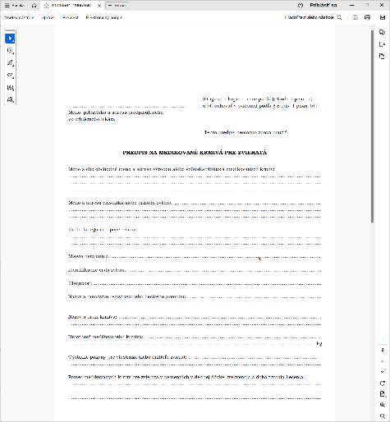
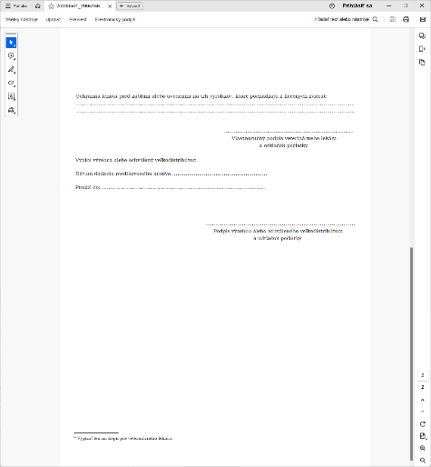
National legislation
Medicated feed
Prescribing MF
- The model prescription for the preparation of medicated feedingstuffs is in
GOVERNMENT REGULATIONS No 41/2004
It must contain all
Data referred to in the Regulation
2019/4 on Medicated
feedingstuffs

Slide 23
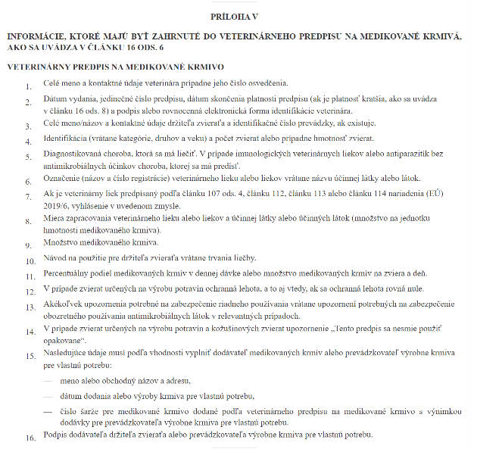
National legislation
Medicated feedinstuffs
Prescribing MF
It must contain all
Data referred to in the
Regulation 2019/4
on Medicated
feedingstuffs

