Slide 1
PORTUGAL
6 AND 7 JUNE 2024

Slide 2
Additional relevant legislation, provisions and/or guidelines to be considered by veterinarians & farmers (II) Lecture 4
PORTUGAL, 6 AND 7 JUNE 2024

Slide 3
EU legal framework on veterinary medicinal products/medicated feed
Regulation (EU) 2019/6 on Veterinary Medicinal Products
Regulation (EU) 2019/4 on Medicated Feed
+ Implementing and delegating Acts

Slide 4
Use of Antimicrobial Veterinary Medicinal Products
EU legislative framework: Regulation (EU) 2019/6 on VETERINARY MEDICINAL PRODUCTS (VMP)
Supporting prudent use and preserving efficacy
antimicrobials or groups of antimicrobials reserved for treatment of certain infections in humans.
!Article 37 (5)
“humans reserve list”
List of antimicrobials which:
are not to be used in accordance with Articles 112, 113 and 114; or
(b) are only to be used in accordance with Articles 112, 113 and 114 subject to certain conditions.
!Article 107 (6)
“ use of AM outside the marketing authorisation”

Slide 5
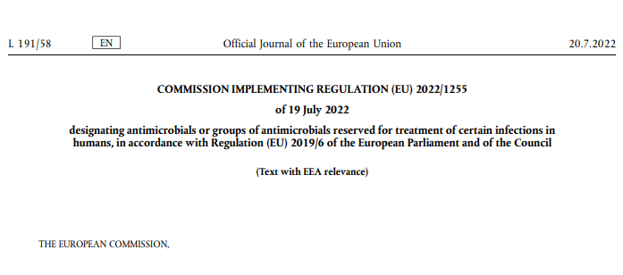
Use of Antimicrobial Medicinal Products
The human reserve list: antimicrobials which are reserved for treatment of certain infections in humans
“reserve list”
The antimicrobials and group of antimicrobials listed in this Regulation cannot be used in veterinary medicinal products.
VMP containing antimicrobials listed in this Regulation cannot be used in medicated feed
The list of antimicrobials or groups of antimicrobials to be reserved for treatment of certain infections in humans should be kept under continual review in the light of new scientific evidence or emerging information
Commission Implementing Regulation (EU) 2022/1255

Slide 6
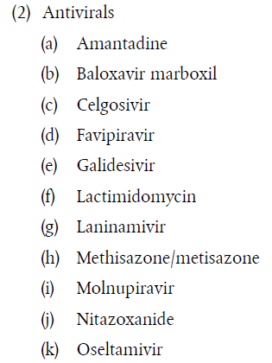
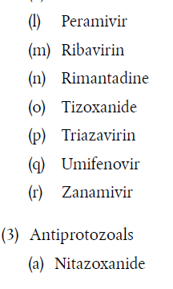
Use of Antimicrobial Medicinal Products
“human reserve list”
Supporting prudent use and preserving efficacy
Commission Implementing Regulation (EU) 2022/1255

Slide 7


Upcoming Delegated and Implementing Legal Acts
List of antimicrobials which shall not be used in accordance with article 112-114 (outside marketing authorisation) or only subject to certain conditions
List of substances authorised for use in food-producing terrestrial animal species or substances contained in a medicinal product for human use authorised in the Union, which may be used in food-producing aquatic species in accordance with Article 114(1)
List of substances which are essential for the treatment of equine species, or which bring added clinical benefit compared to other treatment options available for equine species and for which the withdrawal period for equine species shall be six months.
More info on all delegated and implementing Acts:
https://food.ec.europa.eu/animals/animal-health/vet-meds-med-feed/implementation_en

Slide 8
Use of Antimicrobial Veterinary Medicinal Products
List of antimicrobials which shall not be used outside marketing authorisation
!Article 107(6)
List of antimicrobials which:
  are not to be used in accordance with Articles 112, 113 and 114; or
  are only to be used in accordance with Articles 112, 113 and 114 subject to certain conditions.
“use of AM outside
the marketing authorisation”
Notes:
IF RUNNING OUT OF TIME, THIS SLIDE CAN BE HIDDEN

Slide 9

Upcoming Acts
List of antimicrobials that may be used for food-producing aquatic species
!Article 114
The Commission is to establish, by means of implementing acts, a list of substances used in veterinary medicinal products authorised in the Union for use in food-producing terrestrial animal species or substances contained in a medicinal product for human use authorised in the Union in accordance with Directive 2001/83/EC or Regulation (EC) No 726/2004, which may be used in food-producing aquatic species in accordance with Article 114(1).
Notes:
IF RUNNING OUT OF TIME, THIS SLIDE CAN BE HIDDEN

Slide 10

Upcoming Acts
List of antimicrobials for specific species (equine species)
In 2006 and 2013, the Commission published a list of substances essential for the treatment of Equidae ((EC) CR 1950/2006 & R 122/2013 )
The Commission is now updating the list of substances which are essential for the treatment of equine species, or which bring added clinical benefit compared to other treatment options available for equine species and for which the withdrawal period for equine species shall be six months.
On 9 February 2023, the European Medicines Agency received from the European Commission a request to provide scientific advice for the establishment this list of substances and they are currently preparing an answer.
Notes:
IF RUNNING OUT OF TIME, THIS SLIDE CAN BE HIDDEN

Slide 11
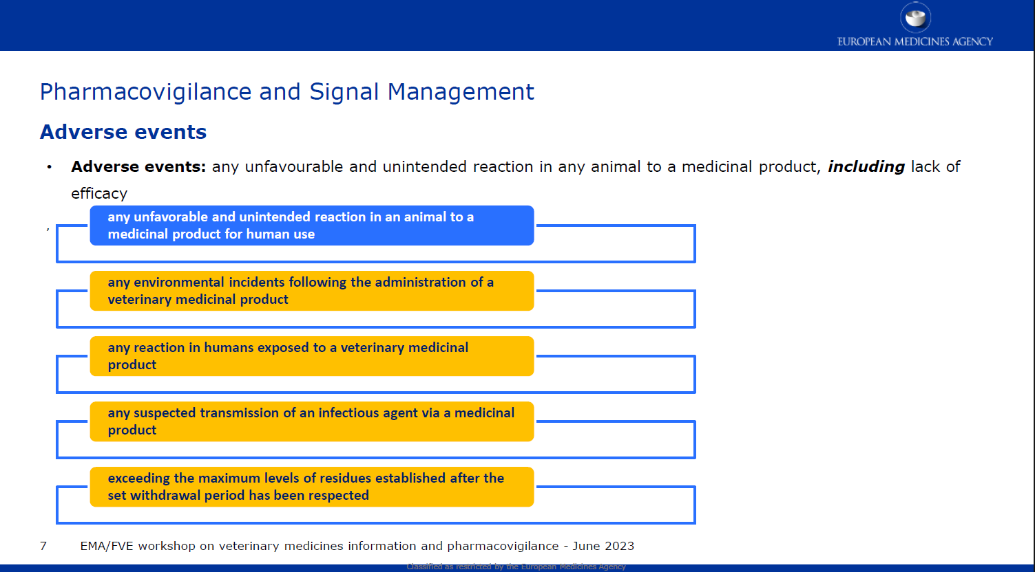
Reporting adverse events (pharmacovigilance)
Do not forget to report adverse events including lack of efficacy!

Slide 12
Disposal of Veterinary Medicine
How and where does pharmaceutical waste occur?
Immediate packaging and the remains of medicines within after use.
VMP or MF that are past their expiry date or that have not been stored in accordance with the instructions.
Prescription of a quantity exceeding the required quantity or uncompleted course of treatment due to either administration difficulties, adverse reactions, change in treatment or because animals died during treatment.
FACTSHEET_PharmaceuticalWasteDisposal.pdf (epruma.eu)

Slide 13
Disposal of Veterinary Medicine
Best practices for disposal
PharmaceuticalWasteDisposal.pdf (epruma.eu)
Everybody (prescribers and users) is responsible for minimising pharmaceutical waste.
Disposal of pharmaceutical waste via waterways should be excluded.
Pharmaceutical waste should be stored in a dedicated container, bin, or facility to ensure adequate protection to animal health, human health, feed, food and the environment and this must be separated from any stocks of veterinary medicines to ensure that the waste cannot be inadvertently used.
Waste must be disposed of in accordance with the Summary of Product Characteristics (SPC) and the waste legislation and national systems developed in consultation with all parties for the collection, transport, and disposal of the waste.
Member States shall ensure that appropriate collection or discard systems are in place for waste veterinary medicinal products (including medicated feed) and to ensure that the location of collection or discard points as well as other relevant information is made available to farmers, animal keepers, veterinarians, and other relevant persons.

Slide 14

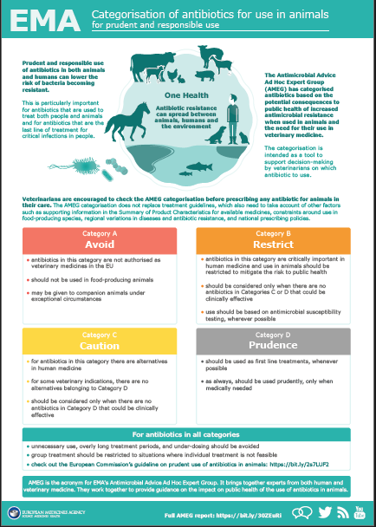
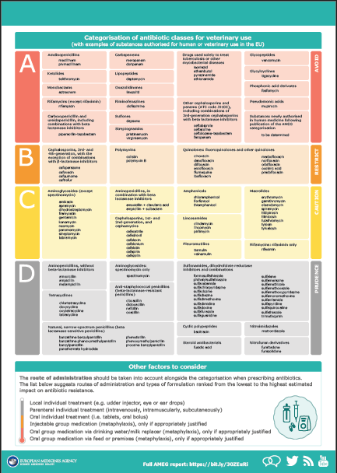
Other considerations for prescriptions

Slide 15
Prudent Use Guidelines
Not legally binding as the previous acts/provisions!
Guideline for the prudent use of
antimicrobials in veterinary medicine 2015/C 299/04​
https://health.ec.europa.eu/system/files/2016-11/2015_prudent_use_guidelines_en_0.pdf
Best-practice framework for the use of antimicrobials in food-producing animals in the EU - Reaching for the next level.
https://epruma.eu/home/best-practice-guides/best-practice-framework-for-the-use-of-antimicrobials-in-food-producing-animals-in-the-eu-reaching-for-the-next-level/

Slide 16
Animal Health Law (Regulation (EU) 2016/429 on transmissible animal disease)
“Prevention is better than cure”
Preventive driven approach:
improvement of animal health and biosecurity measures, good farming practices
Clear responsibility for all players for animal health
  Operators → ensure a high level of animal health and welfare, and biosecurity
  Vets → raise awareness and help in the prevention and spread of pathogens
  CA → protect animal health, human
  health and environment
Prioritising EU intervention
Regulatory tools/interventions for resistant pathogens: "disease agents“
Disease preventive and control measures may apply (surveillance, eradication etc.)
Legal basis monitoring AMR in animal pathogens

Slide 17

PORTUGAL
specifications

Slide 18
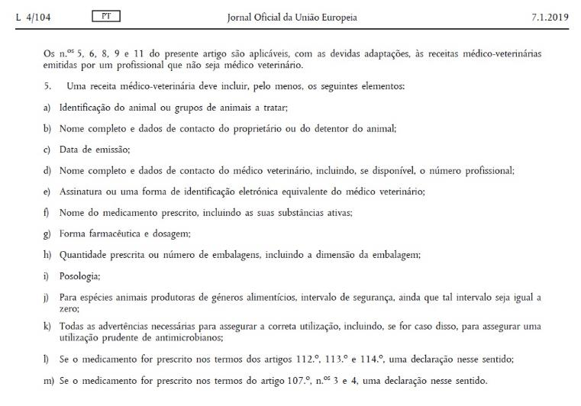
National specifications on additional relevant provisions and/or guidelines
Notes:
Regulamento.2019/6, Art. 105,
nº5

Slide 19
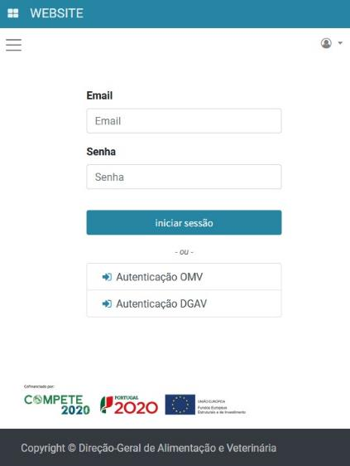

National specifications on additional relevant provisions and/or guidelines
https://pemv.dgav.pt/
Notes:
Autenticação DGAV a partir da

Slide 20
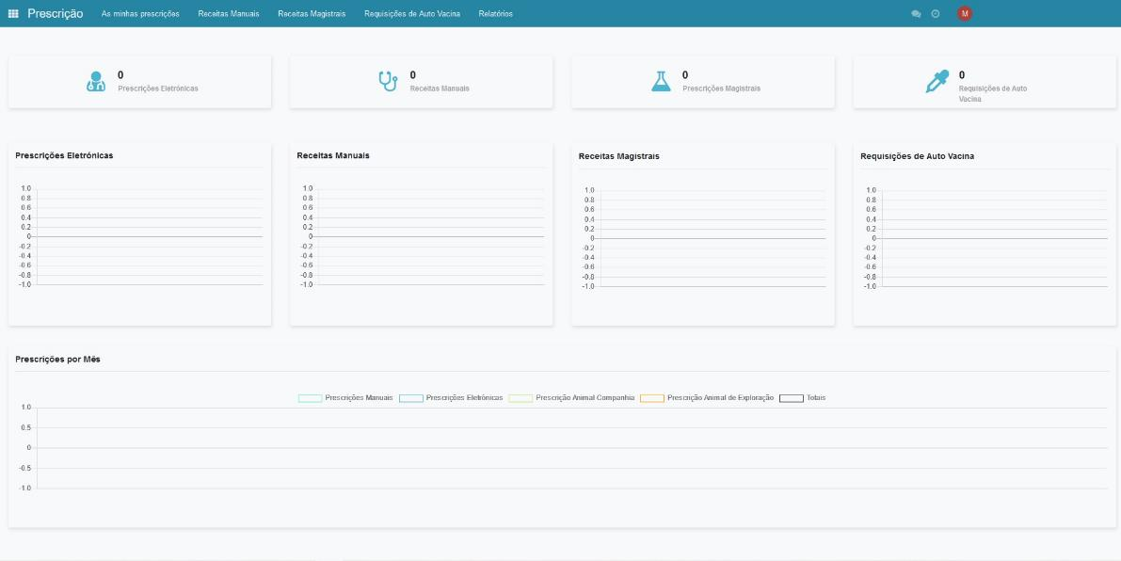
National specifications on additional relevant provisions and/or guidelines
Notes:
As receitas médico-veterinárias eletrónicas não manuais não necessitam da aposição de vinheta médico-veterinária.
A partir da plataforma PEMV é também possível proceder à impressão dos modelos eletrónicos de receita manual.
Pode fazer a emissão de receita de alimento medicamentoso via eletrónica através da PEMV. Está também disponível para impressão a receita de alimento medicamentoso para animais manual.

Slide 21
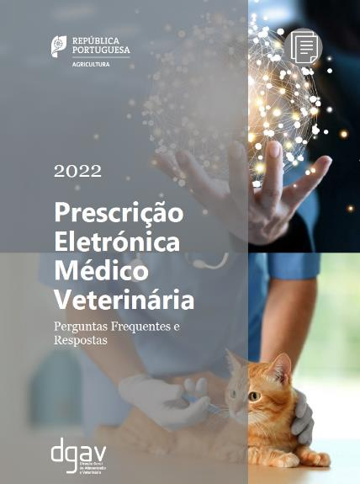
National specifications on additional relevant provisions and/or guidelines
https://pemv.dgav.pt/
Notes:
Autenticação DGAV a partir da

Slide 22
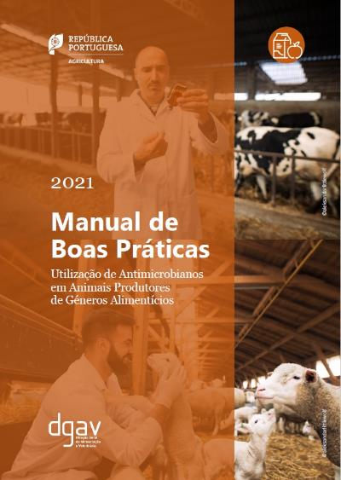
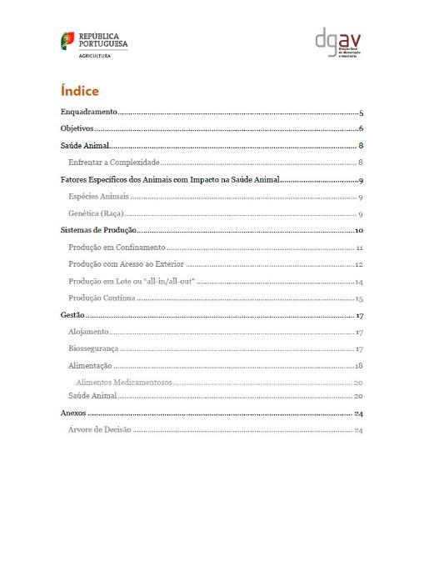
National specifications on additional relevant provisions and/or guidelines
Notes:
Regulamento.2019/6, Art. 105,
nº5

Slide 23
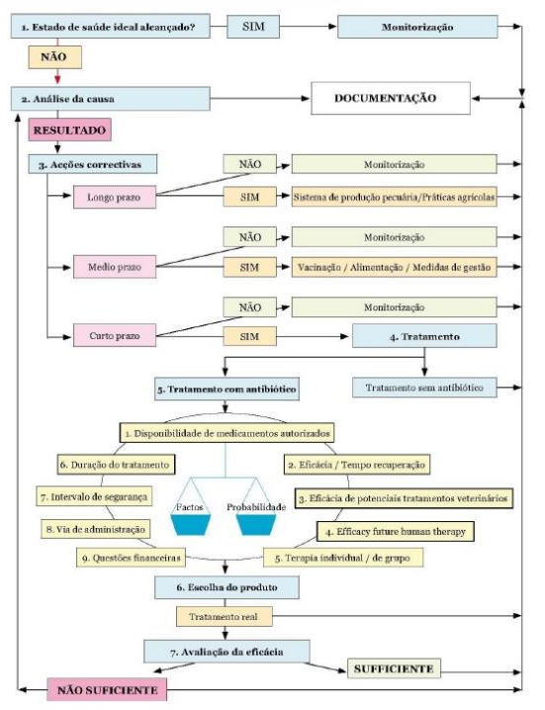
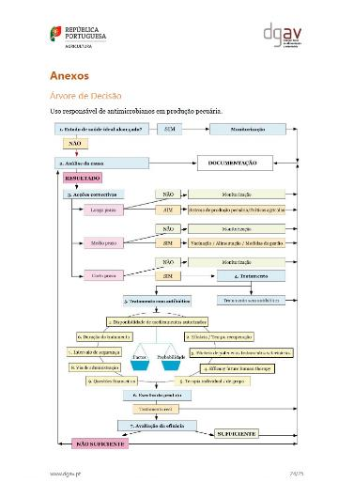
National specifications on additional relevant provisions and/or guidelines
Notes:
Regulamento.2019/6, Art. 105,
nº5

Slide 24
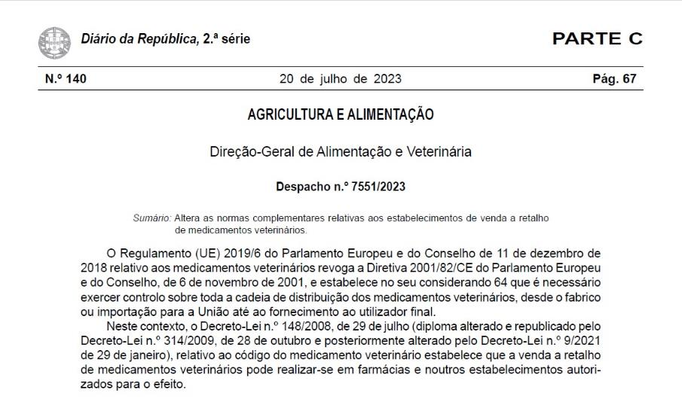
National specifications on additional relevant provisions and/or guidelines
Notes:
Regulamento.2019/6, Art. 105,
nº5

Slide 25
Despacho nº 7551/2023
Veterinary Medicines Stations (PVMV) - establishments that sell veterinary medicines subject to veterinary prescription.
A veterinary medical technical director or a pharmacist accredited by the respective Portuguese professional organisations, to ensure the quality of the carried out activities.
Ownership, technical management or any other link to retail establishments selling veterinary medicines subject to veterinary prescription is incompatible with the clinical practice of veterinary medicine.T
he PVMV collaborates with the DGAV, when necessary, in sharing information on veterinary medicines containing antimicrobials.
Place of Sale of non-prescription veterinary medicines
a technical director or technical manager, pharmacy technician or graduate in Basic Studies in Animal Health Sciences, responsible for all acts carried out within the scope of quality assurance.
Not eligible for distance selling of non-prescription veterinary medicines.

