Slide 1
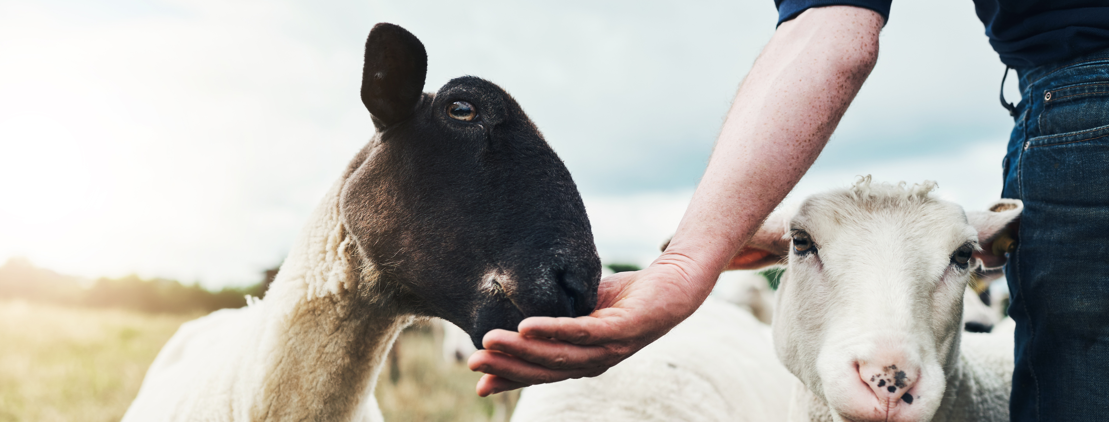

Optimal Housing for Livestock
From DISARM project​​

Slide 2
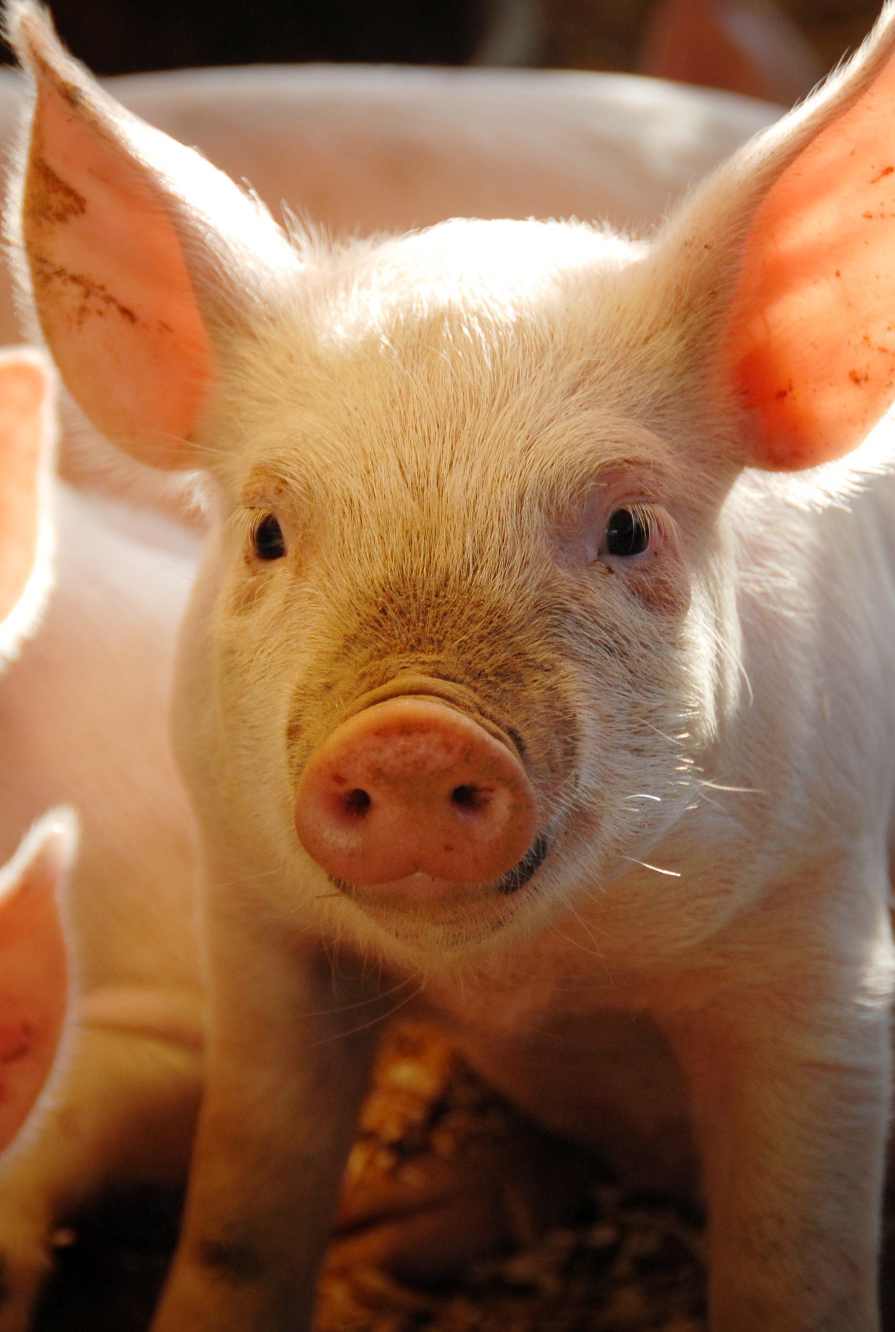
MAIN OBJECTIVES
Inform about the best practices to optimize housing in livestock
Improve animal health
Reduce antimicrobial use

Slide 3
HOUSING CONCERNS SEVERAL SUBJECTS
HOUSING SYSTEM
ENVIRONMENT
GROUP MANAGEMENT
An environment that meets animals’ needs, limits stress, and inhibits infectious disease is another important factor in maintaining high animal health and welfare standards.

Slide 4
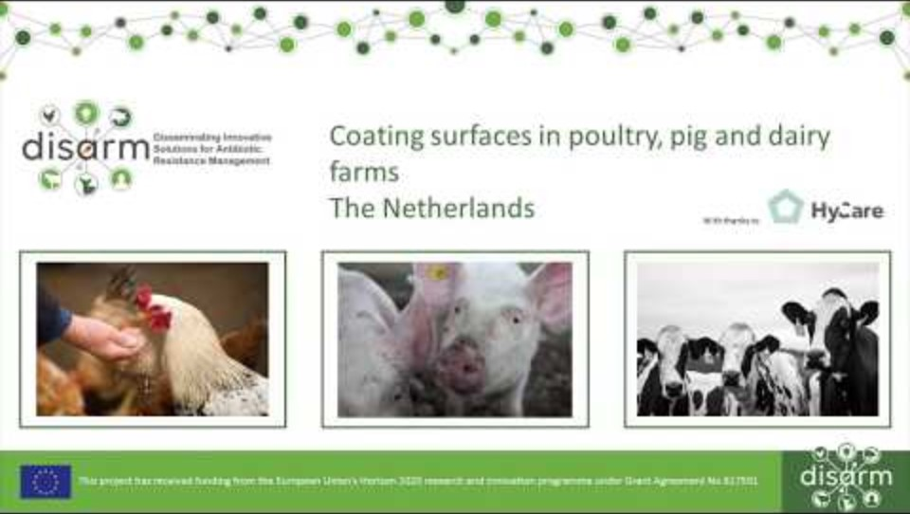
HOUSING SYSTEMS
Coating surfaces in poultry, pig, and dairy farms

Slide 5
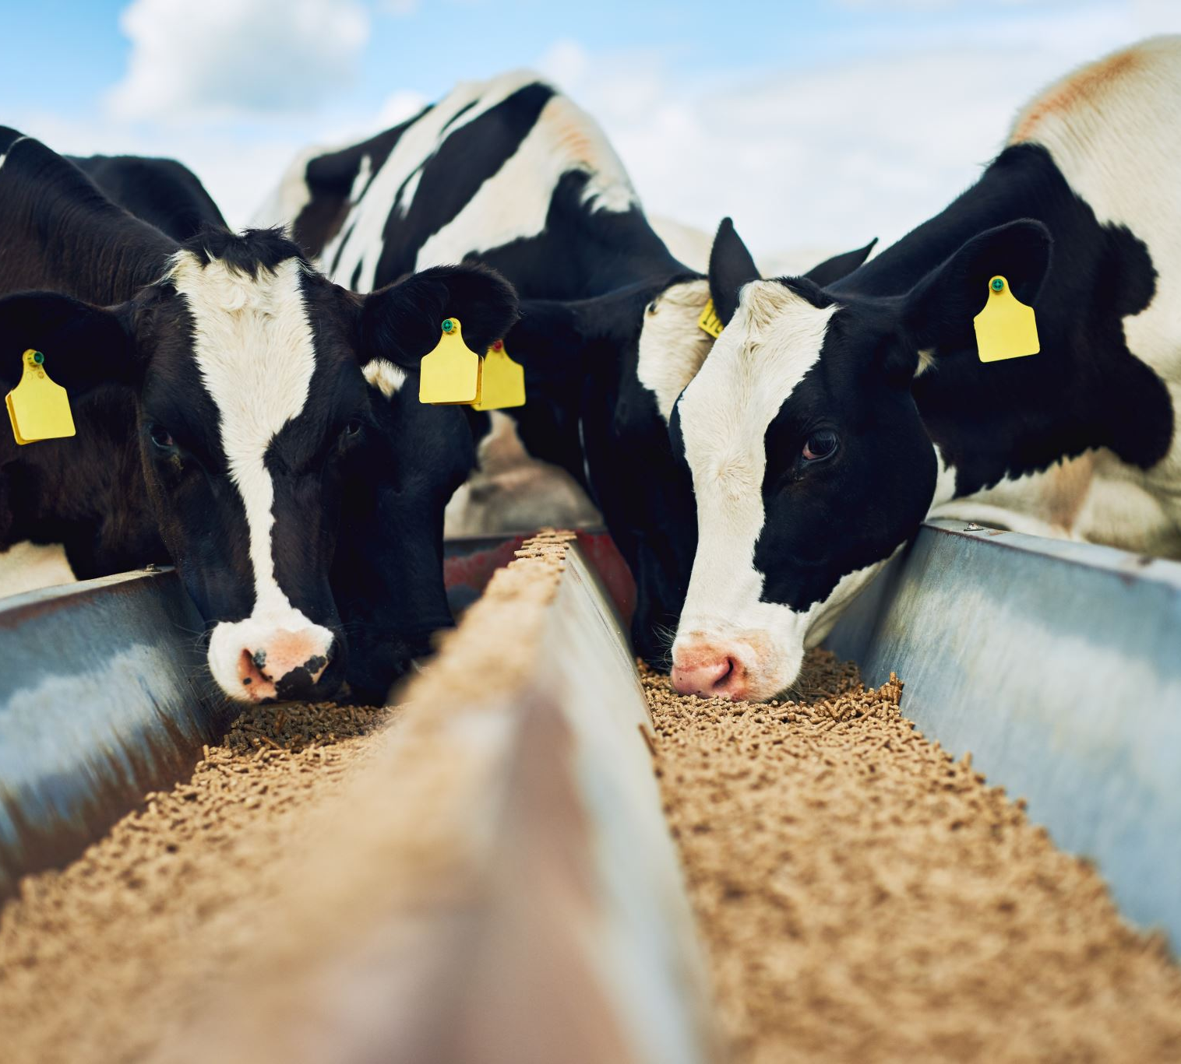
ENVIRONMENT
Providing animals with a clean, dry, comfortable environment that provides for their physical, social, and mental needs can improve production, health, and welfare by reducing negative stress:
Appropriate disinfectants, bedding, and flooring substrates;
Regular cleaning, removal of waste, and topping up of clean, dry bedding and litter material;
Adequate space and facilities in which to rest, exercise and perform species-typical behaviours;
Suitable social and environmental enrichment.
Providing an environment in which animals are happy, comfortable and content can contribute to lower susceptibility to disease and easier management.

Slide 6
GROUP MANAGEMENT
Effective management of animal groups ensures animals have appropriate social contact whilst minimising the risk of injuries and disease thereby reducing the need for antibiotic treatments:
Adequate space to avoid overcrowding;
Animals should be regularly observed to identify early signs of illness or other problems;
Stable groups should be maintained - mixing animals from different groups should be avoided and young animals should be kept separately from older animals;
Clean, disinfect, dry, and rest enclosures to reduce pathogenic load before introducing the next group of animals
Stockpersons should move from young to older animals or change footwear and protective clothing when it is necessary to visit young animals after dealing with adult stock.

Slide 7


Scan this QR code to learn more about the DISARM MAFH approach toolbox or visit https://qrco.de/beiIjS
This project has received funding from the European Union’s Horizon 2020 Research and Innovation Programme under grant agreement no. 817591.

Slide 8
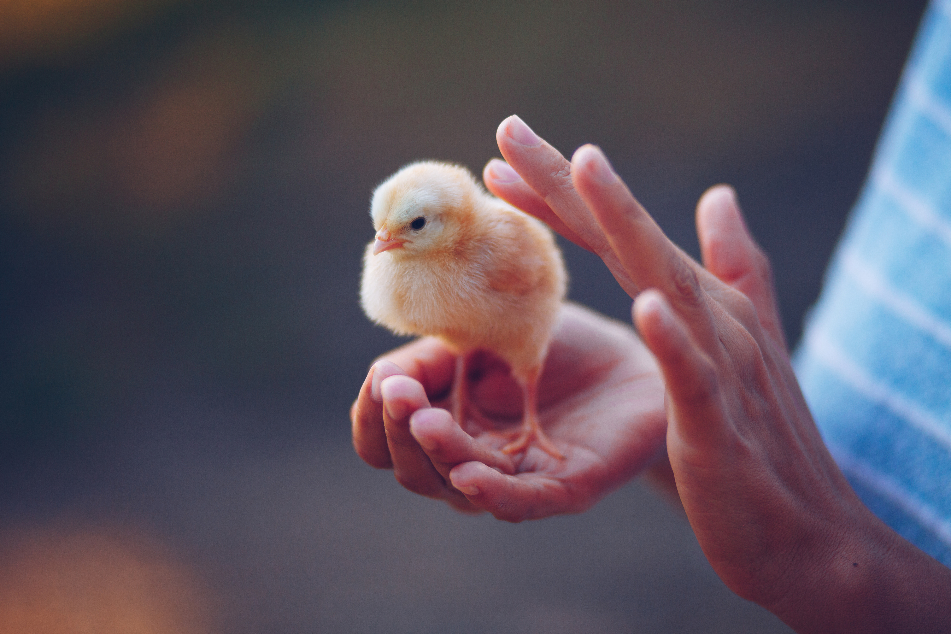
Thank you!

