Slide 1





HealthyLivestock
Use of a health plan on high- welfare pig and broiler farms
A tool to assess existing risks, make farm-specific herd health plans for mitigating these risks, and monitor the effects of risk mitigation measures
P. Ferrari, A. Scollo – CRPA
J. Schraeder, M. Wolthuis - WUR
C. Fourichon, P. Levallois, C. Belloc, M. Leblanc Maridor – INRAE/Oniris
S. Papasolomontos, G. Kefalas, K. Angastiniotis, M. Simitopoulou - VTN

Slide 2
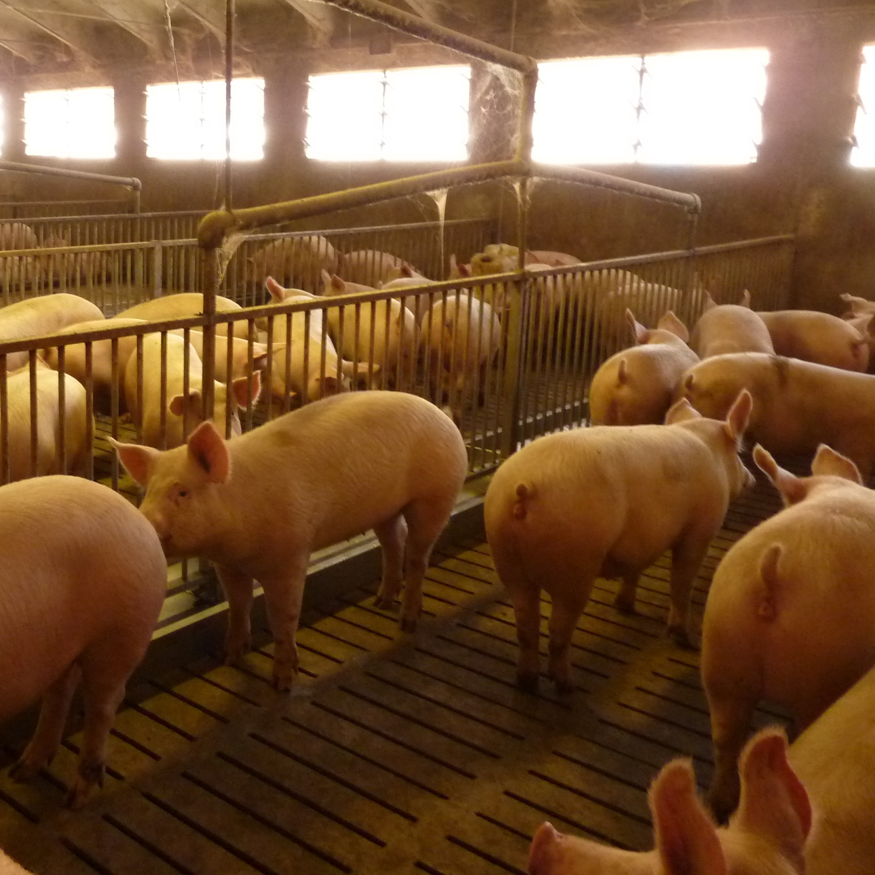
OVERALL OBJECTIVE
Assess systematically disease risks related to housing and management in broiler farms
Define farm tailor-made health plans including biosecurity protocols and adapted to the farm-specific risks.
Monitor the risk mitigation using biomarkers
HOW?
Two BiosEcurity risk Analysis Tools (BEATs): pigs + broiler farms
BiosEcurity Assessment Tool (BEAT) was developed to identify strengths and weaknesses in biosecurity on broiler farms

Slide 3

BIOSECURITY RISK ANALYSIS TOOLS (BEATS)
based on:
Biocheck.Ugent: focuses on the risks of pathogens entering or escaping from the farm (external biosecurity) and their spread over the farm (internal biosecurity)
FAO 3 zone-biosecurity: identifies 3 different zones on and around the farm (i.e. outside the farm, working zone, animal houses) and their 2 interfaces.
PROTOCOLS
based on biomarkers = direct and indirect signs of infectious diseases, such as clinical symptoms and results of lab analysis for bacteriology, virology, serology, and the presence of stress indicators.

Slide 4
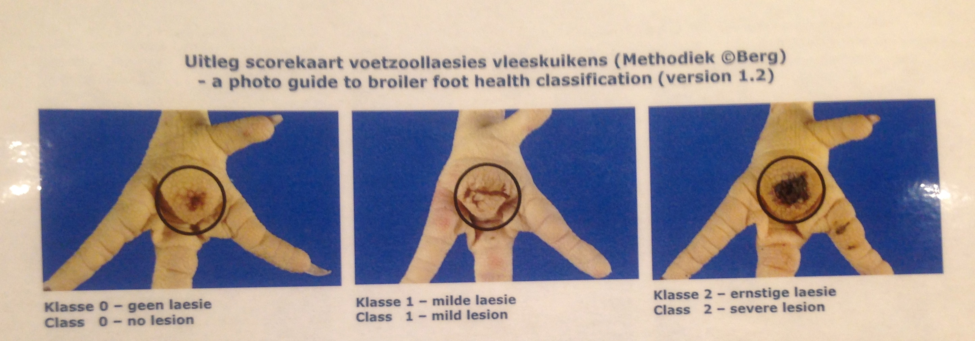
BIOMARKERS FOR BROILER FARMS
Foot pad lesions at slaughter
BIOMARKERS FOR PIG FARMS
Respiratory disease scores (cough, sneezing and labored breathing) and blood/serum lab analysis for PRRS
Feces scores and lab analysis for E. coli
Skin and pluck lesions at slaughter
Haptoglobin, serum/blood lab analysis (i.e. in weaners)
Cortisol and Dehydroepiandrosterone (DHEA) pig hair lab analysis
Bacterial load in pen surfaces after cleaning and disinfection (swabs)
Mortality rates of all pig categories

Slide 5

OUTCOMES FROM BROILER FARMS
Better growth performance: Significantly higher initial weights at day 1 of age
Improved chick quality and development
Less footpad dermatitis
Higher weights at slaughter on day 39
Decreased mortality rate
More resilient and less susceptible to disease
The production costs in Euro/kg are around 4,5 % lower for the on-farm hatched chickens than for the hatchery hatched chickens

Slide 6
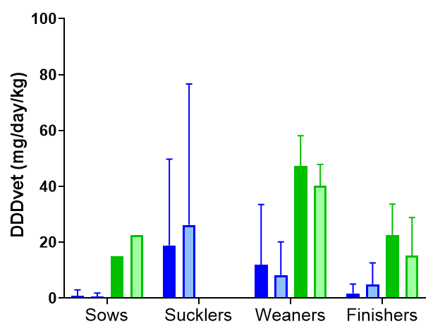
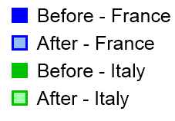
OUTCOMES FROM PIG FARMS
Antimicrobial use
FR: Main use for piglets and weaners with respectively low increasing and decreasing
IT: Main use for weaners with a decreasing for weaners and finishers
A reduction in antimicrobial use was reported in farms with higher use of such antimicrobials
*
*
DDDvet: indicator for antimicrobial consumption
DDDvet: Defined Daily Dose per animal
Calculated for sows, sucklers, weaners, and finishers

Slide 7
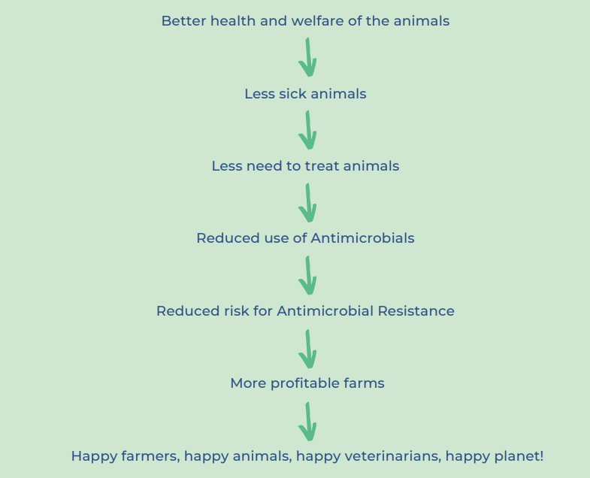
BENEFITS
Positive correlation with the production results and the improvement of the profitability of the farm → will limit the risk of farm economic losses
The production costs of finisher pigs and weaners in Italian farms declined by 2.1 and 6.2%
Improving the broiler’s health by using the BEAT tool will reduce mortality and reduce treatment costs.

Slide 8

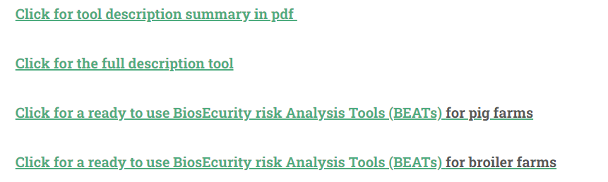
WHY SHOULD YOU DO IT?
Reduce the risk of the introduction and spread of micro-organisms, in particular, pathogenic microorganisms that cause animal diseases, therefore it will enhance the protection of animal health.
HOW CAN YOU USE IT?
If you want to know more about this topic visit https://shorturl.at/aPRU4
or scan this QR code BEAT tool: https://shorturl.at/azR35

Slide 9
Step 1: Define on-farm risk zones: Make a schematic drawing of the farm location and color the risk zones, and identify the buildings, stables, storage sites, pathways et cetera. | Step 2: Go through the risk analysis tool: Answer the questions belonging to the different zones and transition lines between zones.
Step 4: Health plan: Make an action plan with SMART-formulated preventative actions per zone and per transition line between zones: Based on the results of the risk analysis tool, tailormade on-farm health plans can be set up with your farm veterinarian proposing solutions to strengthen biosecurity | Step 3: Interpretation: Analyze together with your farm veterinarian and discuss the opportunities for improvement

Slide 10
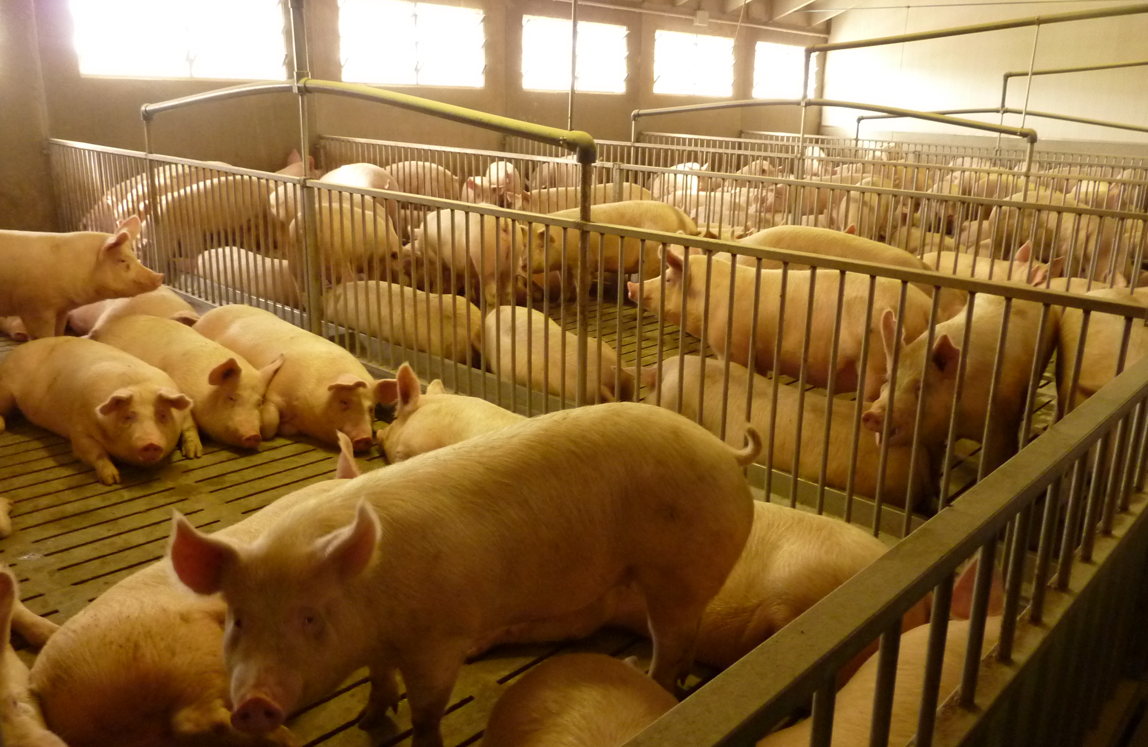
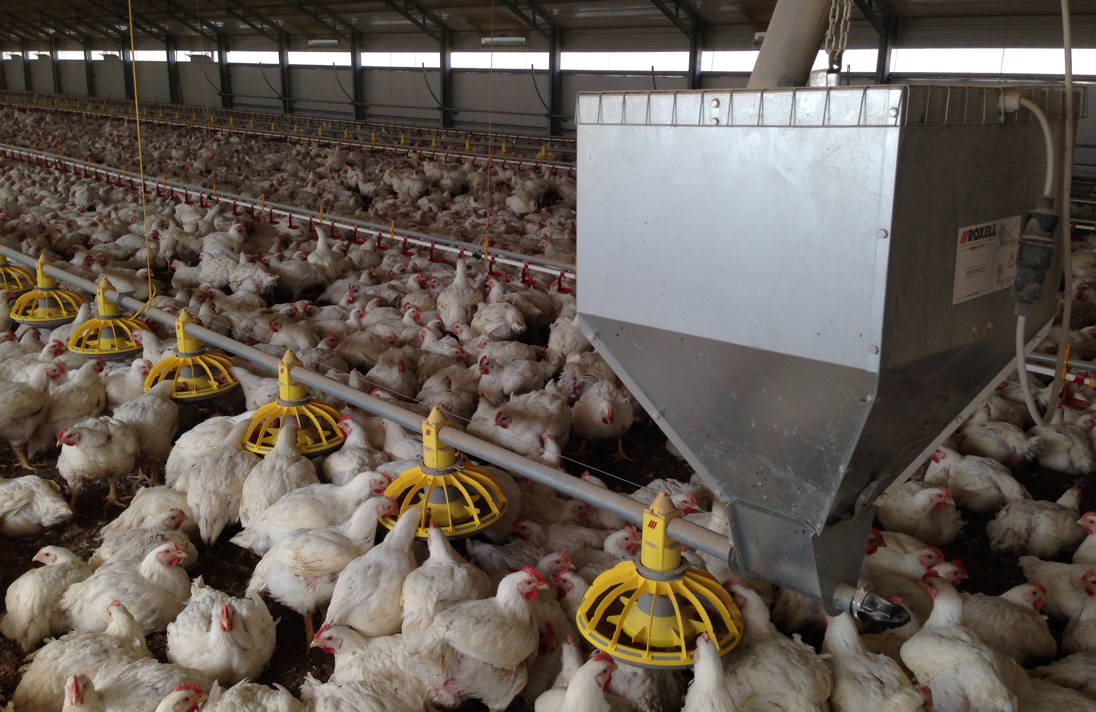
Thank you for your attention!

