Slide 1
Reduction of the use of antibiotics in a swine farm
Marios Christoforou DVM , MSc

Slide 2
Farm profile
Number of sows :420
Genetic : Topics
The swine farm import GP sow around every 4 months .
Import semen from an AI boar station.

Slide 3
Farm Biosecurity level
Farm has a fence .
Two main entries' one for animals sales and the other close to feed facilities .
The feed truck before entering the farm feed facilities are disinfected .Feed truck carry cereals , premix and other feed additives .
All visitor have to wear shoe covers before entering the farm.
All the animals tract must clean and disinfected before entering the farm.

Slide 4
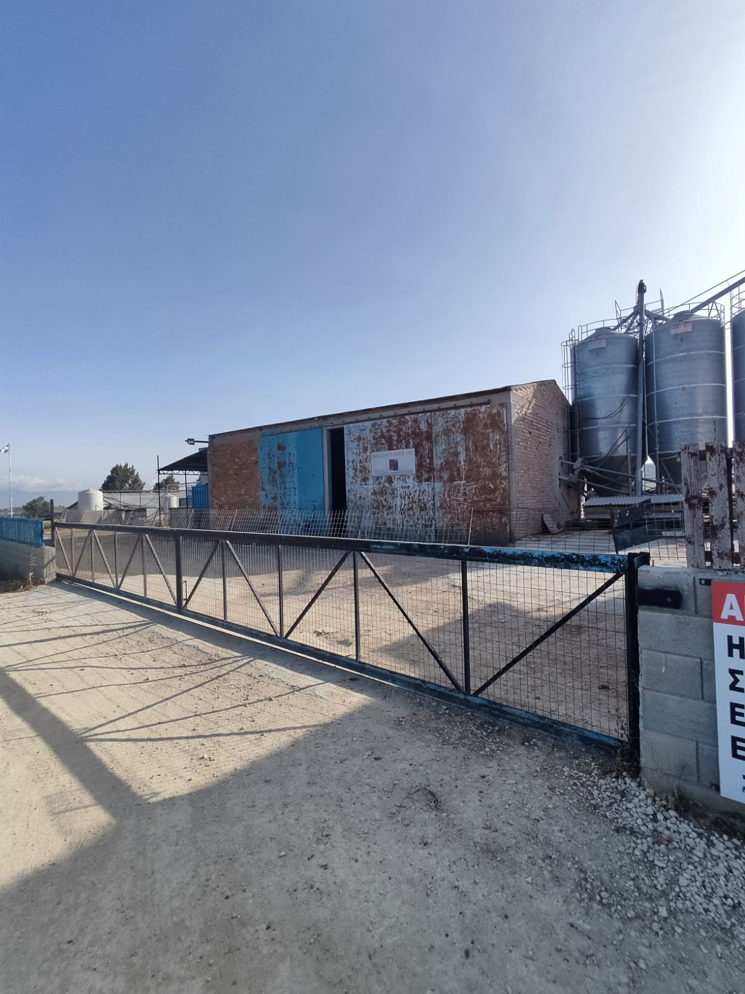
Farm entry

Slide 5
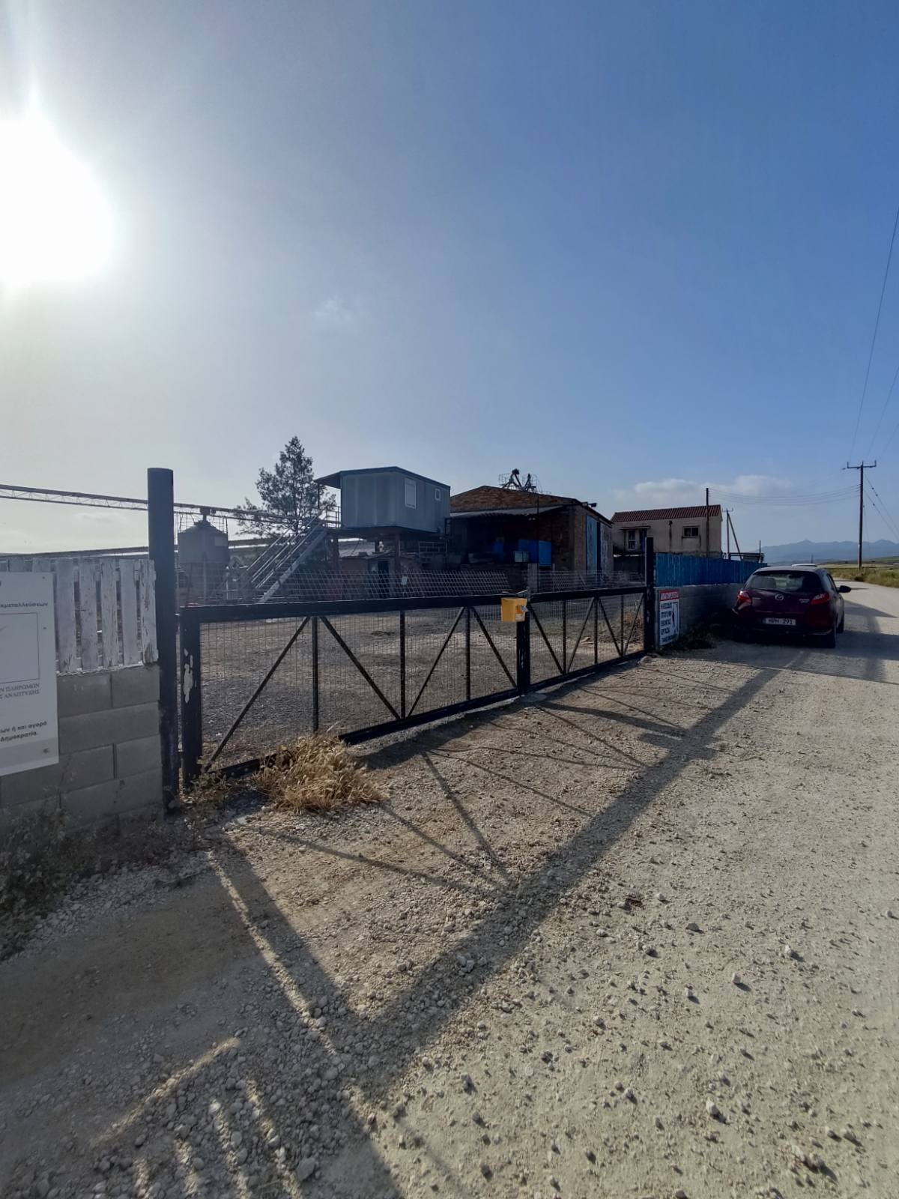
Farm entry

Slide 6
Vaccination protocol
Sows/ Gilts : ERY-SENG Parvo Hipra
Sows/ Gilts : Gletvax
Piglets : Circomax

Slide 7
Reduction of antibiotics
We have started monitoring the use of antibiotic on monthly base for the May 2022.
In the first excel we have only include the use of feed antibiotics .
The high amount of antimicrobials was use in feed for treatment enteric and respiratory diseases.

Slide 8
Reduction of antibiotics
The current medication scheme was continuous use of antibiotics until 15 kg of pigs
In pigs from 15 kg until 75 kg we used a pulse medication scheme one week with medication and 3 weeks without medication.
Sporadic outbreak of mix colitis infection we control them with a medication scheme for Tiamutin or Lincomycin for 21 days

Slide 9
First step
Everything need to be done with a close co operation with the farmer.
We have started to reduce the use of antibiotic in fattening pigs on a weekly base and close monitor the animals.
In a period of 3 months we have managed to stop using antibiotic in pig over 30 kg .

Slide 10
First step
With the withdraw of antibiotic we have starting using organic acids and other feed additives to enhance normal flora of the gastrointestinal tract and make unfavorable environment for the pathogenic bacteria.

Slide 11
First step
Close monitoring from the farm vet
Slaughter house visit for lung scoring
Monitor the growth of the animals
Record keeping of the mortality and other wasting pigs.

Slide 12
Use of feed antibiotics
The farm use only feed antibiotic for 10 days after weaning to control cases of S.suis and PWDS .
In case we have an outbreak of enteric or respiratory disease we use antimicrobials when the vet visit the farm and the first approach is wait and close monitor the pigs.
Use of water antibiotics and injection to affected pigs.
The last option is the use of feed antibiotics.

Slide 13
Vaccination protocol
Serological investigation has indicated that we have outbreak of Swine Influenza virus and we have include it in our vaccination protocol (Respiporc Flu ) .
Also we have change the vaccine for sow and gilts in order to increase immunization for Clostridium type A (Enteroporc Coli AC).

Slide 14
Kg of active ingredient
Years | Feed Medication/kg | Water Medication/kg | Injectables/kg
2022 | 11.1 | 3.8 | 0.2
2023 | 2.1 | 2.1 | 0.3
2024 | 3.53 | 0.785 | 0.3

Slide 15
Final outcome
We have manage to reduce the use of antibiotics 37% in each year.
We have reduce both feed and water antibiotics.
Also we have manage to reduce the use of antibiotic to control neonatal diarrhea with the use of probiotics .

Slide 16
Final outcome
Years | PCU mg/kg | Veterinary Services formula
2022 | 225.58 | 1.31
2023 | 137.0 | 0.9
2024 | 75.7 | 0.48

Slide 17
Next step
Reduce the use of injectable antibiotic in sows with close monitoring during farrowing.
Reduce the movement of the pigs in order to reduce the stress factors.
Build new facilities for weaners pigs .

Slide 18
Conclusions
Close co operation of the farmer and the vet .
The road will be difficult and both farmer and vet will faces difficulties for implementing this program.
There is not a magic recipe and you need to take small step each time.
We need a very good record keeping.
The farm and vet need to speak on daily and then weekly base in the first step of the implementation of the program.
Every farm is a new challenge and failure will always come up.
We need to increase biosecurity and reduce the number of people entering the farm .

Slide 19
Thanks for your Attention!

