Slide 1

Andreou Brothers Pig Farms
> 95% reduction in antibiotic usage
- A 10 year long effort -
George Andreou
Director

Slide 2

Our case study
Who are we?
Agriculture and antibiotics
Consumption in our farms
Problem identification and actions
Results
Take-home message

Slide 3
Who are we?
A family-owned business
50 years in the pig industry
3300 sows
  - 1 multiplication unit
  - 4 farrow to finish units
  - 4 finishing units
100,000 weaned piglets per year
95,000 pigs slaughtered yearly

Slide 4
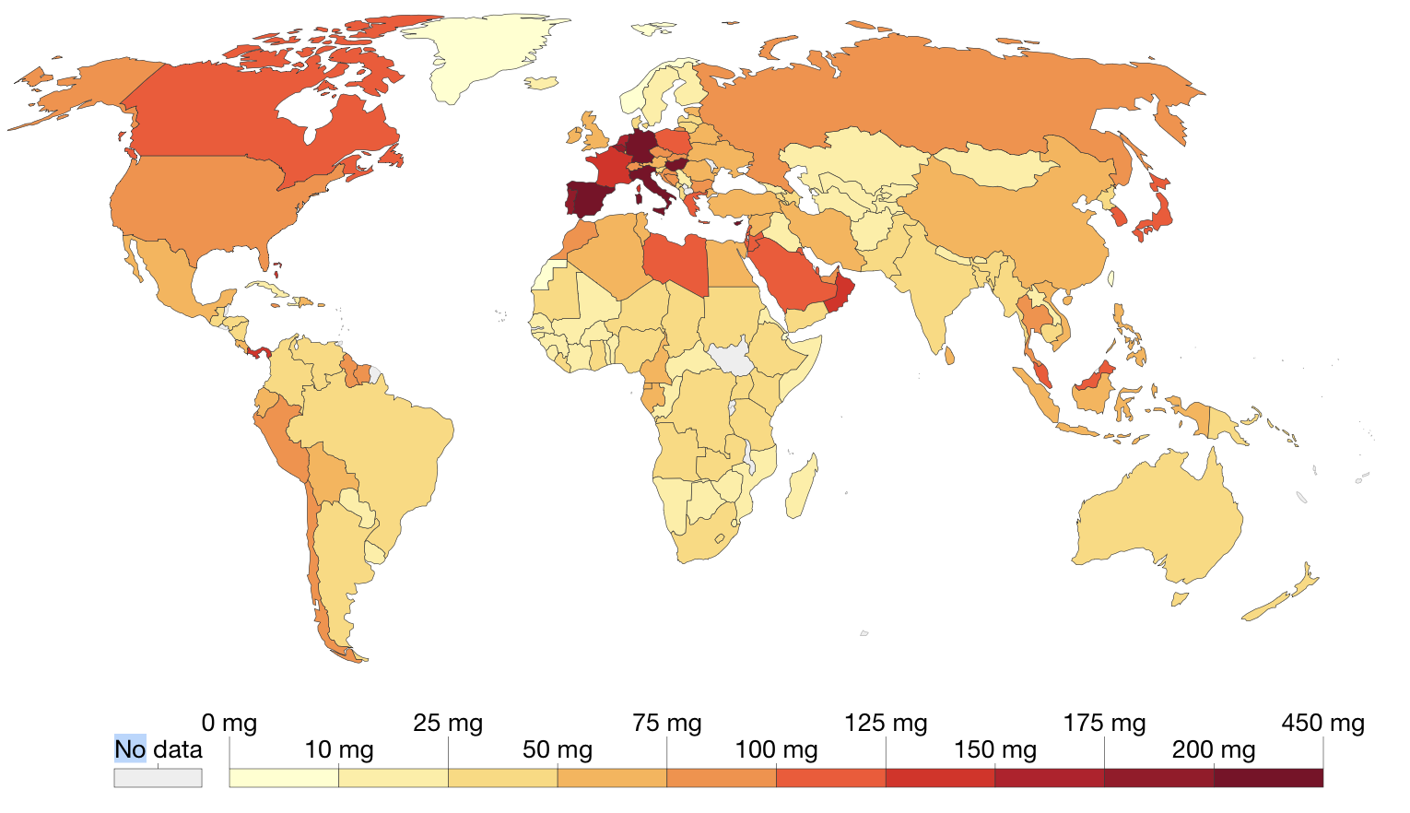
Agriculture and antibiotics
73% of antibiotics worldwide is used in agriculture (Laxminarayan et al. 2019)
2010 European Medicines Agency

Slide 5
Consumption in our farms
«You can’t manage it, if you don’t measure it»
- Peter Drucker, Austrian management consultant
And when we measured it …

Slide 6
And since we measured it…
the responsible action was to manage it!
Factors leading to high antibiotic consumption
  Obviously: disease
  But also:
  Management
  Nutrition
  And moreover:
  “Insecurity”

Slide 7
The obvious microbes…
in grower/finisher pigs
M. HYO
  Attention given to timing and way of vaccination
PCV
  Attention given to timing and way of vaccination
B.HYODYSENTERY
  Created an autoimmune vaccine for sow vaccination
ACTINOBACILLUS
  Created an autoimmune vaccine for sow vaccination
  Vaccinated pigs with a commercially available vaccine
GLASSERELLA
  Vaccinated gilts and sows prior to farrowing
E.COLI
  Vaccinated piglets against oedema disease before weaning

Slide 8
Vaccination timeline
Sows
Ery, Parvo, E.coli, Clostridium Type C
+ Actinobacillus
Pigs
M.hyo, PCV 2
+ B.hyodyse-ntery
+ Atrophic rhi + Glasser
+ Glasser for gilts
+ Clostridium Type A
+ Actinobacillus
Changed timing and way of vaccination
+ Oedema disease
2011 – 2014 2015 2018 2018 2020 2022
2011 – 2014 2015 2019 2024
PREVENTION for 13 different microbes

Slide 9
Management…
with the aim of reducing disease outbreaks and transmission
PERSONNEL
  Training – training – training
  Increased the number of animal scientists
BUILDING
  Renovated buildings to improve internal climate conditions
FARROWING
  Colostrum management
  Reduced cross-fostering to the minimum necessary
NURSERY
  Reduced stocking density (0,30 m²/piglet up to 23kg)
  Chlorination and acidification of water
GROWER - FINISHER
  Avoided mixing pigs from different sources
  Reduced stocking density (0,75 m²/pig)

Slide 10
Management…
with the aim of reducing disease outbreaks and transmission
EXTERNAL BIOSECURITY
  Reduced visits / protective measures for visitors
  Use of quarantine for animal imports
  Vaccinating gilts against farm diseases before entering the farm
  Washing and disinfection of transfer trucks
INTERNAL BIOSECURITY
  Use of appropriate disinfectants per stage of production
  Reduced animal movements between farms
  Attention to movements of personnel and equipment between buildings

Slide 11
Nutrition…
targeting gut health
WATER
  Sanitation of water with chlorine and organic acids
RAW MATERIALS
  Quality control of EVERY batch and corrective actions
  (e.g. reformulation and use of mycotoxin modifiers / binders)
FEED ADDITIVES
  Use of plant antioxidants and essential oils to facilitate gut health
  Use of organic acids and fatty acid monoglycerides to reduce pathogenic bacterial load

Slide 12
By applying all the mentioned actions…
“INSECURITY” was transformed to RESULTS…

Slide 13
The results…
* *
* Including injectable antibiotics

Slide 14
The results…

Slide 15
The results…

Slide 16
Take-home message…
Actions deliver results,
and results provide “SECURITY”

Slide 17
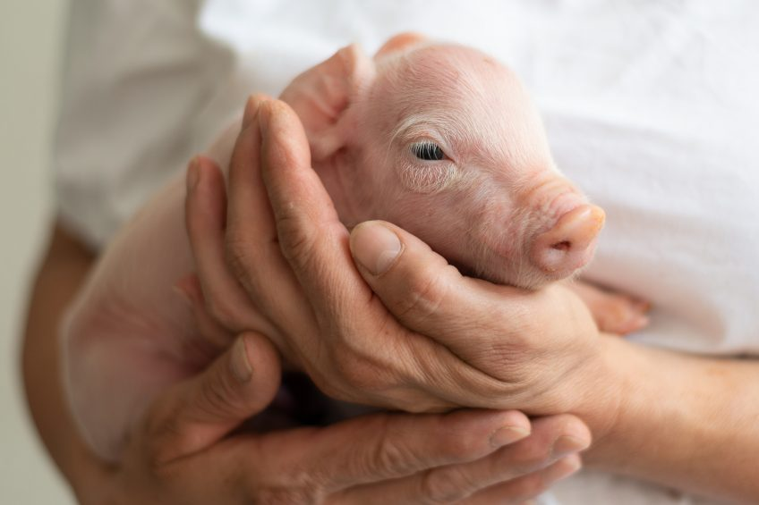
Thank you!

