Slide 1
LITHUANIA
25 SEPTEMBER 2024

Slide 2
Important elements of the new EU Medicated Feed Regulations
Lecture 3
LITHUANIA, 25 SEPTEMBER 2024

Slide 3
EU legal framework on veterinary medicinal products/medicated feed
Regulation (EU) 2019/6 on Veterinary Medicinal Products
Regulation (EU) 2019/4 on Medicated Feed

Slide 4
EU legal framework on veterinary medicinal products/medicated feed
Regulation (EU) 2019/6 on Veterinary Medicinal Products
Regulation (EU) 2019/4 on Medicated Feed

Slide 5
Common rules – Veterinary prescription
Common rules
MEDICATION VIA FEED OR WATER
Different rules apply for
Oral Medication
(on-farm mixing in feed or water by the animal keeper)
Via Feed
Via Water
Medicated Feed
(feed mixed with medicines in feed mill or mobile mixer or via special equipped vehicle by feed business operator )
Reg. (EU) 2019/4
(MF)
Reg. (EU) 2019/6 (VMP)
& Commission Delegated Reg. (EU) 2024/1159
Notes:
Therefore, the delegated act on oral medication applies to veterinary medicinal products administered orally by means of mixing into or addition onto feed and to the mixing of veterinary medicinal products in drinking water or in liquid feed by the animal keeper. It should not apply to the mixing of a veterinary medicinal product into feed by feed business operators irrespectively of whether they operate in a feed mill, with a mobile mixer or an on-farm mixer, which is covered by Regulation (EU) 2019/4.
(f) ‘mobile mixer’ means a feed business operator with a feed establishment consisting of a specifically equipped vehicle for the manufacture of medicated feed; (g) ‘on-farm mixer’ means a feed business operator manufacturing medicated feed for the exclusive use on its farm;

Slide 6
Use of Antimicrobial Veterinary Medicinal Products
EU legislative framework: Regulation (EU) 2019/4 on MEDICATED FEED (MF)
Principles for the use of medicated feed
  Ban on the use of MF with antimicrobials for prophylaxis.
  Requirement for diagnosis of disease prior to the mandatory prescription for MF.
  Limitation on the duration of a treatment and validity of prescription.
  Reduce any potential synergy between feed medication carry-over residues and occurrence of antimicrobial resistance.
  Measures to increase the quality of medicated feed production (more precise dosage) to avoid subtherapeutic exposure.
  Maximum levels of cross-contamination for 24 antimicrobial active substances in non-target feed.
Ban Systematic Prophylaxis

Slide 7
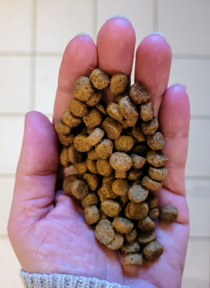
Common rules – Veterinary prescription
Common rules
Veterinary prescriptions in relation to medicated feed (1/2)
Reg.(EU) 2019/4
Article 16
Medicated feed (animal feed mixed with medicines by feed business operator) requires:
a veterinary prescription
can only be issued after clinical examination or any other proper assessment of the health status of the animals
only for diagnosed diseases (except for vaccines and parasitics)
Watch out for interactions with other medications!
Notes:
1. The supply of medicated feed to animal keepers shall be subject to:
(a) the presentation and, in case of manufacturing by on-farm mixers, the possession of a veterinary prescription for medicated feed; and
(b) the conditions laid down in paragraphs 2 to 10.
2. A veterinary prescription for medicated feed shall be issued only after a clinical examination or any other proper assessment of the health status of the animal or group of animals by a veterinarian and only for a diagnosed disease.
3. By way of derogation from paragraph 2, a veterinary prescription for medicated feed containing immunological veterinary medicinal products may be issued also in the absence of a diagnosed disease.
4. By way of derogation from paragraph 2, if it is not possible to confirm the presence of a diagnosed disease, a veterinary prescription for medicated feed containing antiparasitics without antimicrobial effects may be issued based on
the knowledge of the parasite infestation status in the animal or group of animals.

Slide 8
Common rules – Veterinary prescription
Common rules
Veterinary prescriptions in relation to medicated feed (2/2)
Reg.(EU) 2019/4
Article 16
Record keeping: Veterinary prescriptions should be kept by feed mill and the veterinarian prescribing & animal keeper for 5 years
1 prescription = 1 veterinary treatment
Maximum duration of treatment: 2 weeks for antibiotics, 1 month for other medicines
Validity prescription: max 5 days for feed with antimicrobial, max 3 weeks for other medicines for food-producing animals, rest 6 months
Notes:
6. The veterinary prescription for medicated feed shall contain the information set out in Annex V. The original veterinary prescription for medicated feed shall be kept by the manufacturer or, where appropriate, the feed
business operator supplying the medicated feed to the animal keeper. The veterinarian, or the professional person referred to in paragraph 5, issuing the prescription and the keeper of food-producing or fur animal shall keep a copy of the veterinary prescription for medicated feed. The original and copies shall be kept for five years from the date of issuance.
7. With the exception of medicated feed for non-food-producing animals, other than fur animals, medicated feed shall not be used for more than one treatment under the same veterinary prescription for medicated feed.
The duration of a treatment shall comply with the summary of product characteristics of the veterinary medicinal product incorporated in the feed and, where not specified, shall not exceed one month, or two weeks in case of a medicated feed
containing antibiotic veterinary medicinal products.
8. The veterinary prescription for medicated feed shall be valid from the date of its issuance for a maximum period of six months for non-food-producing animals other than fur animals and three weeks for food-producing animals and fur
animals. In the case of medicated feed containing antimicrobial veterinary medicinal products, the prescription shall be valid from the date of its issuance for a maximum period of five days.
9. The veterinarian issuing the veterinary prescription for medicated feed shall verify that that medication is justified for the target animals on veterinary grounds. Furthermore that veterinarian shall ensure that the administration of the
veterinary medicinal product concerned is not incompatible with another treatment or use and that there is no contraindication or interaction where several medicinal products are used. In particular, the veterinarian shall not prescribe
medicated feed with more than one veterinary medicinal product containing antimicrobials.
10. The veterinary prescription for medicated feed shall:
(a) comply with the summary of the product characteristics of the veterinary medicinal product, except for veterinary
medicinal products intended to be used in accordance with Article 112, Article 113 or Article 114 of Regulation (EU)
2019/6;
(b) indicate the daily dose of the veterinary medicinal product which is to be incorporated in a quantity of medicated feed
that ensures the uptake of the dosage by the target animal considering that the feed uptake of diseased animals might
differ from a normal daily ration;
(c) ensure that the medicated feed containing the dosage of the veterinary medicinal product corresponds to at least 50 %
of the daily feed ration on a dry matter basis and that, for ruminants, the daily dose of the veterinary medicinal
product is contained in at least 50 % of the complementary feed except for mineral feed;
(d) indicate the inclusion rate of the active substances, calculated on the basis of the relevant parameters.
11. Veterinary prescriptions for medicated feed issued in accordance with paragraphs 2, 3 and 4 shall be recognized throughout the Union.
12. The Commission may, by means of implementing acts, set a model format for the information set out in
Annex V. That model format shall also be made available in electronic version. Those implementing acts shall be
adopted in accordance with the examination procedure referred to in Article 21(2).

Slide 9

LITHUANIA
specifications

Slide 10


Veterinary Medicines Law, 01/11/2022
Common rules
Scope
Prepared according to Regulation (EU) 2019/6
In force from 01/11/2022
Requirements for authorisation, placing on the market, parallel trade, advertising, use of VMPs, issuance of manufacturing, import, wholesale distribution and retail authorisations
Includes national provisions (more flexible or stricter requirements) foreseen in Regulation (EU) 2019/6

Slide 11

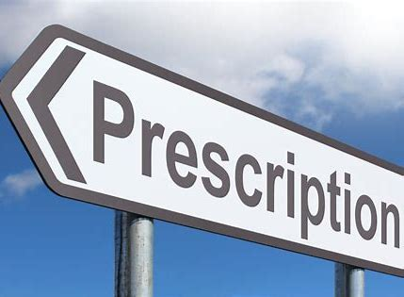
Veterinary Medicines Law, 01/11/2022
Common rules
Veterinary prescription
Article 17
Prescription:
Issued by veterinary service provider or by a veterinarian employed by animal keeper
For only one VMP
VMPs are purchased from veterinary pharmacies
Ordering:
Issued by veterinarian of the keeper of the animal for the treatment of animals kept by that keeper
For more than one VMP
VMPs are purchased from veterinary pharmacies or wholesale distributors

Slide 12
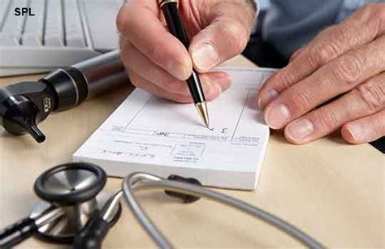
Rules on veterinary prescriptions and orderings for veterinary medicinal products, 15/02/2024
Common rules
Veterinary prescription
Paper form untill 31/12/2025
Electronic form from 01/01/2026
New definition: „ordering for veterinary medicinal products“ means a document in the prescribed form drawn up by a veterinary surgeon employed by the keeper of the animals on the basis of which the keeper of the animals purchases veterinary medicinal products

Slide 13
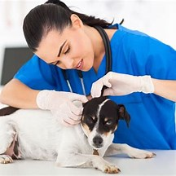
Rules on veterinary prescriptions and orderings for veterinary medicinal products, 15/02/2024
Common rules
Veterinary prescription
Prescription can be issued only by veterinarian who:
              possess valid licence for veterinary practice and
is registered as veterinary service provider or
is employed by veterinary service provider or animal keeper
Orderings can be issued only by veterinarian who:
possess valid licence for veterinary practice and
is employed by animal keeper

Slide 14
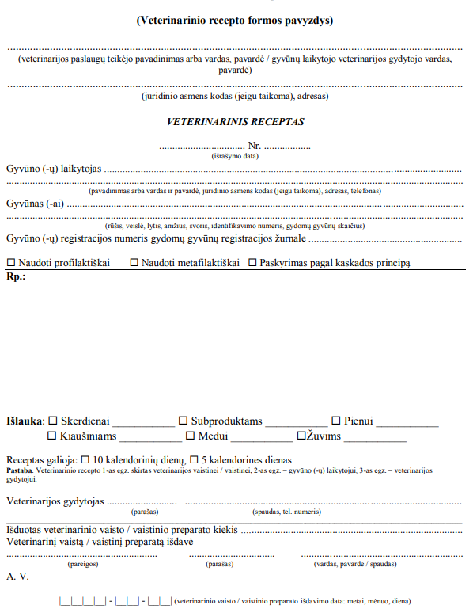
National legislation
Common rules
Veterinary prescription form
Not valid, when are not properly filled in (not clearly filled-in, corrected, not signed or stamped, scanned, photographed or otherwise copied) or have been issued by a veterinarian who is not authorised to issue them.
No prescription can be issued by veterinary service provider for VMP, which is intended for the veterinarian's exclusive use only (according PL)

Slide 15
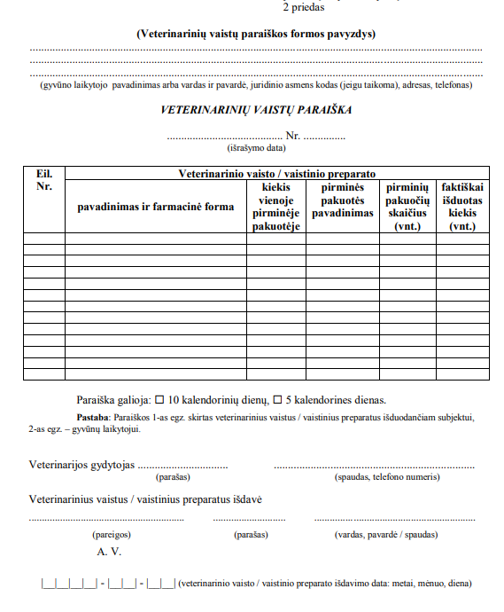
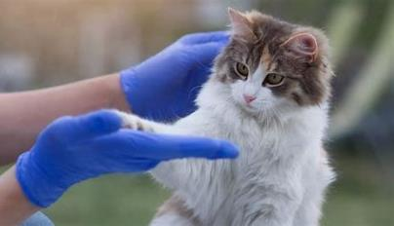


National legislation
Common rules
Ordering form

Slide 16
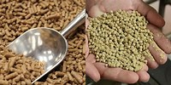
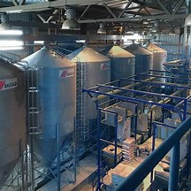
National situation
Common rules
Medicated feed
  Approval of feed business operators producing medicated feed:
  Responsibility – Centralised Authorisation Division, SFVS
  Requirements – Feed hygiene regulation 183/2006 and Medicated feed regulation 2019/4
0 approvals

Slide 17
Thank you

