Slide 1
SUCCESSFUL CASES OF CATTLE MASTITIS TREATMENT BASED ON LABARATORY TESTS
Private veterinarian Virginijus Kanapė
Presented by: private veterinarian Paulina Urbutė

Slide 2
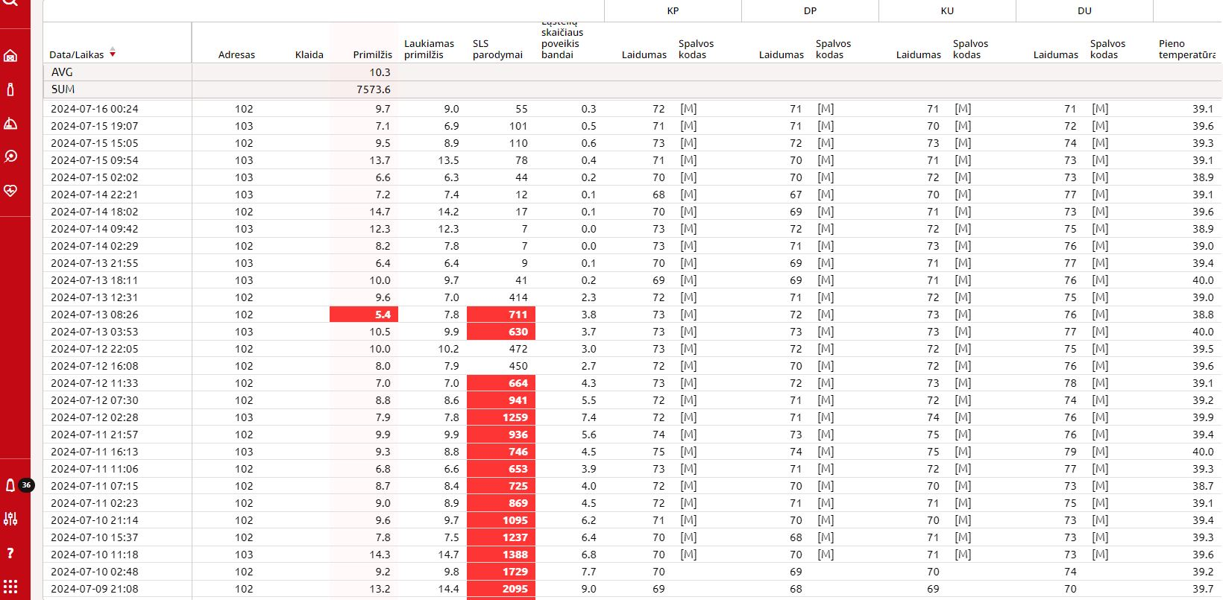
MASTITIS CASE NO.1

Slide 3
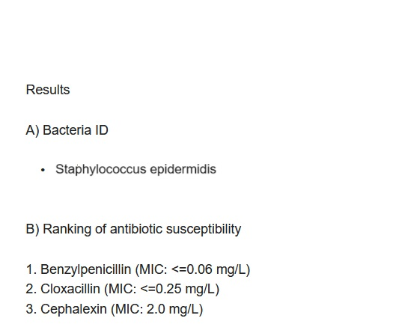
MASTITIS CASE nO.1: TEST RESULTs

Slide 4
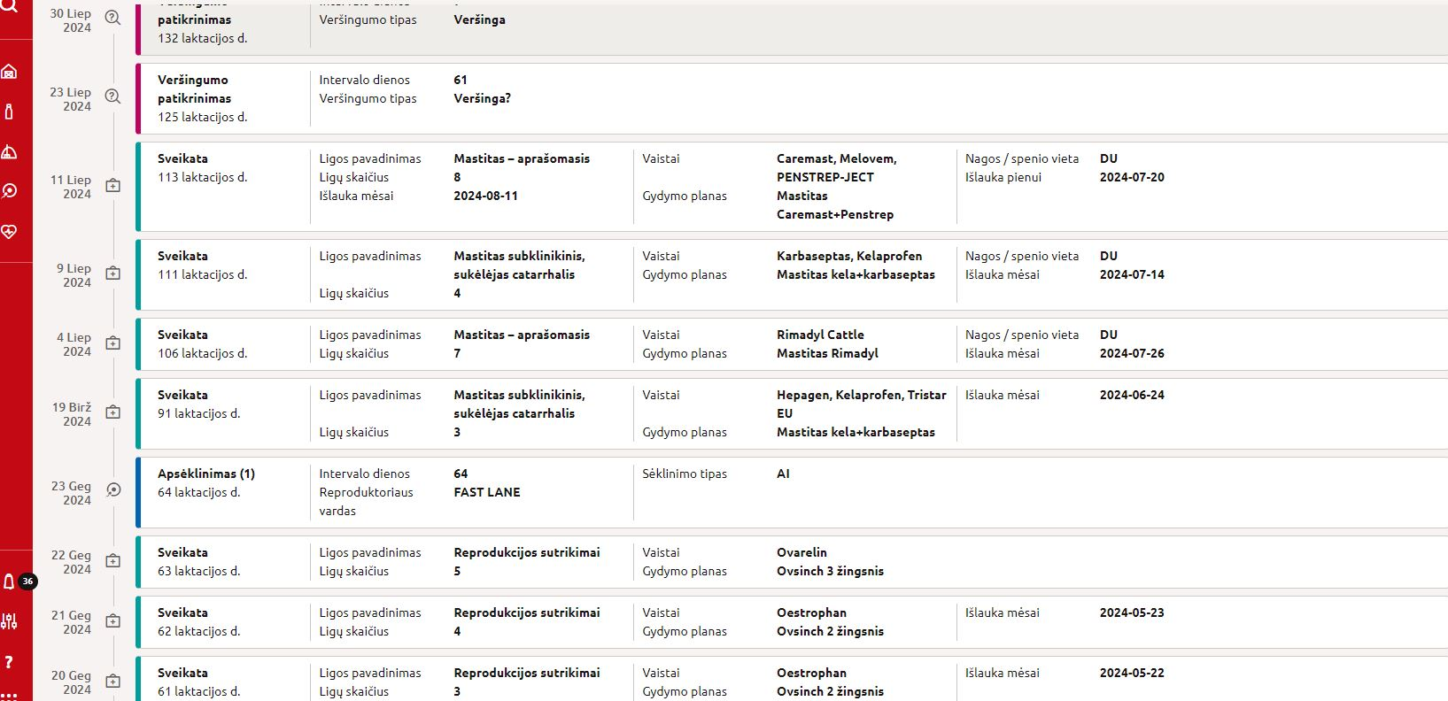
MASTITIS CASE NO.1: TREATMENT

Slide 5
MASTITIS CASE NO.1: TREATMENT

Slide 6
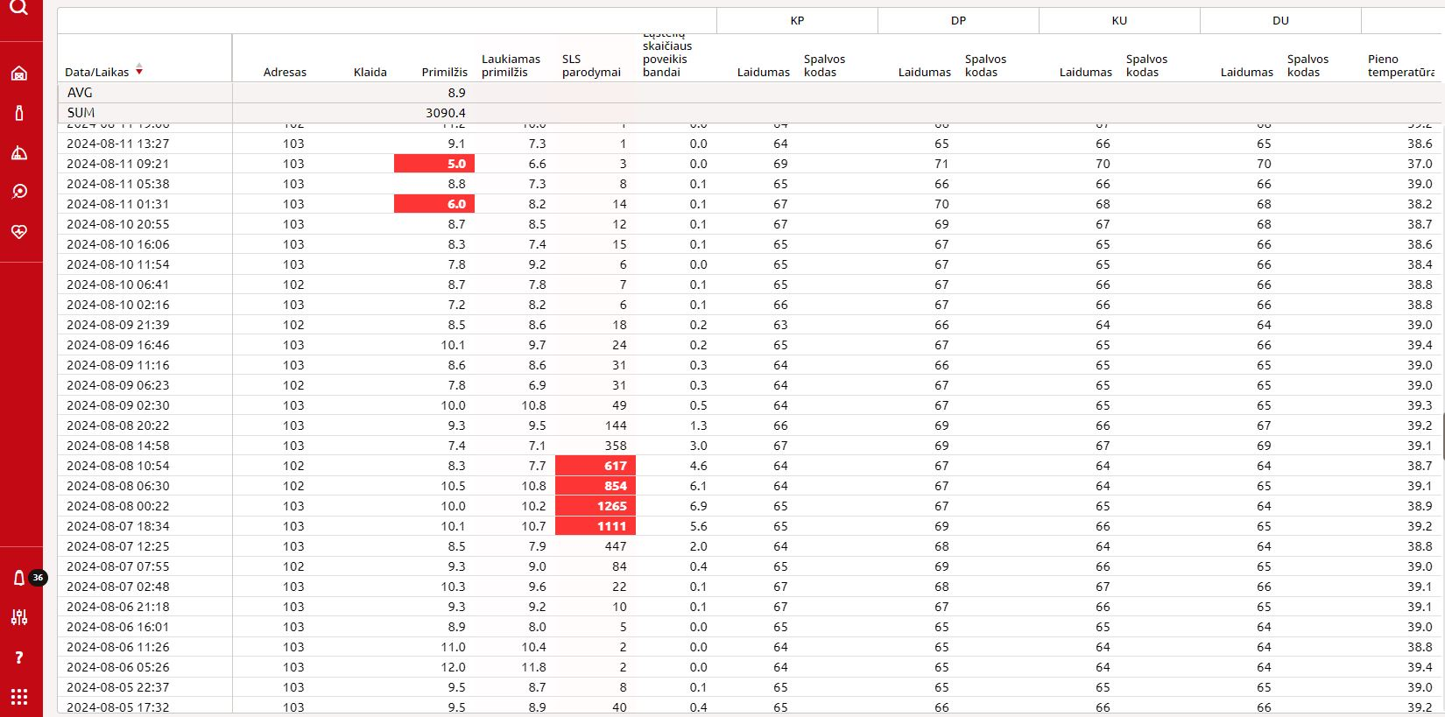
MASTITIS CASE NO.2 (SUBCLINICAL)

Slide 7
MASTITIS CASE NO.2 : TEST RESULTs

Slide 8
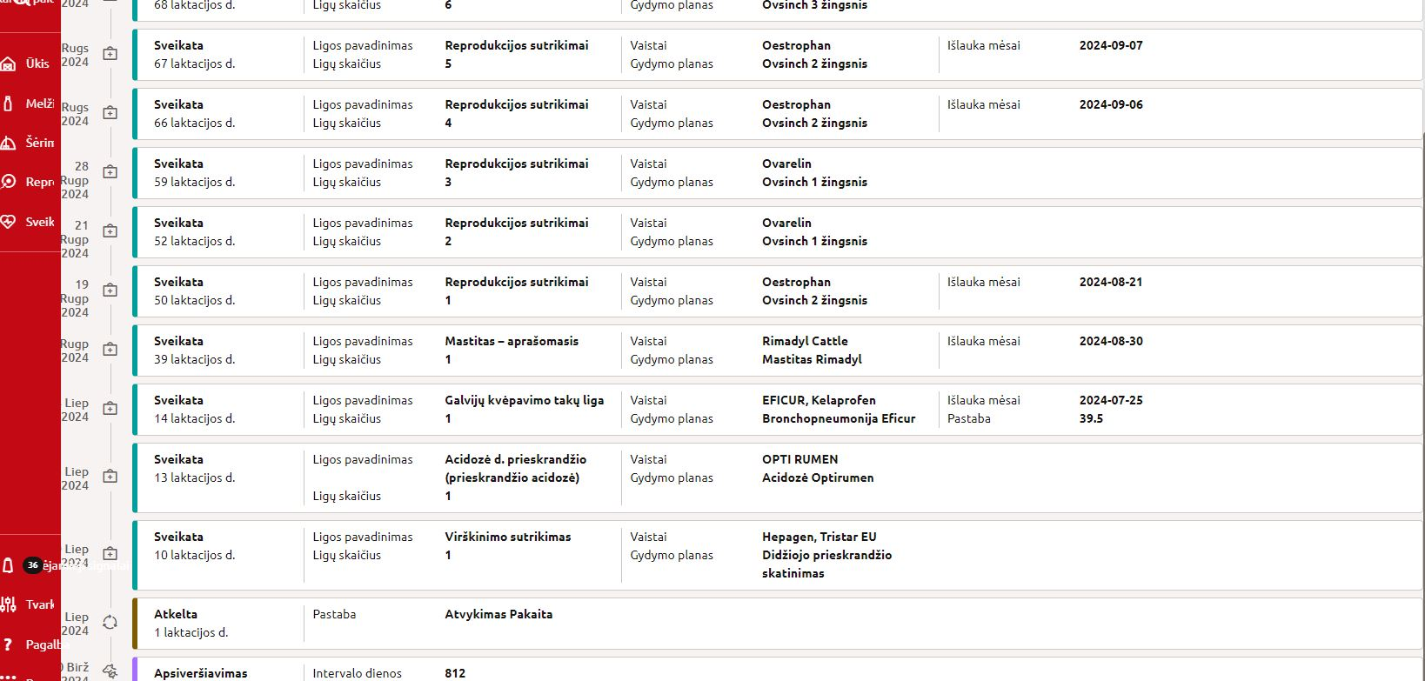
MASTITIS CASE NO. 2 : TREATMENT

Slide 9
MASTITIS CASE NO. 2 : TREATMENT

Slide 10
THANK YOU FOR YOUR ATTENTION!

