Slide 1
POLAND
21 & 22 OCTOBER 2024

Slide 2
Additional relevant legislation, provisions and/or guidelines to be considered by veterinarians & farmers (II) Lecture 4
POLAND 21 & 22 OCTOBER 2024

Slide 3
EU legal framework on veterinary medicinal products/medicated feed
Regulation (EU) 2019/6 on Veterinary Medicinal Products
Regulation (EU) 2019/4 on Medicated Feed
+ Implementing and delegating Acts

Slide 4
Use of Antimicrobial Veterinary Medicinal Products
EU legislative framework: Regulation (EU) 2019/6 on VETERINARY MEDICINAL PRODUCTS (VMP)
Supporting prudent use and preserving efficacy
antimicrobials or groups of antimicrobials reserved for treatment of certain infections in humans.
!Article 37 (5)
“humans reserve list”
List of antimicrobials which:
are not to be used in accordance with Articles 112, 113 and 114; or
(b) are only to be used in accordance with Articles 112, 113 and 114 subject to certain conditions.
!Article 107 (6)
“ use of AM outside the marketing authorisation”

Slide 5
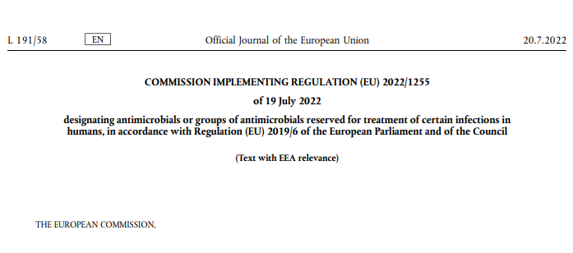
Use of Antimicrobial Medicinal Products
The human reserve list: antimicrobials which are reserved for treatment of certain infections in humans
“reserve list”
The antimicrobials and group of antimicrobials listed in this Regulation cannot be used in veterinary medicinal products.
VMP containing antimicrobials listed in this Regulation cannot be used in medicated feed
The list of antimicrobials or groups of antimicrobials to be reserved for treatment of certain infections in humans should be kept under continual review in the light of new scientific evidence or emerging information
Commission Implementing Regulation (EU) 2022/1255

Slide 6
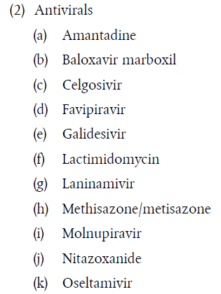
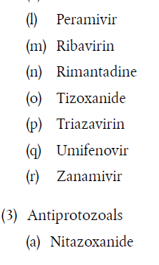
Use of Antimicrobial Medicinal Products
“human reserve list”
Supporting prudent use and preserving efficacy
Commission Implementing Regulation (EU) 2022/1255

Slide 7


Upcoming Delegated and Implementing Legal Acts
List of antimicrobials which shall not be used in accordance with article 112-114 (outside marketing authorisation) or only subject to certain conditions
List of substances authorised for use in food-producing terrestrial animal species or substances contained in a medicinal product for human use authorised in the Union, which may be used in food-producing aquatic species in accordance with Article 114(1)
List of substances which are essential for the treatment of equine species, or which bring added clinical benefit compared to other treatment options available for equine species and for which the withdrawal period for equine species shall be six months.
More info on all delegated and implementing Acts:
https://food.ec.europa.eu/animals/animal-health/vet-meds-med-feed/implementation_en

Slide 8
Use of Antimicrobial Veterinary Medicinal Products
List of antimicrobials which shall not be used outside marketing authorisation
!Article 107(6)
List of antimicrobials which:
  are not to be used in accordance with Articles 112, 113 and 114; or
  are only to be used in accordance with Articles 112, 113 and 114 subject to certain conditions.
“use of AM outside
the marketing authorisation”
Notes:
IF RUNNING OUT OF TIME, THIS SLIDE CAN BE HIDDEN

Slide 9

Upcoming Acts
List of antimicrobials that may be used for food-producing aquatic species
!Article 114
The Commission is to establish, by means of implementing acts, a list of substances used in veterinary medicinal products authorised in the Union for use in food-producing terrestrial animal species or substances contained in a medicinal product for human use authorised in the Union in accordance with Directive 2001/83/EC or Regulation (EC) No 726/2004, which may be used in food-producing aquatic species in accordance with Article 114(1).
Notes:
IF RUNNING OUT OF TIME, THIS SLIDE CAN BE HIDDEN

Slide 10

Upcoming Acts
List of antimicrobials for specific species (equine species)
In 2006 and 2013, the Commission published a list of substances essential for the treatment of Equidae ((EC) CR 1950/2006 & R 122/2013 )
The Commission is now updating the list of substances which are essential for the treatment of equine species, or which bring added clinical benefit compared to other treatment options available for equine species and for which the withdrawal period for equine species shall be six months.
On 9 February 2023, the European Medicines Agency received from the European Commission a request to provide scientific advice for the establishment this list of substances and they are currently preparing an answer.
Notes:
IF RUNNING OUT OF TIME, THIS SLIDE CAN BE HIDDEN

Slide 11
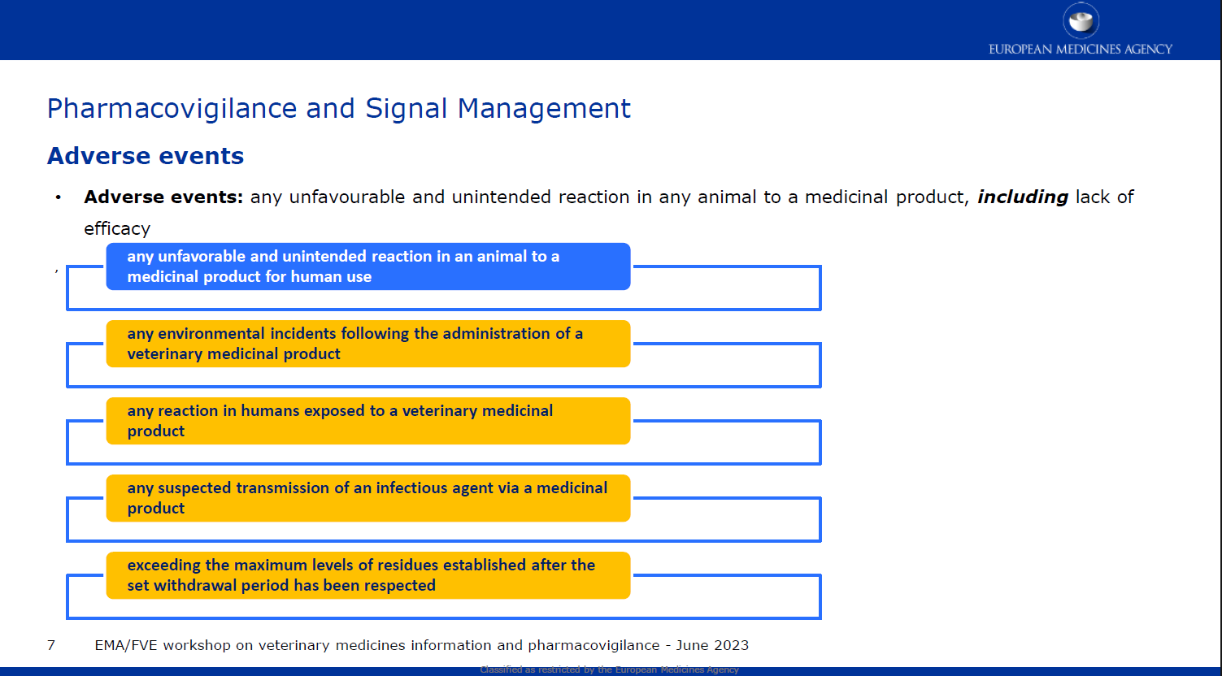
Reporting adverse events (pharmacovigilance)
Do not forget to report adverse events including lack of efficacy!

Slide 12
Disposal of Veterinary Medicine
How and where does pharmaceutical waste occur?
Immediate packaging and the remains of medicines within after use.
VMP or MF that are past their expiry date or that have not been stored in accordance with the instructions.
Prescription of a quantity exceeding the required quantity or uncompleted course of treatment due to either administration difficulties, adverse reactions, change in treatment or because animals died during treatment.
FACTSHEET_PharmaceuticalWasteDisposal.pdf (epruma.eu)

Slide 13
Disposal of Veterinary Medicine
Best practices for disposal
PharmaceuticalWasteDisposal.pdf (epruma.eu)
Everybody (prescribers and users) is responsible for minimising pharmaceutical waste.
Disposal of pharmaceutical waste via waterways should be excluded.
Pharmaceutical waste should be stored in a dedicated container, bin, or facility to ensure adequate protection to animal health, human health, feed, food and the environment and this must be separated from any stocks of veterinary medicines to ensure that the waste cannot be inadvertently used.
Waste must be disposed of in accordance with the Summary of Product Characteristics (SPC) and the waste legislation and national systems developed in consultation with all parties for the collection, transport, and disposal of the waste.
Member States shall ensure that appropriate collection or discard systems are in place for waste veterinary medicinal products (including medicated feed) and to ensure that the location of collection or discard points as well as other relevant information is made available to farmers, animal keepers, veterinarians, and other relevant persons.

Slide 14

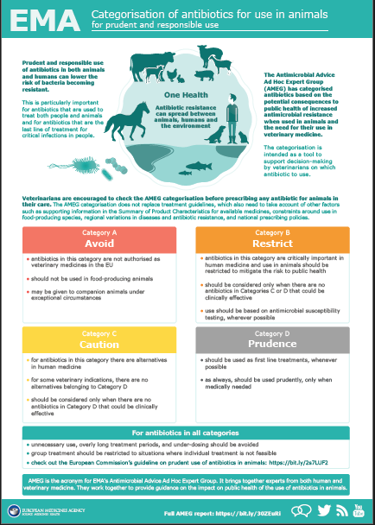
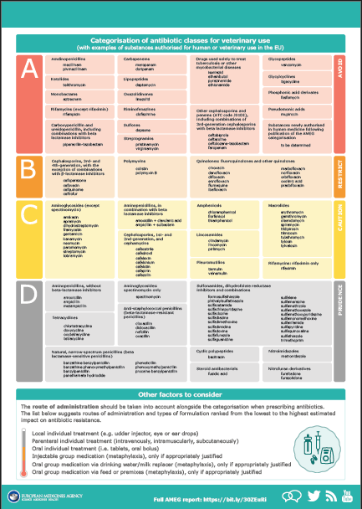
Other considerations for prescriptions

Slide 15
Prudent Use Guidelines
Not legally binding as the previous acts/provisions!
Guideline for the prudent use of
antimicrobials in veterinary medicine 2015/C 299/04​
https://health.ec.europa.eu/system/files/2016-11/2015_prudent_use_guidelines_en_0.pdf
Best-practice framework for the use of antimicrobials in food-producing animals in the EU - Reaching for the next level.
https://epruma.eu/home/best-practice-guides/best-practice-framework-for-the-use-of-antimicrobials-in-food-producing-animals-in-the-eu-reaching-for-the-next-level/

Slide 16
Animal Health Law (Regulation (EU) 2016/429 on transmissible animal disease)
“Prevention is better than cure”
Preventive driven approach:
improvement of animal health and biosecurity measures, good farming practices
Clear responsibility for all players for animal health
  Operators → ensure a high level of animal health and welfare, and biosecurity
  Vets → raise awareness and help in the prevention and spread of pathogens
  CA → protect animal health, human
  health and environment
Prioritising EU intervention
Regulatory tools/interventions for resistant pathogens: "disease agents“
Disease preventive and control measures may apply (surveillance, eradication etc.)
Legal basis monitoring AMR in animal pathogens

Slide 17

POLAND
specifications

Slide 18
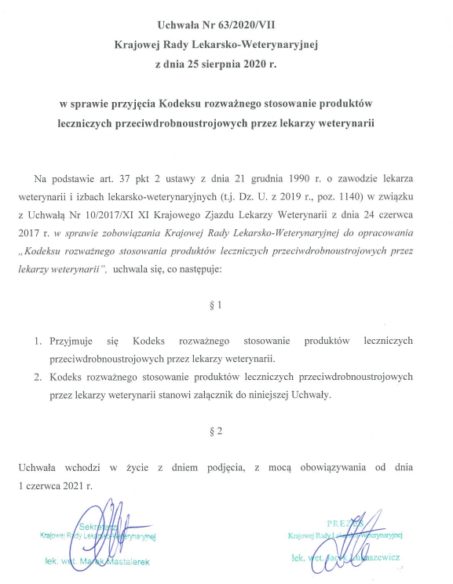
POLAND – national provisions
Zasady ogólne
Regulation (UE) 2019/6
CODE OF THE PRUDENT USE OF ANTIMICROBIAL MEDICINAL PRODUCTS BY VETTERINARIANS
Resolution No. 63/2020/VII of the National Veterinary Medical Council of August 25, 2020
https://vetpol.org.pl/wp-content/uchwaly/VII_kadencja/Kodeks_stosowania_antybiotyk%C3%B3w.pdf
Poultry
Pigs
Cattle
Horses
Rabbits
Companion animals
-> Categorization of antibiotics for use in animals according to: EMA

Slide 19
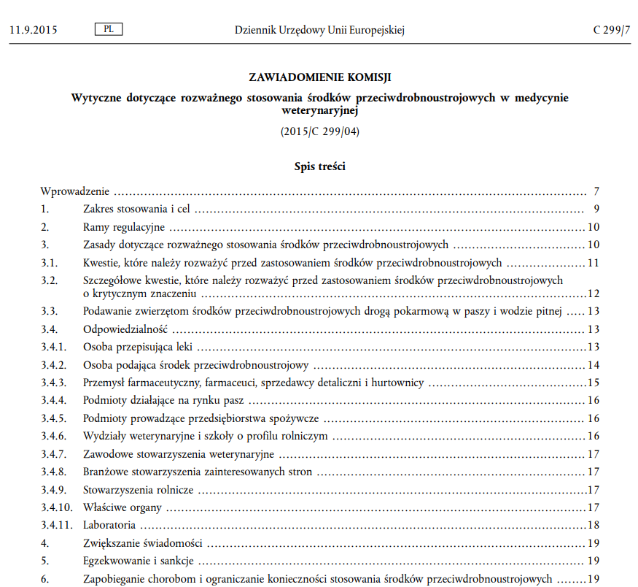
POLAND – national provisions
Zasady ogólne
Regulation (UE) 2019/6
Commission Notice — Guidelines for the prudent use of antimicrobials in veterinary medicine
(2015/C 299/04)
https://health.ec.europa.eu/document/download/190841e8-5975-4390-a304-908c259592ab_pl?filename=2015_prudent_use_guidelines_pl.pdf

Slide 20
POLAND – national provisions
Zasady ogólne
Regulation (UE) 2019/6
Provisions taking into account the provisions contained in Regulation (EU) 2019/6
Act of June 23, 2022 amending the Act on Veterinary Inspection and certain other acts (Journal of Laws of 2022, item 1570)
Act of August 5, 2022 amending the Act on the professions of nurse and midwife and certain other acts (Journal of Laws 2022, item 1733)
Act of November 4, 2022 on the animal identification and registration system (Journal of Laws 2022, item 2727)
Notes:
Some of the provisions contained in Regulation (UE) 2019/6 are reflected in other laws.
There is no Act related to the Regulation introducing a single act into the legal order regulating the issues of veterinary medicinal products.
Work on it is ongoing.

Slide 21
POLAND – national provisions
Zasady ogólne
Regulation (UE) 2019/6
Act of June 23, 2022 amending the Act on Veterinary Inspection and certain other acts (Journal of Laws of 2022, item 1570)
https://isap.sejm.gov.pl/isap.nsf/download.xsp/WDU20220001570/T/D20221570L.pdf
The main purpose of the Act is to define tasks and competences in relation to the implementation of obligations arising from Regulation 2017/625
Additionally, the Act aims to facilitate the collection of data by the Veterinary Inspection on the use of antimicrobial medicinal products.
Purpose: Regulation 2019/6", in Art. Article 57 requires Member States of the European Union (EU) to collect data on antimicrobial medicinal products used in food-producing animals at farm level.
Intended effect: to enable direct or indirect evaluation of the use of antimicrobial medicinal products in animals
Notes:
1. The data obtained so far concerned the sales volume of antimicrobial agents and came from pharmaceutical wholesalers of veterinary medicinal products.
2. Regulation 2019/6", in art. Article 57 requires Member States of the European Union (EU) to collect data on antimicrobial medicinal products used in food-producing animals at farm level.
3. Intended effect: to enable direct or indirect evaluation of the use of antimicrobial medicinal products in animals
4. Data collection at Union level is intended to identify trends and identify possible risk factors that may lead to the development of measures to reduce the risks of antimicrobial resistance and reduce their use.
5. Being aware of the risks associated with irresponsible use of these agents, efforts should be made to reduce their use and the phenomenon of antibiotic resistance.
Such actions will mean improving the safety of Polish food for consumers and increasing its competitiveness.

Slide 22
POLAND – national provisions
Zasady ogólne
Regulation (UE) 2019/6
Act of August 5, 2022 amending the Act on the professions of nurse and midwife and certain other acts (Journal of Laws 2022, item 1733)
https://isap.sejm.gov.pl/isap.nsf/DocDetails.xsp?id=WDU20220001733
Purpose: The purpose of the Act is, among others, creation of national regulations of competence for the authorities responsible for marketing authorization and supervision of the production, trade and use of veterinary medicinal products.
Intended effect:
Use in the manufacturing process only of active substances from registered suppliers (manufacturers, importers and distributors of active substances).
Polish entrepreneurs conducting business in the field of production, import and distribution of active substances used to produce veterinary medicinal products will be able to sell substances to entrepreneurs located in other European Union Member States.
Notes:
New provisions in the Act regarding the provisions regulating the competences of the authorities competent for marketing authorization and supervision over the production, trade and use of WPL
They impose an obligation to register manufacturers of veterinary medicinal products will be able to fulfill their obligation specified in Art. 93 of Regulation 2019/6, which involves using only active substances from registered suppliers (manufacturers, importers and distributors of active substances) in the manufacturing process.
At the same time, it should be emphasized that thanks to the above regulation, Polish entrepreneurs operating in the field of production, import and distribution of active substances used to produce veterinary medicinal products will be able to sell substances to entrepreneurs located in other European Union Member States.

Slide 23
POLAND – national provisions
Zasady ogólne
Regulation (UE) 2019/6
Act of November 4, 2022 on the animal identification and registration system
(Journal of Laws 2022, item 2727)
https://isap.sejm.gov.pl/isap.nsf/DocDetails.xsp?id=WDU20220002727
Objective: the need to introduce new European Union regulations into the Polish legal system regarding the identification and registration of animals in relation to the identification and registration of equidae and specifying templates of identification documents for these animals
Intended effect: changing the content and format of information necessary to apply Art. 112 section 4 and art. 115 section 5 to be included in the unique lifetime identification document

Slide 24
POLSKA – przepisy uzupełniające
Zasady ogólne
Rozporządzenie (UE) 2016/4296
Draft animal health act
Regulation (EU) 2016/429 of the European Parliament and of the Council of 9 March 2016 on transmissible animal diseases and amending and repealing certain acts in the field of animal health ("Animal Health Law") (OJ L 84, 31/03/2016, page 1, as amended)
https://legislacja.rcl.gov.pl/projekt/12385701/katalog/13061607#13061607
Project: In art. 54 section 5 of the draft act introduces provisions that implement the obligations arising from the European Green Deal and the Farm to Fork Strategy, which indicate as a goal to be achieved by 2030 a 50% reduction in the use of antimicrobials for animals kept on farms and in the field of aquaculture, and the fact that Poland as one of the leaders in the sale of veterinary medicinal products indicates the need to undertake and coordinate actions on many levels.
Purpose: introducing, publishing and implementing by 1 March 2024 a national action plan to combat antimicrobial resistance based on the One Health approach.
Intended effect: reducing increased antimicrobial resistance through their appropriate use in both human and veterinary medicine
Notes:
The threat of antibiotic resistance is serious. If no further action is taken, it is predicted that the global death toll from antimicrobial resistance could reach over 10 million per year by 2050, which is more than the expected number of deaths from cancer and diabetes combined, which could result in catastrophic economic damage.

