Slide 1
DG Health and Food Safety (DG SANTE) Health and food audits and analysis
DG SANTE Directorate F
AMR related work
AMRFV Hands-on training – 21 & 22 October 2024, Warsaw
Iwona Decewicz, SANTE F, unit F5, auditor/project leader:
ECDC/DG SANTE AMR One Health joint country visits

Slide 2
WHO is SANTE F?
SANTE F: Part of DG SANTE (Ireland)
2024 July-December: Work Programme now published
89785009-d5e6-45ad-b92c-b58f57e3685b_en (europa.eu)
Health and food audits and analysis:
Unit F5: Health Protection

Slide 3
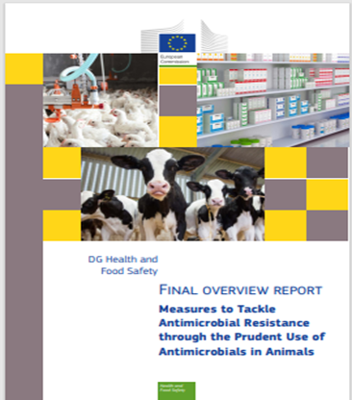
F5 AMR work streams (previous)
Fact finding missions on prudent use of antimicrobials in animals
(2016, 2019) – 2 overview reports
Overview report on non-EU
Countries Policies
and measures
(2017)
Review of National Action Plans (2022) – overview report (One Health perspective)
All reports published on Food Audits and Analysis | Food Safety (europa.eu)

Slide 4
F5 AMR work streams (current)
One Health country visits with ECDC (Member States) and ECDC and EFSA (Western Balkans)
Audits: monitoring of AMR in certain foods of animal origin and food-producing animals
Audits: controls on Veterinary Medicinal Products (scope limited to AMR related issues in veterinary settings)

Slide 5
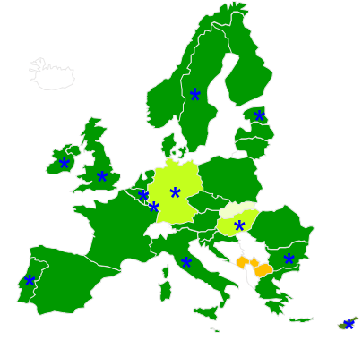
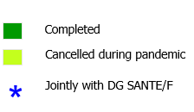
AMR One Health Joint Country Visits
Objective: to support the development and/or review of national AMR strategies
Developed from:
ECDC country visits (large coverage in EU)
SANTE prudent use fact-finding missions (but
more ‘strategy orientated’)
environmental aspects also covered
SANTE F & ECDC joint visits since 2017
In EU: carried out on invitation only.
Team composition: ECDC & SANTE F
representatives supported by National Experts
9 Member States visited so far
New, since 2023 and ongoing: 3 EU- candidate countries with ECDC, ECDC contractor, EFSA and National Experts

Slide 6
Audits: AMR monitoring
Monitoring of AMR in certain foods of animal origin and food-producing animals
❖ Requirements of Commission Implementing Decision (EU) 2020/1729
In collaboration with EFSA regarding reported data.
2023: Ireland, Portugal, Malta and Croatia
2024: The Netherlands, Poland and Greece (some focus on larger importers )
Some challenges regarding representativeness of samples, e.g. late start in implementation of plans, sampling at BCPs

Slide 7
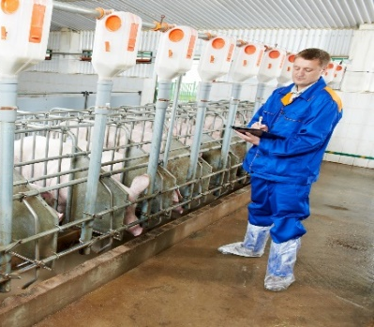
Audits: Regulation (EU) No 2019/6 on Veterinary Medicinal Products – focus on AMR
Objective: to assess official controls on certain provisions concerning antimicrobials (AM)
Focusing on aspects of which have an impact on AMR. For instance:
- use of AM for prophylaxis/metaphylaxis only under certain conditions
- no use of AM for growth promotion or to compensate for poor hygiene
- no use of AM in the reserve list
- record keeping requirements
2023: Denmark and Poland (link to the report)
https://ec.europa.eu/food/audits-analysis/audit-report/details/4754
2024: The Netherlands, Poland and Italy

Slide 8
Thank you!
Health and Food Safety audits video:
https://audiovisual.ec.europa.eu/en/video/I-131693

