Slide 1
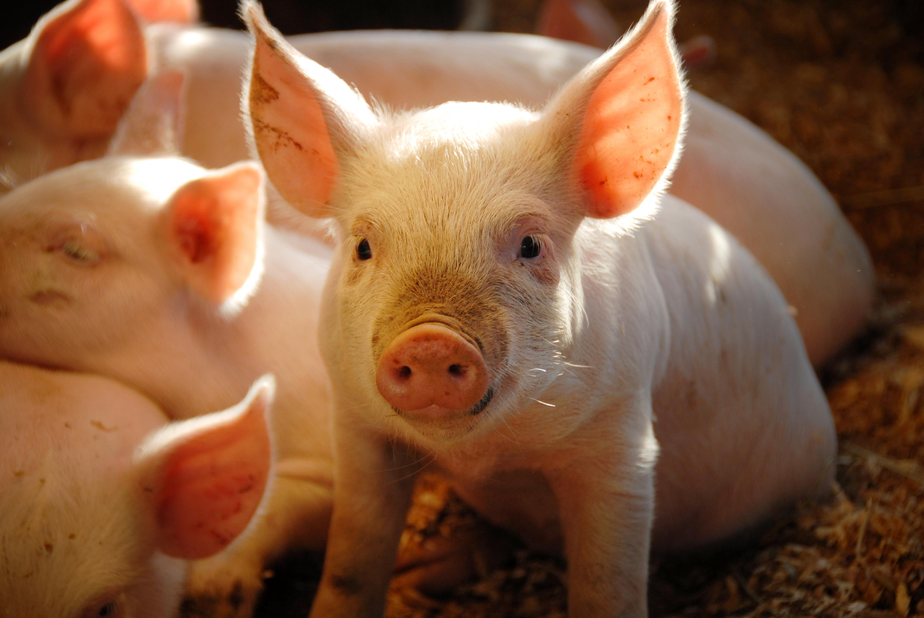


FARM HEALTH TEAM TOOLBOX: IMPROVE BIOSECURITY WITH YOUR MULTI-ACTOR FARM HEALTH TEAM
From the DISARM Project
Disseminating Innovative Solutions for Antibiotic Resistance Management

Slide 2
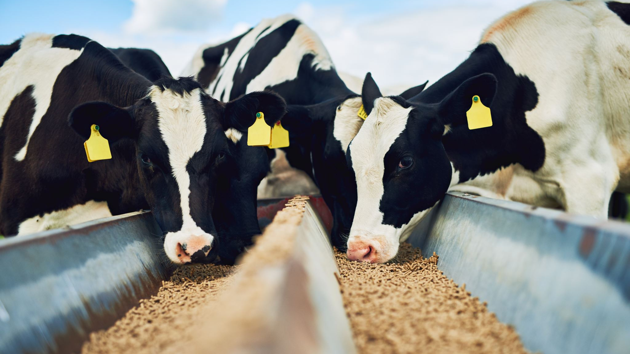
About the project
Platform that can be used by farmers, veterinarians, and other actors as a guide to optimize farm health planning using a Farm Health Team approach.
Working together as a team can be an efficient and proactive way to improve livestock health on a farm.

Slide 3
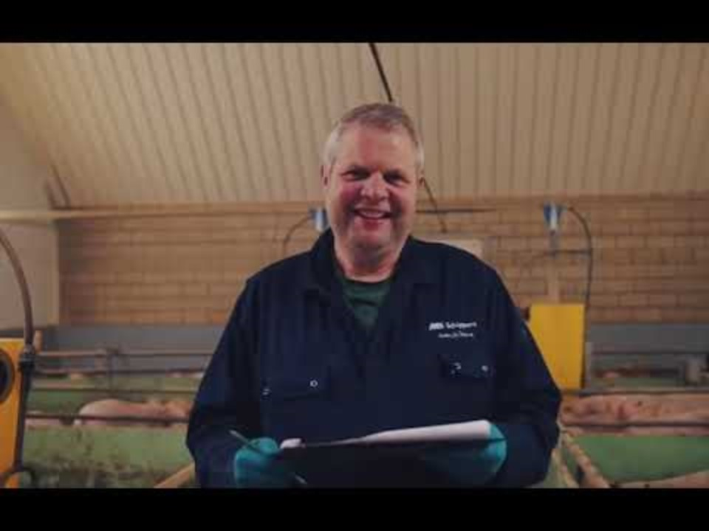
Achievements of the DISARM project

Slide 4
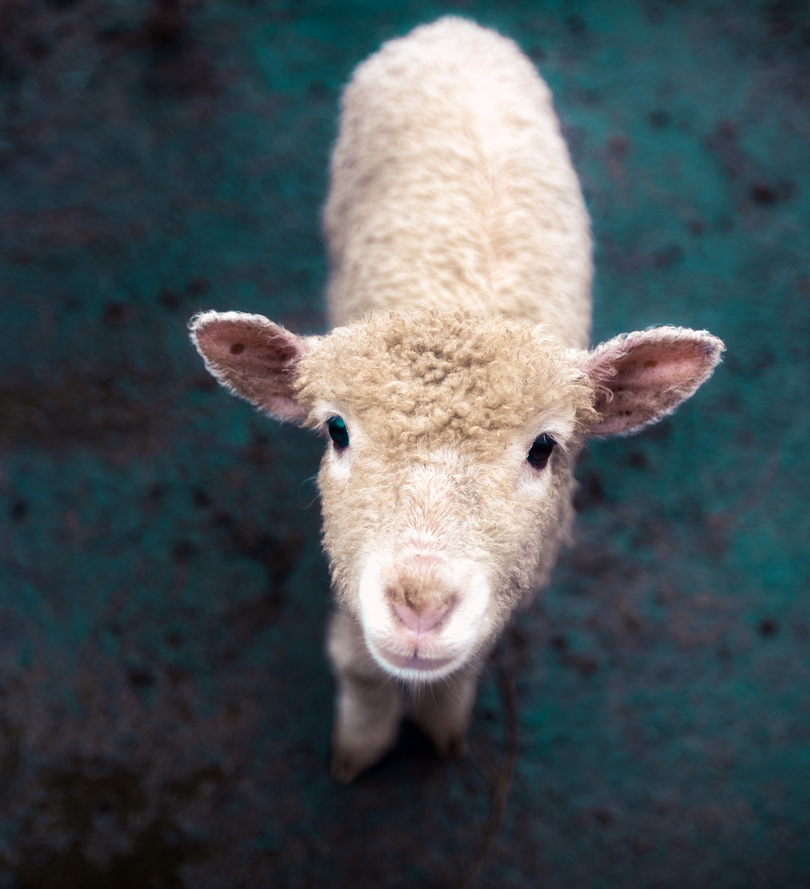
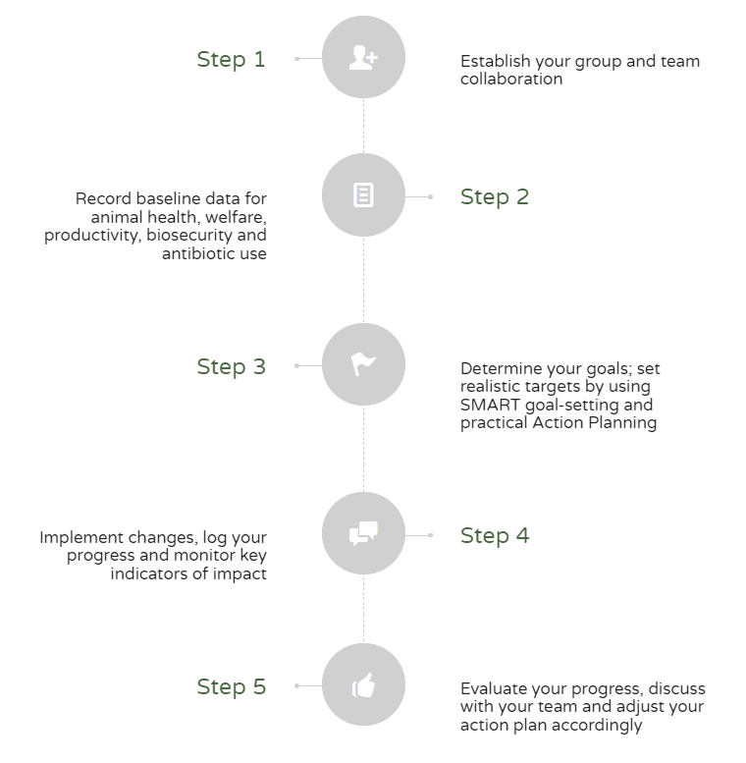
Set up your own Farm Health Team in Five Steps
Three persons know more than one
Coherent and streamlined advice in a tailor-made action plan
Shared ownership, motivation, and accountability from teamwork
Support for farmers from other team members in making the change
Farm Health Plan gives structure, traceability, and overview of progress

Slide 5
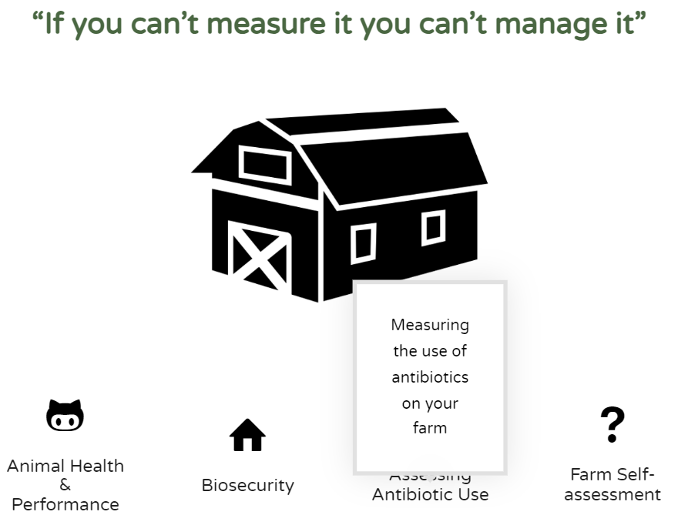
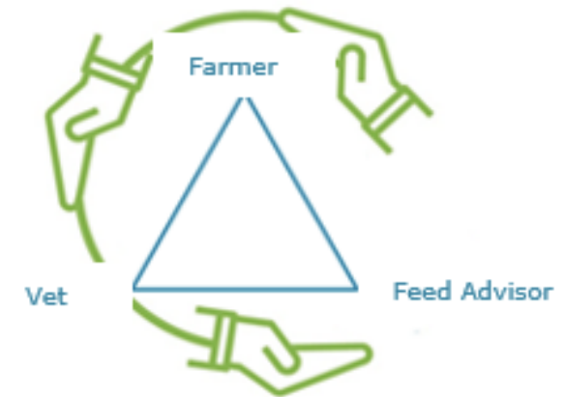
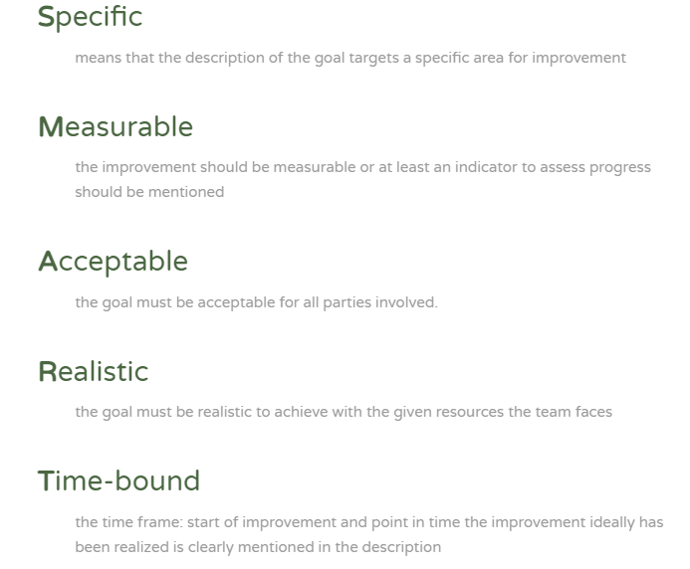
Let’s try it!
Step 1: Creating your team and successful collaboration
Step 2: Mapping your starting situation
Step 3: Design of the action plan
For example: My farm worker is going to order boots next Monday in sizes 36 to 46 so that all visitors will always use boots as soon as they visit the poultry houses.

Slide 6
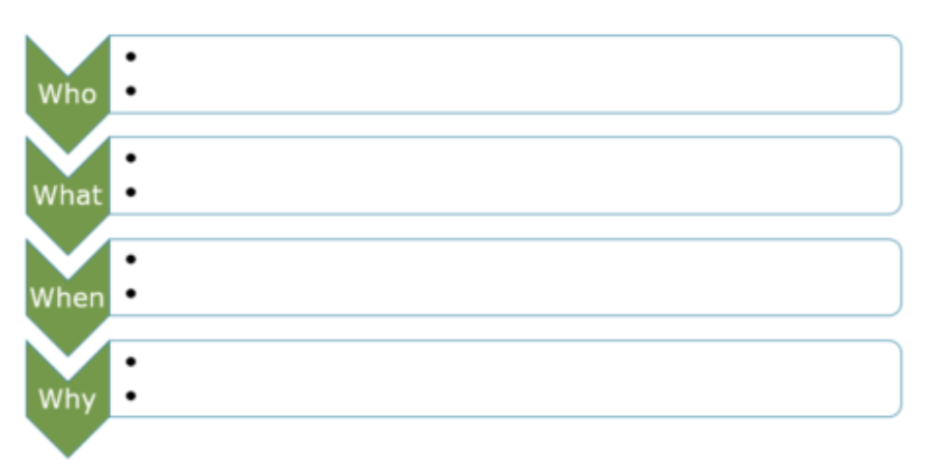

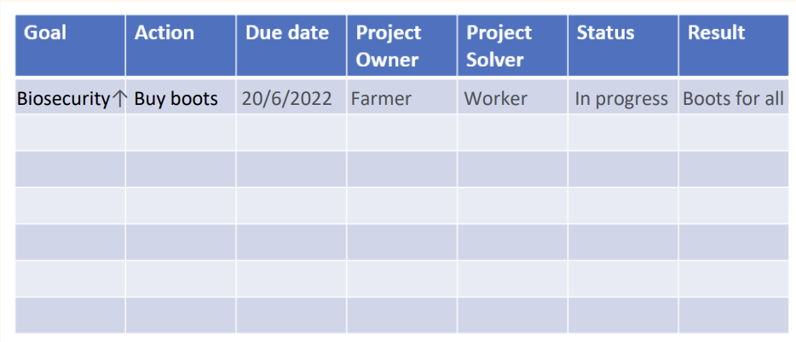
Let’s try it!
This template will help you to define who needs to take responsibility for what activity, when and why!
Step 4: Implement changes, log your progress, and monitor key indicators of impact (do)
  For example:
      Monday: order boots
      From week 28: I will check it all visitors always use boots as soon as they visit the poultry houses.
Step 5: Evaluate your progress, discuss with your team and adjust your plan accordingly (check + act)

Slide 7
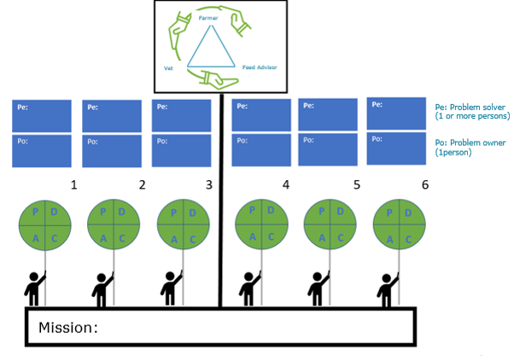
“Keep all the signs in the air!”
In the end….
Multiple SMART goals with corresponding “PlanDo-Check-Act (PDCA) circles” will be created by the Multi-Actor team to get closer to the mission (e.g. biosecurity compliance).
The circles influence the final mission, but often they also affect each other.
Consider the mission as an equilibrium bar on which the PCDA circles balance. If one circle does not go well, the mission will be unbalanced.

Slide 8
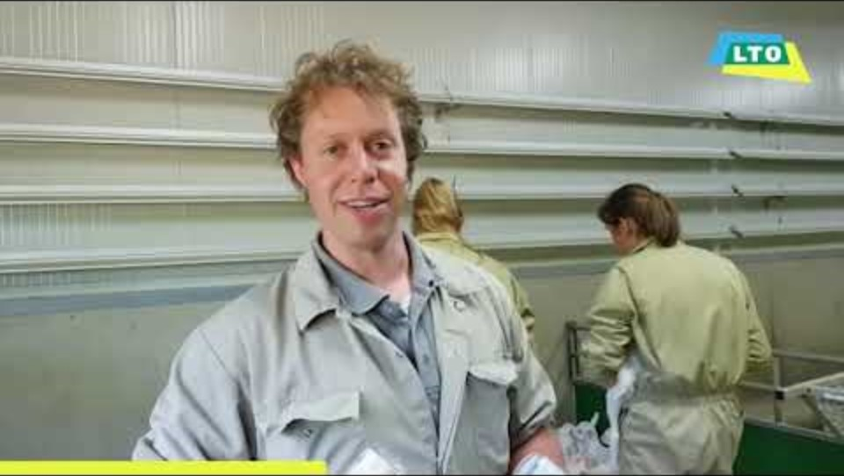
Practical video: Using a multi-actor plan on a goat farm

Slide 9
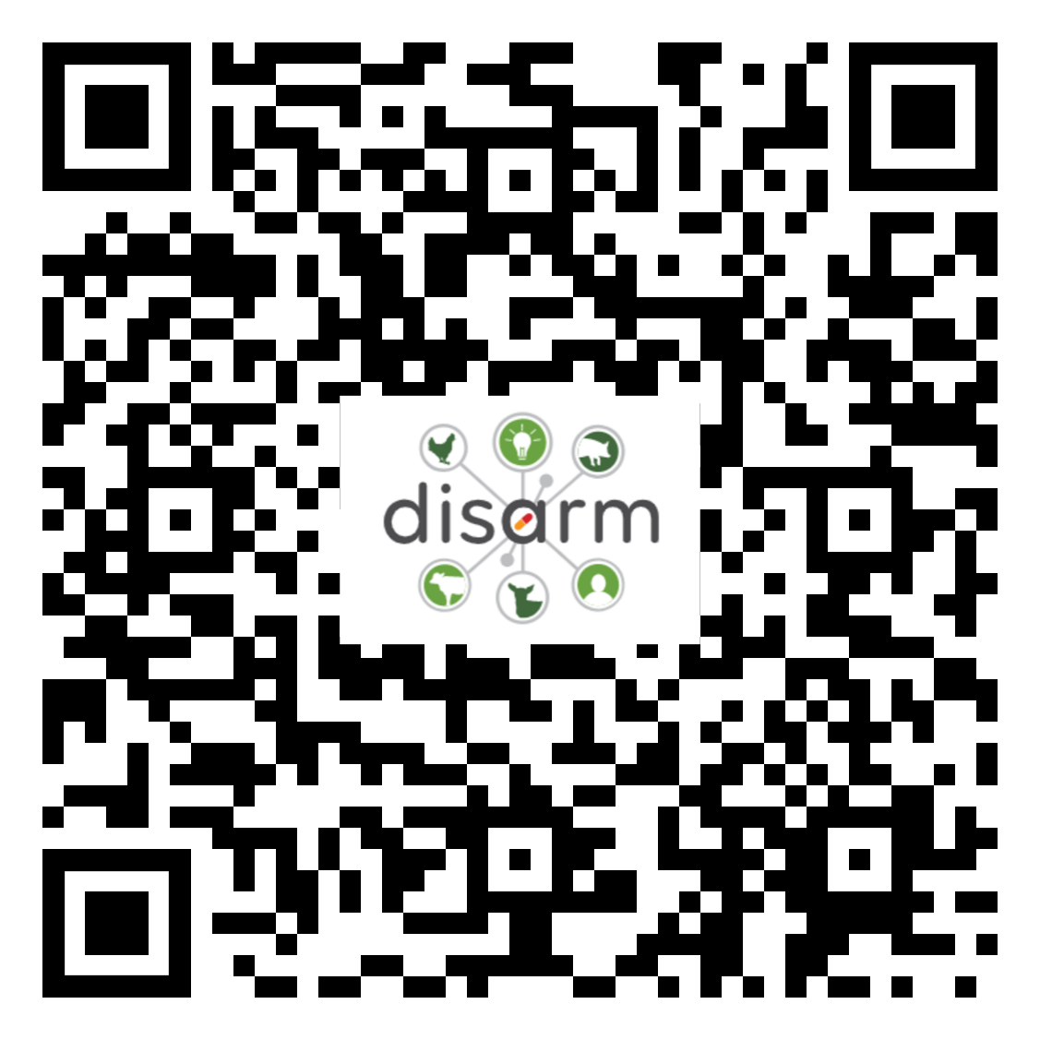

Farm Health Team Toolbox - Disarm Project
Scan this QR code to learn more about the DISARM MAFH approach toolbox or visit
https://shorturl.at/ETYZ9
This project has received funding from the European Union’s Horizon 2020 research and innovation programme under grant agreement No.817591

