Slide 1
CZECH REPUBLIC
21 & 22 NOVEMBER 2024

Slide 2
Introduction to overall EU regulatory framework: focus on veterinary medicinal products Regulation .
CZECH REPUBLIC, 21 & 22 NOVEMBER 2024

Slide 3
EU legal framework on veterinary medicinal products/medicated feed
Regulation (EU) 2019/6 on Veterinary Medicinal Products
Regulation (EU) 2019/4 on Medicated Feed

Slide 4
Definitions and general principles
‘veterinary prescription’ means a document issued by a veterinarian for a veterinary medicinal product or a medicinal product for human use for its use in animals.
‘antimicrobial’ means any substance with a direct action on micro-organisms used for treatment or prevention of infections or infectious diseases, including antibiotics, antivirals, antifungals and anti-protozoals
Antimicrobial veterinary medicinal products must only be available on veterinary prescription.

Slide 5
ANTIMICROBIAL VERSUS ANTIBIOTICS
Antimicrobials
Antibiotics
Antifungal, Antiprotozoal
Antiviral
RESISTANCE!
Antiparasitic
EU Regulation

Slide 6
Common rules – Veterinary prescription
Some medicines are subject to veterinary prescription for reasons of safety (for animals and people!), efficacy & potential resistance, and possible misuse.
(a) narcotic drugs or psychotropic substances
(b) medicines for food-producing animals
(c) antimicrobials
(d) if a prior diagnosis is needed
(e) euthanasia products
(f) new active substances (< 5 yr)
(g) vaccines
(h) hormones or thyrostatics or beta-agonists

Slide 7
Common rules – Veterinary prescription
shall NOT be applied routinely
shall NOT be used to compensate for poor hygiene, inadequate animal husbandry, lack of care or poor farm management.
Ways of antimicrobial use
Preventive (Prophylaxis)
Group administration (metaphylaxis)
Treatment
Growth promotion
Individual treatment
Group treatment
ONLY for exceptional cases (when risk infection very high/consequences severe)
Antibiotic treatment ONLY to individual animals
Other antimicrobials ONLY to restricted number of animals
ONLY when the risk of spread of an infection or of an infectious disease in the group of animals is high
where no other appropriate alternatives are available
PROHIBITED !

Slide 8
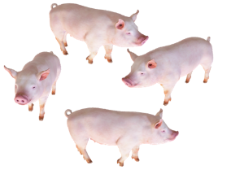

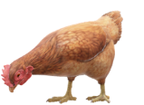




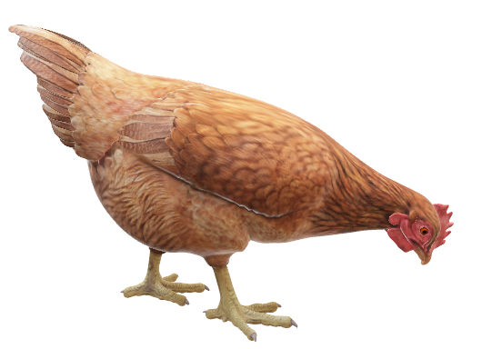



Uses of antimicrobials other than to treat sick animals
Prophylaxis
Metaphylaxis
When antimicrobials are administered to animals at risk of an infection or disease
A measure taken to maintain health and prevent infection or disease from occurring
When antimicrobials are administered to animals with clinical signs and to clinically healthy animals belonging to the same flock or pen
Some of the infections are treated before their clinical appearance
HEALTH
Start of the infectious disease
DISEASE
No symptoms
symptoms
early
conventional
Preventive
Curative treatment / control
Notes:
Prophylaxis: The word comes from the Greek for "an advance guard," an apt term for a measure taken to fend off a disease or another unwanted consequence. A prophylactic is a medication or a treatment designed and used to prevent a disease from occurring, before the disease is evidenced.
In the context of VMP Regulation the following definitions apply:
Prophylaxis’ means “the administration of a medicinal product to an animal or group of animals before clinical signs of a disease, in order to prevent the occurrence of disease or infection”. (Article 4(16) of Regulation (EU) 2019/6).
Metaphylaxis’ means “the administration of a medicinal product to a group of animals after a diagnosis of clinical disease in part of the group has been established, with the aim of treating the clinically sick animals and controlling the spread of the disease to animals in close contact and at risk and which may already be subclinically infected”. (Article 4(15) of Regulation (EU) 2019/6).
Metaphylaxis: Treatment of a group of animals without evidence of disease, which are in close contact with other animals that do have evidence of infectious disease
Prophylaxis/prevention and metaphylaxis involves administering antimicrobials to 'healthy' individuals to 'prevent' infections, but for prophylaxis/prevention there is a perceived 'risk', whereas metaphylaxis could be a definable 'hazard'

Slide 9

4. EU framework on veterinary medicinal products and medicated feed
Regulation (EU) 2019/6 on Veterinary Medicinal Products (VMP Regulation)
Prophylaxis
Only in exceptional cases, for the administration to an individual animal (antibiotics) or a restricted number of animals (other antimicrobials) when the risk of an infection or of an infectious disease is very high and the consequences are likely to be severe.
Metaphylaxis
Only when the risk of spread of an infection or of an infectious disease in the group of animals is high and where no other appropriate alternatives are available.
Member States may provide guidance regarding such other appropriate alternatives and shall actively support the development and application of guidelines which promote the understanding of risk factors associated with metaphylaxis and include criteria for its initiation.

Slide 10
4. EU framework on veterinary medicinal products and medicated feed
General principles of the Veterinary Medicinal Products Regulation
Veterinary medicinal products shall be used in accordance with the terms of the marketing authorization.
All veterinary prescriptions should be based on a clinical examination or other proper assessment by a veterinarian
List of antimicrobials reserved for humans only*
Obligation for Member States to collect data on sale and use of antimicrobials
Commission Implementing Regulation (EU) 2022/1255 of 19 July 2022 designating antimicrobials or groups of antimicrobials reserved for treatment of certain infections in humans, in accordance with Regulation (EU) 2019/6 of the European Parliament and of the Council
Notes:
Note to trainers: This slide comes back to other parts of the presentation. If there is time, it could be useful to provide a brief summary of the topics. If not, it could be hidden.

Slide 11

Common rules – Veterinary prescription
Common rules
VETERINARY PRESCRIPTIONS
!Article 105
The veterinarian can issue a veterinary prescription only after he or she has made a clinical examination or any other proper assessment of the health status of the animal or group of animals
The veterinarian can issue a veterinary prescription for an antimicrobial only after he or she has diagnosed an infectious disease
The veterinarian has to be able to provide justification for the prescription of an antimicrobial, especially for preventive (prophylaxis) and group (metaphylaxis) administration
Notes:
DISCUSS last two points

Slide 12
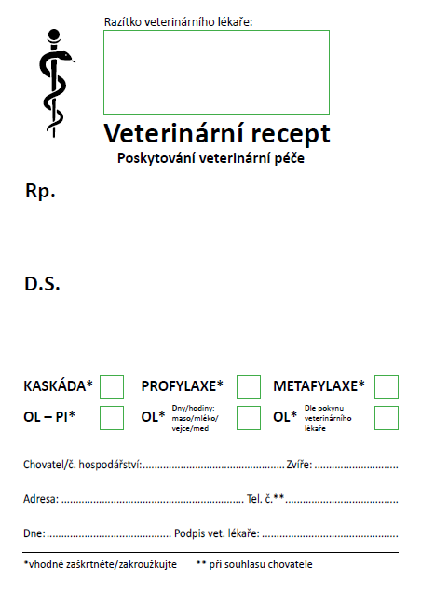
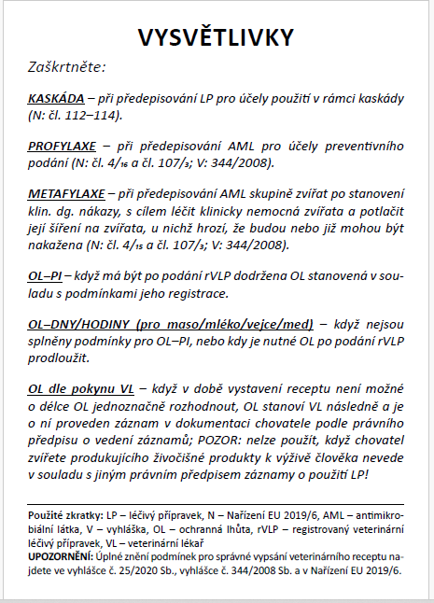
Common rules – Veterinary prescription Czechia
Identification Veterinarian (prof nr)
Name of medicine (active ingredient), form and strength.
Quantity prescribed
Dosage regimen
A prescription for an antimicrobial is only valid 5 days after the prescription is made.
Note necessary if prescription is Art 107 3-4 or 112-114)
Notes:
We can check if a template is available in different countries and if so, include the country template
RE blue box. Explain what is use under art 112-114.

Slide 13
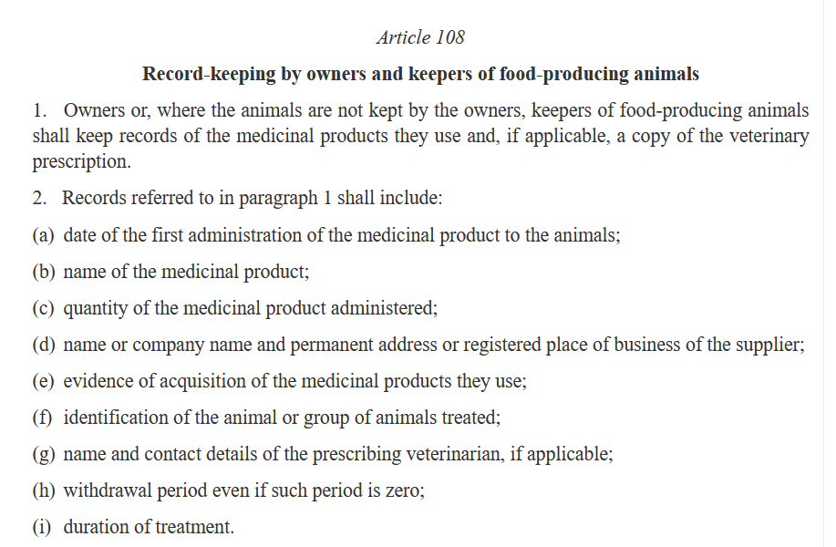

Common rules – Veterinary prescription
Common rules
Record keeping
Reg.(EU) 2019/6 (VPM)
Article 108
OBLIGATIONS

Slide 14
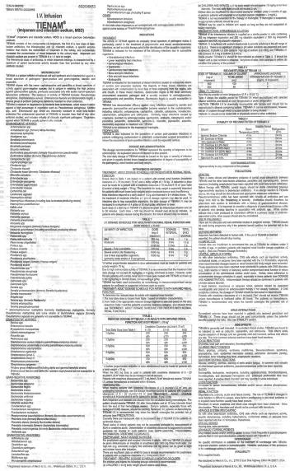
Common rules – Veterinary prescription
Common rules
Marketing Authorisation
Reg.(EU) 2019/6 (VPM)
Principle Rule
Veterinary medicines must be used according to the marketing authorisation (SPC/leaflet)
You need to use a veterinary medicine for the indication, species and dosage regime detailed in the SPC/leaflet. If there is no veterinary product authorized for a certain indication/species or there is a shortage -> you can use the rules of Art. 112-114

Slide 15
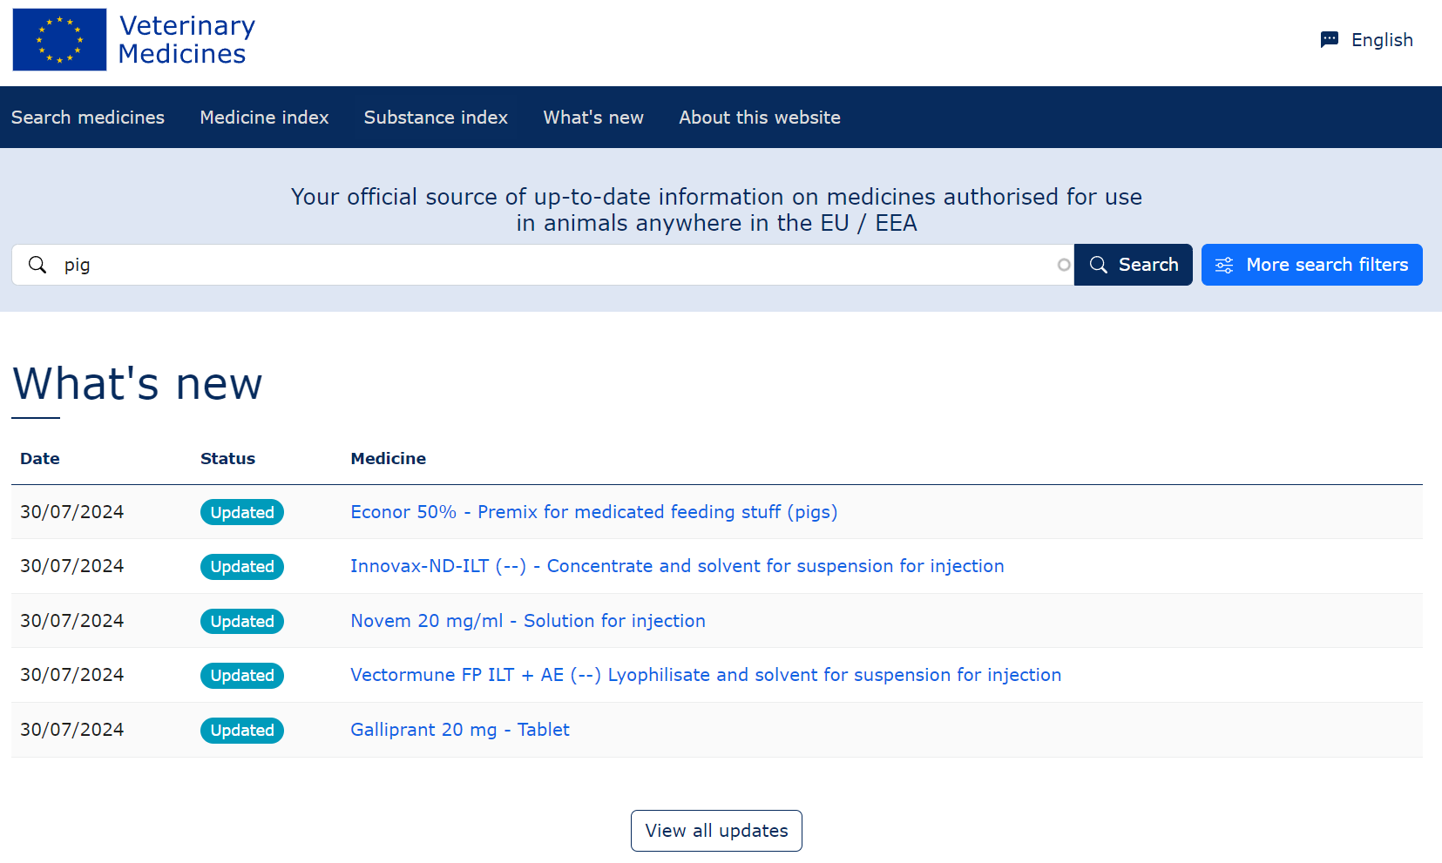
You can consult the EU database with all authorised veterinary medicines: https://medicines.health.europa.eu/veterinary/

Slide 16

Common rules – Use of veterinary medicinal products
outside the terms of the marketing authorisation
When no medicine authorised for food-producing animals or authorized ones are not available
Common rules
Product authorised (Art106(1)) in your country for the species and indication concerned
Must use this product
3rd country products :
In cases where none of the foregoing options are available → use a VMP authorised in a third country for the same animal species and the same indication
If not, under vet responsibility
& to avoid unacceptable suffering
Product authorised for the:
- same/another indication
- in same/another food-producing species
- in the same/another EU country
Select a product
Not for vaccines !
If none, use
Select a product
“use outside marketing authorisation”
Product authorised in the EU for non-food animal for same indication
If none, use
A human medicine authorised
Select a product
If none, use
VMP prepared extemporaneously in accordance with the terms of a veterinary prescription.
Prepare a product
Notes:
Article 113 Use of medicinal products outside the terms of the marketing authorisation in food-producing terrestrial animal species
derogation from Article 106(1): where there is no authorised vmp in a MS for an indication concerning a food-producing terrestrial animal species, the veterinarian may, under his or her direct personal responsibility, and in particular to avoid causing unacceptable suffering, exceptionally treat the animals concerned with the following medicinal product:
a vmp authorised under this Regulation in the relevant MS or in another MS for use for the same/another indication, in the same or another food-producing species;
if there is no vmp as referred to in point (a) of this paragraph, for the same indication; a vmp authorised under this Regulation in the relevant Member State for use in a non-food-producing animal species
if there is no vmp as referred to in point (a) or (b) of this paragraph, a medicinal product for human use authorised in accordance with Directive 2001/83/EC or Regulation (EC) No 726/2004;
if there is no medicinal product as referred to in point (a), (b) or (c) of this paragraph, a vmp prepared extemporaneously in accordance with the terms of a veterinary prescription.
Except as regards immunological veterinary medicinal products, where there is no medicinal product available as referred to in paragraph 1, the veterinarian responsible may under his or her direct personal responsibility, and in particular to avoid causing unacceptable suffering, exceptionally treat food-producing terrestrial animals with a veterinary medicinal product authorised in a third country for the same animal species and same indication.
The veterinarian may administer the medicinal product personally or allow another person to do so under the veterinarian’s responsibility, in accordance with national provisions.
4. This Article shall apply also when an authorised veterinary medicinal product is not available in the relevant Member State

Slide 17

Use of medicinal products outside the terms of the marketing authorisation in food-producing terrestrial animals
Product authorised in your own country for the species and indication
  Product authorised in your own country or another EU Member State
          for the same or another food-producing terrestrial animal species,
          for the same or another indication.
  Product authorised in your own country
  for use in non-food-producing animal for the same indication.
  Product authorised for human use.
  Product prepared extemporaneously.
  Product authorised in а third country
    for the same animal species and the same indication (not for vaccines!)
If none, under vet’s responsibility & to avoid unacceptable suffering
If none, use
If none, use
Don’t forget special withdrawal periods
If none, use
If none, use
Notes:
First you have to see if there is a product authorised in your own country for the species and indication
If not:
Product authorised in your own country or another EU Member State
for the same or another food-producing terrestrial animal species,
for the same or another indication.
if none, then
Product authorised in your own country
for use in non-food-producing animal for the same indication.
if none, then
Product authorised for human use.
if none, then
Product prepared extemporaneously.
if none, then
Product authorised in third country country
for the same animal species and the same indication.

Slide 18

Common rules – Use of Veterinary Medicinal Products
When no authorized medicine is available for food-producing aquatic animals or authorized ones are not available
Common rules
Product authorised in your country for the aquatic animal species and indication concerned
Must use this product
3rd country products :
In cases where none of the foregoing options are available → use a VMP authorised in a third country for the same animal species and the same indication
If not, use
Product authorised for the:
- same/another indication
- in same/another food-producing aquatic species
- in the same/another EU country
Select a product
If not, use
Not for vaccines !
“cascade use of AM”
Product authorised in the EU for food-producing terrestrial species (substance list under development)
Select a product
If not, use
A human medicine authorised (substance list under development)
Select a product
If not, use
VMP prepared extemporaneously in accordance with the terms of a veterinary prescription
Prepare a product
Notes:
Article 114 Use of medicinal products for food-producing aquatic species
1. By way of derogation from Article 106(1), where there is no authorised vmp in a MS for an indication concerning a food-producing aquatic species, the veterinarian responsible may, ……
a veterinary medicinal product authorised under this Regulation in the relevant MS or in another MS for use in the same or in another food-producing aquatic species and for the same indication or for another indication;
a veterinary medicinal product authorised under this Regulation in the relevant Member State or in another Member State for use with a food producing terrestrial species containing a substance present in the list established in accordance with paragraph 3;
a medicinal product for human use authorised in accordance with Directive 2001/83/EC or Regulation (EC) No 726/2004 and containing substances present in the list established in accordance with paragraph 3 of this Article; or
a veterinary medicinal product prepared extemporaneously in accordance with the terms of a veterinary prescription.
2. By way of derogation from points (b) and (c) of paragraph 1, and until the list referred to in paragraph 3 is established, the veterinarian responsible may,
veterinary medicinal product authorised under this Regulation in the relevant Member State or in another Member State for use with a food-producing terrestrial animal species;
b) if there is no veterinary medicinal product as referred to in point (a) of this paragraph, a medicinal product for human use authorised in accordance with Directive 2001/83/EC or Regulation (EC) No 726/2004.
3. The Commission shall, by means of implementing acts, at the latest within five years from 28 January 2022, establish a list of substances used in veterinary medicinal products authorised in the Union for use in food-producing terrestrial animal species or substances contained in a medicinal product for human use authorised in the Union, which may be used in food-producing aquatic animals
4. Except as regards immunological veterinary medicinal products, where there is no medicinal product available as referred to in paragraphs 1 and 2, the veterinarian responsible may, under his or her direct personal responsibility and in particular to avoid causing unacceptable suffering, exceptionally treat food-producing aquatic species with a veterinary medicinal product authorised in a third country for the same species and same indication.

Slide 19

Use of medicinal products outside the terms of the marketing authorisation in food-producing aquatic animals
Product authorised in your own country for the species and indication
  Product authorised in your own country or another EU Member State
          for the same or another food-producing aquatic species,
          for the same or another indication.
  Product authorised in your own country or another EU Member State
  for use in food-producing terrestrial animal*
  Product authorised for human use*
  Product prepared extemporaneously.
  Product authorised in а third country
    for the same animal species and the same indication. (not for vaccines!)
If none, under vet’s responsibility & to avoid unacceptable suffering
If none, use
If none, use
Don’t forget special withdrawall periods
If none, use
If none, use
Notes:
First you have to see if there is a product authorised in your own country for the species and indication
Product authorised in your own country or another EU Member State
for the same or another food-producing aquatic species,
for the same or another indication.
if none, then
Product authorised in your own country or another EU Member State
for use in food-producing terrestrial animal *
containing a substance present on the list.
if none, then
Product authorised for human use *
containing substances present on the list.
if none, then
D) Product prepared extemporaneously.
if none, then
Product authorised in third country country
for the same animal species and the same indication.
Commission must make a list, when list is available b) and c) only products from the list
by 2027 the Commission will adopt a regulation with a list of substances and then the products used under b) and c) should contain only substances included in that list.

Slide 20

EU Commission Implementing Regulation (EU) 2024/1973 of 18 July 2024
Establishing a list of antimicrobials which shall not be used in accordance with Articles 112 and 113 of Regulation (EU) 2019/6 of the European Parliament and of the Council or which shall only be used in accordance with those Articles subject to certain conditions.
It shall apply from 8 August 2026.

Slide 21
Thank you!

