Slide 1
CZECH REPUBLIC
21 & 22 NOVEMBER 2024

Slide 2
Additional relevant legislation, provisions and/or guidelines to be considered by veterinarians & farmers (II) Lecture 4
CZECH REPUBLIC, 21 & 22 NOVEMBER 2024

Slide 3
EU legal framework on veterinary medicinal products/medicated feed
Regulation (EU) 2019/6 on Veterinary Medicinal Products
Regulation (EU) 2019/4 on Medicated Feed
+ Implementing and delegating Acts

Slide 4
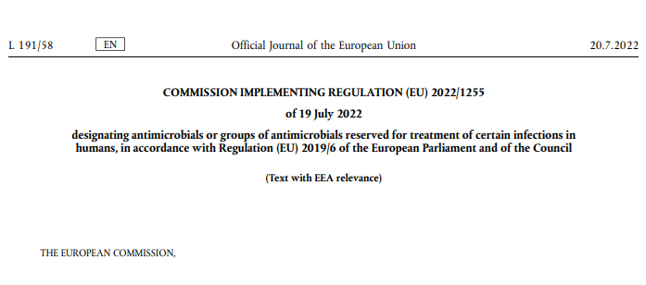
CERTAIN ANTIMICROBIALS ARE PROHIBITED TO USE FOR ANIMAL TREATMENT
The human reserve list: antimicrobials which are reserved for treatment of certain infections in humans
“reserve list”
The antimicrobials and group of antimicrobials listed in this Regulation cannot be used in animals under any circumstances.
This list will be kept under continual review in the light of new scientific evidence or emerging information
Commission Implementing Regulation (EU) 2022/1255

Slide 5
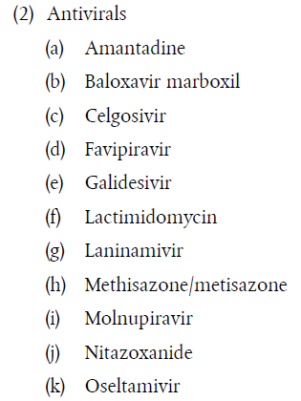
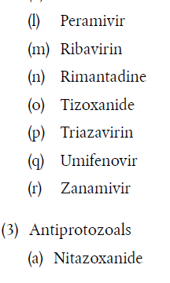
ANTIMICROBIALS ON THE HUMAN RESERVE LIST
“human reserve list”
Supporting prudent use and preserving efficacy
Commission Implementing Regulation (EU) 2022/1255

Slide 6
CERTAIN ANTIMICROBIALS ARE NOT ALLOWED OR CONDITIONALLY ALLOWED TO USE UNDER ART 112 & 113*
Commission Implementing Regulation (EU) 2024/1973 lists antimicrobials which cannot be used in accordance with article 112 & 113* (outside the marketing authorisation) or can only be used subject to certain conditions.
Some examples:
      Third- and fourth-generation cephalosporins cannot be used in accordance with Article 113 in poultry
      Polymyxins are allowed only after prior pathogen identification and susceptibility testing showing that they are likely to be effective and other preferable antimicrobials would not be effective.
      Quinolones (including fluoroquinolones) cannot be used in accordance with Article 113 for salmonellosis in poultry or for metaphylaxis of salmonellosis in animals other than poultry
All details here: https://eur-lex.europa.eu/eli/reg_impl/2024/1973/oj
This Act will apply from 8 August 2026

Slide 7


Upcoming Delegated and Implementing Legal Acts
List of substances authorised for use in food-producing terrestrial animal species or substances contained in a medicinal product for human use authorised in the Union, which may be used in food-producing aquatic species in accordance with Article 114(1)
List of substances which are essential for the treatment of equine species, or which bring added clinical benefit compared to other treatment options available for equine species and for which the withdrawal period for equine species shall be six months.
More info on all delegated and implementing Acts:
https://food.ec.europa.eu/animals/animal-health/vet-meds-med-feed/implementation_en

Slide 8

Upcoming Acts
List of antimicrobials that may be used for food-producing aquatic species
!Article 114
The Commission will establish a list of substances used in veterinary medicinal products authorised in the Union for use in food-producing terrestrial animal species or substances contained in a medicinal product for human use authorised in the Union in accordance with Directive 2001/83/EC or Regulation (EC) No 726/2004, which may be used in food-producing aquatic species in accordance with Article 114(1).
Notes:
IF RUNNING OUT OF TIME, THIS SLIDE CAN BE HIDDEN

Slide 9
Upcoming Acts
List of antimicrobials for specific species (equine species)
The Commission published a list of substances essential for the treatment of Equidae (Commission Regulations (EC) No. 1950/2006 & No. 122/2013 )
The VMP Regulation requires the Commission to establish a list of substances which are essential for the treatment of equine species, or which bring added clinical benefit compared to other treatment options available for equine species and for which the withdrawal period for equine species shall be six months to be established
In July 2024 EMA published its scientific advice regarding the list of substances which are essential for the treatment of equine species (SA - Art115(5) - List of substances essential for equine species (europa.eu)
The Commission is now working on the required implementing act.
Notes:
IF RUNNING OUT OF TIME, THIS SLIDE CAN BE HIDDEN

Slide 10
It is crucial to report adverse events (pharmacovigilance)
Unintended, unfavourable reaction in animals to a veterinary or human medicine
Lack of efficacy of a veterinary medicine
Any environmental incidents after applying a veterinary medicine
Any noxious reaction to humans
Exceeding the MRL when withdrawal period was respected
Any suspected transmission of an infectious agent via the medicine
Do not forget to report adverse events including lack of efficacy!
Adverse events are:
Why report? To ensure safety, monitor efficacy, prevent harm, guide regulation and to inform research.

Slide 11
Disposal of Veterinary Medicines
How and where does pharmaceutical waste occur?
Immediate packaging and the remains of medicines within after use.
VMP or MF that are past their expiry date or that have not been stored in accordance with the instructions.
Prescription of a quantity exceeding the required quantity or uncompleted course of treatment due to either administration difficulties, adverse reactions, change in treatment or because animals died during treatment.
FACTSHEET_PharmaceuticalWasteDisposal.pdf (epruma.eu)

Slide 12
Disposal of Veterinary Medicines
Best practices for disposal
PharmaceuticalWasteDisposal.pdf (epruma.eu)
Everybody (prescribers and users) is responsible for minimising pharmaceutical waste.
Disposal of pharmaceutical waste via waterways should be excluded.
Pharmaceutical waste should be stored in a dedicated container, bin, or facility to ensure adequate protection to animal health, human health, feed, food and the environment and this must be separated from any stocks of veterinary medicines to ensure that the waste cannot be inadvertently used.
Waste must be disposed of in accordance with the Summary of Product Characteristics (SPC) and the waste legislation and national systems developed in consultation with all parties for the collection, transport, and disposal of the waste.
Member States shall ensure that appropriate collection or discard systems are in place for waste veterinary medicinal products (including medicated feed) and to ensure that the location of collection or discard points as well as other relevant information is made available to farmers, animal keepers, veterinarians, and other relevant persons.

Slide 13

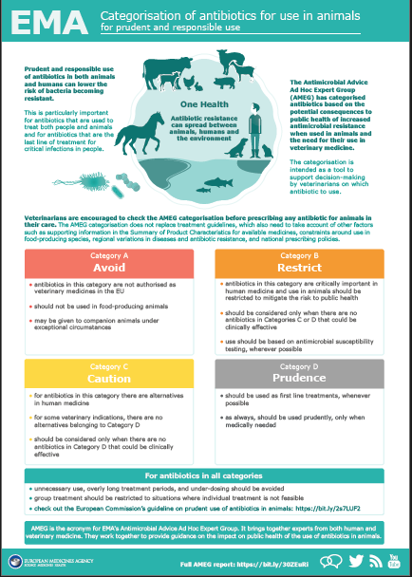
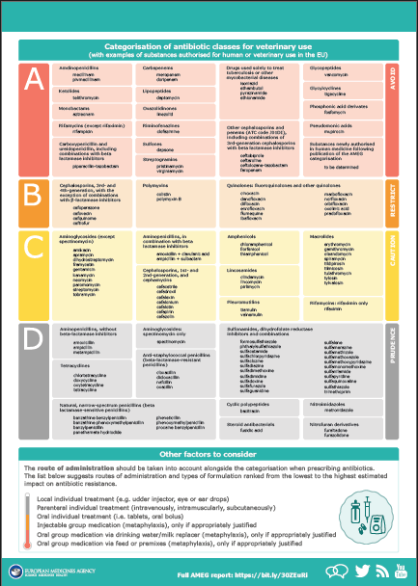
Other considerations for prescriptions

Slide 14
Prudent Use Guidelines
Not legally binding as the previous acts/provisions!
Guideline for the prudent use of
antimicrobials in veterinary medicine 2015/C 299/04​
https://health.ec.europa.eu/system/files/2016-11/2015_prudent_use_guidelines_en_0.pdf
Best-practice framework for the use of antimicrobials in food-producing animals in the EU - Reaching for the next level.
https://epruma.eu/home/best-practice-guides/best-practice-framework-for-the-use-of-antimicrobials-in-food-producing-animals-in-the-eu-reaching-for-the-next-level/

Slide 15
Animal Health Law (Regulation (EU) 2016/429 on transmissible animal disease)
“Prevention is better than cure”
Preventive driven approach:
improvement of animal health and biosecurity measures, good farming practices
Clear responsibility for all players for animal health
  Operators → ensure a high level of animal health and welfare, and biosecurity
  Vets → raise awareness and help in the prevention and spread of pathogens
  CA → protect animal health, human
  health and environment
Prioritising EU intervention
Regulatory tools/interventions for resistant pathogens: "disease agents“
Disease preventive and control measures may apply (surveillance, eradication etc.)
Legal basis monitoring AMR in animal pathogens

Slide 16

National provisions

Slide 17

Use of VMPs
Article 106 (1): Vet medicinal products shall be used in accordance with the terms of the marketing authorisation (= SPC)
Article 106 (3): Member States may lay down any procedures they deem necessary for the implementation of Articles 110 to 114 and 116.
FOOD PROTDUCING ANIMALS
For food producing terrestrial animals čl. 113
Derogation of the Article 106/1 - where there is no authorised VMP a Member State for an indication concerning, another VMP/MP can be used according to the „cascade“ principle
  CASCADE / OFF – label : exceptionally, to avoid causing unacceptable suffering !
Decision on use in cascade/off label is under discretion of VETERINARIAN =>
After use under the cascade /off label
=>withdrawal period shall not be less than WP defined under Article 115!
National conditions reflects Reg (EU) 2019/6 and are defined in Act on Pharmaceuticals 314/2022 especially §9 (9) ...
Notes:
=> Zamysleme se, zda tedy vybraný patogen např. AMR patogen), nebo „indikace“ charakterizována jistou patogenezí nemůže být považována za odlišnou od indikace v SPC, aby byl umožněno například zvýšení dávky/prodloužení podání v nezbytně nutných případech.

Slide 18
ANTIMICROBIALS
NATIONAL MEASURES TO ENSURE RESPONSIBLE USE OF ANTIMICROBIALS
Art. 107/7 A Member State may further restrict or prohibit the use of certain antimicrobials in animals on its territory if the administration of such antimicrobials to animals is contrary to the implementation of a national policy on prudent use of antimicrobials.
Art 107/8 Measures adopted by the Member States on the basis of paragraph 7 shall be proportionate and justified.
(EU) 2019/6
§9a (3) conditions for use of antimicrobials
§9a (4) conditions for use of antimicrobials under (national) prudent use regimen
§40 (6) substances under prudent use regimen
Act on pharmaceuticals
314/2022 Sb.

Slide 19
Rules for use - antimicrobials
Act on pharmaceuticals – as amended 314/2022
§9a Conditions for use of antimicrobial medicinal products
in veterinary care
Attention !
ATM UNDER PRUDENT USE REGIMEN § 40
Justification for the use
Considering presence of the disease causing infectious agent and its susceptibility to antimicrobial used
Based on anamnesis
epidemiological data
results of clinical examination
use of rapid diagnostic methods
or
resulst of laboratory investigation

Slide 20
VMPs containing antimicrobials under prudent use regimen:
Act No. 314/2022
§40 was amended with following text
„(6) ISCVBM in decision on the marketing authorisation stipulate prudent use regimen for VMP and by this mean restrict conditions of use for VMP of concern ... based on considering the risk of development or spread of resistance with importance for public health.
In the decision (on marketing authorisation ISCVBM may,
except the conditions under § 9a further stipulate
a) restrictions of indication, way, extent or conditions of use of VMP
or
b) conditions, which shall be fulfilled prior use of the product,
emphasise especially:
  Confirmation of the disease ethiological agent and testing of susceptibility to active substance in VMP
  or
  Impossibility of use of another treatment option with lower risks of resistance spread or development
Decree linked to this Act further establish list of the active substances, which, once present in VMP, provide a base that such VMP will fall under the prudent use regimen, based on the decision on marketing authorisation of such VMP by ISCVBM.
RISK MANAGEMENT!

Slide 21

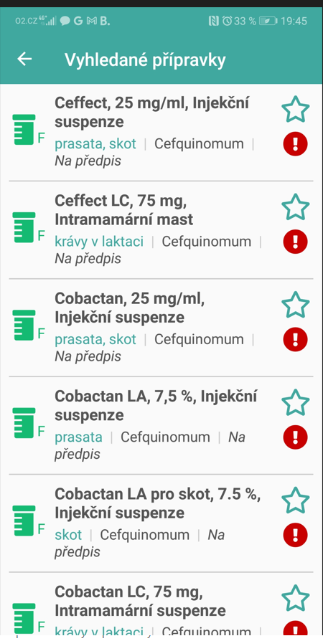
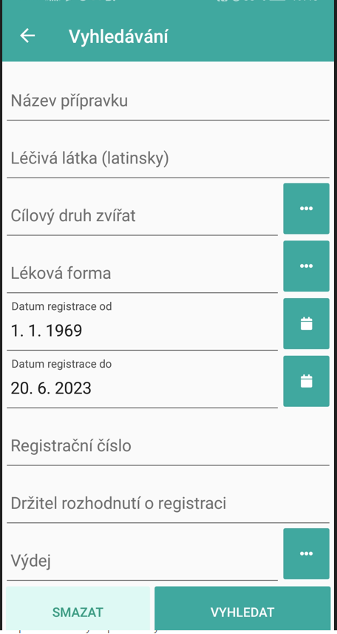
ANTIMICROBIALS UNDER PRUDENT USE REGIMEN - ČR
Cephalosporins III. and IV. generation:
Ceftiofur (III) - INJ
Cefoperazon (III) – IMM LC
Cefquinome (IV) – IMM LC, DC a INJ
Fluoroquinolones:
Enrofloxacin (INJ i PO)
Marbofloxacin (INJ)
Aminoglycosides:
Gentamicin (INJ)
Kanamycin (IMM)
Ansamycins:
Rifaximin (IMM, Topic)
Product can be easily identified by
mobile APP on VMPs,
which is on line linked to database of VMPs in ISVBM
SINCE 1998
Strengthened by
344/2008
Do not forget that colistin is last choice antimicrobial
(yet not listed in CZ legislation as „prudent use regimen antimicrobial.“

Slide 22
VMPs containing antimicrobials: Act No. 314/2022
IMPLEMENTATION of Reg (EU) 2019/6 and (EU) 2019/4, whenever relevant
§ 9a
Conditions for use of antimicrobial medicinal products in veterinary care – see in detail above
§34
(4) Institute or Veterinary Institute vary, suspend or withdraw marketing authorisation of medicinal product, when concerns
...
m) the medicinal product containing antimicrobial, which is reserved for treatment of certain infections of human, based on Comission implementing act, pursuant to Article 37 (5) of the Regulation on veterinary meeicinal products.
§40
(6) Veterinary Institute in decision on the marketing authorisation stipulate prudent use regimen for antimicrobial ans restrict by this means conditions of use for such product – see in detail above
Specific rules for manufacturing, placing on the market, prescription and use of medicated feed
§ 73 ... See rules for medicated feed - in previous presentation

