Slide 1
LATVIA
3 & 4 DECEMBER 2024

Slide 2
Additional relevant legislation, provisions and/or guidelines to be considered by veterinarians & farmers (II) Lecture 4
LATVIA, 3 & 4 DECEMBER 2024

Slide 3
EU legal framework on veterinary medicinal products/medicated feed
Regulation (EU) 2019/6 on Veterinary Medicinal Products
Regulation (EU) 2019/4 on Medicated Feed
+ Implementing and delegating Acts

Slide 4
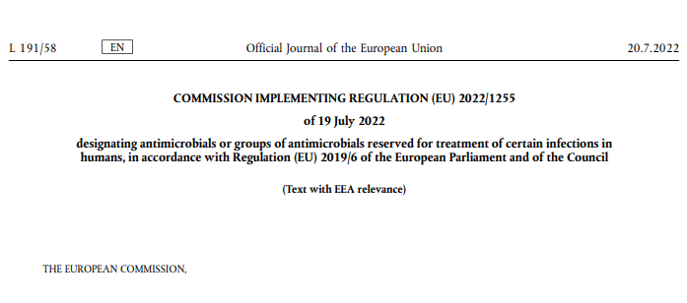
CERTAIN ANTIMICROBIALS ARE PROHIBITED TO USE FOR ANIMAL TREATMENT
The human reserve list: antimicrobials which are reserved for treatment of certain infections in humans
“reserve list”
The antimicrobials and group of antimicrobials listed in this Regulation cannot be used in animals under any circumstances.
This list will be kept under continual review in the light of new scientific evidence or emerging information
Commission Implementing Regulation (EU) 2022/1255

Slide 5
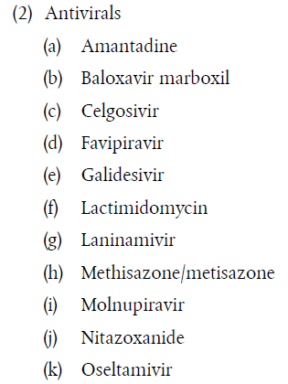
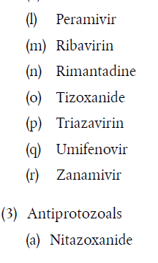
ANTIMICROBIALS ON THE HUMAN RESERVE LIST
“human reserve list”
Supporting prudent use and preserving efficacy
Commission Implementing Regulation (EU) 2022/1255

Slide 6
CERTAIN ANTIMICROBIALS ARE NOT ALLOWED OR CONDITIONALLY ALLOWED TO USE UNDER ART 112 & 113*
Commission Implementing Regulation (EU) 2024/1973 lists antimicrobials which cannot be used in accordance with article 112 & 113* (outside the marketing authorisation) or can only be used subject to certain conditions.
Some examples:
      Third- and fourth-generation cephalosporins cannot be used in accordance with Article 113 in poultry
      Polymyxins are allowed only after prior pathogen identification and susceptibility testing showing that they are likely to be effective and other preferable antimicrobials would not be effective.
      Quinolones (including fluoroquinolones) cannot be used in accordance with Article 113 for salmonellosis in poultry or for metaphylaxis of salmonellosis in animals other than poultry
All details here: https://eur-lex.europa.eu/eli/reg_impl/2024/1973/oj
This Act will apply from 8 August 2026

Slide 7


Upcoming Delegated and Implementing Legal Acts
List of substances authorised for use in food-producing terrestrial animal species or substances contained in a medicinal product for human use authorised in the Union, which may be used in food-producing aquatic species in accordance with Article 114(1)
List of substances which are essential for the treatment of equine species, or which bring added clinical benefit compared to other treatment options available for equine species and for which the withdrawal period for equine species shall be six months.
More info on all delegated and implementing Acts:
https://food.ec.europa.eu/animals/animal-health/vet-meds-med-feed/implementation_en

Slide 8

Upcoming Acts
List of antimicrobials that may be used for food-producing aquatic species
!Article 114
The Commission will establish a list of substances used in veterinary medicinal products authorised in the Union for use in food-producing terrestrial animal species or substances contained in a medicinal product for human use authorised in the Union in accordance with Directive 2001/83/EC or Regulation (EC) No 726/2004, which may be used in food-producing aquatic species in accordance with Article 114(1).
Notes:
IF RUNNING OUT OF TIME, THIS SLIDE CAN BE HIDDEN

Slide 9
Upcoming Acts
List of antimicrobials for specific species (equine species)
The Commission published a list of substances essential for the treatment of Equidae (Commission Regulations (EC) No. 1950/2006 & No. 122/2013 )
The VMP Regulation requires the Commission to establish a list of substances which are essential for the treatment of equine species, or which bring added clinical benefit compared to other treatment options available for equine species and for which the withdrawal period for equine species shall be six months to be established
In July 2024 EMA published its scientific advice regarding the list of substances which are essential for the treatment of equine species (SA - Art115(5) - List of substances essential for equine species (europa.eu)
The Commission is now working on the required implementing act.
Notes:
IF RUNNING OUT OF TIME, THIS SLIDE CAN BE HIDDEN

Slide 10
It is crucial to report adverse events (pharmacovigilance)
Unintended, unfavourable reaction in animals to a veterinary or human medicine
Lack of efficacy of a veterinary medicine
Any environmental incidents after applying a veterinary medicine
Any noxious reaction to humans
Exceeding the MRL when withdrawal period was respected
Any suspected transmission of an infectious agent via the medicine
Do not forget to report adverse events including lack of efficacy!
Adverse events are:
Why report? To ensure safety, monitor efficacy, prevent harm, guide regulation and to inform research.

Slide 11
Disposal of Veterinary Medicines
How and where does pharmaceutical waste occur?
Immediate packaging and the remains of medicines within after use.
VMP or MF that are past their expiry date or that have not been stored in accordance with the instructions.
Prescription of a quantity exceeding the required quantity or uncompleted course of treatment due to either administration difficulties, adverse reactions, change in treatment or because animals died during treatment.
FACTSHEET_PharmaceuticalWasteDisposal.pdf (epruma.eu)

Slide 12
Disposal of Veterinary Medicines
Best practices for disposal
PharmaceuticalWasteDisposal.pdf (epruma.eu)
Everybody (prescribers and users) is responsible for minimising pharmaceutical waste.
Disposal of pharmaceutical waste via waterways should be excluded.
Pharmaceutical waste should be stored in a dedicated container, bin, or facility to ensure adequate protection to animal health, human health, feed, food and the environment and this must be separated from any stocks of veterinary medicines to ensure that the waste cannot be inadvertently used.
Waste must be disposed of in accordance with the Summary of Product Characteristics (SPC) and the waste legislation and national systems developed in consultation with all parties for the collection, transport, and disposal of the waste.
Member States shall ensure that appropriate collection or discard systems are in place for waste veterinary medicinal products (including medicated feed) and to ensure that the location of collection or discard points as well as other relevant information is made available to farmers, animal keepers, veterinarians, and other relevant persons.

Slide 13

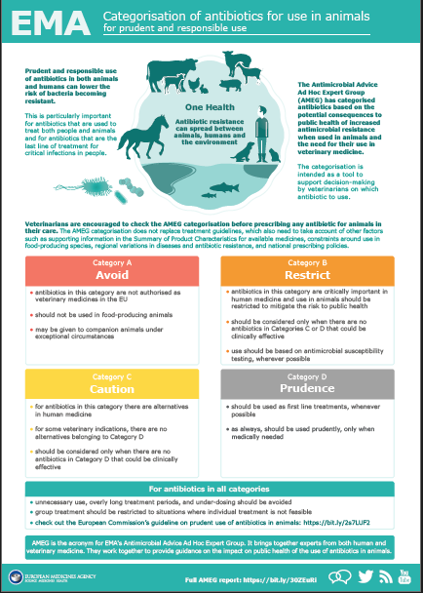
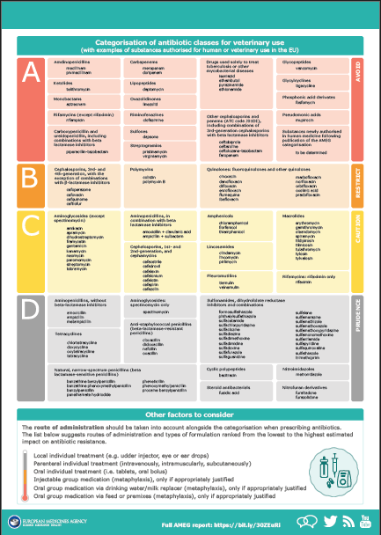
Other considerations for prescriptions

Slide 14
Prudent Use Guidelines
Not legally binding as the previous acts/provisions!
Guideline for the prudent use of
antimicrobials in veterinary medicine 2015/C 299/04​
https://health.ec.europa.eu/system/files/2016-11/2015_prudent_use_guidelines_en_0.pdf
Best-practice framework for the use of antimicrobials in food-producing animals in the EU - Reaching for the next level.
https://epruma.eu/home/best-practice-guides/best-practice-framework-for-the-use-of-antimicrobials-in-food-producing-animals-in-the-eu-reaching-for-the-next-level/

Slide 15
Animal Health Law (Regulation (EU) 2016/429 on transmissible animal disease)
“Prevention is better than cure”
Preventive driven approach:
improvement of animal health and biosecurity measures, good farming practices
Clear responsibility for all players for animal health
  Operators → ensure a high level of animal health and welfare, and biosecurity
  Vets → raise awareness and help in the prevention and spread of pathogens
  CA → protect animal health, human
  health and environment
Prioritising EU intervention
Regulatory tools/interventions for resistant pathogens: "disease agents“
Disease preventive and control measures may apply (surveillance, eradication etc.)
Legal basis monitoring AMR in animal pathogens

Slide 16

National provisions

Slide 17

Surveillance and control
The Ministry of Agriculture (MoA) is the leading Ministry in Latvia involved in the food chain and animal health
The Veterinary and Food department (VFD) of the Ministry has overall responsibility for supervising the development and implementation of policy and for drafting legislative acts
https://www.zm.gov.lv/veterinarija/#jump
The Food and Veterinary service (FVS) is institution under supervision of MoA and is only Competent Authority responsible for controls on food and feed safety, animal health and welfare in the country and at the border posts.
The FVS veterinary control system was accredited in accordance with ISO 17020 by LATAK (Latvian Accreditation body) in 2009. This accreditation includes the territorial structure units (TSU)
http://www.zm.gov.lv/partikas-un-veterinarais-dienests/#jump
Institute of Food Safety, Animal Health and Environment «BIOR» carries out laboratory testing for official samples, performs Reference Laboratory tasks and performs risk assesment
https://bior.lv/en/about-institute-bior/about-us

Slide 18
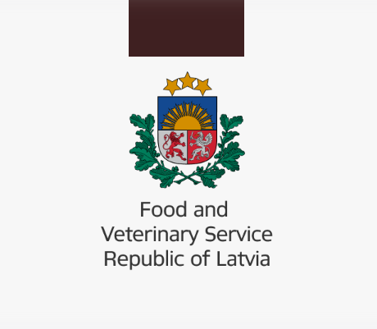
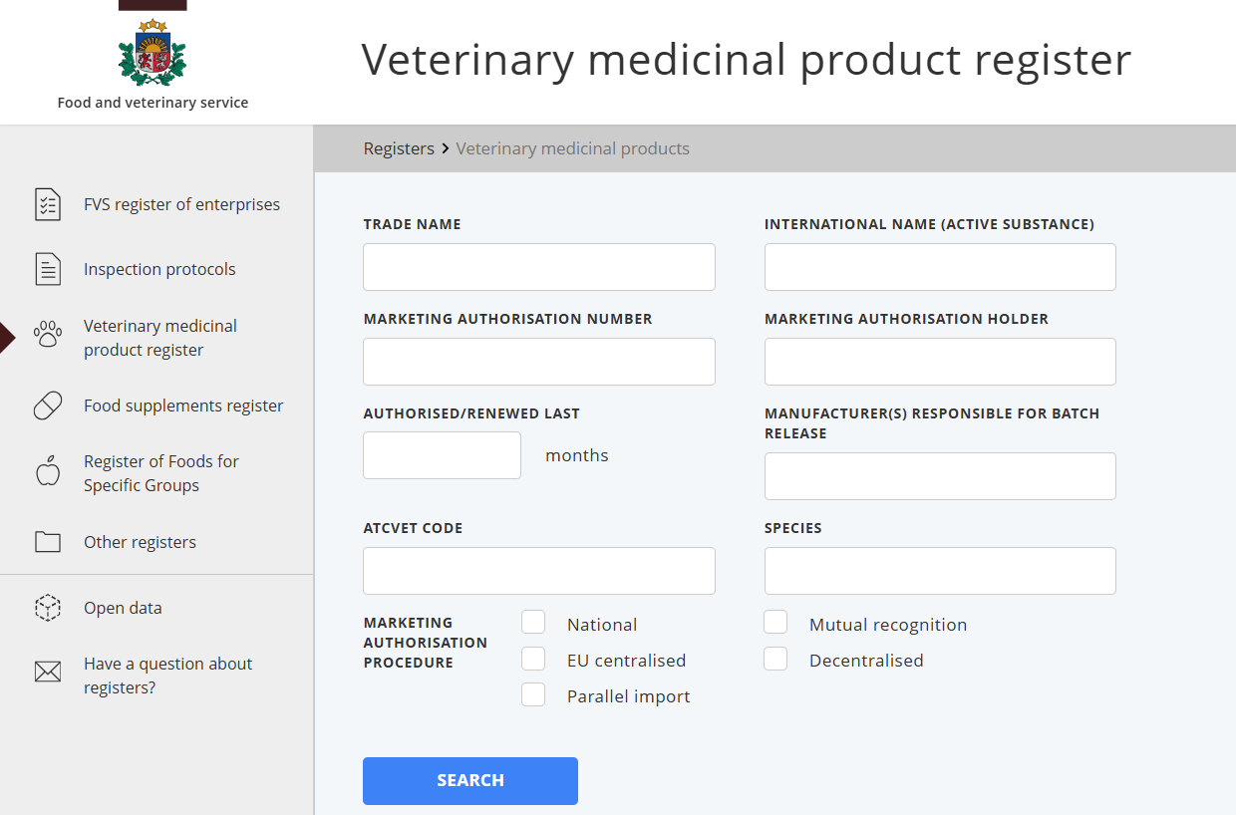
Veterinary medicinal product registration and monitoring

Slide 19
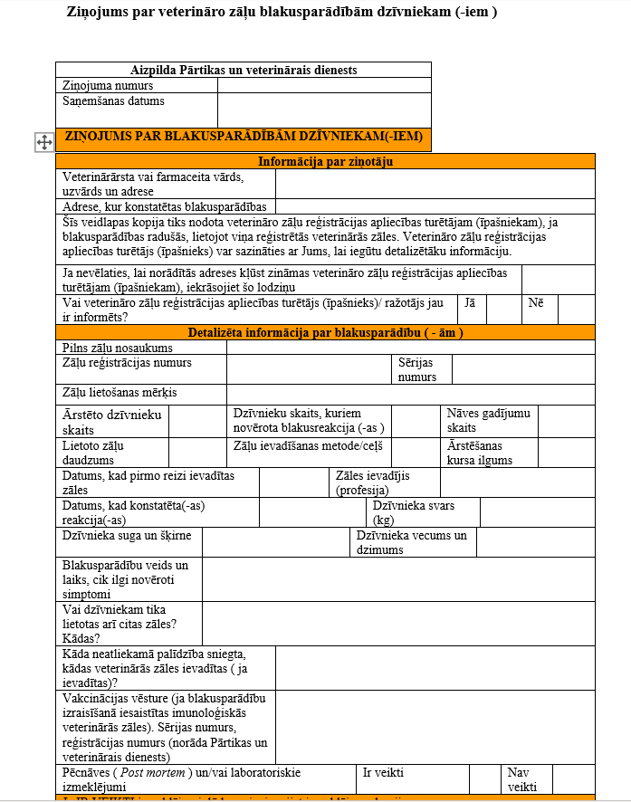
Side effect reporting
Side effects caused by the use of veterinary medicinal products must be reported to Food and Veterinary Service
https://www.pvd.gov.lv/lv/veterinaro-zalu-blakusparadibu-uzraudziba

Slide 20
Kopējā lauksaimniecības politika (KLP)
TARGET –
Do not increase sales volumes of antimicrobial agents by more than 10%, based on 2018 data
TOOLS -
Education and training of the public, animal owners/keepers and veterinary practitioners promoting awareness of the responsible and prudent use of AMR and AM
Effective management of animal health - compliance with biosecurity measures, control and prevention of infectious diseases, balanced and nutritious feed, appropriate keeping conditions, selection of the most suitable breeds, care of animal nails, etc.
Develop and use a unified electronic data recording system, where the animal owner/keeper, in cooperation with a practicing veterinarian, would ensure data recording of AM used in animals

Slide 21
NDP and GAP
NATIONAL DEVELOPMENT PLAN | – the development of the country, where the protection of public and animal health is important, observing the basics of the "one health" approach. [269], [285]
GOVERNMENT ACTION PLAN | – higher value products for the domestic market and for export In the Public Health Guidelines 2021-2027 and in the "One health" plan for limiting antimicrobial resistance and prudent use of antibiotics 2023-2027 implementation and sustainability of the planned measures. [24.1]

Slide 22
Public Health Guidelines 2021-2027
Develop and implement a unified development planning document for the human health, animal health and environment sectors 2023-2027. for limiting the spread of antimicrobial resistance in order to ensure the implementation and sustainability of the initiated policy, promote the implementation of the "One Health" principle in limiting antimicrobial resistance
Increase public awareness of antimicrobial resistance by organizing awareness campaigns
TASK:
Reduce the risks of the spread of antimicrobial resistance
To educate medical personnel about the responsible and cautious use of antibiotics
Promote research on antimicrobial resistance to identify the most effective methods of intervention and surveillance
Educate veterinary practitioners and animal keepers on the responsible and prudent use of antimicrobials

Slide 23
"One health" plan for limiting antimicrobial resistance and prudent use of antibiotics 2023-2027
AIM | Promote targeted and effective limitation and combating of the development and spread of AMR, ensure coordinated activities of participating institutions and organizations
THE RESULT | Limited development and spread of antimicrobial resistance. Changed patterns of antimicrobial use, achieving responsible and prudent use of antimicrobials in society, healthcare and animal health

Slide 24
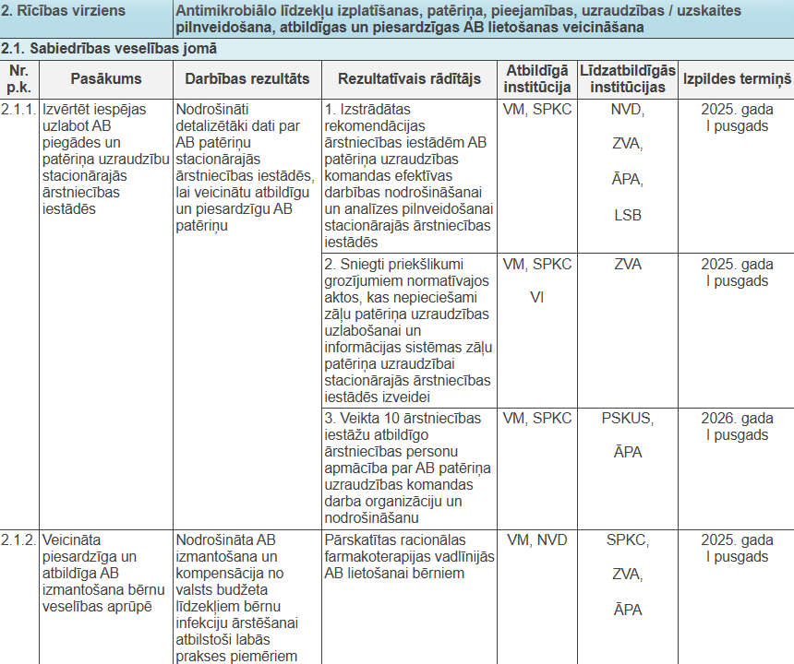
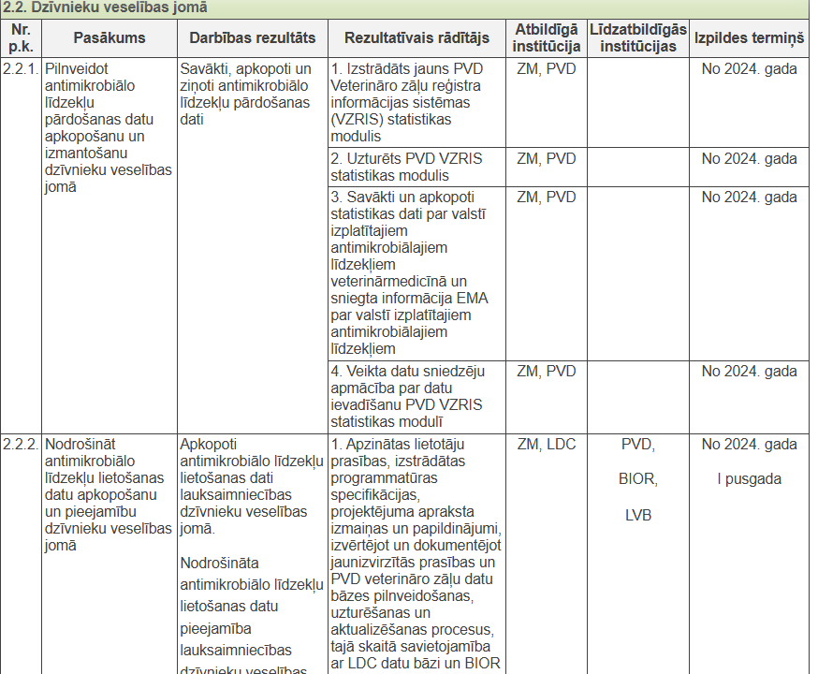
"One health" AMR Action Plan 2023-2027

Slide 25
ACTIONS IN THE FIELD OF ANIMAL HEALTH
 | Microorganism resistance monitoring, collection of consumption data of antimicrobial agents
 | Animal health management
 | Responsible and prudent use of antimicrobials
 | AMR Education, science and awareness on AMR issues

Slide 26


Interdisciplinary committee for combating AMR
Human health sector
Animal health sector
Environmental sector
  Ministry of Health – leading the committee
  Centre for Disease Prevention and Control – the secretariat of the committee
  State Agency of Medicines
  Health Inspectorate
  The National Health Service
  Ministry of Agriculture
  Food and Veterinary Service
  Institute of Food Safety, Animal health and Environment «BIOR»
Ministry of Climate and Energy
  Children’s Clinical University Hospital
  Riga East Clinical University Hospital
  Pauls Stradins Clinical University Hospital
  Latvian Association of Veterinarians
  Latvia University of Life Sciences and Technologies
  Faculty of Veterinary Medicine
  The Latvian association of Microbiologists
  Latvian association of rural general practitioners
  Latvian association of general practitioners

Slide 27
Interdisciplinary committee for combating AMR
AIM
  Assess current AMR situation and use of antimicrobials, provide proposals for improvement
  Provide evaluation of other issues related to AMR and prudent use of antimicrobials

Slide 28
Interdisciplinary committee for combating AMR
TASKS
  Prioritize issues in AMR and antimicrobial use and develop suggestions and recommendations for possible solutions
  Assess legal acts and proposals on AMR and prudent use of antimicrobials and provide proposals to the Ministry of Health or Ministry of Agriculture for the necessary amendments in regulatory acts
  Make proposals for the development of a National Policy on antimicrobial resistance
  and prudent use of antimicrobials
  Ensure the exchange of topical information and examples of good practice
  between sectors and various institutions on issues related to antimicrobial resistance and prudent use of antimicrobials

Slide 29
Interdisciplinary committee for combating AMR
RIGHTS
  Request and receive the necessary information from the state and
  local governmental institution, associations and foundations for its activities
  Invite other specialists as experts (from the same or other institutions)

Slide 30
The working group of containment of AMR
in the area of animal health
AIM
Ensure a focused and effective prevention of AMR in the area of animal health
Ministry of Agriculture
Food and Veterinary Service
Latvian Association of Veterinarians
Agricultural Data Centre
Animal breeder’s associations
Institute of Food Safety, Animal Health and Environment "BIOR"
Latvian Rural Consultation and Education Center
University of Life Sciences and Technologies
Faculty of Veterinary medicine

Slide 31
Guidelines for limiting the development of antimicrobial resistance at the stage of agricultural production and veterinary practice in Latvia
Developed in 2018
Aim:
Provide a summary of the spread of AMR, its causes and factors contributing to its spread, as well as recommendations for increasing the efficiency of AB use and reducing AMR resistance. In addition, information is also provided on the responsibility of the various parties involved and the major activities in the fight against AMR on a global scale
Guidelines topics:
Antibiotic selection priority list
Antibiotics belong to the antibiotic class
Classification of antibiotics
Principles of action of antibiotics
Development and spread of AMR
etc.
https://bior.lv/sites/default/files/inline-files/Vadlinijas.VPP_.pdf

Slide 32
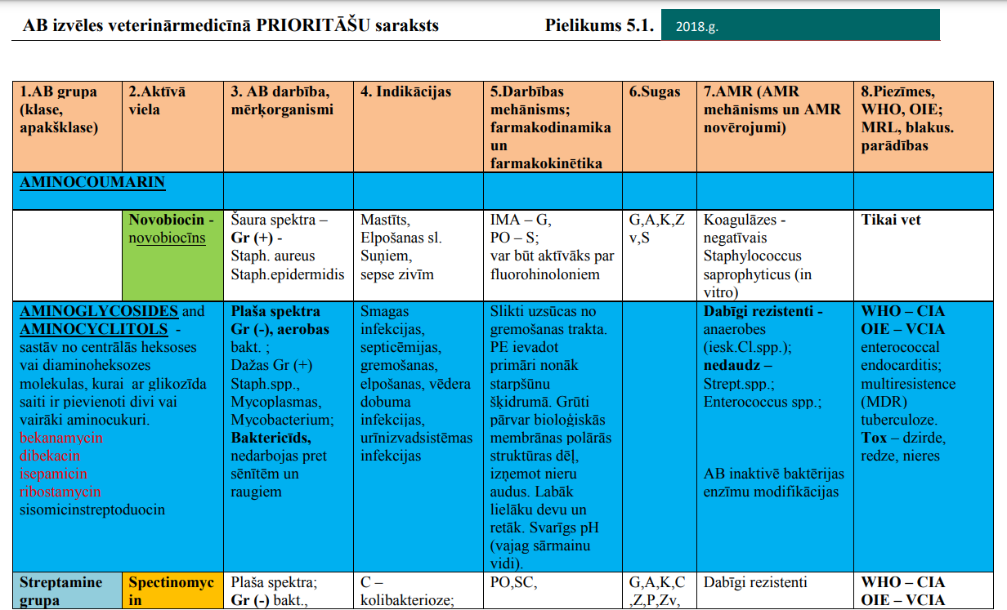
Guidelines for limiting the development of antimicrobial resistance at the stage of agricultural production and veterinary practice in Latvia
https://bior.lv/sites/default/files/inline-files/Vadlinijas.VPP_.pdf

Slide 33
LATOHOP project
EU TSI Project
“Support to the implementation of the One Health action plan
for containing antimicrobial resistance in Latvia” LATOHOP
Project time period (end of 2019 - middle of 2022)
    Main partners of the project:
    Swedish Board of Agriculture
    Public Health Agency of Sweden
    Ministry of Health of Latvia
    Ministry of Agriculture of Latvia
    stakeholders from public health and animal health sectors

Slide 34
LATOHOP project outcomes
OUTCOMES
Sustainability plan for continued work on implementing the One Health NAP
Human and animal health professionals are provided with skills and tools for prudent use of antibiotics as a means to prevent and contain AMR
  An intersectoral coordinating mechanism (ICM) is put in place to support information sharing and collaboration between sectors on various aspects of AMR among relevant professionals

Slide 35
BALTOHOP project
Grant Nordic Council of Ministers through NordForsk
“BALTic One Health One Plan” BALTOHOP
Project time period (01.02.2023. – 01.07.2025)
    Project owner: Sweden
    Project Facilitators:
    Sweden
    Norway
    Danmak
    Beneficiaries:
    Latvia
    Estonia
    Lithuania

Slide 36
TSI 2023 – 2025
Continue the initiated structural reform in the framework of "One Health" in the field of antimicrobial resistance and zoonoses
TARGETS
Improve the intersectoral cooperation in "One Health" approach
Improve the existing risk assessment in the country and crisis-risk intersectoral communication
Improve the existing professional education opportunities for non-stop planning and implementation of a skillful One health policy
Improve public awareness and understanding of “One health” approach,
as well as crisis-risk communication

Slide 37
RISK ASSESSMENT PROJECTS
 | Research study on the spread of antibacterial agent residues in meat of Latvian origin
Project timeline: 2018 – 2023
 | Research study on antimicrobial resistance of zoonotic agents and indicator bacteria in cattle and pig farms in Latvia
Project timeline: 2020 – 2023
 | Research study on prevalence of antimicrobial agents and antimicrobial resistance of zoonotic agents and indicator bacteria in surface and wastewater samples
Project timeline: 2023

