Slide 1
Hands-on training for farmers and veterinarians:
Group exercises
LATVIA, 3 & 4 DECEMBER 2024

Slide 2
“Prevention is better than cure”
Part I
Global need: reduction Antimicrobial resistance
New regulatory framework
Preventive measures to be implemented at farm level
Part II
Changes at farm level: Common understanding between farmers and veterinarians
Notes:
The second part of the hands-on-training focuses on the idea of “Prevention is better than cure”. Farmers and veterinarians will work together exploring changes at farm level as preventive measures to reduce the need of reducing antimicrobial use. These implies that a common understanding between farmers and veterinarians is needed.

Slide 3
“Prevention is better than cure”
Let’s work together to prevent and reduce the use of antimicrobials…
By creating action points on YOUR (client’s) farm
Notes:
“Let's work together to prevent and reduce the use of antimicrobial”.

Slide 4
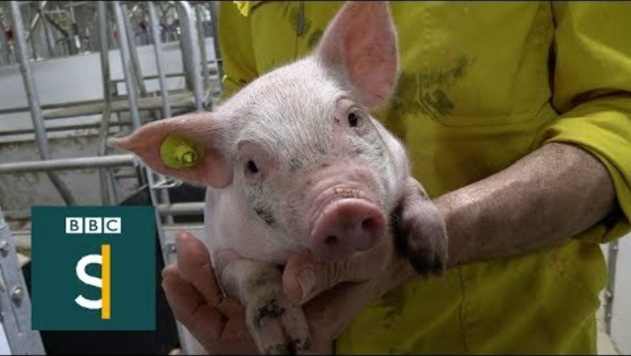
WHY?
Notes:
https://www.youtube.com/watch?v=jFuQqwBmN8A
The video will be shown with English subtitles. There is no possibility of showing the video in the native language of each country. The video is in English, and the audio will be translated by the interpreters

Slide 5
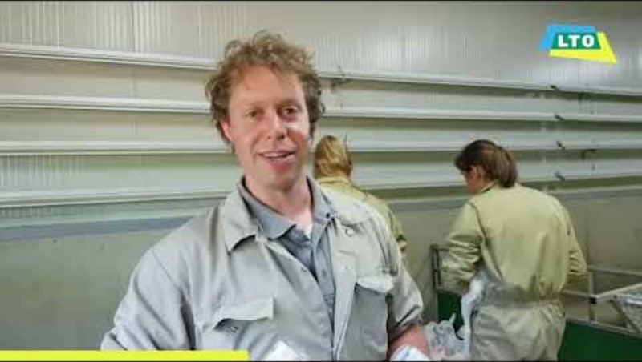
Foster collaboration between farmers and veterinarians
There is more and more collaboration between the farmer and the veterinarian to improve animal health and to reduce the use of antimicrobials on farm level…Because it is effective!
The aim for today is to identify common key areas in which farmers and veterinarians can collaborate, which leads to further improvement.
Notes:
Rational: A strong and well-established relationship between farmers and veterinarians forms the cornerstone for implementing effective measures at farm level to prevent and reduce the use of antimicrobials. It is therefore crucial to identify common key areas in which they can collaborate to foster trust between veterinarians and farmers. When both groups are able to identify the problems and solutions, this will set a strong basis for improvement.
Link to video: https://www.youtube.com/watch?v=cu7cIIlbOd8
The video will be shown with English subtitles. There is no possibility of showing the video in the native language of each country. The video is in Dutch and there is no possibility of audio translation, since the interpreters translate from English to the native language.

Slide 6
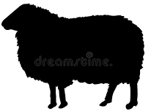
We will do the following group exercises:
GE 1
Identify problems and opportunities
Group exercise 1
Identify problems and opportunities
husbandry practices
to reduce and responsible use of antimicrobials
Problems& opportunities of farmers identified
Problems & opportunities of veterinarians identified
Group exercise 2
Find solutions to address barriers
2 a
2 b
to improve husbandry practices
to reduce and responsible use of antimicrobials
GE 2a
Identify
GE 2b
Group exercise 3
Sharing, presenting outcomes
3 a
3 b
GE 3a
List husbandry practices
Measures to reduce and responsible use of antimicrobials
GE 3b
Notes:
The activity will consist in agreeing action points at farm level, measures that are personally valuable to both farmers and veterinarians.
GE1: farmers and veterinarians in separated groups, grouped by specie
GE2 A & B: farmers and veterinarians are grouped together by specie
GE3 : presentations of the outcomes of GE2
The aim of the exercise is to identify different challenges and opportunities observed in the field that impact the implementation of best practices and further reduction of AMU, such as husbandry conditions, disease situation, biosecurity, animal health visits, diagnostic testing, prescription and use of antimicrobials, etc. The findings of this GE1 will serve as a basis for GE2a and GE2b.

Slide 7
Announcement
After group exercise 2a and 2b, you will be asked to write down a SMART action point for yourself – to be implemented on your / your client’s farm
For example:
By analyzing the blood and slaughter line test results and adjusting the vaccination policy accordingly, there will be no cough in weanling piglets within 2 months.

Slide 8
Group exercise 1
Identify problems / barriers towards implementing best practices
Please, answer to the following questions:
1. What are the most used antimicrobials in your species and for which conditions?
2. Share good practices that you have implemented or planning to implement to allow a reduced use of antimicrobials
Husbandry practices
Reduced and responsible use of antibiotics
Other
3. Name the reasons why these best practices are not easy to implement?
Notes:
In other countries: Farmers and veterinarians in separate groups
The aim of the exercise is to identify different challenges and opportunities observed in the field that impact the implementation of best practices and further reduction of AMU, such as husbandry conditions, disease situation, biosecurity, animal health visits, diagnostic testing, prescription and use of antimicrobials, etc. The findings of this GE1 will serve as a basis for GE2a and GE2b.

Slide 9
Examples of husbandry practices
Feeding and nutrition,
Housing and infrastructure,
Reproductive management,
Preventive management,
Welfare,
Records and documentation
Biosecurity
Hygiene
Genetics
Notes:
Use this slide in case it is necessary to visually explain examples of husbandry practices.

Slide 10
Examples of responsible use of antimicrobials
diagnostic tests,
drug administration,
drug dosage,
alternatives to the use of antimicrobials,
monitoring and review of antimicrobial use practices, among others
pathogen identification
susceptibility testing
Notes:
Use this slide in case it is necessary to visually explain examples of the reduced and responsable need of antimicrobials.

Slide 11
Group exercise 2a – Find solutions to the problems & barriers identified in GE1– husbandry practices
Farmers and veterinarians should be grouped together per species.
Take a flip-over to answer the following questions (work with post-its)
What were the problems/barriers previously identified in GE1? (focus on husbandry practices)
What are the solutions to address these barriers?
Create a SMART goal for yourself - to be implemented on your / your client’s farm
Notes:
Farmers and veterinarians grouped toguether per specie
Topics for discussion (non-exhaustive):
o Hygiene practices
o Biosecurity measures
o Nutrition
o Animal welfare
o Vaccines schemes
o Other management measures
Participants should identify solutions concerning husbandry practices (separated from the reduced and responsible use of antimicrobials). If necessary, provide the examples of husbandry practices: feeding and nutrition, housing and infrastructure, reproductive management, preventive management, welfare, records and documentation, among others.
Explain that the time limit is for GE2a in general, not per question.
Do not show all the questions at once, to let participants go into depth in each question.
“reduced and reduction and responsible use of antibiotics’: disease prevention, diagnostic tests, drug administration, drug dosage, alternatives to antimicrobials, monitoring and review of antimicrobial use practices, among others

Slide 12
Group exercise 2b - Find solutions to address problems & barriers from GE1 –Reduced and responsible use of antimicrobials
Farmers and veterinarians should be grouped together per species.
Take a flip-over to answer the following questions (work with post-its)
What were the barriers towards a reduced and responsible use of antimicrobials identified in GE1?
What are the solutions to address these barriers?
Create a SMART goal for yourself - to be implemented on your / your client’s farm
Notes:
Farmers and veterinarians grouped toguether per specie
Topics for discussion (non-exhaustive):
o Hygiene practices
o Biosecurity measures
o Nutrition
o Animal welfare
o Vaccines schemes
o Other management measures
Participants should identify solutions concerning the reduced and responsible use of antimicrobials (separated from husbandry practices).
If necessary, provide the examples of the reduced and reduction and responsible use of antimicrobials’: disease prevention, diagnostic tests, drug administration, drug dosage, alternatives to antimicrobials, monitoring and review of antimicrobial use practices, among others
Explain that the time limit is for GE2b, not per question.
Do not show all the questions at once, to let participants go into depth in each question.

Slide 13
Group exercise 3a: Presentation of the outcomes: solutions to improved husbandry practices
Each table addresses one presenter
“In what way can improved husbandry practices contribute to the reduction of AMU?”
Each presenter presents one outcome of his/her table session
Then we continue to the next table – mention an outcome that haven’t been mentioned before!
Notes:
In case there is remaining time for discussion:
Questions:
What are the similarities with the outcomes of your sector?
What are the differences?
What raises questions? / What stands out?
Focus on husbandry practices. If necessary, return to the slide with examples.

Slide 14
Group exercise 3b: Presentation of the outcomes: measures to reduce and use antimicrobials in a more responsible way
Each table will be represented by one presenter.
“In what way can other measures to be implemented contribute to the reduction of AMU?”
Each presenter presents one outcome of his/her table session
Then we continue to the next table – mention an outcome that haven’t been mentioned before!
Notes:
Presenter will often be one of the trainers
In case there is remaining time for discussion:
Questions:
What are the similarities with the outcomes of your sector?
What are the differences?
What raises questions? / What stands out?
Focus on the reduction and the responsible use of antimicrobials: If necessary, return to the slide with examples.

Slide 15
Farmers and veterinarians working together towards a common goal

