Slide 2
Reduction of antibiotics usage in broiler farms
Tatjana Lisakovska
M. Med. Vet.

Slide 3














Our group
GRAIN TRADE
FLOUR
FOOD PRODUCT
SEEDS, FERTILIZER, PLANT CARE PRODUCT
AGRICULTURAL EQUIPMENT
POULTRY FARMING AND PROCESSING
Since the year 2021
TRADE OF ROW MATERIALS FOR ANIMAL FEED
AGRICULTURAL PRODUCTION

Slide 4
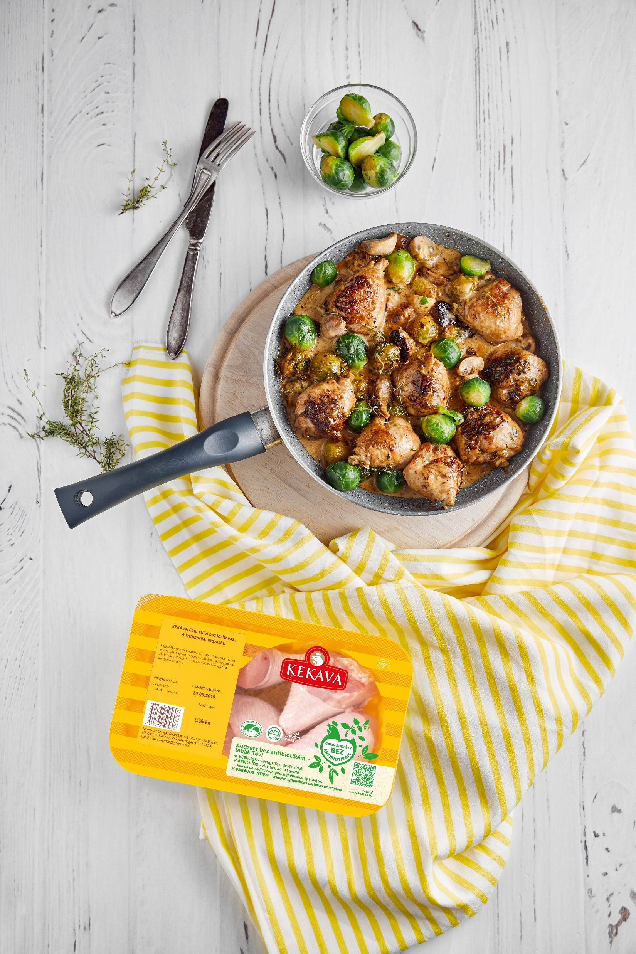

About the company
FOUNDED | 1967
SALES VOLUME | 36 000 tons
TURNOVER | 112 million EUR
QUALITY | Raised without antibiotics since 2017

Slide 5

KEKAVA FOODS the only full-cycle
poultry meat producer in Latvia
Eggs, from own company poultry breeders
Chicks, hatched from own company hatching eggs
Own company poultry breeders
Meat poultry-broilers
Kekava Foods Trader market pleace and sale in customer markets over Latvia
Certified poultry slaughterhouse
Delivery to traiding pleace
Meat products

Slide 6

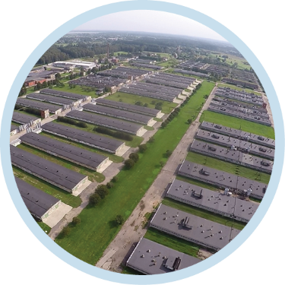



Production sites
RIGA
KEKAVA
BAUSKA
Production of frozen salted and processed products
93 hectares
64 broiler un 30 breeder flock
Hatchery
Fresh and processed meat production
Administration
35 hectares
36 broiler flock
Hatchery
Feed production

Slide 7
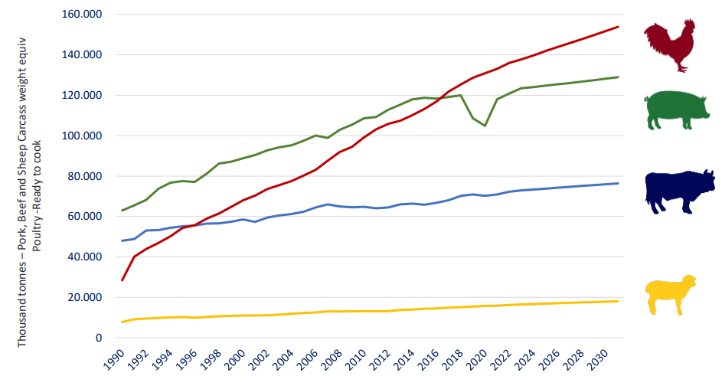
Poultry meat consumption is the
No.1 choice globally

Slide 8
Dynamic of antibiotic consumption in broilers
Notes:
https://scholar-press.com/uploads/papers/k8Gt8n3sRG1bZC0amR0sKheFu6V5QX1e6rXcHfaT.pdf

Slide 9
Broilers
Notes:
https://scholar-press.com/uploads/papers/k8Gt8n3sRG1bZC0amR0sKheFu6V5QX1e6rXcHfaT.pdf

Slide 10
Colibacteriosis is the main reason of antibiotic usage for broilers
Colibacteriosis is the main reason for chicken death:
1st and 2nd week of life, between 7% and 17%
3rd and 4th week of life, between 2% and 8%
5th and 6th week of life, between 1,5%-7%

Slide 11
Antibiotic susceptibility of
Escherichia coli isalates
Disc diffusion test | Day old breeder chick |  |  | Day old chick /hatchery/
 | 2018 | 2019 | 2020 | 2018 | 2019 | 2020
Tilmicosin TIL 15 | 90,9 | 100 | 100 | 100 | 100 | 100
Sulphametoxazole RL 25 | 90,9 | 91 | 67 | 91,83 | 86,67 | 63,2
Doxycycline DO 30 | 27,3 | 10 | 33,3 | 31,14 | 33,3 | 21,5
Enrofloxacin ENR5 | 0 | 0 | 0 | 0,48 | 7,69 | 5,26
Amoxycillin/clavulinic acid AMC 30 | 18,2 | 18 | 0 | 31,25 | 13,13 | 31,6
Amoxycillin AML 10 | 81,8 | 100 | 50 | 100 | 70 | 89,47
Notes:
Būs bilde no laboratorijas

Slide 12
Prudent and responsibe use of antibiotics for broilers is part of internal procedures
AVOID
RESTRICT
CAUTION
PRUDENCE
European Medicine Agency:
A
B
D
C
Company:
NOT USE
USE A LITTLE
NOT USE
B – NOT EFFECTIVE
POULTRY FARMING FOR MEAT
(broilers)
Individual group
1 x per cycle
Colibacteriosis¹
Other²
Regulation No 2016/6
Article 107
Point 4
B

Slide 13
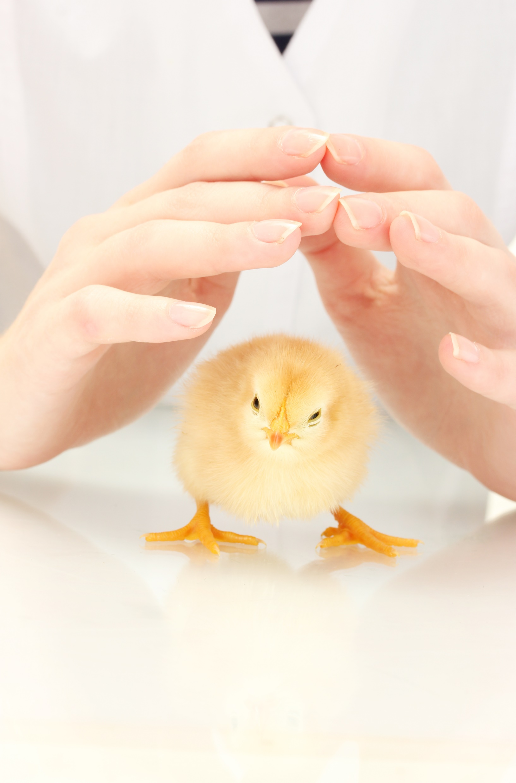
11 important steps on the way to antibiotic – free poultry
Health status of day – old chick
Hygiene
Nutrition
Keeping conditions
Bird care
Veterinary surveillance
Personnel training
Biosafety
Motivation
Investments
Management

Slide 14
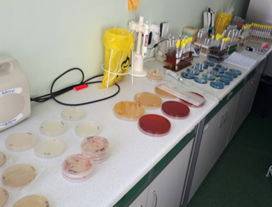
24h surveillance: Company’s veterinary service
/4 veterinarians and 4 veterinary assistants/
On-site welfare monitoring
LABORATORY SURVEILLANCE OF DISEASE
BACTERIA/VIRUSES
APPROPRIATE VACCINATION STRATEGY
MONITORING OF VACCINATION EFFECTIVENESS
REGULAR POST-MORTEM INVESTIGATION
CLINICAL OBSERVATION
Control of productivity indicator /access to digital records/
Statistics
Diagnosis
Breeder in rearing Breeder in production
Broilers
Technical implementation
Antibody titter

Slide 15
The opportunity of laboratory diagnostics
MICROBIOLOGY
Internal laboratory
SEROLOGY
Internal laboratory /BIOCHEK/
MOLECULAR DIAGNOSTICS
Laboratory Diagnostics (CUXHAVEN)
Bior-state
Vaxxinova /Leipzig/
Laboratory Diagnostics (CUXHAVEN)
Laboratory Diagnostics (CUXHAVEN)
GD Animal Health (DEVENTER)
https://www.gdanimalhealth.com/en/Lab-services

Slide 16
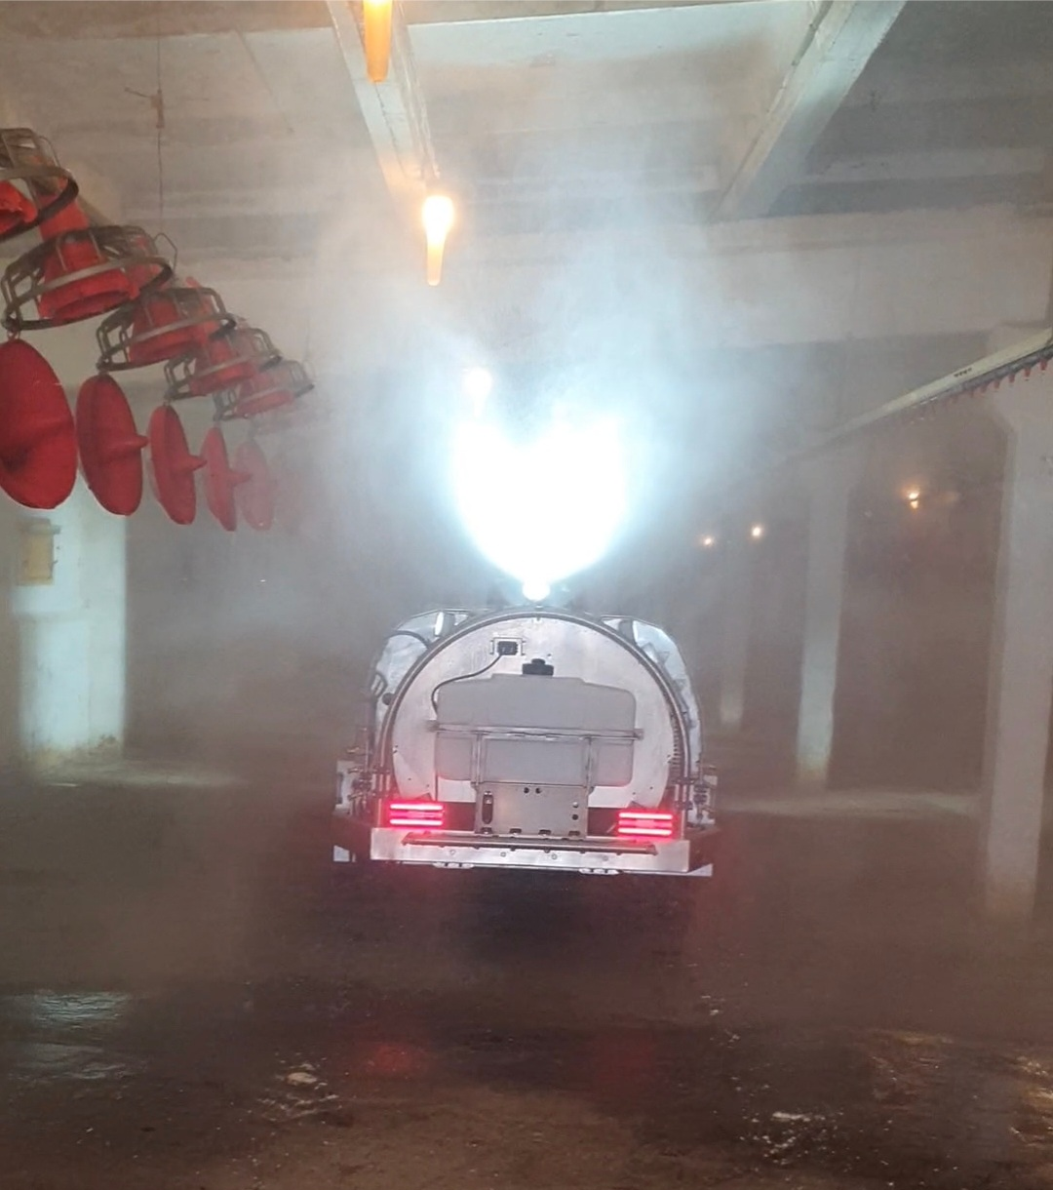
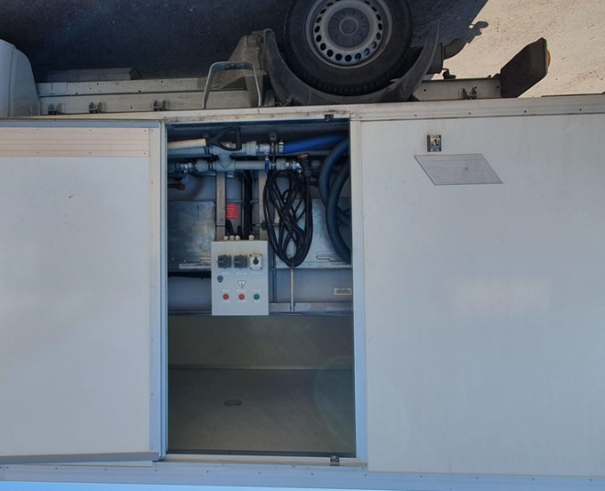
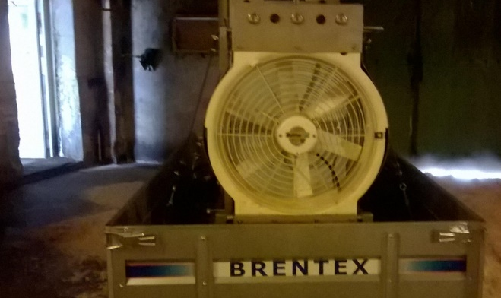
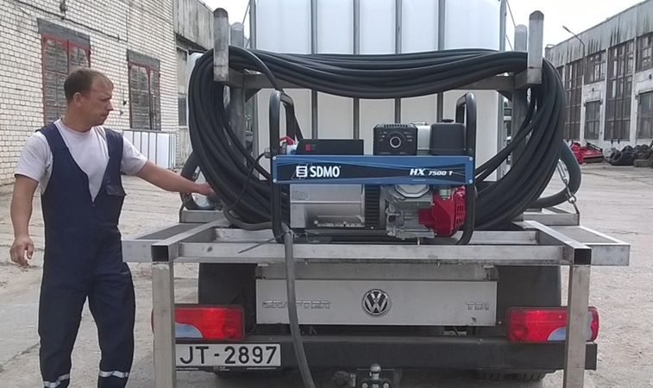
HYGIENE: Effective disinfection
Modern disinfection equipment

Slide 17

The complex approach– healthy intestinal tract
ORGNIC ACIDS
PLANT EXTRACTS
Control of the microbial background in feed, drinking water and the intestinal tract of the birds
Promotion of the growth of benifical microflora in the intestinal tract of birds
Providing intestinal integrity and a natural barrier function

Slide 18

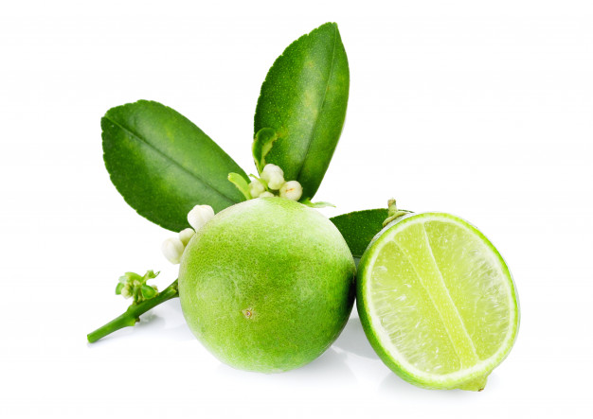
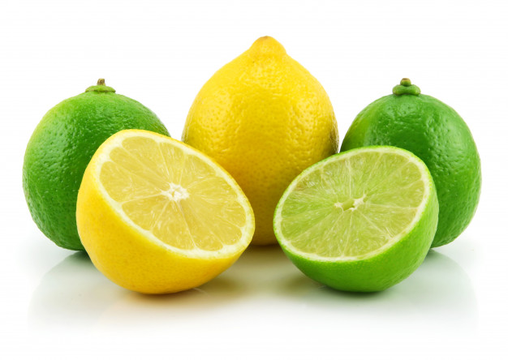
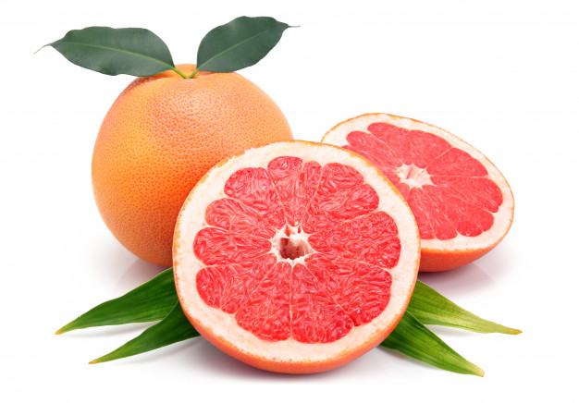
The importance of organic acids in broiler feed
Impove feed absorption
Improves the condition or the intestinal mucosa
Improve natural protective capability
REDUCES NUTRIENT LOSS
INCREASE THE ABSORPTION SURFACE OF THE INTESTINAL WALL
REDUCE ANTIBIOTIC USE

Slide 19

Fatty acids in the fight agains microorganisms
FORMIC ACID
(C1)
PROPIONIC ACID
(C3)
BUTYRIC ACID
(C4)
LACTIC ACID
SHORT CHAIN FATTY ACID: C1-C4

Slide 20
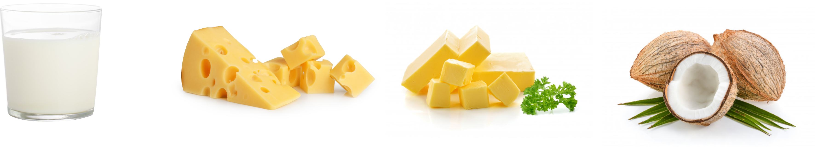
Fatty acids in feed for gut health
CAPRYLIC ACID
(C8)
CAPRIC ACID(C10)
CAPROIC ACID
(C6)
LAURIC ACID
(C12)
MEDIUM CHAIN FATTY ACIDS: C6-C14

Slide 21

Plant-based feed additives in broiler feed
THYMOL, CARVACROL
antimicrobial / antiviral / antiparasitic / antixidant
POLYPHRNENES, TERPENES, ANISALDEHIDES
increase enzyme activity and reduce oxidative stress
POLYPHENOLS
for normalizing intestinal microflora
ALCALOID CAPSACIIN
antibacterial / antifungal

Slide 22
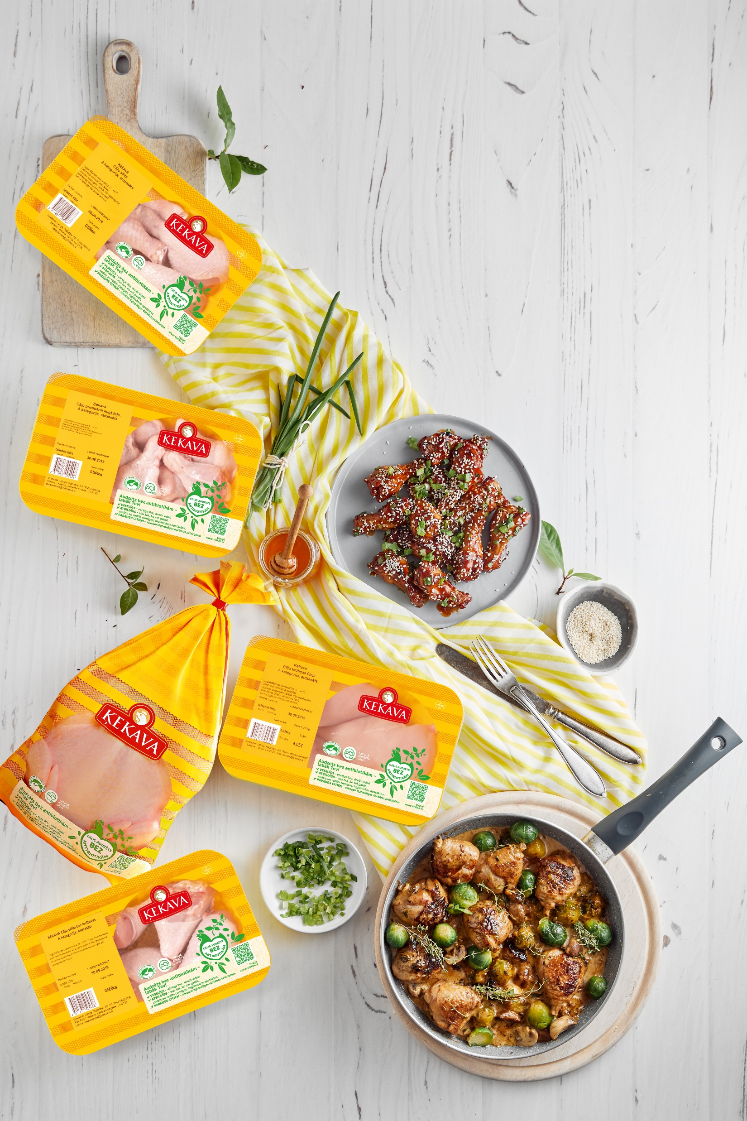

Our goal is to continuously improve, using the latest scientific discoveries, so that the product we produce meet the highest consumer requirements.

Slide 23
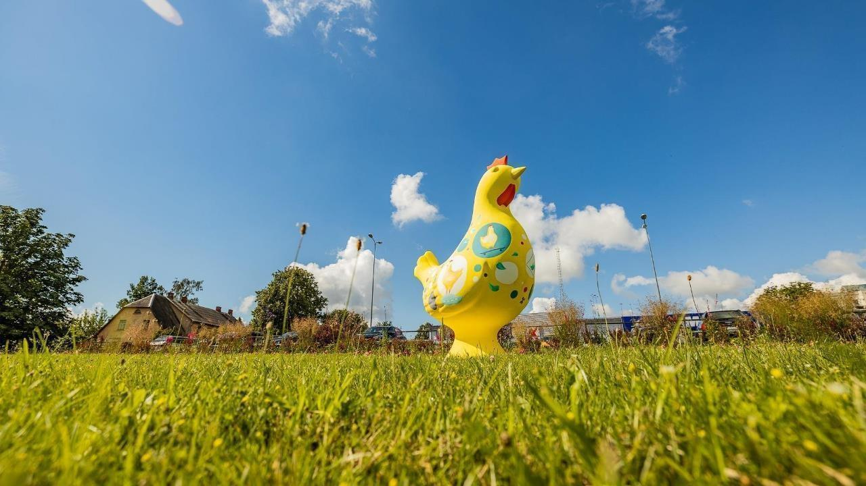

Paldies!
Thank you!

