Slide 1


Practical training for farmers and veterinarians.
New ways to fight antimicrobial resistance

Slide 2
Successful cooperation between a veterinarian and a pig farming company Owner
SIA “Gaižēni”
Director Alekss Rasmussen
Veterinarian Iveta Rundele

Slide 3
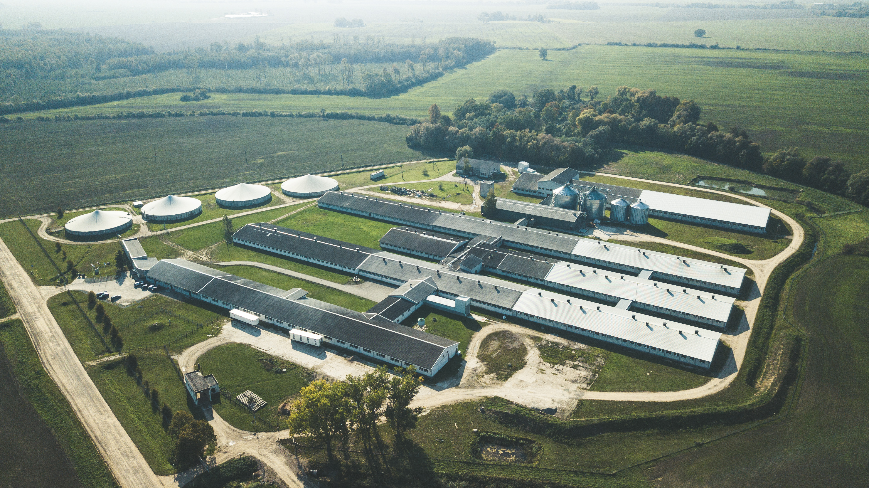

Slide 4
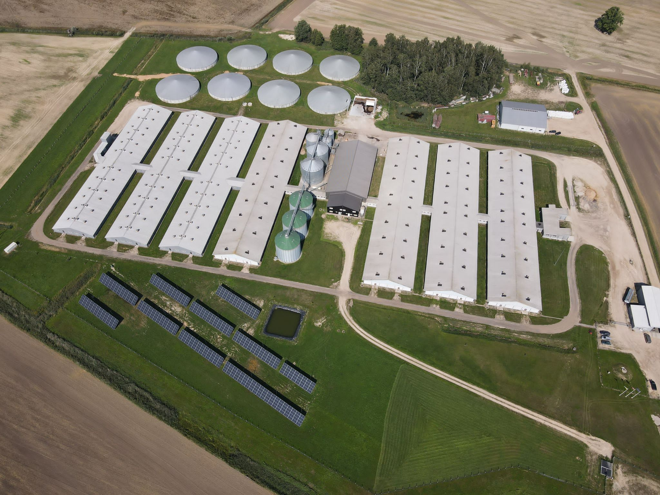

Slide 5
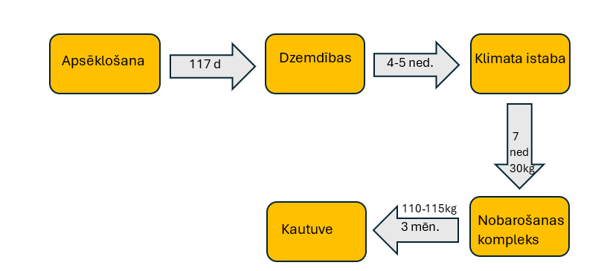
Farm profile
Full cycle production
Insemination
Birth
Climate room
4-5 w
7 w
30kg
Slaughter house
Fattening complex
3 m

Slide 6



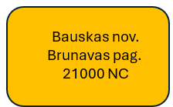
The company has four holdings
Cēsu nov.
Priekuļu pag.
Breeding holding
530 sows
Cēsu nov.
Priekuļu pag.
Fattening pig holding
2300 FS
Bauskas nov.
Islīces pag.
2650 sows
Bauskas nov.
Brunavas pag.
21000 FS
The reproduction of the herd is ensured by the company itself:
Basically three breeds are used - Yorkshire, Landrace and Djurok.
Crossbreeding of breeds is carried out in the breeding holding.

Slide 7
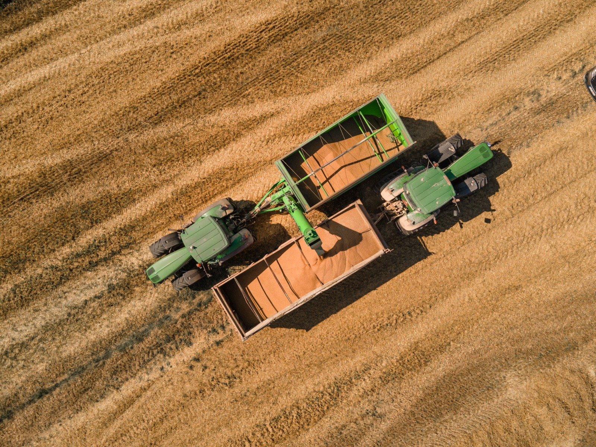
Crop production
⅓ of the raw materials needed for feed is grown by the company itself
About 1000 ha in Cesis
600 ha in Bauska
The company also grows its own legumes to reduce the use of soy
Notes:
The feed production plant is registered in the PVD feed registration register

Slide 8
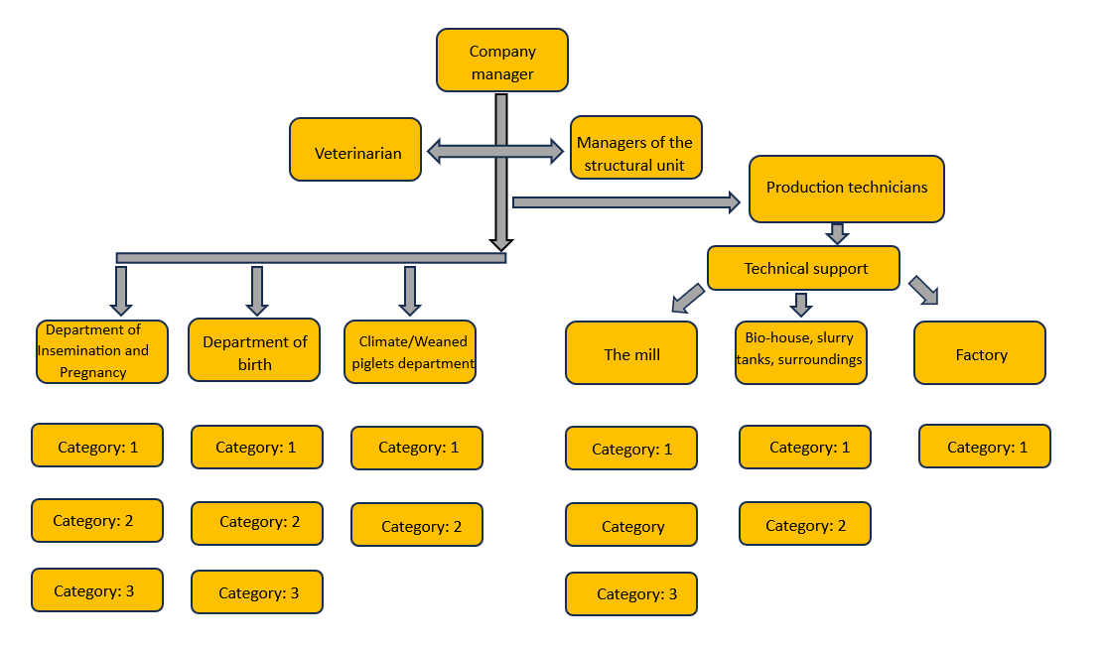
The basic principle of the organization

Slide 9
Minimum requirements to reduce the risk of antimicrobial resistance in pig farming
Biosecurity;
Surveillance of infectious diseases;
Quarantine of imported animals;
Herd health status and its management;
Effective, antibiotic-free feed additives;
High building hygiene, combined with a disease control plan developed for a specific farm and type of farming and strict biosecurity;
A well-designed vaccination program (adapted to specific conditions);
High-quality housing environment, and minimized stress factors for pigs, provision of welfare requirements;
A complete feed base that considers the functional properties of the ingredients;
High quality of care, hygiene and veterinary care for sows, suckling piglets and weaned piglets;
All Full/All Empty pig farming strategy.

Slide 10
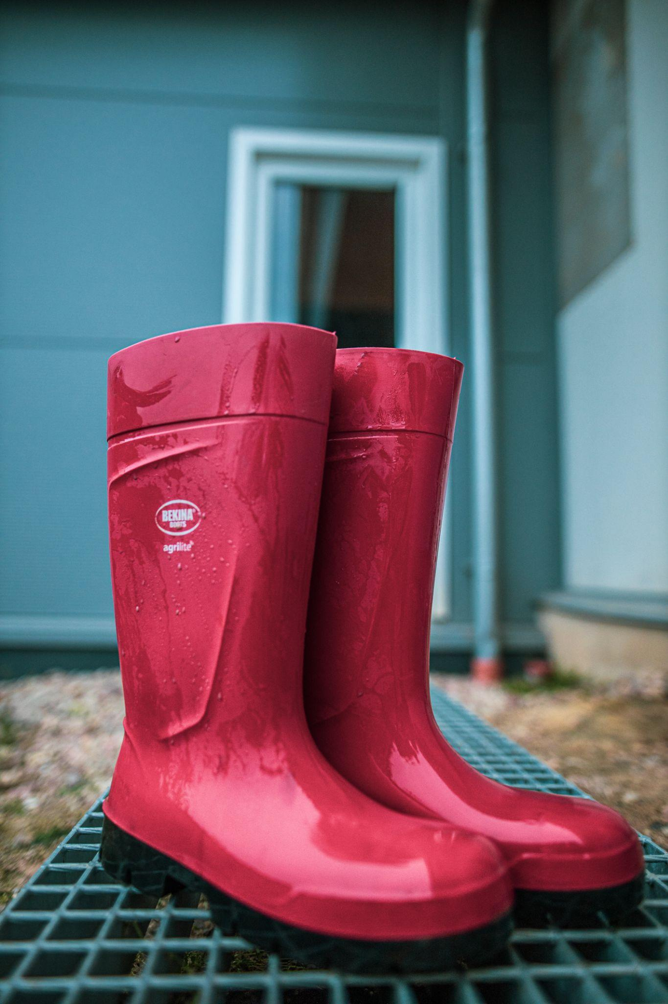
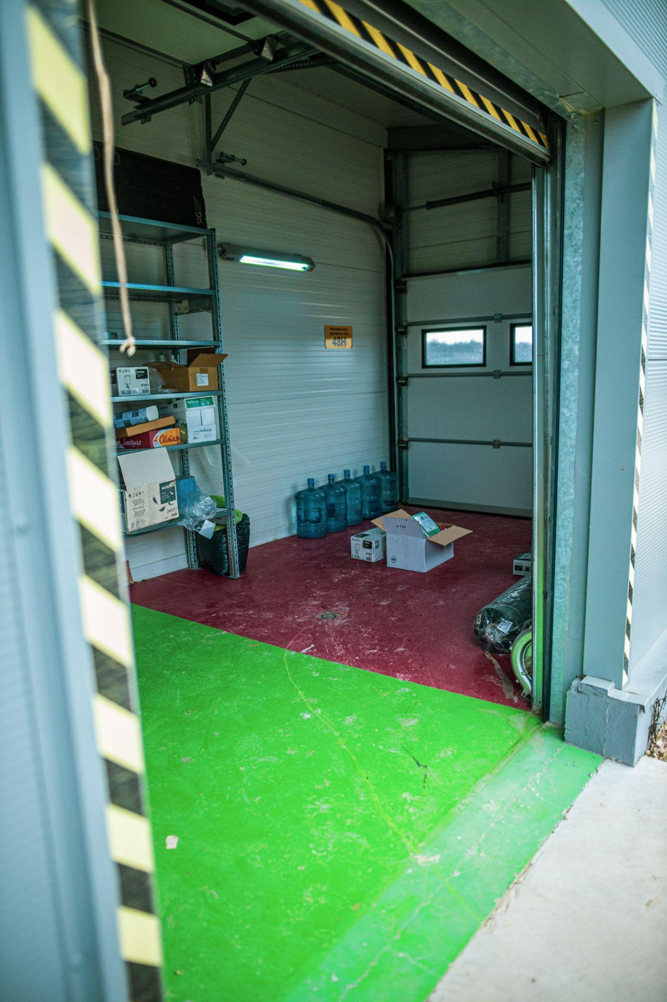
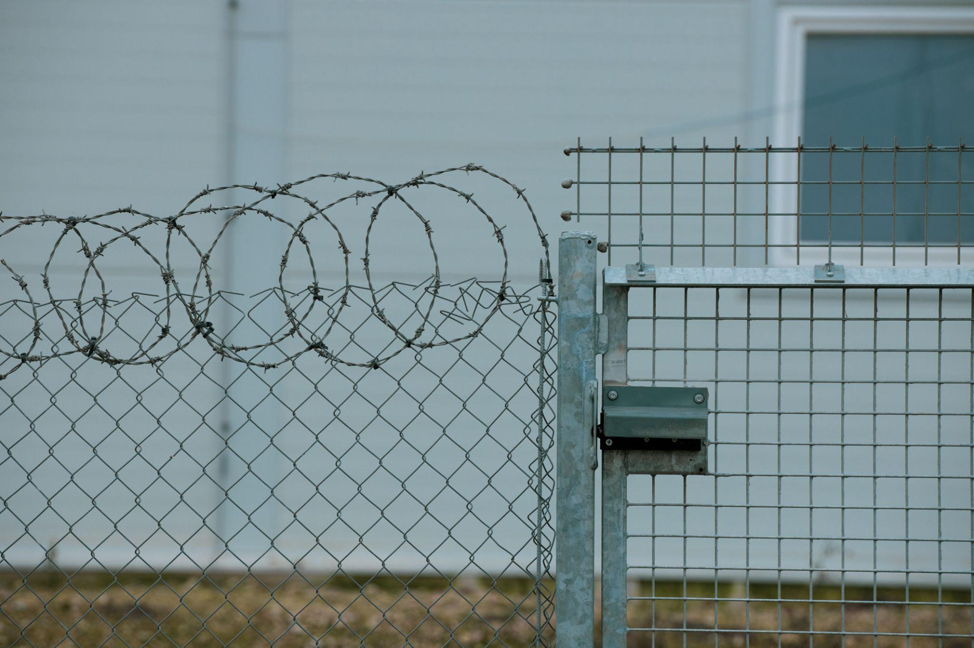
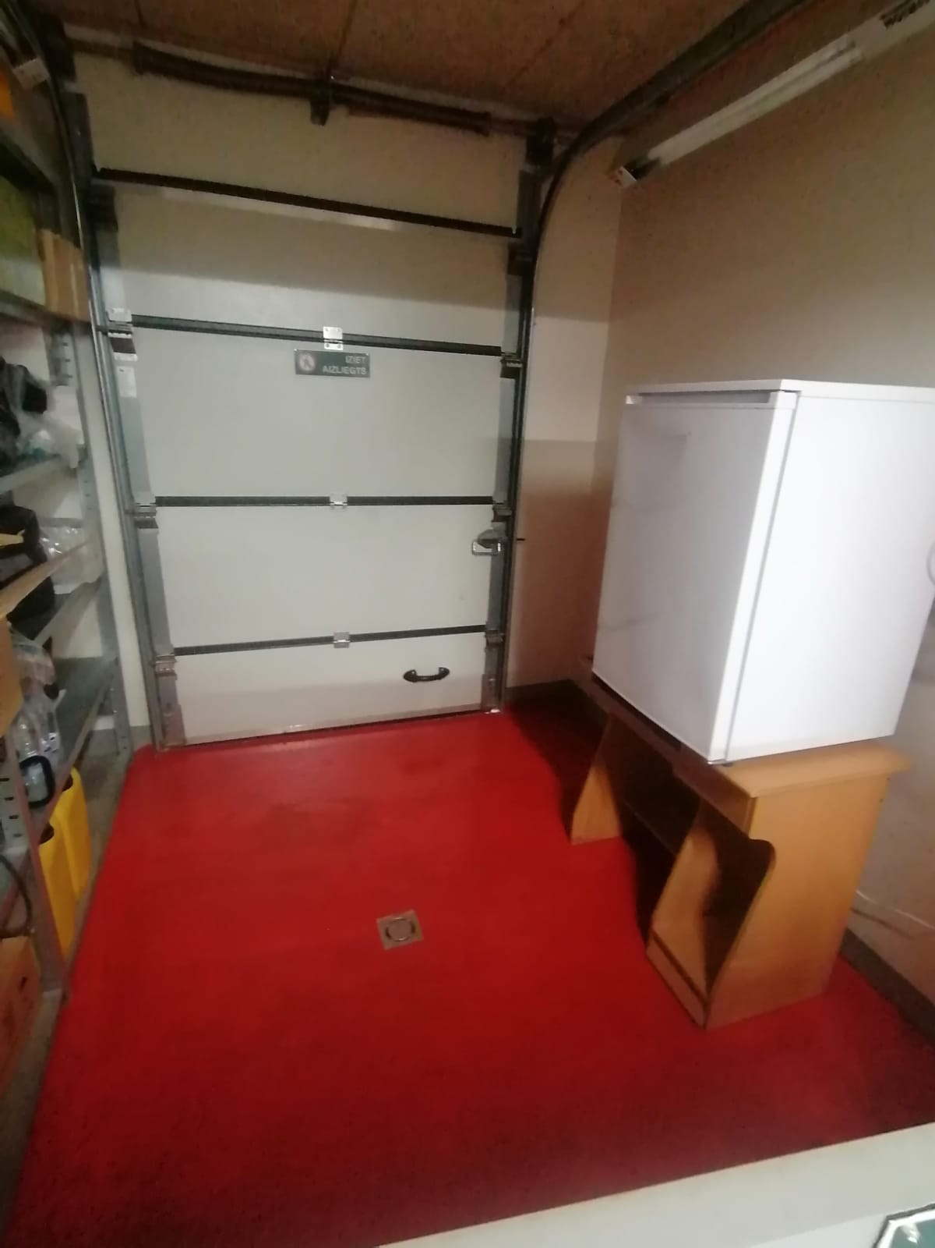
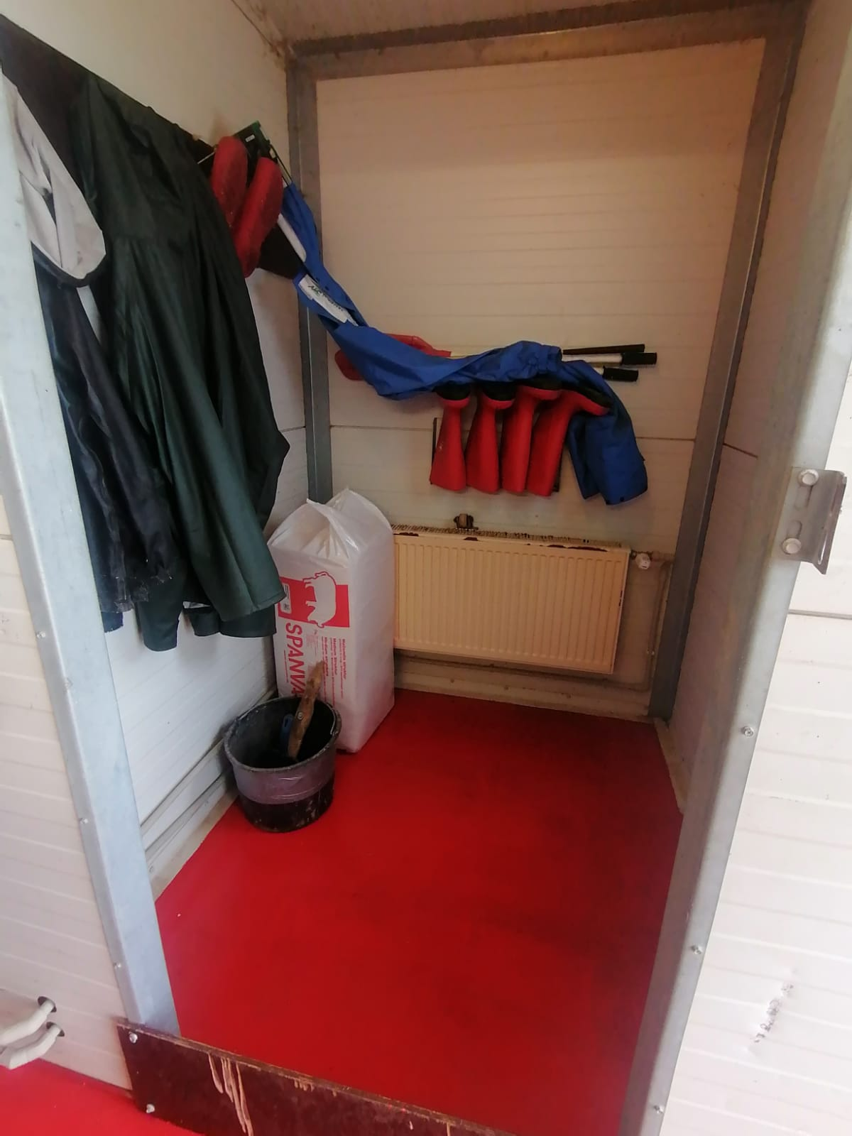
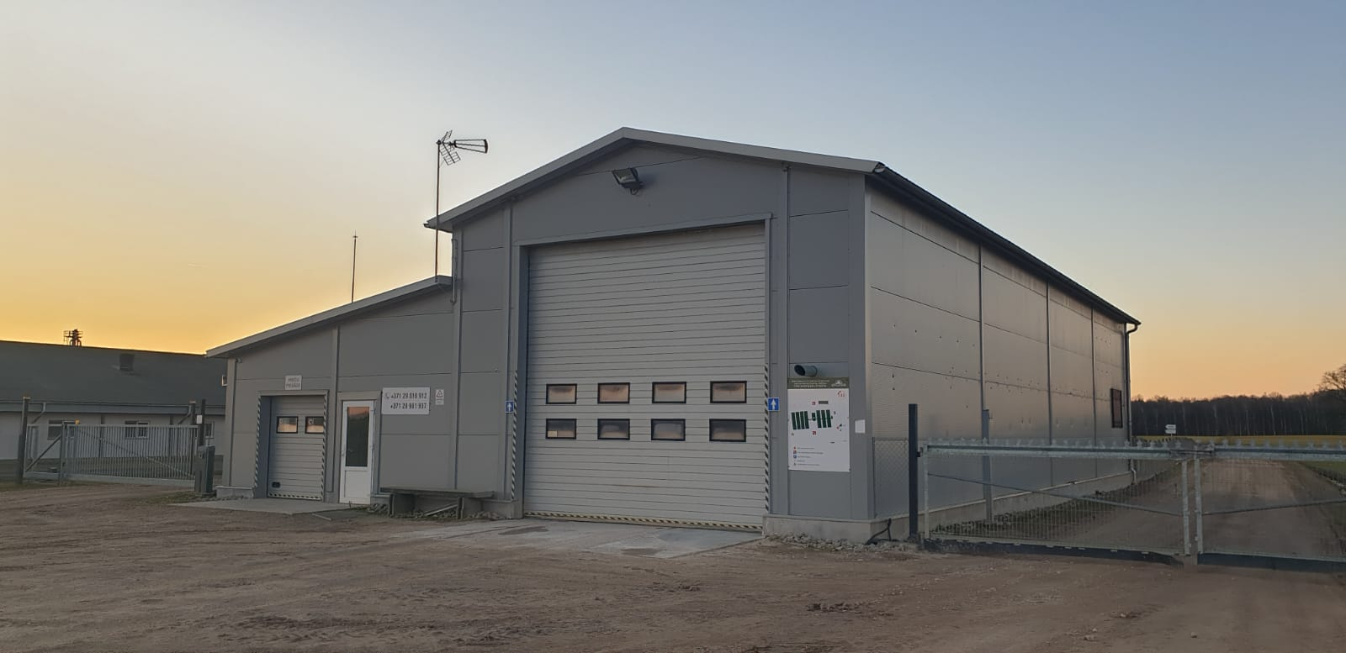
Biosecurity level - high Biosecurity plans, procedures, training, process routines, control and updating
External
Territory
Entry into holdings
Bio-house
Traffic flow
Red product areas
The principle of ramps
Internal
Principle - full, empty
Washing and disinfection
Animal flow
Cleanliness and hygiene

Slide 11
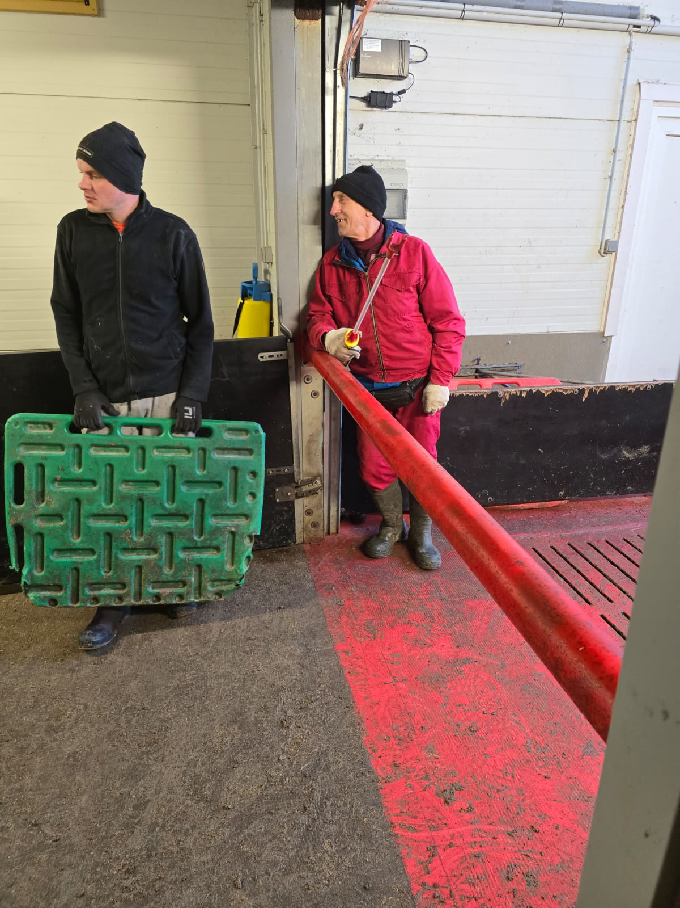
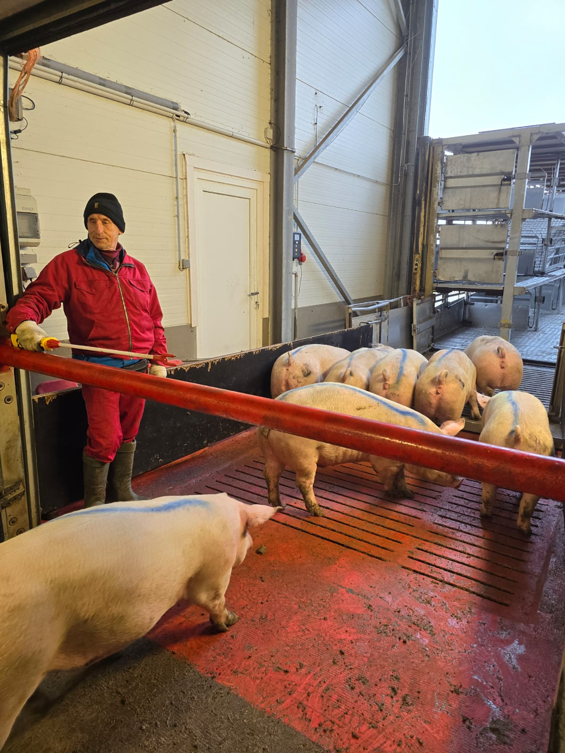
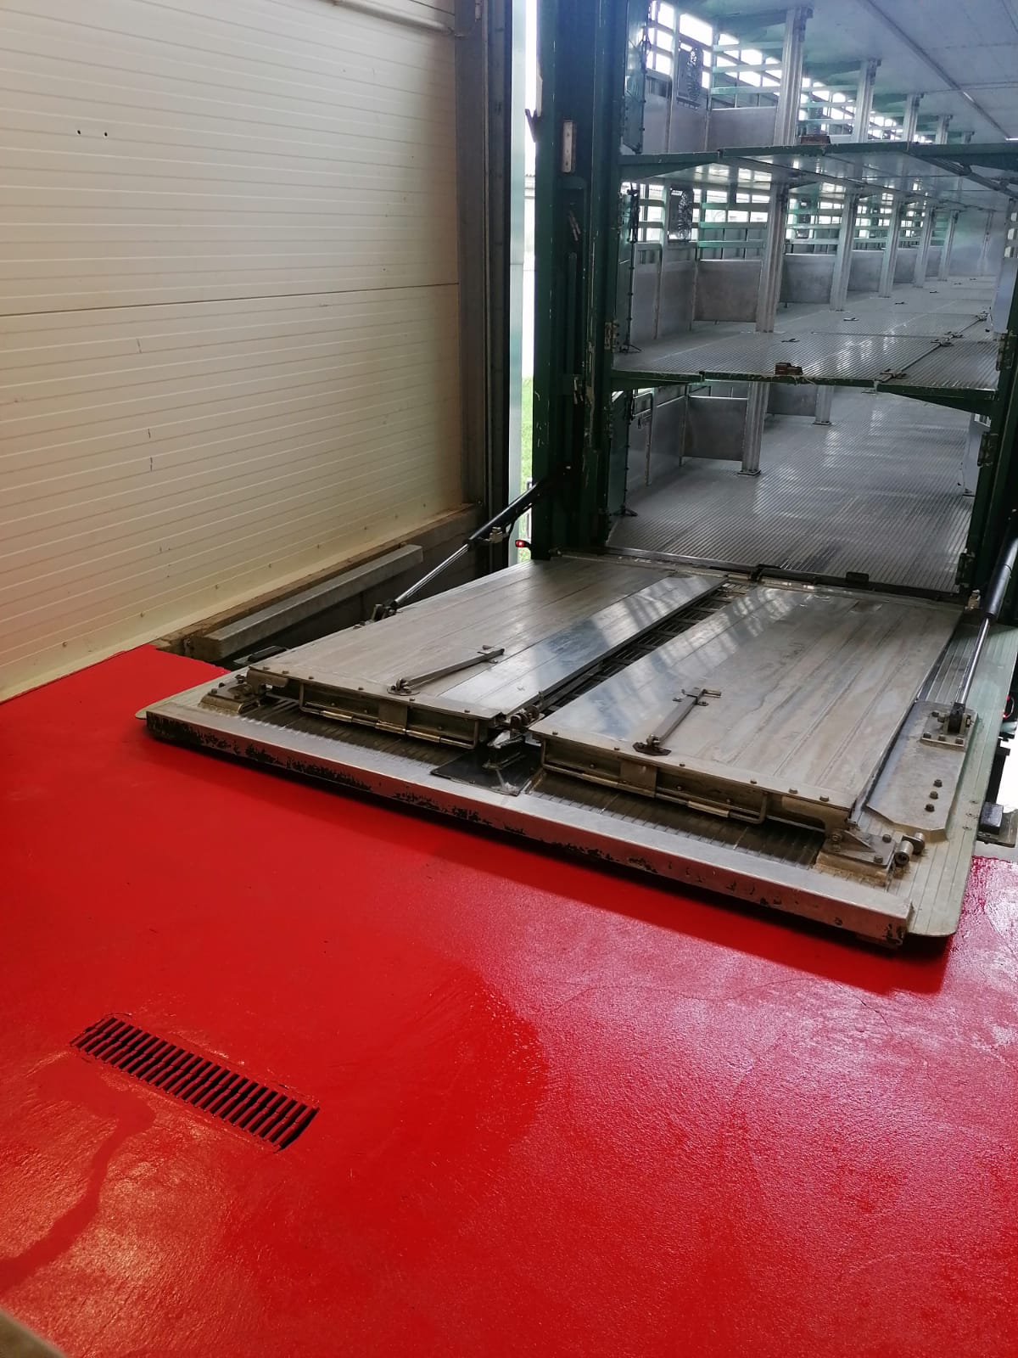
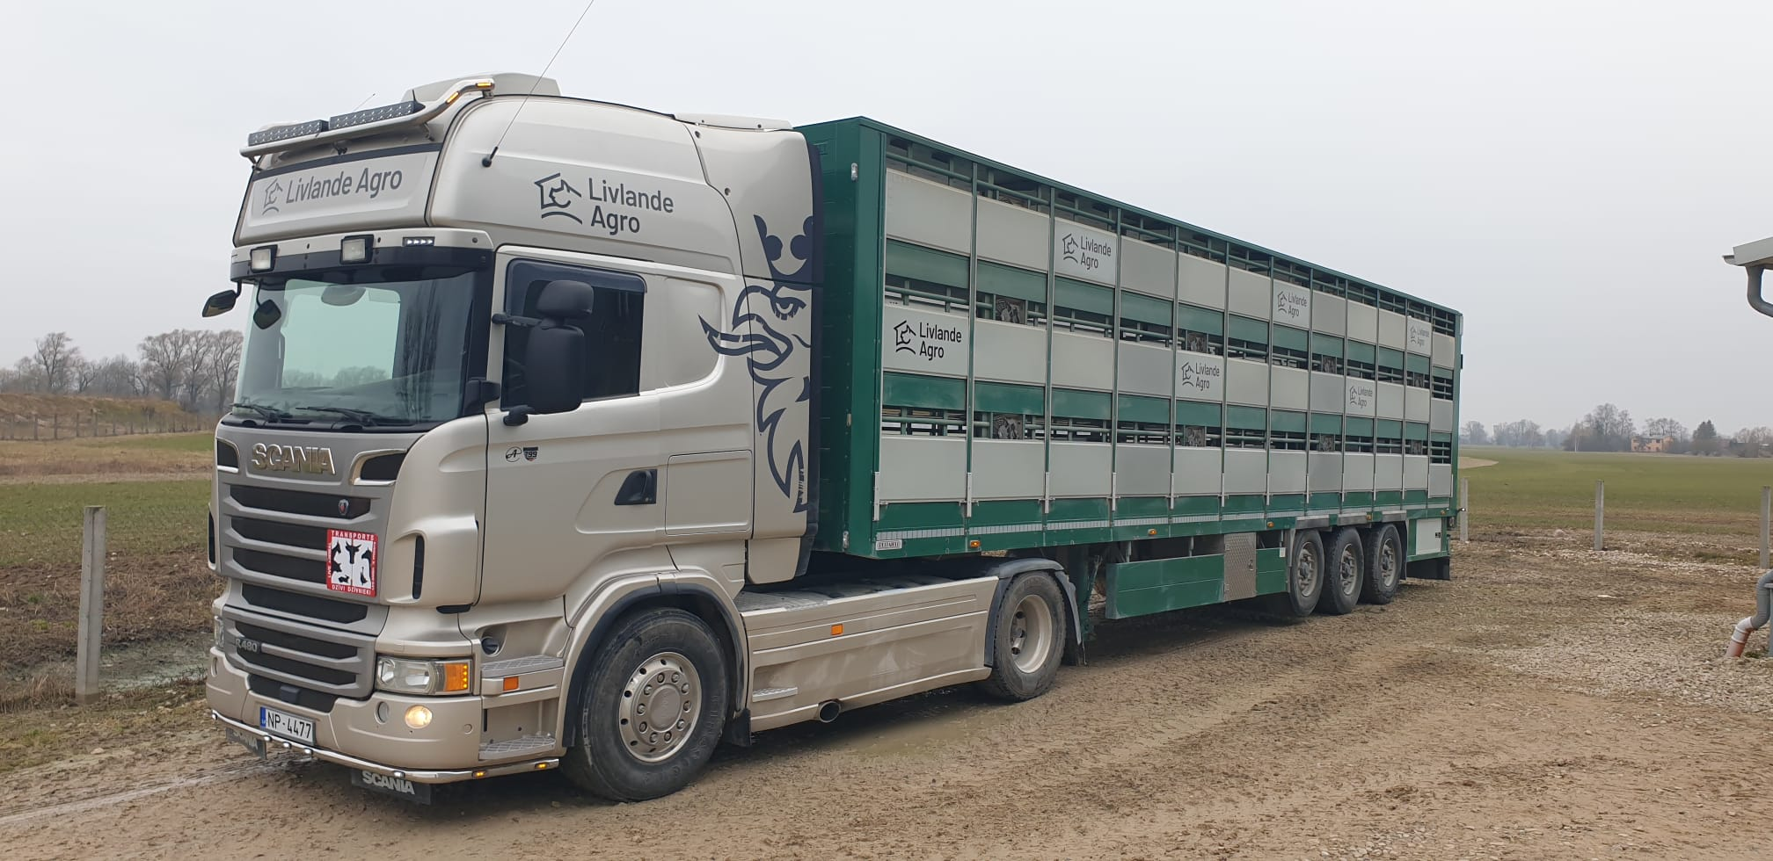
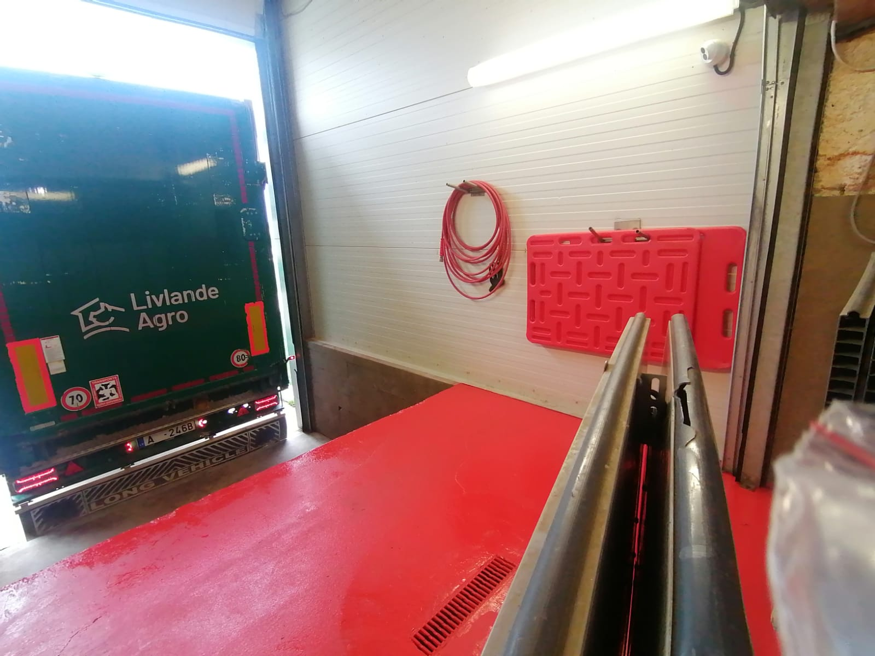
Transport
Animal carrier permit TIPS1 issued by PVD;
Certificate issued by the Road Transport Directorate for self-transportation of cargo;
The company has its own driver;
Own tractor and animal transport trailers;
Approved working order for moving animals from holding to holding;
Approved procedures for disinfection of transport vehicles and compliance with the principle of ramps

Slide 12
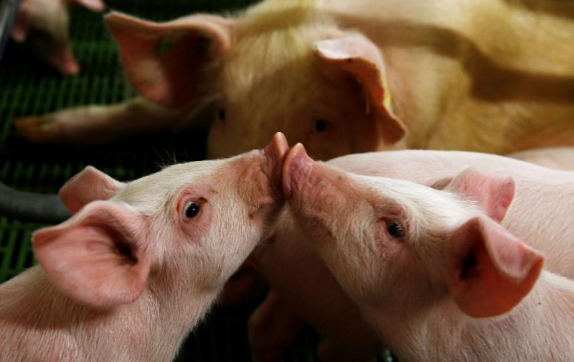
Herd health status
Animal herd health monitoring takes place in accordance with the STATE MONITORING PLAN OF ANIMAL INFECTIOUS DISEASES OF THE LV MINISTRY OF AGRICULTURE AND VETERINARY SERVICE.
1. Status of herd officially free of Brucellosis - granted on 27.06.2014.
2. Status of herd free of Aujeski's disease - granted on 11.11.2021.
3. In the herd, according to the plan, during diagnostic examinations, the following infectious diseases are monitored:
Passive surveillance of African swine fever;
Classical swine fever - examinations negative;
CRRS - examinations negative;
Brucellosis - to maintain the status;
Aujeski's disease - to maintain status;
TBC

Slide 13
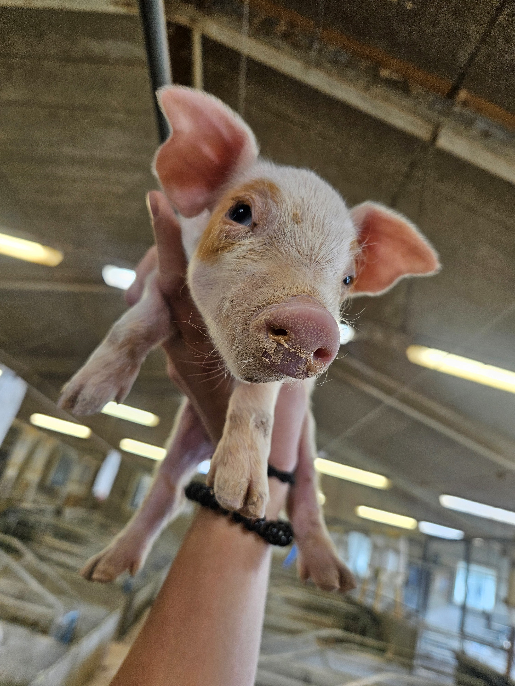
4. The herd is free of specific pathogens:
CRRS
Mycoplasma spp.;
Actinobacillus pleuropneumoniae;
Chlamydophila abortus,
The presence of pathogenic microflora and the invasion of parasites - controlled with laboratory tests.

Slide 14
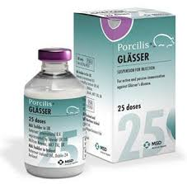
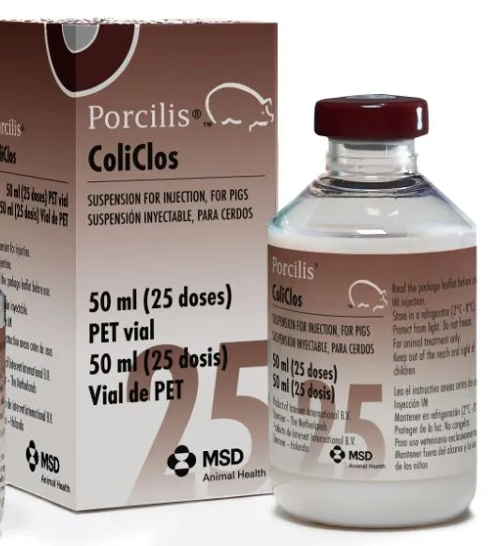
Vaccination protocols
Preventive vaccinations of herd animals against the following diseases:
Swine erysipelas;
Porcine parvoviral infection;
Swine circovirus infection;
Leptospirosis;
Swine influenza;
Haemophilus parasuis infection;
Colibacillosis, necrotic enteritis and enterotoxemia.
The herd of fattening pigs is not vaccinated.

Slide 15














Cooperation partners
Notes:
Grow Energy, Cūku Ciltsdarba Centrs, Rivona un mazie gaļas pārstrādes uzņēmumi

Slide 16
ASPECTS OF COOPERATION
State authorized certified veterinarian
Authorization of the business owner
Disease control, monitoring
Execution of the plan of anti-epidemic measures,
Necessary documentation,
Records,
Reporting,
Handling of binding permits,
Provision of inspections,
Ensuring animal exports - documentation.

Slide 17
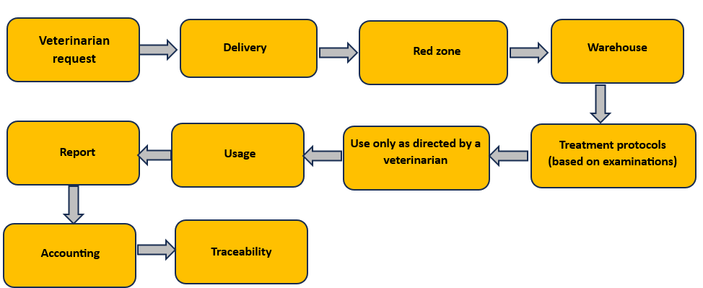
Circulation and use of medicines
The company has a permit for the purchase of medicines issued by PVD
Circulation, according to legislation
Referral of antibiotic consumption to Denmark, evaluation of results.
A company-provided and funded medication warehouse program.

Slide 18
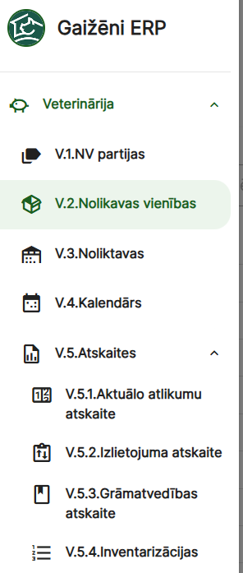
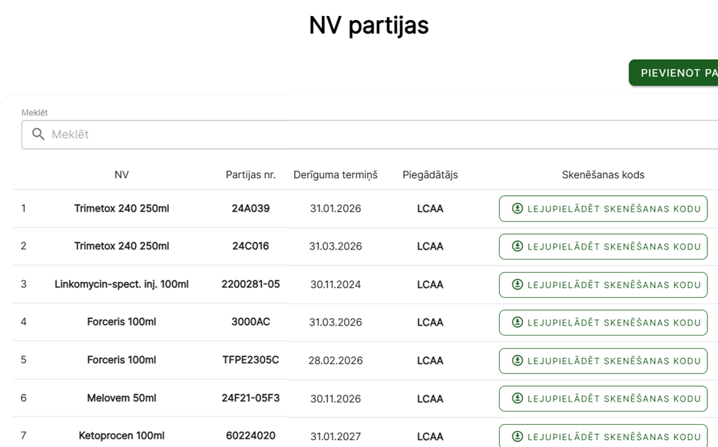

Slide 19
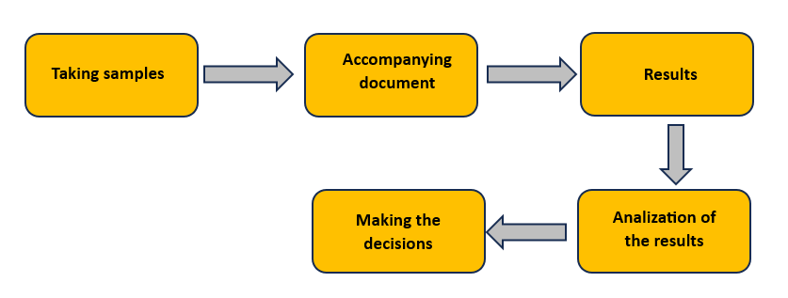
Authorization of the company owner to conclude contracts for the necessary investigations

Slide 20
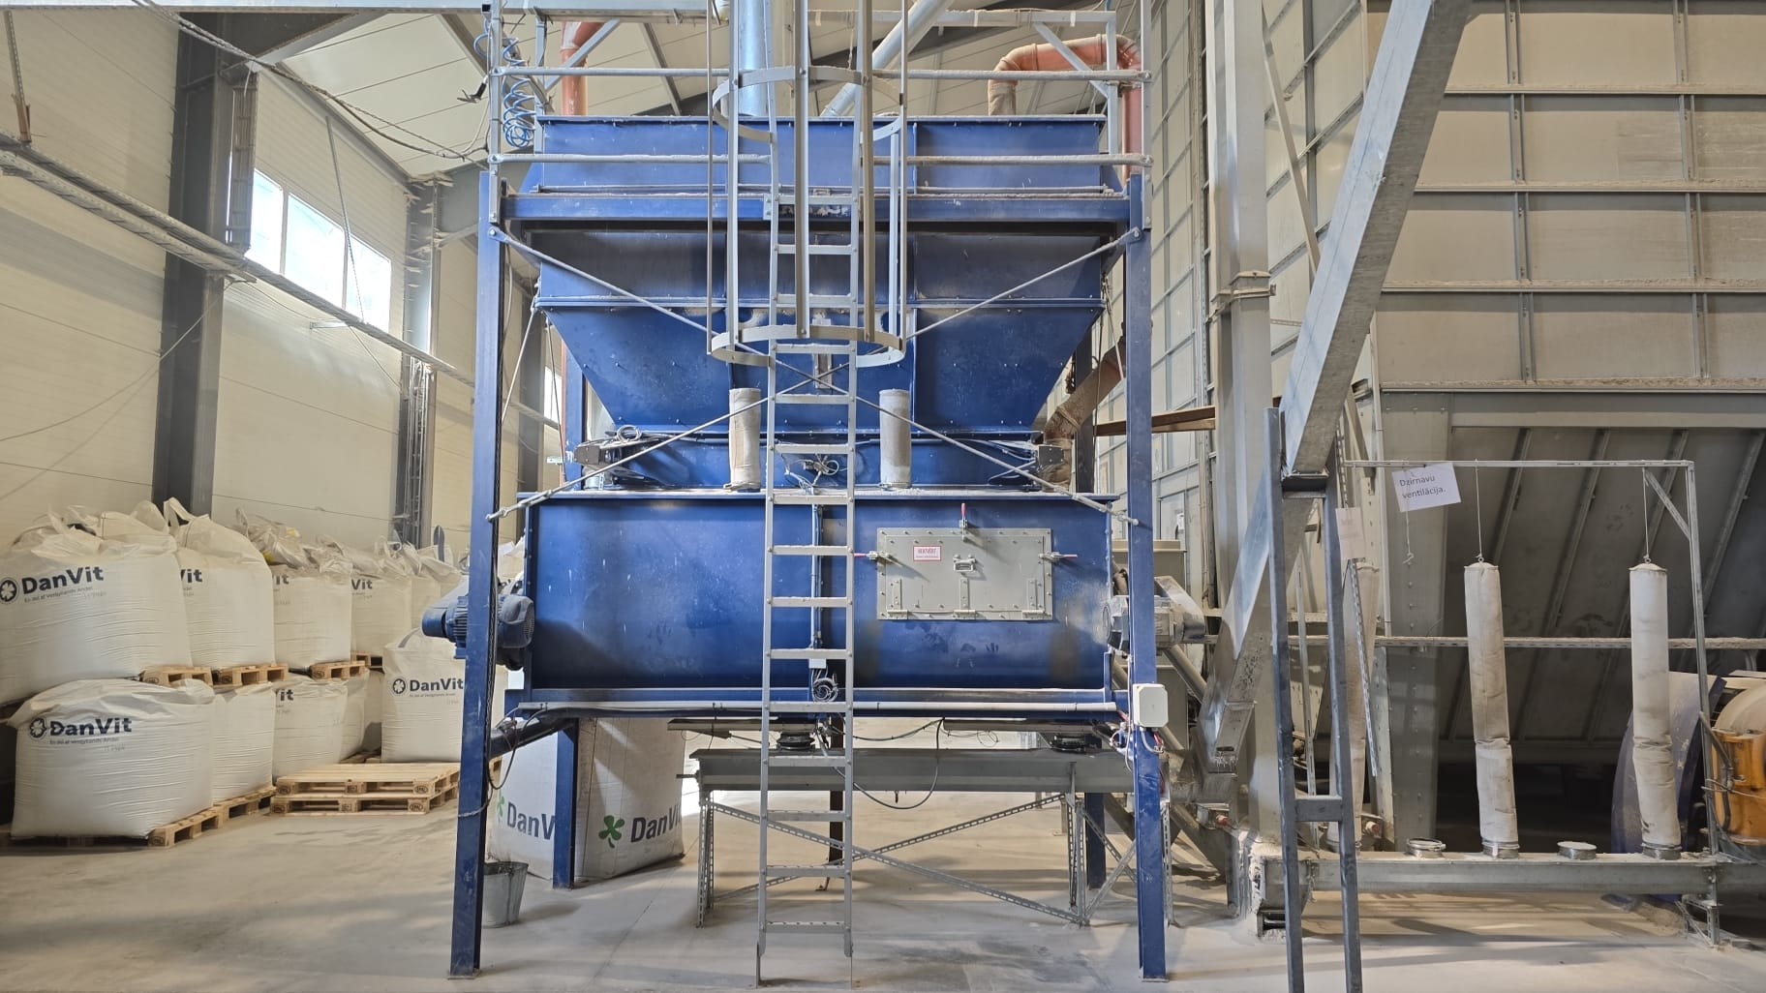
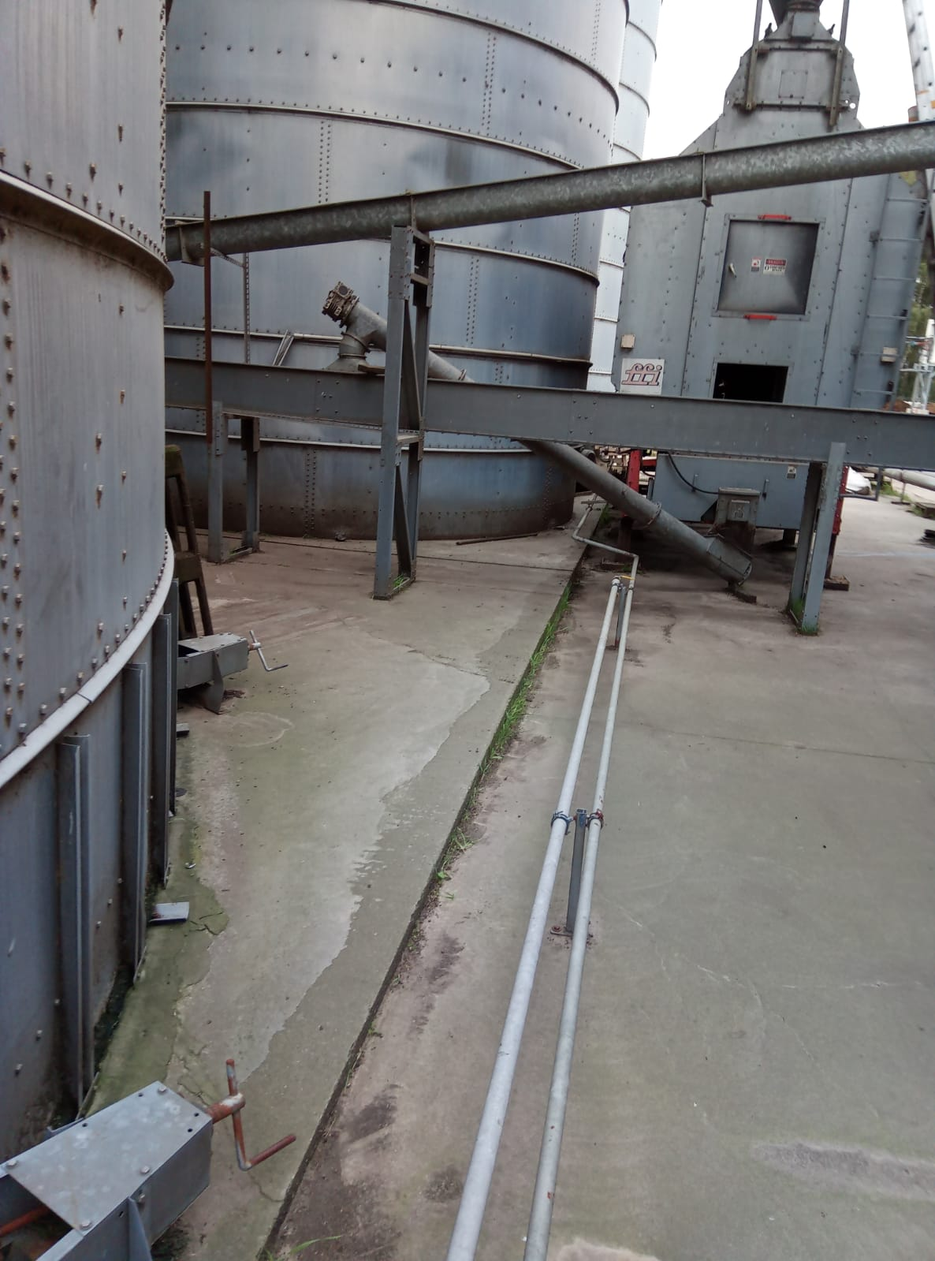
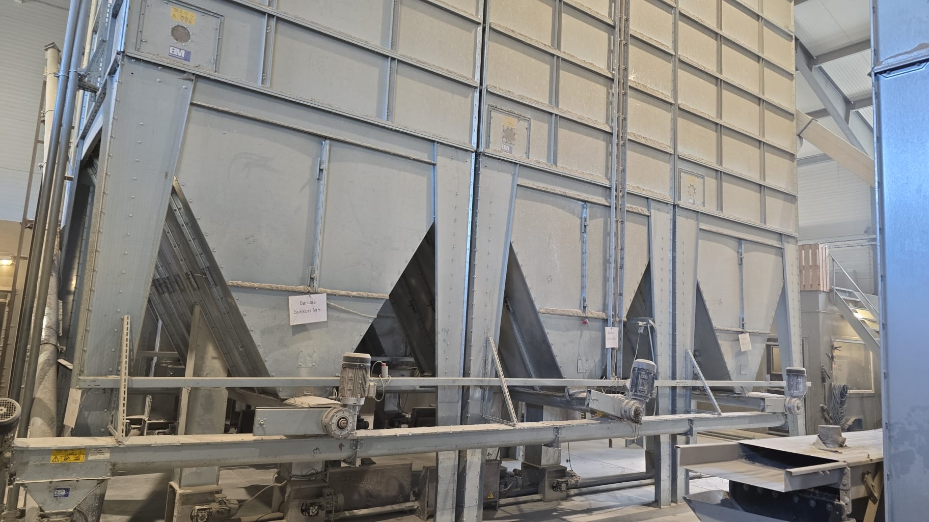
Feed production
Registration certificate of an animal feed distribution company issued by PVD;
Feed production manual;
Feed and water quality self-monitoring plans;
Feed sampling and evaluation

Slide 21
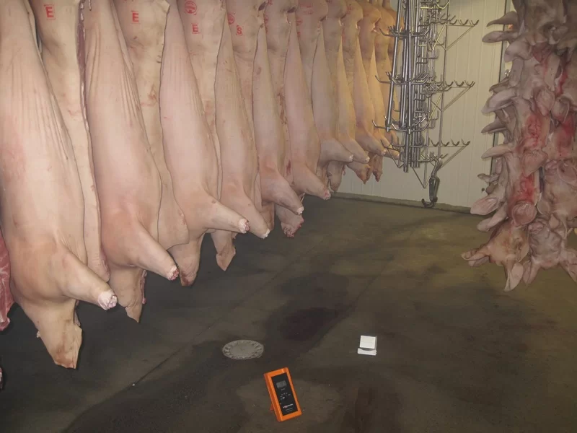
Cooperation with slaughterhouses
Providing the necessary documentation;
Cooperation with State-authorized experts in slaughterhouses – feedback and circulation of information;
Solving problems and complaints.

Slide 22
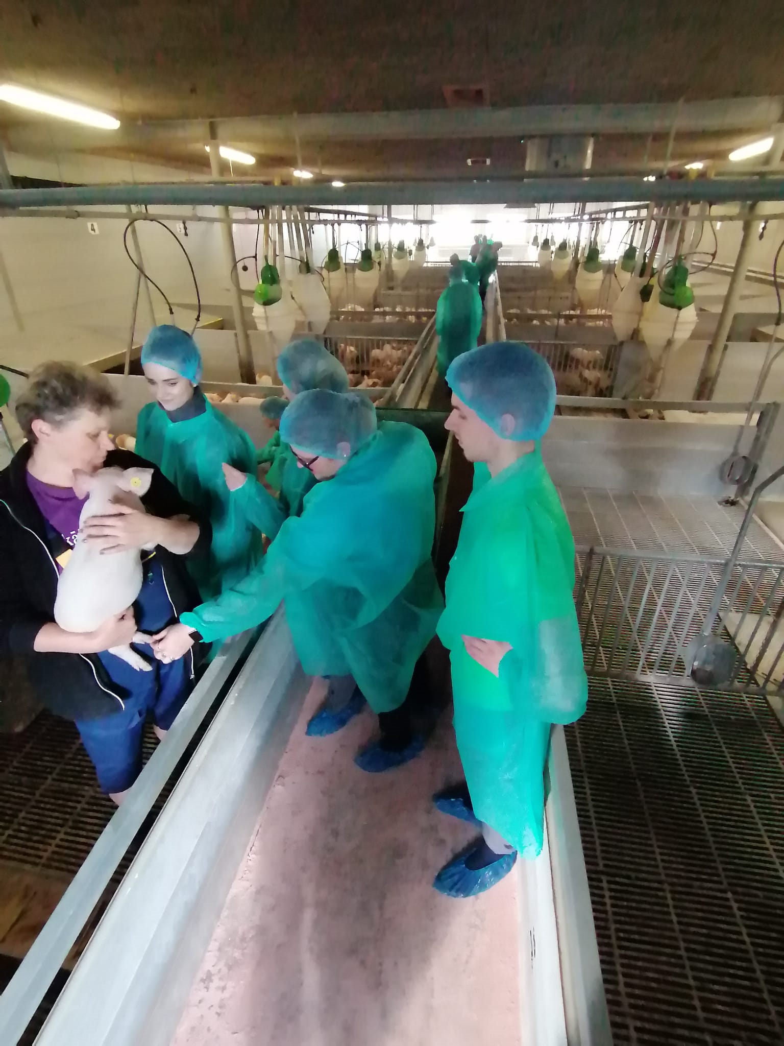
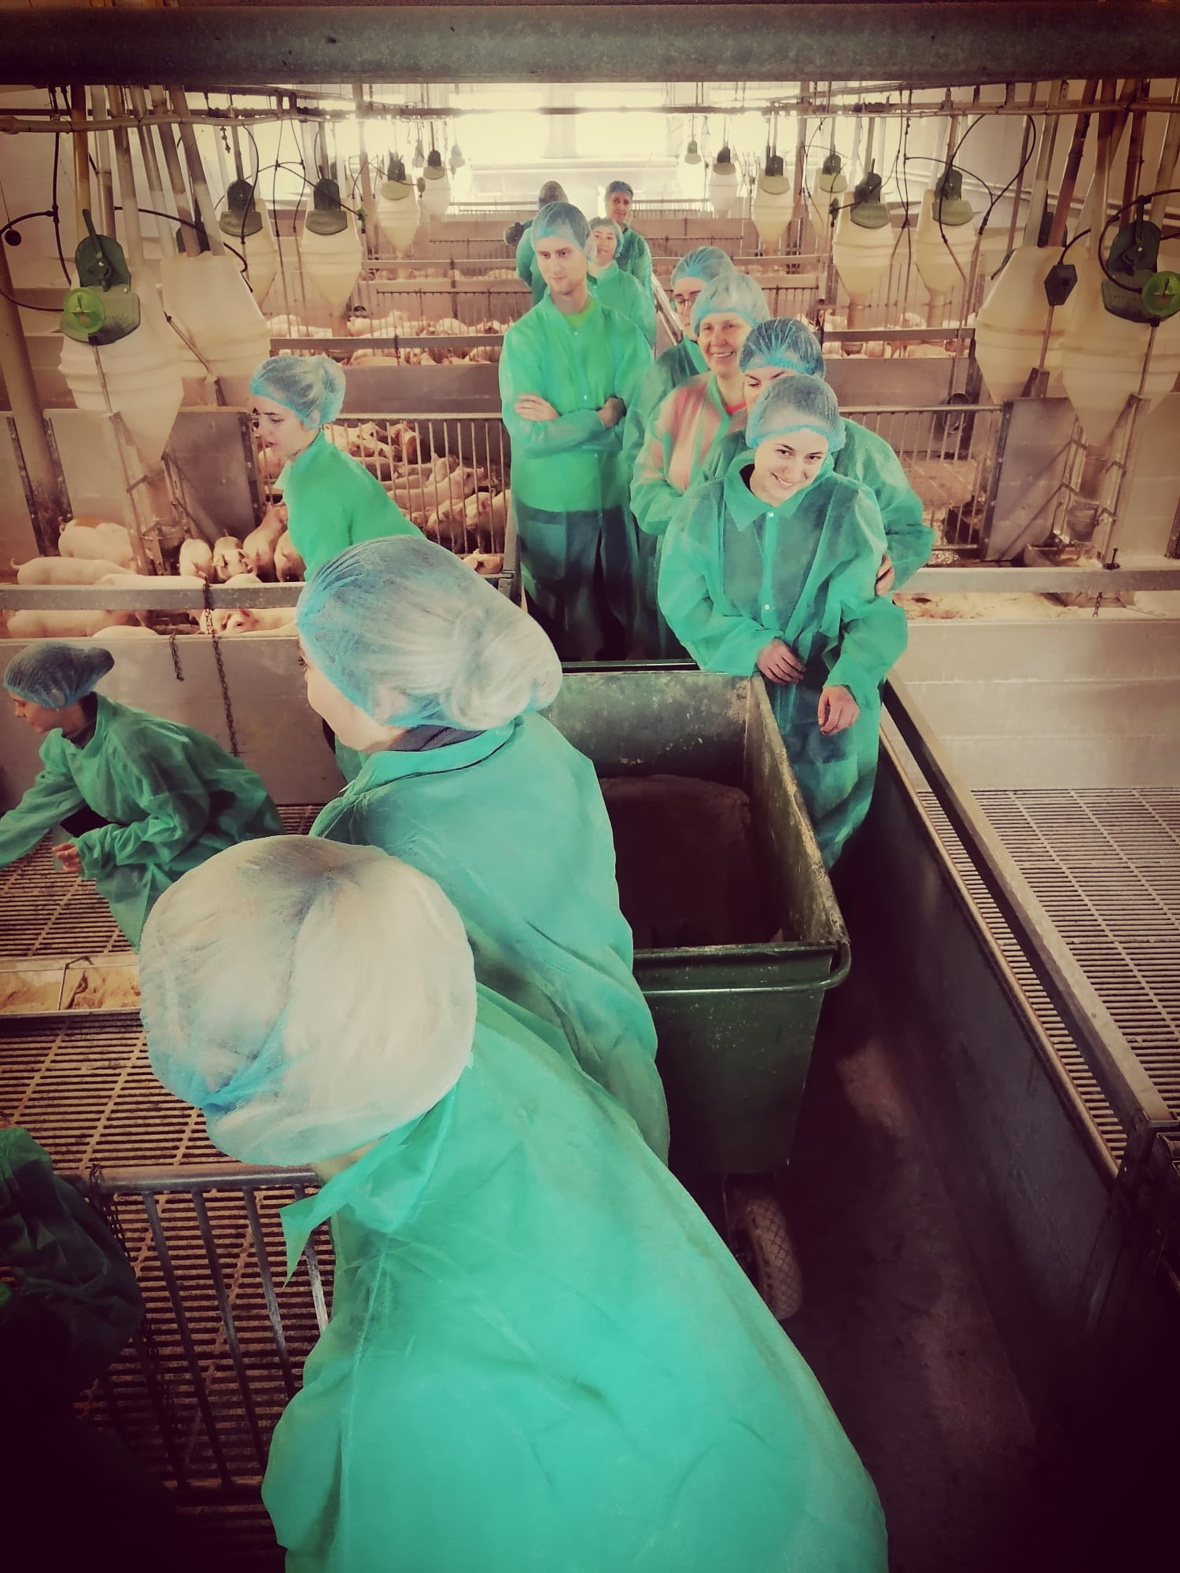
Development and outlook for the future
Training of young specialists - cooperation with LBTU
Co-financing of studies
Notes:
Latvia University of Life Sciences and Technologies

Slide 23

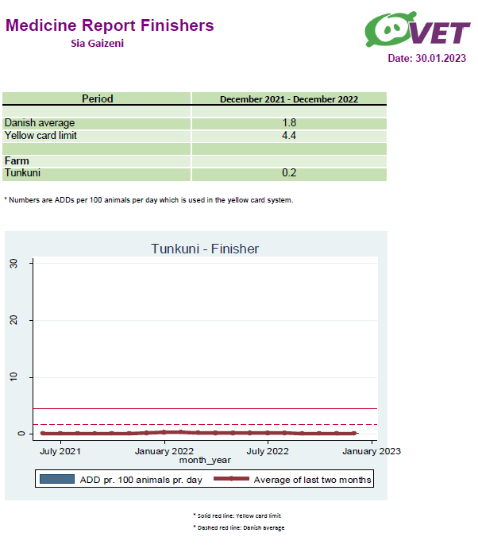
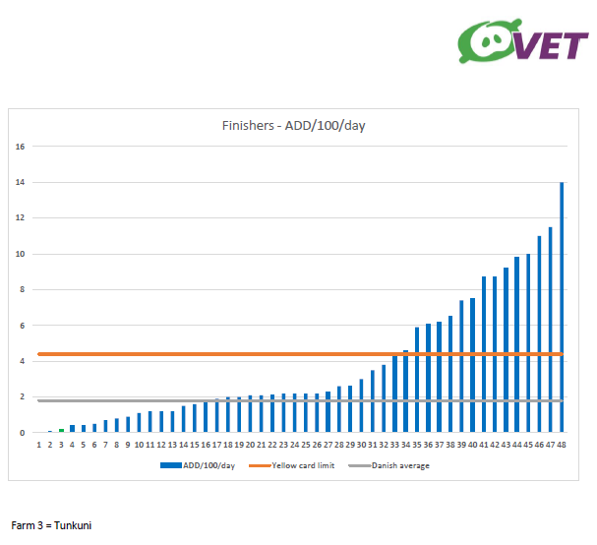
Insight of average consumption of antibiotics in 2022 for fattening pigs

Slide 24

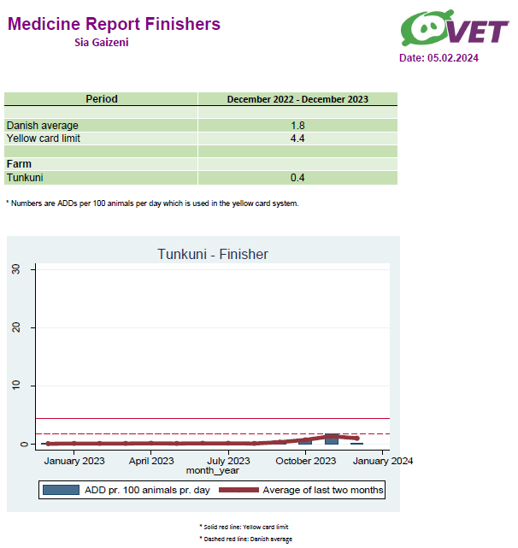
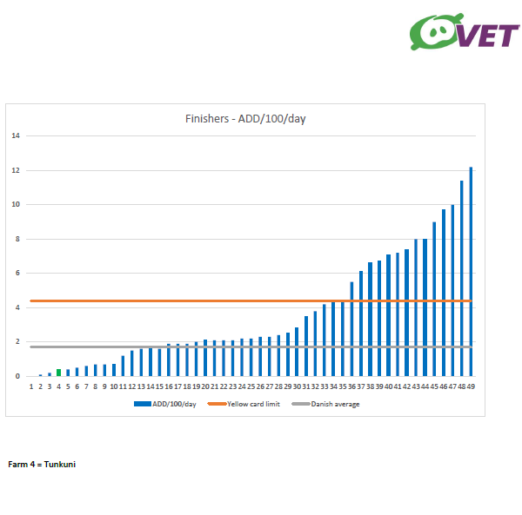
Insight of average consumption of antibiotics in 2023 for fattening pigs

Slide 25
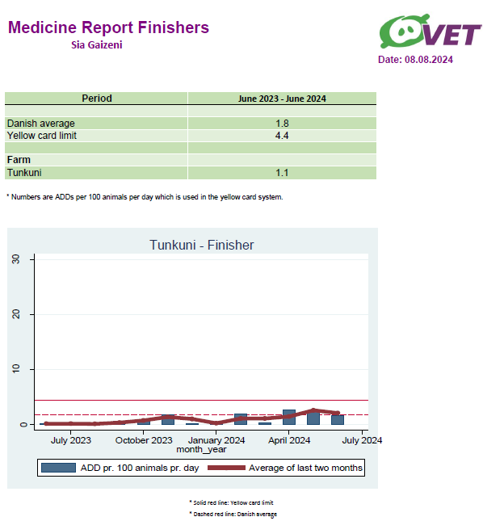
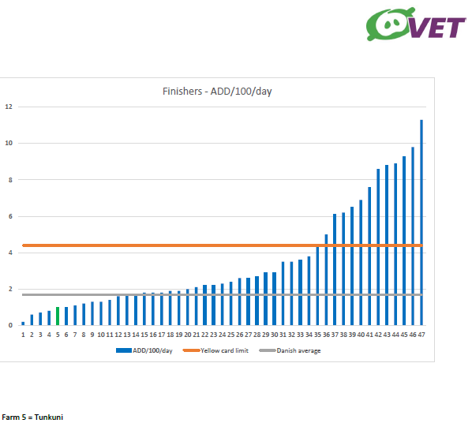
Insight of average consumption of antibiotics in 2024 for fattening pigs

Slide 26
Conclusions
The path to antibiotic-free pig farming and the reduction of antimicrobial resistance lies in close cooperation between owners and veterinarians, based on:
Mutual professionalism, trust, responsibility and honesty.

Slide 27
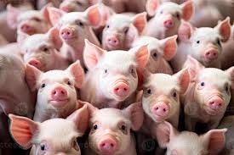
Thank you for your attention!

