Slide 1
SLOVENIA
12 DECEMBER 2024

Slide 2
Important elements of the new EU Medicated Feed Regulations
Lecture 3
SLOVENIA, 12 DECEMBER 2024

Slide 3
EU legal framework on veterinary medicinal products/medicated feed
Regulation (EU) 2019/6 on Veterinary Medicinal Products
Regulation (EU) 2019/4 on Medicated Feed

Slide 4
Common rules – Veterinary prescription
Common rules
MEDICATION VIA FEED OR WATER
Different rules apply for
Oral Medication
(on-farm mixing in feed or water by the animal keeper)
Via Feed
Via Water
Medicated Feed
(feed mixed with medicines in feed mill or mobile mixer or via special equipped vehicle by feed business operator )
Reg. (EU) 2019/4
(MF)
Reg. (EU) 2019/6 (VMP)
& Commission Delegated Reg. (EU) 2024/1159
Notes:
Therefore, the delegated act on oral medication applies to veterinary medicinal products administered orally by means of mixing into or addition onto feed and to the mixing of veterinary medicinal products in drinking water or in liquid feed by the animal keeper. It should not apply to the mixing of a veterinary medicinal product into feed by feed business operators irrespectively of whether they operate in a feed mill, with a mobile mixer or an on-farm mixer, which is covered by Regulation (EU) 2019/4.
(f) ‘mobile mixer’ means a feed business operator with a feed establishment consisting of a specifically equipped vehicle for the manufacture of medicated feed; (g) ‘on-farm mixer’ means a feed business operator manufacturing medicated feed for the exclusive use on its farm;

Slide 5
Use of Antimicrobial Veterinary Medicinal Products
EU legislative framework: Regulation (EU) 2019/4 on MEDICATED FEED (MF)
Principles for the use of medicated feed
  Ban on the use of MF with antimicrobials for prophylaxis.
  Requirement for diagnosis of disease prior to the mandatory prescription for MF.
  Limitation on the duration of a treatment and validity of prescription.
  Reduce any potential synergy between feed medication carry-over residues and occurrence of antimicrobial resistance.
  Measures to increase the quality of medicated feed production (more precise dosage) to avoid subtherapeutic exposure.
  Maximum levels of cross-contamination for 24 antimicrobial active substances in non-target feed.
Ban Systematic Prophylaxis

Slide 6
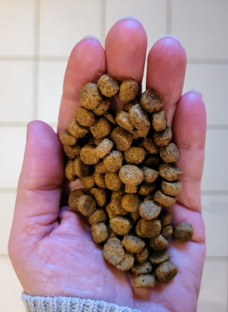
Common rules – Veterinary prescription
Common rules
Veterinary prescriptions in relation to medicated feed (1/2)
Reg.(EU) 2019/4
Article 16
Medicated feed (animal feed mixed with medicines by feed business operator) requires:
a veterinary prescription
can only be issued after clinical examination or any other proper assessment of the health status of the animals
only for diagnosed diseases (except for vaccines and parasitics)
Watch out for interactions with other medications!
Notes:
1. The supply of medicated feed to animal keepers shall be subject to:
(a) the presentation and, in case of manufacturing by on-farm mixers, the possession of a veterinary prescription for medicated feed; and
(b) the conditions laid down in paragraphs 2 to 10.
2. A veterinary prescription for medicated feed shall be issued only after a clinical examination or any other proper assessment of the health status of the animal or group of animals by a veterinarian and only for a diagnosed disease.
3. By way of derogation from paragraph 2, a veterinary prescription for medicated feed containing immunological veterinary medicinal products may be issued also in the absence of a diagnosed disease.
4. By way of derogation from paragraph 2, if it is not possible to confirm the presence of a diagnosed disease, a veterinary prescription for medicated feed containing antiparasitics without antimicrobial effects may be issued based on
the knowledge of the parasite infestation status in the animal or group of animals.

Slide 7
Common rules – Veterinary prescription
Common rules
Veterinary prescriptions in relation to medicated feed (2/2)
Reg.(EU) 2019/4
Article 16
Record keeping: Veterinary prescriptions should be kept by feed mill and the veterinarian prescribing & animal keeper for 5 years
1 prescription = 1 veterinary treatment
Maximum duration of treatment: 2 weeks for antibiotics, 1 month for other medicines
Validity prescription: max 5 days for feed with antimicrobial, max 3 weeks for other medicines for food-producing animals, rest 6 months
Notes:
6. The veterinary prescription for medicated feed shall contain the information set out in Annex V. The original veterinary prescription for medicated feed shall be kept by the manufacturer or, where appropriate, the feed
business operator supplying the medicated feed to the animal keeper. The veterinarian, or the professional person referred to in paragraph 5, issuing the prescription and the keeper of food-producing or fur animal shall keep a copy of the veterinary prescription for medicated feed. The original and copies shall be kept for five years from the date of issuance.
7. With the exception of medicated feed for non-food-producing animals, other than fur animals, medicated feed shall not be used for more than one treatment under the same veterinary prescription for medicated feed.
The duration of a treatment shall comply with the summary of product characteristics of the veterinary medicinal product incorporated in the feed and, where not specified, shall not exceed one month, or two weeks in case of a medicated feed
containing antibiotic veterinary medicinal products.
8. The veterinary prescription for medicated feed shall be valid from the date of its issuance for a maximum period of six months for non-food-producing animals other than fur animals and three weeks for food-producing animals and fur
animals. In the case of medicated feed containing antimicrobial veterinary medicinal products, the prescription shall be valid from the date of its issuance for a maximum period of five days.
9. The veterinarian issuing the veterinary prescription for medicated feed shall verify that that medication is justified for the target animals on veterinary grounds. Furthermore that veterinarian shall ensure that the administration of the
veterinary medicinal product concerned is not incompatible with another treatment or use and that there is no contraindication or interaction where several medicinal products are used. In particular, the veterinarian shall not prescribe
medicated feed with more than one veterinary medicinal product containing antimicrobials.
10. The veterinary prescription for medicated feed shall:
(a) comply with the summary of the product characteristics of the veterinary medicinal product, except for veterinary
medicinal products intended to be used in accordance with Article 112, Article 113 or Article 114 of Regulation (EU)
2019/6;
(b) indicate the daily dose of the veterinary medicinal product which is to be incorporated in a quantity of medicated feed
that ensures the uptake of the dosage by the target animal considering that the feed uptake of diseased animals might
differ from a normal daily ration;
(c) ensure that the medicated feed containing the dosage of the veterinary medicinal product corresponds to at least 50 %
of the daily feed ration on a dry matter basis and that, for ruminants, the daily dose of the veterinary medicinal
product is contained in at least 50 % of the complementary feed except for mineral feed;
(d) indicate the inclusion rate of the active substances, calculated on the basis of the relevant parameters.
11. Veterinary prescriptions for medicated feed issued in accordance with paragraphs 2, 3 and 4 shall be recognized throughout the Union.
12. The Commission may, by means of implementing acts, set a model format for the information set out in
Annex V. That model format shall also be made available in electronic version. Those implementing acts shall be
adopted in accordance with the examination procedure referred to in Article 21(2).

Slide 8
Delegated Regulation (EU) 2024/1159 on Oral Administration
Lays down rules to ensure the effective and safe use of VMPs authorised and prescribed for oral administration via routes other than medicated feed and administered by the animal keeper to food-producing animal
To avoid reduction of effectiveness, resistance development, contamination
Covers VMPs in drinking water or mixed in or spread on feed by the animal owner. Does not cover medicated feed (also not if mixed by mobile mixer by feed operator on farm).
Important role for veterinarians – they should evaluate equipment, species, situation on the farm, etc before prescribing. They should also advise the owner on how to dose correctly and on correct disposal.
Important role for animal keeper: needs to properly store, prepare, have suitable equipment to administer and dispose of the leftovers. Ensure the feed/water is suitable. Ensure no contamination.
Notes:
SUPPLEMENTARY SLIDES TO USE IN CASE QUESTIONS CONCERNING ORAL MEDICATION COME UP
Oral medication has more risks of being ineffective than giving an individual treatment. So these extra rules are to avoid products losing effectiveness, to avoid the development and spread of resistance and to avoid contamination or unintended administration to non-target species or people or spread in the environment.
It covers all oral medication, except medicated feed mixed by a feed operator. This Regulation applies to authorised and prescribed veterinary medicinal products administered orally in drinking water, mixed into feed, or administered on the surface of feed immediately prior to feeding and administered by the animal keeper to food-producing animals
Veterinarians have a crucial role here: they need to know the situation on the farm, the equipment, the feed, etc before prescribing to be sure the VMP can be effectively given. They also need to advise the animal owner on how to dispose or remove remaining medicines.
- Oral administration of VMPs in solid feed can lead to animals competing for the same feed and give risk of underdosage and overdosage. This is especially important for antimicrobials and antiparasitics as it may lead to antimicrobial and antiparasitic resistance. Therefore, the prescription and oral administration of an antimicrobials or antiparasitics by mixing into solid feed or administration on the surface of solid feed immediately prior to feeding should only be allowed when the animals are fed individually or when the intake of the veterinary medicinal product by individual animals can be effectively controlled in a small group of animals.

Slide 9
Delegated Regulation (EU) 2024/1159 on Oral Administration
Lays down rules to ensure the effective and safe use of VMPs authorised and prescribed for oral administration via routes other than medicated feed and administered by the animal keeper to food-producing animal
The mixing of antibiotics or antiparasitics in solid feed should only be done fоr animals fed individually or for a small group of animals. MS may restrict those uses only to animals individually fed (if not harming animal health or welfare). Administration via drinking water for groups of animals is allowed.
EXCEPT - If medicated feed is not available, or waiting for delivery, it is allowed for aquatic animals to mix antimicrobials and antiparasitics in feed for group treatment
It is not allowed to administer several antimicrobials at the same time
Only on veterinary prescription based on a diagnosis and indicating the target species and the number of animals to be treated.
Be careful with biocides, feed additives or other substances used simultaneously, they can interact
Notes:
SUPPLEMENTARY SLIDES FOR IF SOME QUESTIONS COME ON THE DA ORAL MEDICATION
Oral medication has more risks of being ineffective than giving an individual treatment. So these extra rules are to avoid products losing effectiveness, to avoid the development and spread of resistance and to avoid contamination or unintended administration to non-target species or people or spread in the environment.
It covers all oral medication, except medicated feed mixed by a feed operator.
Veterinarians have a crucial role here: they need to know the situation on the farm, the equipment, the feed, etc before prescribing to be sure the VMP can be effectively given. They also need to advise the animal owner on how to dispose or remove remaining medicines.
- Oral administration of VMPs in solid feed can lead to animals competing for the same feed and give risk of underdosage and overdosage. This is especially important for antimicrobials and antiparasitics as it may lead to antimicrobial and antiparasitic resistance. Therefore, the prescription and oral administration of an antimicrobials or antiparasitics by mixing into solid feed or administration on the surface of solid feed immediately prior to feeding should only be allowed when the animals are fed individually or when the intake of the veterinary medicinal product by individual animals can be effectively controlled in a small group of animals.

Slide 10
Delegated Regulation (EU) 2024/1159 on Oral Administration
Lays down rules to ensure the effective and safe use of VMPs authorised and prescribed for oral administration via routes other than medicated feed and administered by the animal keeper to food-producing animal
MS may develop further national guidelines to facilitate the application of that Regulation.
Shall apply from 9 November 2025.
Notes:
SUPPLEMENTARY SLIDES FOR IF SOME QUESTIONS COME ON THE DA ORAL MEDICATION
Oral medication has more risks of being ineffective than giving an individual treatment. So these extra rules are to avoid products losing effectiveness, to avoid the development and spread of resistance and to avoid contamination or unintended administration to non-target species or people or spread in the environment.
It covers all oral medication, except medicated feed mixed by a feed operator.
Veterinarians have a crucial role here: they need to know the situation on the farm, the equipment, the feed, etc before prescribing to be sure the VMP can be effectively given. They also need to advise the animal owner on how to dispose or remove remaining medicines.
- Oral administration of VMPs in solid feed can lead to animals competing for the same feed and give risk of underdosage and overdosage. This is especially important for antimicrobials and antiparasitics as it may lead to antimicrobial and antiparasitic resistance. Therefore, the prescription and oral administration of an antimicrobials or antiparasitics by mixing into solid feed or administration on the surface of solid feed immediately prior to feeding should only be allowed when the animals are fed individually or when the intake of the veterinary medicinal product by individual animals can be effectively controlled in a small group of animals.

Slide 11

National provisions

Slide 12
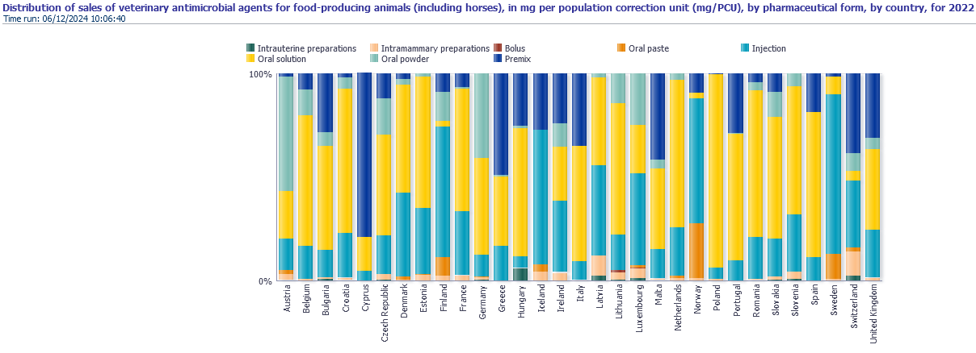
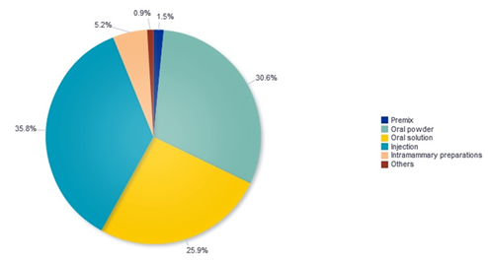
vir: EMA
EMA, 2015:

Slide 13
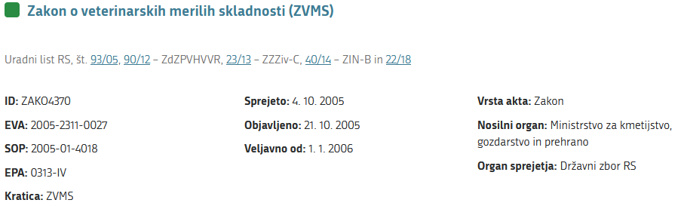
VETERINARY CONTROL
LEGAL BASIS:
MEDICINES ACT
VETERINARY ACT
VETERINARY COMPLIANCE CRITERIA ACT (ZVMS); https://pisrs.si/pregledPredpisa?id=ZAKO4370
  GRANTS POWERS AND AUTHORITIES REGARDING PLACING ON THE MARKET AND TRADING
  TRACEABILITY – MANDATORY RECORDS
  MONITORING EFFECTIVENESS
  USERS – PROFESSIONAL USE, ISSUANCE
  PROVIDES SUPERVISION
  MONITORING INFORMATION SYSTEM
  PRESCRIBES PENALTIES FOR NON-COMPLIANCE
  VETERINARY MEDICINES: ARTICLES - 34, 35, 36
  MEDICATED FEED: ARTICLE 29

Slide 14


National legal requirements
Follow recomendations: Prevention is better than cure & EU Farm to Fork strategy (traceability)
Agency for Medicinal Products and Medical Devices of the Republic of Slovenia (JAZMP) – reponsible for registration / paralle import & pharmacovigilance of MEDICINAL PRODUCTS FOR VETERINARY USE
Administration of the Republic of Slovenia for Food Safety, Veterinary Sector and Plant Protection (UVHVVR) – responsible for INSPECTION OF USE OF VETERINARY MEDICINS
Legislation in force easily accesable on their websites:
  https://www.jazmp.si/predpisi/
  https://www.gov.si/teme/zdravila-v-veterinarski-medicini/

Slide 15
VETERINARIANS – in addition to what has already been said
Legal Compliance:
Veterinarians must ensure that medicated feed conforms to the veterinary prescription.
Medicated feed should not contain more than one veterinary medicinal product containing antimicrobials.
Labeling and tracking:
Veterinarians should provide accurate information on prescriptions, including the daily dose and prescribed medication content.
Keeping copies of prescriptions for at least five years.
Restrictions for antimicrobials:
The use of antimicrobials is allowed only in exceptional cases.
Prophylaxis (preventive use) is not allowed, except when the risk of disease is very high.

Slide 16
BREEDERS OF LIVESTOCK
Use of medicated feed:
Medicated feed can be used only for animals for which it is prescribed and in accordance with a veterinary prescription.
The use of antimicrobial medicated feed for prophylaxis is prohibited unless strict conditions are met.
Withdrawal period and food safety:
Breeders must strictly observe the withdrawal periods specified on the prescription for all food-producing animals.
The use of medicated feed with an expired shelf life is prohibited.
Waste disposal system:
Breeders must dispose of unused medicated feed or expired drugs in accordance with the relevant regulations – harmless destruction.
Member States must provide systems for the collection or disposal of these products and inform breeders thereof.

Slide 17
Record keeping:
Breeders should keep accurate records of the use of medicated feed, including dates, dosages, and compliance with withdrawal periods.
These records must be kept for at least 5 years.
Storage and transport:
Medicated feed may only be stored and transported in sealed packaging that cannot be reused.
Nadzor in kazni:
Veterinarians and breeders are obliged to comply with the regulations. Infringements shall be sanctioned by effective, proportionate and dissuasive penalties laid down by the Member States.
VETERINARIANS AND BREEDERS

Slide 18
Thank you

