Slide 1
SLOVENIA
12 DECEMBER 2024

Slide 2
Additional relevant legislation, provisions and/or guidelines to be considered by veterinarians & farmers (II) Lecture 4
SLOVENIA, 12 DECEMBER 2024

Slide 3
EU legal framework on veterinary medicinal products/medicated feed
Regulation (EU) 2019/6 on Veterinary Medicinal Products
Regulation (EU) 2019/4 on Medicated Feed
+ Implementing and delegating Acts

Slide 4
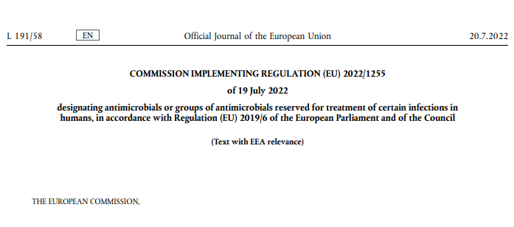
CERTAIN ANTIMICROBIALS ARE PROHIBITED TO USE FOR ANIMAL TREATMENT
The human reserve list: antimicrobials which are reserved for treatment of certain infections in humans
“reserve list”
The antimicrobials and group of antimicrobials listed in this Regulation cannot be used in animals under any circumstances.
This list will be kept under continual review in the light of new scientific evidence or emerging information
Commission Implementing Regulation (EU) 2022/1255

Slide 5
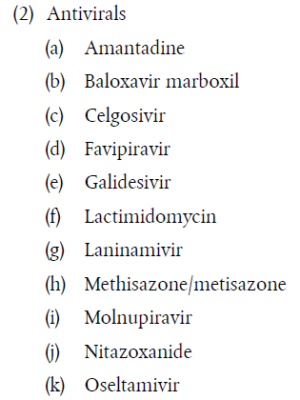
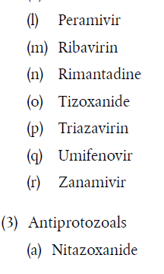
ANTIMICROBIALS ON THE HUMAN RESERVE LIST
“human reserve list”
Supporting prudent use and preserving efficacy
Commission Implementing Regulation (EU) 2022/1255

Slide 6
CERTAIN ANTIMICROBIALS ARE NOT ALLOWED OR CONDITIONALLY ALLOWED TO USE UNDER ART 112 & 113*
Commission Implementing Regulation (EU) 2024/1973 lists antimicrobials which cannot be used in accordance with article 112 & 113* (outside the marketing authorisation) or can only be used subject to certain conditions.
Some examples:
      Third- and fourth-generation cephalosporins cannot be used in accordance with Article 113 in poultry
      Polymyxins are allowed only after prior pathogen identification and susceptibility testing showing that they are likely to be effective and other preferable antimicrobials would not be effective.
      Quinolones (including fluoroquinolones) cannot be used in accordance with Article 113 for salmonellosis in poultry or for metaphylaxis of salmonellosis in animals other than poultry
All details here: https://eur-lex.europa.eu/eli/reg_impl/2024/1973/oj
This Act will apply from 8 August 2026

Slide 7


Upcoming Delegated and Implementing Legal Acts
List of substances authorised for use in food-producing terrestrial animal species or substances contained in a medicinal product for human use authorised in the Union, which may be used in food-producing aquatic species in accordance with Article 114(1)
List of substances which are essential for the treatment of equine species, or which bring added clinical benefit compared to other treatment options available for equine species and for which the withdrawal period for equine species shall be six months.
More info on all delegated and implementing Acts:
https://food.ec.europa.eu/animals/animal-health/vet-meds-med-feed/implementation_en

Slide 8

Upcoming Acts
List of antimicrobials that may be used for food-producing aquatic species
!Article 114
The Commission will establish a list of substances used in veterinary medicinal products authorised in the Union for use in food-producing terrestrial animal species or substances contained in a medicinal product for human use authorised in the Union in accordance with Directive 2001/83/EC or Regulation (EC) No 726/2004, which may be used in food-producing aquatic species in accordance with Article 114(1).
Notes:
IF RUNNING OUT OF TIME, THIS SLIDE CAN BE HIDDEN

Slide 9
Upcoming Acts
List of antimicrobials for specific species (equine species)
The Commission published a list of substances essential for the treatment of Equidae (Commission Regulations (EC) No. 1950/2006 & No. 122/2013 )
The VMP Regulation requires the Commission to establish a list of substances which are essential for the treatment of equine species, or which bring added clinical benefit compared to other treatment options available for equine species and for which the withdrawal period for equine species shall be six months to be established
In July 2024 EMA published its scientific advice regarding the list of substances which are essential for the treatment of equine species (SA - Art115(5) - List of substances essential for equine species (europa.eu)
The Commission is now working on the required implementing act.
Notes:
IF RUNNING OUT OF TIME, THIS SLIDE CAN BE HIDDEN

Slide 10
It is crucial to report adverse events (pharmacovigilance)
Unintended, unfavourable reaction in animals to a veterinary or human medicine
Lack of efficacy of a veterinary medicine
Any environmental incidents after applying a veterinary medicine
Any noxious reaction to humans
Exceeding the MRL when withdrawal period was respected
Any suspected transmission of an infectious agent via the medicine
Do not forget to report adverse events including lack of efficacy!
Adverse events are:
Why report? To ensure safety, monitor efficacy, prevent harm, guide regulation and to inform research.

Slide 11
Disposal of Veterinary Medicines
How and where does pharmaceutical waste occur?
Immediate packaging and the remains of medicines within after use.
VMP or MF that are past their expiry date or that have not been stored in accordance with the instructions.
Prescription of a quantity exceeding the required quantity or uncompleted course of treatment due to either administration difficulties, adverse reactions, change in treatment or because animals died during treatment.
FACTSHEET_PharmaceuticalWasteDisposal.pdf (epruma.eu)

Slide 12
Disposal of Veterinary Medicines
Best practices for disposal
PharmaceuticalWasteDisposal.pdf (epruma.eu)
Everybody (prescribers and users) is responsible for minimising pharmaceutical waste.
Disposal of pharmaceutical waste via waterways should be excluded.
Pharmaceutical waste should be stored in a dedicated container, bin, or facility to ensure adequate protection to animal health, human health, feed, food and the environment and this must be separated from any stocks of veterinary medicines to ensure that the waste cannot be inadvertently used.
Waste must be disposed of in accordance with the Summary of Product Characteristics (SPC) and the waste legislation and national systems developed in consultation with all parties for the collection, transport, and disposal of the waste.
Member States shall ensure that appropriate collection or discard systems are in place for waste veterinary medicinal products (including medicated feed) and to ensure that the location of collection or discard points as well as other relevant information is made available to farmers, animal keepers, veterinarians, and other relevant persons.

Slide 13
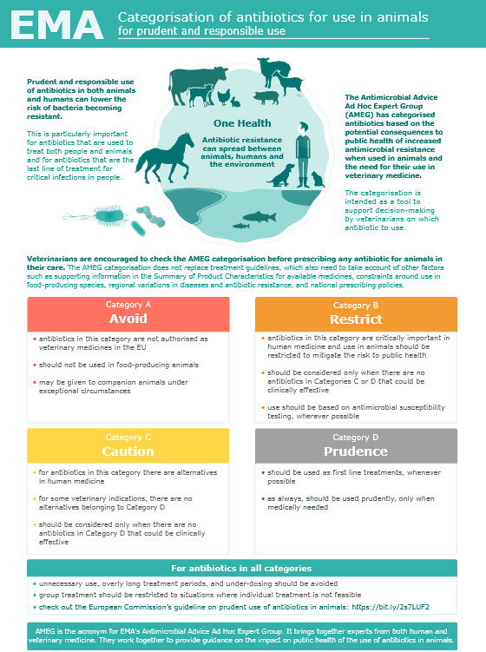
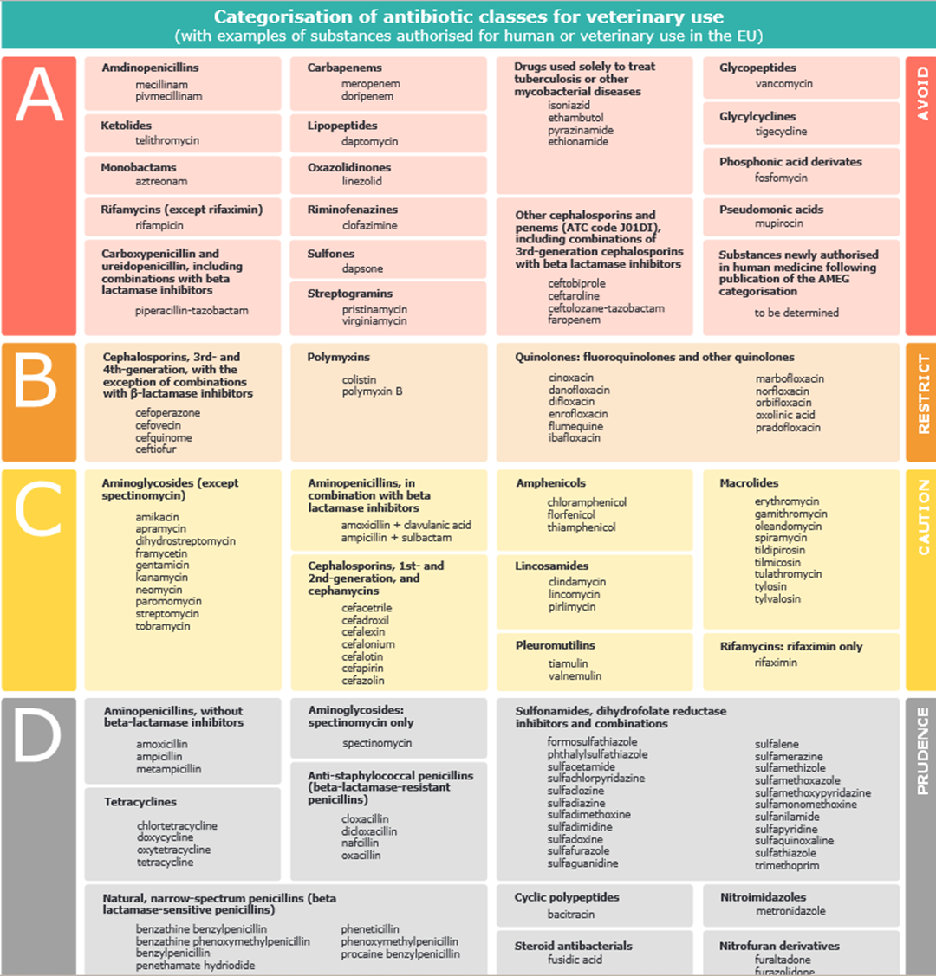

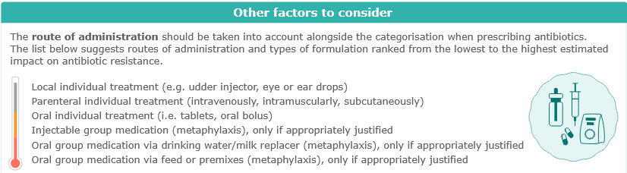
Other considerations for prescriptions

Slide 14
Prudent Use Guidelines
Not legally binding as the previous acts/provisions!
Guideline for the prudent use of
antimicrobials in veterinary medicine 2015/C 299/04​
https://health.ec.europa.eu/system/files/2016-11/2015_prudent_use_guidelines_en_0.pdf
Best-practice framework for the use of antimicrobials in food-producing animals in the EU - Reaching for the next level.
https://epruma.eu/home/best-practice-guides/best-practice-framework-for-the-use-of-antimicrobials-in-food-producing-animals-in-the-eu-reaching-for-the-next-level/

Slide 15
Animal Health Law (Regulation (EU) 2016/429 on transmissible animal disease)
“Prevention is better than cure”
Preventive driven approach:
improvement of animal health and biosecurity measures, good farming practices
Clear responsibility for all players for animal health
  Operators → ensure a high level of animal health and welfare, and biosecurity
  Vets → raise awareness and help in the prevention and spread of pathogens
  CA → protect animal health, human
  health and environment
Prioritising EU intervention
Regulatory tools/interventions for resistant pathogens: "disease agents“
Disease preventive and control measures may apply (surveillance, eradication etc.)
Legal basis monitoring AMR in animal pathogens

Slide 16

National provisions

Slide 17
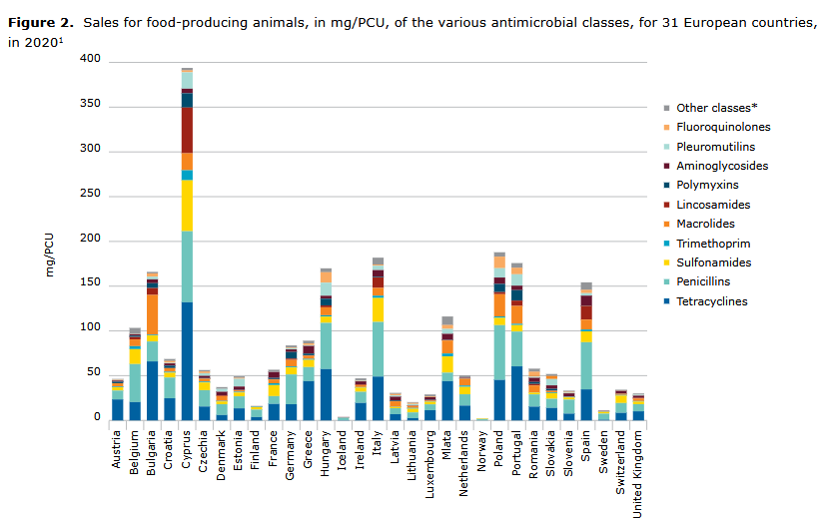
EMA, 2022

Slide 18
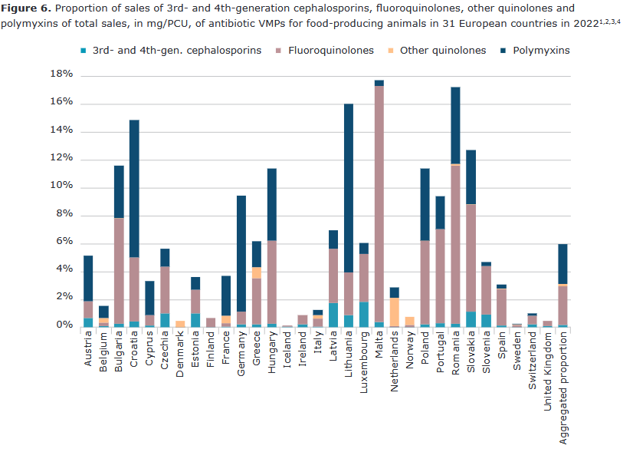
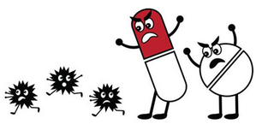
CIA (EMA, 2022)

Slide 19
Regulation implementing Regulation (Regulation (EU) 2019/6) on veterinary medicinal products - Official Gazette of the Republic of Slovenia, No. 109/23
https://pisrs.si/pregledPredpisa?id=URED8611
Antimicrobial VMPs are only dispensed in the Republic of Slovenia on the basis of a veterinary prescription.
Wholesalers deliver antimicrobial VMPs to retailers, i.e. pharmacies and veterinary organisations.
Wholesalers are required by law to report to the competent authority on the turnover (sales) of all medicinal products.

Slide 20
GUIDELINES FOR PRUDENT USE
https://www.gov.si/teme/zdravila-v-veterinarski-medicini/
AMR
NATIONAL "ONE HEALTH" STRATEGY FOR THE MANAGEMENT OF MICROBIAL RESISTANCE (2019-2024)
3. NRL for antimicrobial susceptability testing
National veterinary institute – Institute for microbiolgy at Veterinary faculty UL
The regional units (Kranj, Ljubljana, Novo mesto, Nova Gorica, Celje, Maribor, Murska Sobota) of the National Veterinary Institute (NVI) perform professional and operational activities – concerning AMR

Slide 21
Withdrawal period for medicinal products used outside the terms of the marketing authorisation in food-producing animal species (Article 115)
for meat and offal from food-producing mammals and poultry and farmed game birds the withdrawal period shall not be less than:
the longest withdrawal period provided in its summary of the product characteristics for meat and offal multiplied by factor 1,5;
28 days if the medicinal product is not authorised for food-producing animals;
one day, if the medicinal product has a zero withdrawal period and is used in a different taxonomic family than the target species authorised;
2. for milk from animals producing milk for human consumption the withdrawal period shall not be less than:
the longest withdrawal period for milk provided in the summary of the product characteristics for any animal species multiplied by factor 1,5;
seven days, if the medicinal product is not authorised for animals producing milk for human consumption;
one day, if the medicinal product has a zero withdrawal period;
3. for eggs from animals producing eggs for human consumption the withdrawal period shall not be less than:
the longest withdrawal period for eggs provided in the summary of the product characteristics for any animal species multiplied by factor 1,5;
10 days, if the product is not authorised for animals producing eggs for human consumption;
KASK
IP-V
IP-H
RULES ALSO FOR FISH

Slide 22
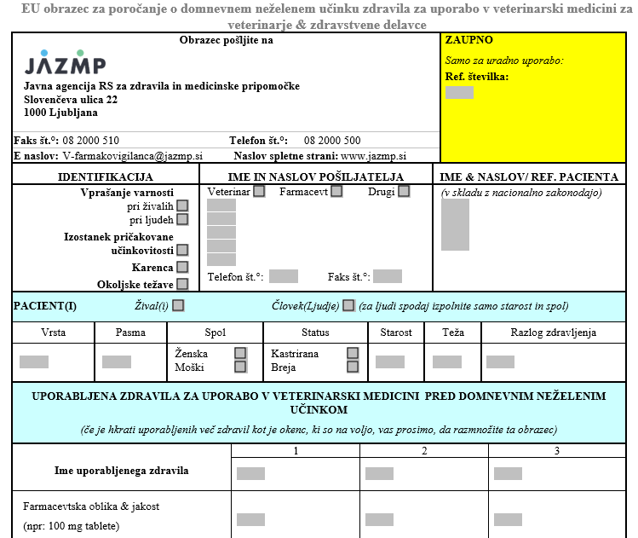
Adverse effects
JAZMP
Wholesalers
Veterinarians

