Slide 1
GOOD PRACTICE EXAMPLE– Perutnina Ptuj
Veterinarska ambulanta PP

Slide 2
Veterinarska ambulanta PP
Since 1997.
5 Doctors of Veterinary Medicine.
9 Veterinary Technicians.
Prevention – vaccinations.
Curative – use of medications.
Own serological laboratory.

Slide 3
Antibiotic usage in mg/kg

Slide 4
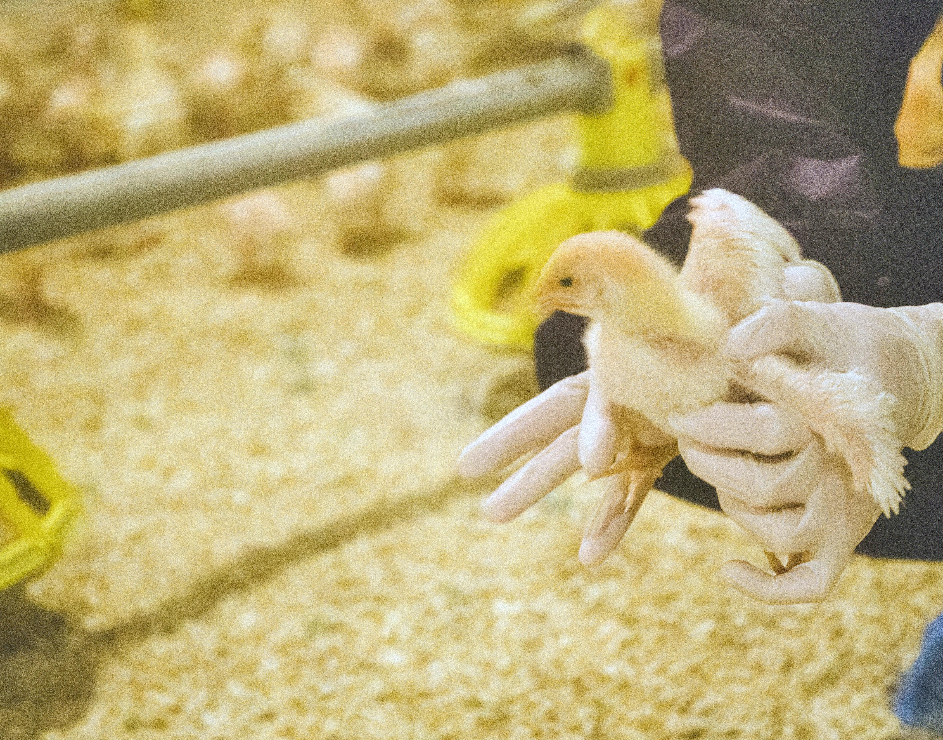
2024
1.1.2024 to 31.10.2024 (November not yet completed).
15,59 mg/kg.
Increased deaths in the first 7 days.
Systemic inflammation.
Diarrhea.
Problems in the locomotor system.
Viral diseases - vaccination program.

Slide 5
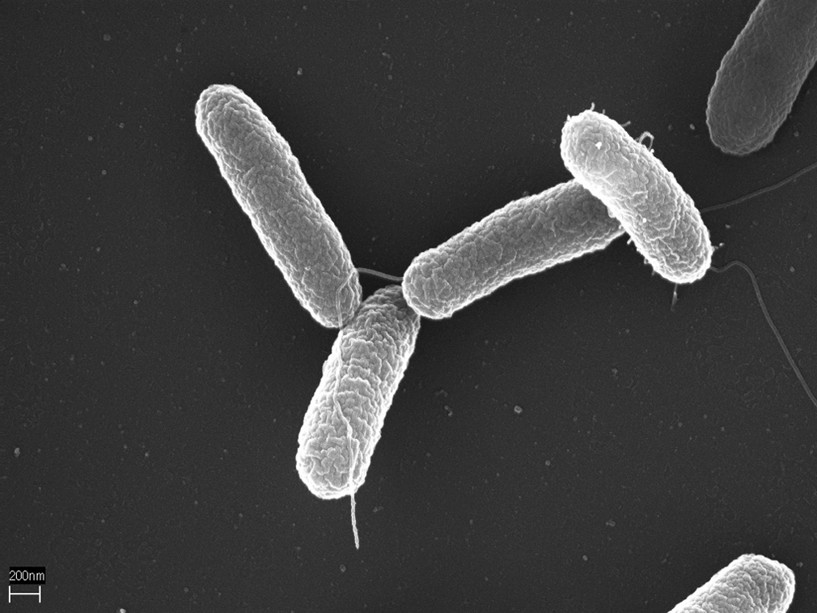
Prevention program
From 2020, individual breeders.
From 2021, all breeders.
Measured water pH.
Use of lactic acid (or other acids).
Use of probiotics.

Slide 6
Preventive program - operation
Lactic acid:
Purpose of lowering pH.
Antimicrobial effect – destruction of bacterial walls, structures and reduction of reproduction.
The use of organic acid reduces the number of bacteria in the intestine (Salmonella, Campylobacter).
Improving stomach function.
Protein breakdown in the stomach.
Lower pH ensures a stable environment (preventing the development of unwanted microorganisms), stable intestinal microflora.

Slide 7
Preventive program - operation
Probiotics:
Beneficial bacteria to help animals with health, function and growth.
Important in young animals – when a stable intestinal microflora has not yet been established (it is established approximately two weeks after hatching).
They cover the intestinal mucosa and prevent harmful bacteria from binding to the gastrointestinal mucosa.
Protecting chickens from dangerous infections.
Older age of chickens – when resistance, immune system and stressful situations decrease.
After antibiotic therapy.

Slide 8
QUESTIONS?

Slide 9
THANK YOU FOR YOUR ATTENTION!

