Slide 1
GREECE
7 FEBRUARY 2025

Slide 2
Additional relevant legislation, provisions and/or guidelines to be considered by veterinarians & farmers (II)
Lecture 4
7 FEBRUARY 2025

Slide 3
EU legal framework on veterinary medicinal products/medicated feed
Regulation (EU) 2019/6 on Veterinary Medicinal Products
Regulation (EU) 2019/4 on Medicated Feed
+ Implementing and delegating Acts

Slide 4
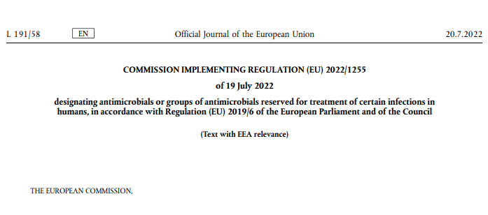
CERTAIN ANTIMICROBIALS ARE PROHIBITED TO USE FOR ANIMAL TREATMENT
The human reserve list: antimicrobials which are reserved for treatment of certain infections in humans
“reserve list”
The antimicrobials and group of antimicrobials listed in this Regulation cannot be used in animals under any circumstances.
This list will be kept under continual review in the light of new scientific evidence or emerging information
Commission Implementing Regulation (EU) 2022/1255

Slide 5
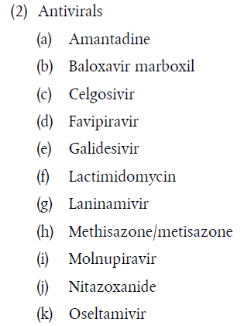
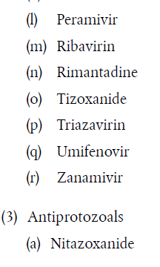
ANTIMICROBIALS ON THE HUMAN RESERVE LIST
“human reserve list”
Supporting prudent use and preserving efficacy
Commission Implementing Regulation (EU) 2022/1255

Slide 6
CERTAIN ANTIMICROBIALS ARE NOT ALLOWED OR CONDITIONALLY ALLOWED TO USE UNDER ART 112 & 113*
Commission Implementing Regulation (EU) 2024/1973 lists antimicrobials which cannot be used in accordance with article 112 & 113* (outside the marketing authorisation) or can only be used subject to certain conditions.
Some examples:
Third- and fourth-generation cephalosporins cannot be used in accordance with Article 113 in poultry
Polymyxins are allowed only after prior pathogen identification and susceptibility testing showing that they are likely to be effective and other preferable antimicrobials would not be effective.
Quinolones (including fluoroquinolones) cannot be used in accordance with Article 113 for salmonellosis in poultry or for metaphylaxis of salmonellosis in animals other than poultry
All details here: https://eur-lex.europa.eu/eli/reg_impl/2024/1973/oj
This Act will apply from 8 August 2026

Slide 7
Upcoming Delegated and Implementing Legal Acts
List of substances authorised for use in food-producing terrestrial animal species or substances contained in a medicinal product for human use authorised in the Union, which may be used in food-producing aquatic species in accordance with Article 114(1)
List of substances which are essential for the treatment of equine species, or which bring added clinical benefit compared to other treatment options available for equine species and for which the withdrawal period for equine species shall be six months.
More info on all delegated and implementing Acts: https://food.ec.europa.eu/animals/animal-health/vet-meds-med-feed/implementation_en

Slide 8
Upcoming Acts
List of antimicrobials that may be used for food-producing aquatic species
!Article 114
The Commission will establish a list of substances used in veterinary medicinal products authorised in the Union for use in food-producing terrestrial animal species or substances contained in a medicinal product for human use authorised in the Union in accordance with Directive 2001/83/EC or Regulation (EC) No 726/2004, which may be used in food-producing aquatic species in accordance with Article 114(1).
Notes:
IF RUNNING OUT OF TIME, THIS SLIDE CAN BE HIDDEN

Slide 9
Upcoming Acts
List of antimicrobials for specific species (equine species)
The Commission published a list of substances essential for the treatment of Equidae (Commission Regulations (EC) No. 1950/2006 & No. 122/2013 )
The VMP Regulation requires the Commission to establish a list of substances which are essential for the treatment of equine species, or which bring added clinical benefit compared to other treatment options available for equine species and for which the withdrawal period for equine species shall be six months to be established
In July 2024 EMA published its scientific advice regarding the list of substances which are essential for the treatment of equine species (SA - Art115(5) - List of substances essential for equine species (europa.eu)
The Commission is now working on the required implementing act.
Notes:
IF RUNNING OUT OF TIME, THIS SLIDE CAN BE HIDDEN

Slide 10
It is crucial to report adverse events (pharmacovigilance)
Unintended, unfavorable reaction in animals to a veterinary or human medicine
Lack of efficacy of a veterinary medicine
Any environmental incidents after applying a veterinary medicine
Any noxious reaction to humans
Exceeding the MRL when withdrawal period was respected
Any suspected transmission of an infectious agent via the medicine
Do not forget to report adverse events including lack of efficacy!
Adverse events are:
Why report? To ensure safety, monitor efficacy, prevent harm, guide regulation and to inform research.

Slide 11
Disposal of Veterinary Medicines
How and where does pharmaceutical waste occur?
Immediate packaging and the remains of medicines within after use.
VMP or MF that are past their expiry date or that have not been stored in accordance with the instructions.
Prescription of a quantity exceeding the required quantity or uncompleted course of treatment due to either administration difficulties, adverse reactions, change in treatment or because animals died during treatment.
FACTSHEET_PharmaceuticalWasteDisposal.pdf (epruma.eu)

Slide 12
Disposal of Veterinary Medicines
Best practices for disposal
PharmaceuticalWasteDisposal.pdf (epruma.eu)
Everybody (prescribers and users) is responsible for minimising pharmaceutical waste.
Disposal of pharmaceutical waste via waterways should be excluded.
Pharmaceutical waste should be stored in a dedicated container, bin, or facility to ensure adequate protection to animal health, human health, feed, food and the environment and this must be separated from any stocks of veterinary medicines to ensure that the waste cannot be inadvertently used.
Waste must be disposed of in accordance with the Summary of Product Characteristics (SPC) and the waste legislation and national systems developed in consultation with all parties for the collection, transport, and disposal of the waste.
Member States shall ensure that appropriate collection or discard systems are in place for waste veterinary medicinal products (including medicated feed) and to ensure that the location of collection or discard points as well as other relevant information is made available to farmers, animal keepers, veterinarians, and other relevant persons.

Slide 13
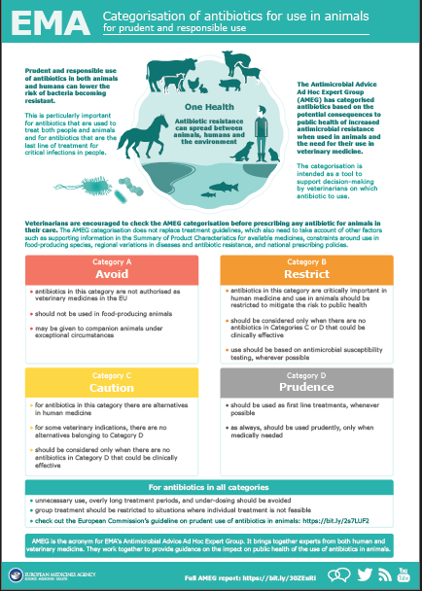
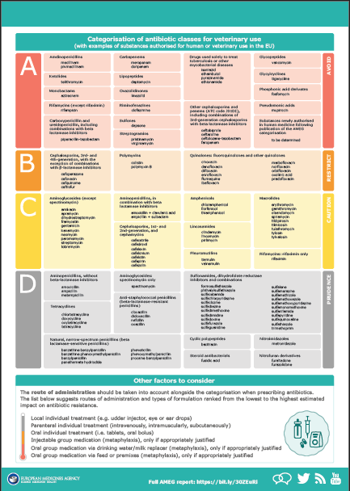
Other considerations for prescriptions

Slide 14
Prudent Use Guidelines
Not legally binding as the previous acts/provisions!
Guideline for the prudent use of antimicrobials in veterinary medicine 2015/C 299/04​
https://health.ec.europa.eu/system/files/2016-11/2015_prudent_use_guidelines_en_0.pdf
Best-practice framework for the use of antimicrobials in food-producing animals in the EU - Reaching for the next level.
https://epruma.eu/home/best-practice-guides/best-practice-framework-for-the-use-of-antimicrobials-in-food-producing-animals-in-the-eu-reaching-for-the-next-level/

Slide 15
Animal Health Law (Regulation (EU) 2016/429 on transmissible animal disease)
“Prevention is better than cure”
Preventive driven approach:
improvement of animal health and biosecurity measures, good farming practices
Clear responsibility for all players for animal health
Operators → ensure a high level of animal health and welfare, and biosecurity
Vets → raise awareness and help in the prevention and spread of pathogens
CA → protect animal health, human
health and environment
Prioritising EU intervention
Regulatory tools/interventions for resistant pathogens: "disease agents“
Disease preventive and control measures may apply (surveillance, eradication etc.)
Legal basis monitoring AMR in animal pathogens

Slide 16
National provisions

Slide 17
Competent authorities – Greece
National Organization for Medicines (EOF) – Responsible for marketing approval, monitoring clinical trials, pharmacovigilance, contucting inspections of production units and overseeing the marketing of veterinary medicines, medicated feed and intermediate products
Ministry of Rural Development and Food, Directorate of Animal Protection and Veterinary Drugs, Department of Veterinary Medicines, Residues and Veterinary Supplies - Develops and implements the legislative framework for the marketing, disposal and use of VMP, ensuring harmonization with European Legislation. Also involved in the planning, organization, monitoring, surveillance, and evaluation of official control system.
Veterinary Services of Regional Units – Responsible for the approval and official control of veterinary pharmacies (both wholesale and retail), veterinary practices/ clinics. Also oversees official controls of farms regarding the use of veterinary medicinal products (VMPs) and medicated feed (MF).

Slide 18
National Legislation
L.2538/1997
M.D. 310584/1998
L. 2945/2001
L. 3698/2008
M.D. 282371/2006
L. 3955/2011
L.4691/2020
L.4711/2020
Retail sale of veterinary medicinal products is permitted only from licensed premises under the supervision of a qualified responsible scientist:
Veterinary Pharmacies
Veterinary practice/clinics (for the animals they examine/monitor)
Pharmacies
Veterinarians that are not authorized to prescribe:
Engage in VMP trading businesses
Hold a valid VMP retail or wholesale shop license
Participate in activities related to the production, importation and/or marketing of VMP
Official veterinarians (with some exceptions)

Slide 19
National Legislation – New Ministerial Desitions
M.D. 410185/31-12-2024
for the implementation of Reg. 2019/6 and Executive Reg. 2021/1248
measures on Good Distribution Practice (GDP) for the wholesale, distribution and storage of veterinary medicinal products
conditions and procedure for granting a license for the wholesale sale of veterinary drugs
operation and obligations of veterinary drug wholesale businesses
measures for at the distance retailing of veterinary medical products

Slide 20
National Legislation – New Ministerial Desitions
M.D. 407523/27-12-2024
Electronic prescription of veterinary drugs
Operation of an information system integrated with the Unified Digital Portal of the Public Administration (gov.gr), for the electronic prescription of VMP and MF intended for food-producing animals (mammals, birds, fish, bees)
Mandatory electronic prescription of VMP and MF for cattle, pigs, broilers, laying hens and turkeys
Optional for the other species of food producing animals until 01/01/2026

Slide 21
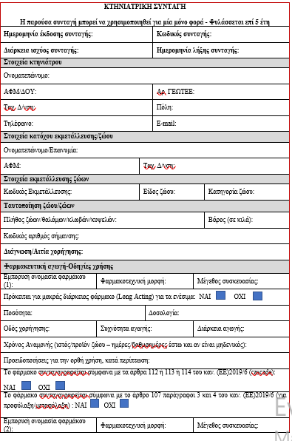
National Legislation – New Ministerial Desitions
M.D. 407523/27-12-2024:
Administrator of the information system: Ministry of Rural Development and Food
Users of the information system:
Veterinarians authorized to prescribe (dispensing veterinary prescriptions)
• Responsible scientists of enterprises authorized to retail GMP (implementing veterinary prescriptions)
• Farmers (access limited to prescriptions and records related to their farm)
Veterinary services (access to prescriptions and farm/business registers within their areas of responsibility)

Slide 22
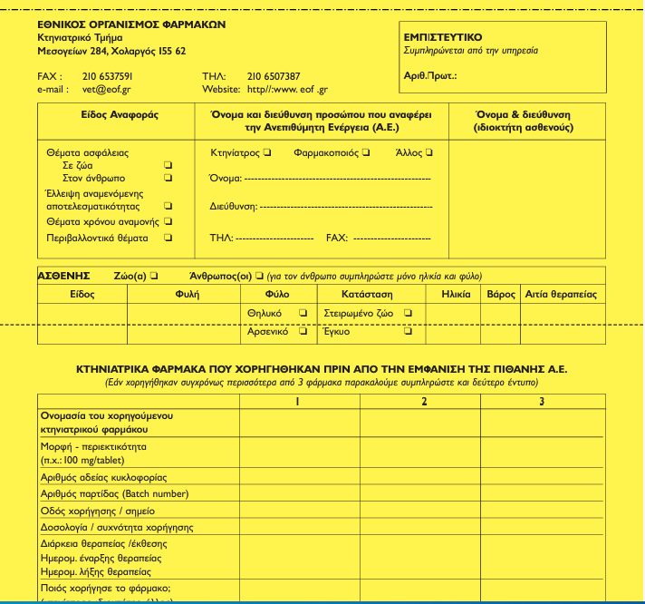
Pharmacovigilance
Yellow card
Available from National Organization for Medicines (EOF)
EOF Website
Send to EOF by post or electronically

Slide 23
Withdrawal and destruction
Producers, importers, distributors and manufacturers are responsible for withdrawing and/or destroying VMP and MF, that are expired or due to expire within the current semester
The management (storage, transport and destruction) of waste (unused, expired, inappropriate SPCs and FZs), must comply with the applicable regulations concerning solid or hazardous waste, based on the specific case at hand

