Slide 1
Hands-on training for farmers and veterinarians:
Case study I: Exploring the social factors affecting the implementation of biosecurity measures in Spain

Slide 2
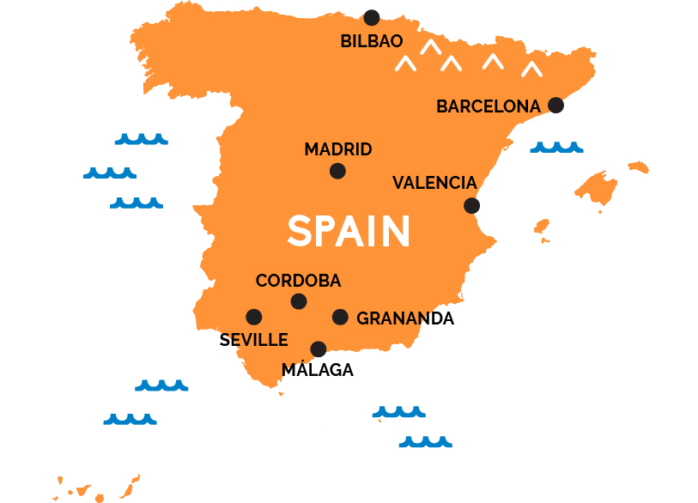
Context

Slide 3
Information sources
Internal world of the farmer
Decision-making of dairy farmers influenced by psychosocial factors
Social dynamics
Official veterinary services
Time and space

Slide 4


Information sources
Visits and proximity experiences
Internal world of the farmer
Bars, pubs, or restaurants
Social dynamics
Farmers
Time and treatment given–received
Official veterinary services
Veterinarians
Trust relationship
Time and space
Training
and communication skills

Slide 5

Information sources
Internal world of the farmer
Social dynamics
Adaptation
Effectiveness and benefits
Official veterinary services
Pre‐disposition
Return and
performance
Time and space
Individual experiences
Importance and focus

Slide 6

Information sources
Internal world of the farmer
Tradition
Social dynamics
Internal dynamics
Social pressure or influence
Official veterinary services
External dynamics
Coordination
Time and space
Farm workers

Slide 7


Information sources
Internal world of the farmer
Questioning
Social dynamics
Mandatory or voluntary
Comparative
grievances
Official veterinary services
Reality approach
Importance and focus
Time and space
Relevance

Slide 8


Information sources
Internal world of the farmer
Social dynamics
Time and space
Official veterinary services
Time and space

Slide 9
Perceived veterinarian contradictions: who is right?
Face-to-face veterinarian meetings: do the meetings actually take
place?
Basic biosecurity measures
Communication between veterinarians and dairy farmers

Slide 10
Perceived veterinarian contradictions: who is right?
Face-to-face veterinarian meetings: do the meetings actually take
place?
Basic biosecurity measures
Contradictions
"(...) The best measure is for vets to bring clean boots, properly clean. Nothing’s worse than them arriving with manure on their boots, putting on disposable plastic overshoes and then dragging their feet along; when they go from here to there, the plastic gets broken and so the contact is obviously the same as not having any protection at all. I think that the vets should see that for themselves; farmers shouldn’t have to ask for this. And on top of that, they don’t like it when you tell them (...)"
Expertise
“(…) I once had an AHV (animal health veterinarians) contracted by the HAD (Health Defence Associations) who got here with worn-out boots, it was impossible for him to clean them. And he said: ‘If you want, I can put bags over my boots’; but he didn’t have any disposable plastic overshoes in the car either. He was here for a very short time. He was a young vet who’d only recently finished his degree, which is even more serious (…)”

Slide 11
Perceived veterinarian contradictions: who is right?
Face-to-face veterinarian meetings: do the meetings actually take
place?
Basic biosecurity measures
Meetings
“(…) So they tell me: ‘I’ve got problems with Bovine Viral Diarrhoea’. So, you talk to the AHV (animal health veterinarians) contracted by the HAD (Health Defence Associations), that’s their area, and you get involved in the HDA program to control it. And it’s like what I said: ‘I don’t have the time to come here every time a calf’s born, I don’t have time and it’s not my area of specialisation’. I think that specialisation is leading us towards this, to look for collaboration. We need to meet up more (…)”
Responsibilities
“(…) There’s very rarely any direct conflict. I don’t find myself in situations where I need to say to a farmer: ‘You decide: either listen to me, and give the animal a branded vaccine [the veterinarian understands this as a biosecurity measure], or listen to them, and do something else’. That doesn’t really happen very often; but what does happen is that we keep knocking the ball backwards and forwards into each other’s court (…)”

Slide 12
Perceived veterinarian contradictions: who is right?
Face-to-face veterinarian meetings: do the meetings actually take
place?
Basic biosecurity measures
Official control programs
“(…) I think that there has to be some common sense, doing things right. It’s a problem that needs a solution, a little common sense and doing things as they should be done. Then there’d be no problems, not even for things like fences. Common sense is very variable; for one person, one measure might be normal and for another it could be complete nonsense. It’s all very complicated; I think that the authorities should have basic standards to apply, which we might like or might not (…)”
Effectiveness
“(…) The measures have to be really effective. If the authorities say that you have to wear a disinfection backpack, I can’t see that working because the backpack’ll never be touched and that’ll be the end of it. But, if they force you to have a place for trucks with disinfectant, that’d be more effective, I think. It is the same as closing your perimeter with fences: you can’t close in all your hectares, it’s just not feasible (…)”

Slide 13
Hands-on training for farmers and veterinarians:
Case study I: Exploring the social factors affecting the implementation of biosecurity measures in Spain

