Slide 1
AUSTRIA
27 FEBRUARY 2025

Slide 2
Additional relevant legislation, provisions and/or guidelines to be considered by veterinarians & farmers (II) Lecture 4
27 FEBRUARY 2025

Slide 3
EU legal framework on veterinary medicinal products/medicated feed
Regulation (EU) 2019/6 on Veterinary Medicinal Products
Regulation (EU) 2019/4 on Medicated Feed
+ Implementing and delegating Acts

Slide 4
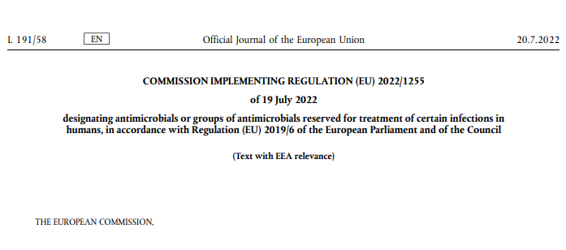
CERTAIN ANTIMICROBIALS ARE PROHIBITED TO USE FOR ANIMAL TREATMENT
The human reserve list: antimicrobials which are reserved for treatment of certain infections in humans
“reserve list”
The antimicrobials and group of antimicrobials listed in this Regulation cannot be used in animals under any circumstances.
This list will be kept under continual review in the light of new scientific evidence or emerging information
Commission Implementing Regulation (EU) 2022/1255

Slide 5
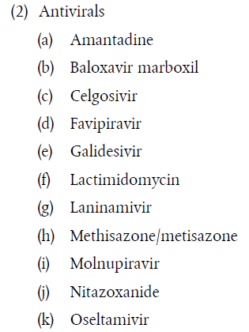
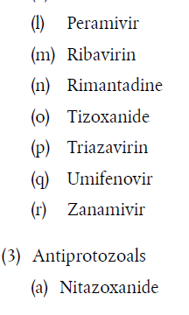
ANTIMICROBIALS ON THE HUMAN RESERVE LIST
“human reserve list”
Supporting prudent use and preserving efficacy
Commission Implementing Regulation (EU) 2022/1255

Slide 6
CERTAIN ANTIMICROBIALS ARE NOT ALLOWED OR CONDITIONALLY ALLOWED TO USE UNDER ART 112 & 113*
Commission Implementing Regulation (EU) 2024/1973 lists antimicrobials which cannot be used in accordance with article 112 & 113* (outside the marketing authorisation) or can only be used subject to certain conditions.
Some examples:
      Third- and fourth-generation cephalosporins cannot be used in accordance with Article 113 in poultry
      Polymyxins are allowed only after prior pathogen identification and susceptibility testing showing that they are likely to be effective and other preferable antimicrobials would not be effective.
      Quinolones (including fluoroquinolones) cannot be used in accordance with Article 113 for salmonellosis in poultry or for metaphylaxis of salmonellosis in animals other than poultry
All details here: https://eur-lex.europa.eu/eli/reg_impl/2024/1973/oj
This Act will apply from 8 August 2026

Slide 7


Upcoming Delegated and Implementing Legal Acts
List of substances authorised for use in food-producing terrestrial animal species or substances contained in a medicinal product for human use authorised in the Union, which may be used in food-producing aquatic species in accordance with Article 114(1)
List of substances which are essential for the treatment of equine species, or which bring added clinical benefit compared to other treatment options available for equine species and for which the withdrawal period for equine species shall be six months.
More info on all delegated and implementing Acts:
https://food.ec.europa.eu/animals/animal-health/vet-meds-med-feed/implementation_en

Slide 8

Upcoming Acts
List of antimicrobials that may be used for food-producing aquatic species
!Article 114
The Commission will establish a list of substances used in veterinary medicinal products authorised in the Union for use in food-producing terrestrial animal species or substances contained in a medicinal product for human use authorised in the Union in accordance with Directive 2001/83/EC or Regulation (EC) No 726/2004, which may be used in food-producing aquatic species in accordance with Article 114(1).
Notes:
IF RUNNING OUT OF TIME, THIS SLIDE CAN BE HIDDEN

Slide 9
Upcoming Acts
List of antimicrobials for specific species (equine species)
The Commission published a list of substances essential for the treatment of Equidae (Commission Regulations (EC) No. 1950/2006 & No. 122/2013 )
The VMP Regulation requires the Commission to establish a list of substances which are essential for the treatment of equine species, or which bring added clinical benefit compared to other treatment options available for equine species and for which the withdrawal period for equine species shall be six months to be established
In July 2024 EMA published its scientific advice regarding the list of substances which are essential for the treatment of equine species (SA - Art115(5) - List of substances essential for equine species (europa.eu)
The Commission is now working on the required implementing act.
Notes:
IF RUNNING OUT OF TIME, THIS SLIDE CAN BE HIDDEN

Slide 10
It is crucial to report adverse events (pharmacovigilance)
Unintended, unfavourable reaction in animals to a veterinary or human medicine
Lack of efficacy of a veterinary medicine
Any environmental incidents after applying a veterinary medicine
Any noxious reaction to humans
Exceeding the MRL when withdrawal period was respected
Any suspected transmission of an infectious agent via the medicine
Do not forget to report adverse events including lack of efficacy!
Adverse events are:
Why report? To ensure safety, monitor efficacy, prevent harm, guide regulation and to inform research.

Slide 11
Disposal of Veterinary Medicines
How and where does pharmaceutical waste occur?
Immediate packaging and the remains of medicines within after use.
VMP or MF that are past their expiry date or that have not been stored in accordance with the instructions.
Prescription of a quantity exceeding the required quantity or uncompleted course of treatment due to either administration difficulties, adverse reactions, change in treatment or because animals died during treatment.
FACTSHEET_PharmaceuticalWasteDisposal.pdf (epruma.eu)

Slide 12
Disposal of Veterinary Medicines
Best practices for disposal
PharmaceuticalWasteDisposal.pdf (epruma.eu)
Everybody (prescribers and users) is responsible for minimising pharmaceutical waste.
Disposal of pharmaceutical waste via waterways should be excluded.
Pharmaceutical waste should be stored in a dedicated container, bin, or facility to ensure adequate protection to animal health, human health, feed, food and the environment and this must be separated from any stocks of veterinary medicines to ensure that the waste cannot be inadvertently used.
Waste must be disposed of in accordance with the Summary of Product Characteristics (SPC) and the waste legislation and national systems developed in consultation with all parties for the collection, transport, and disposal of the waste.
Member States shall ensure that appropriate collection or discard systems are in place for waste veterinary medicinal products (including medicated feed) and to ensure that the location of collection or discard points as well as other relevant information is made available to farmers, animal keepers, veterinarians, and other relevant persons.

Slide 13

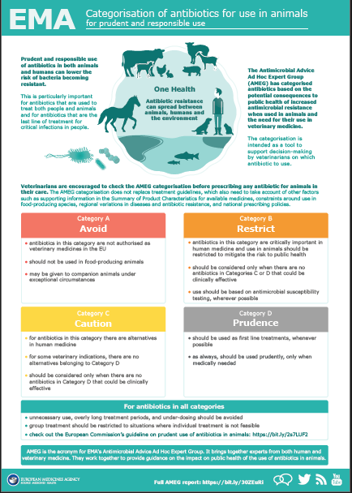
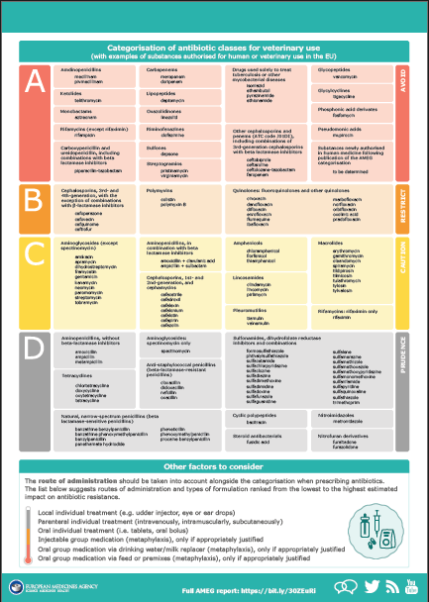
Other considerations for prescriptions

Slide 14
Prudent Use Guidelines
Not legally binding as the previous acts/provisions!
Guideline for the prudent use of
antimicrobials in veterinary medicine 2015/C 299/04​
https://health.ec.europa.eu/system/files/2016-11/2015_prudent_use_guidelines_en_0.pdf
Best-practice framework for the use of antimicrobials in food-producing animals in the EU - Reaching for the next level.
https://epruma.eu/home/best-practice-guides/best-practice-framework-for-the-use-of-antimicrobials-in-food-producing-animals-in-the-eu-reaching-for-the-next-level/

Slide 15
Animal Health Law (Regulation (EU) 2016/429 on transmissible animal disease)
“Prevention is better than cure”
Preventive driven approach:
improvement of animal health and biosecurity measures, good farming practices
Clear responsibility for all players for animal health
  Operators → ensure a high level of animal health and welfare, and biosecurity
  Vets → raise awareness and help in the prevention and spread of pathogens
  CA → protect animal health, human
  health and environment
Prioritising EU intervention
Regulatory tools/interventions for resistant pathogens: "disease agents“
Disease preventive and control measures may apply (surveillance, eradication etc.)
Legal basis monitoring AMR in animal pathogens

Slide 16

National provisions

Slide 17
AT legal framework for veterinary medicines, especially antibiotics
Austrian Veterinary Medicinal Act TAMG - BGBl. I Nr. 186/2023
“Veterinary antibiotic flow rate regulation“
“Veterinary medicinal specialties application regulation”
„Animal Health Service regulation (TGD-VO)
➔ currently under revision!!

Slide 18
Building blocks for legal certainty
Veterinary Medicinal
Act TAMG
Collective amendment of 30 regulations
Veterinary antibiotic flow rate regulation
AB-Guidelines
Came into force in January 2025
Currently developing a technical proposal
Revision should come over the summer
➔ derzeit in Überarbeitung!!

Slide 19
Structure of the Veterinary Medicines Act TAMG
I. Main section: General provisions (§§ 1 – 4)
II. Main section (§§ 5 – 48)
  I. Section: Placing on the market
  II. Section: Advertising and control
  III. Section: Operating regulations
  IV. Section: Market surveillance and pharmacovigilance
  V. Section: Wholesale distribution
  VI. Section: Official control of veterinary drugs
III. Main section (§§ 49 – 81)
  I. Section: Retail distribution
  II. Section: Application of veterinary medicines
  III. Section: Documentation
  IV. Section: Special provisions for medicated feed
  V. Section: Official control of the use of veterinary medicinal products
IV. Main section: Fees / Sanctions / Transitional and Final Provisions (§§ 82 – 94)
Wie und wo entstehen Arzneimittelabfälle?
Pharmaceutical industry
Veterinarians

Slide 20
Application of veterinary medicines
Important new AB regulations in TAMG Section III
§ 54. Veterinary prescription of antimicrobial drugs
Responsibility of animal owner/veterinarian!
Benchmark system (see separate slides for benchmark system)
Measures to reduce the use of AB
➔ Further regulations will be developed in a timely manner by REGULATION
§ 61. Use of antimicrobial drugs
➔ GUIDELINES will be revised shortly (1st revision has already been done)
Notes:
WENN DIE ZEIT KNAPP WIRD, KANN DIESE FOLIE AUSGEBLENDET WERDEN

Slide 21
Application of veterinary medicines
§ 54 Veterinary prescription of AB
Good data on AB use has been collected in Austria for many years
It is urgently necessary to use this data to improve, reduce or optimize the use of AB
This should be done by establishing a legally stipulated benchmark system (BM reports for pigs already established, but without measures) - currently not planned for horses, small animals and veterinarians
In Section 54 Paragraph 3, the benchmark system was precisely defined and stipulated that goals and threshold values ​​for the benchmark system are set by means of the VO (Vet-Antibiotics-Volume Flows-VO).
A 3-year average should be used as the basis for the threshold value in relation to the respective type of use (e.g. fattening pig, laying hen...)
Notes:
WENN DIE ZEIT KNAPP WIRD, KANN DIESE FOLIE AUSGEBLENDET WERDEN

Slide 22
Application of veterinary medicines
§ 54 Responsibility for animal owners/veterinarians & animal health service
Paragraph 4 stipulates that animal owners and veterinarians are responsible for achieving the reduction goals! Implementation of the measures by the animal owner and veterinarian!
The measures must be ordered by the state governor with a decision, if necessary with a reasonable deadline to be set at the same time and with the necessary conditions or requirements. These must be complied with by the animal owner or veterinarian.
For participants of the animal health service who take part in a corresponding nationwide animal health program recognized by the BMSGPK, the setting of measures and their control are entrusted to the respective animal health service
Notes:
WENN DIE ZEIT KNAPP WIRD, KANN DIESE FOLIE AUSGEBLENDET WERDEN

Slide 23
Application of veterinary medicines
Measures if the threshold value is exceeded (§ 54 Abs. 4)
a mandatory consultation with the respective supervising veterinarian using a standardized and published protocol;
an action plan with a deadline for implementing improvement measures;
Completion of mandatory training for the animal owner or veterinarian
a paid company visit and advice from independent experts;
If an exceedance cannot be eliminated or avoided despite the implementation of measures ordered in accordance with points 1 to 4, a company visit by the responsible authority with the possible assistance of independent experts
If an exceedance cannot be eliminated or avoided despite the implementation of measures ordered in accordance with points 1 to 5, a reduction in the animal population or the population density
Animal health service
Notes:
WENN DIE ZEIT KNAPP WIRD, KANN DIESE FOLIE AUSGEBLENDET WERDEN

Slide 24
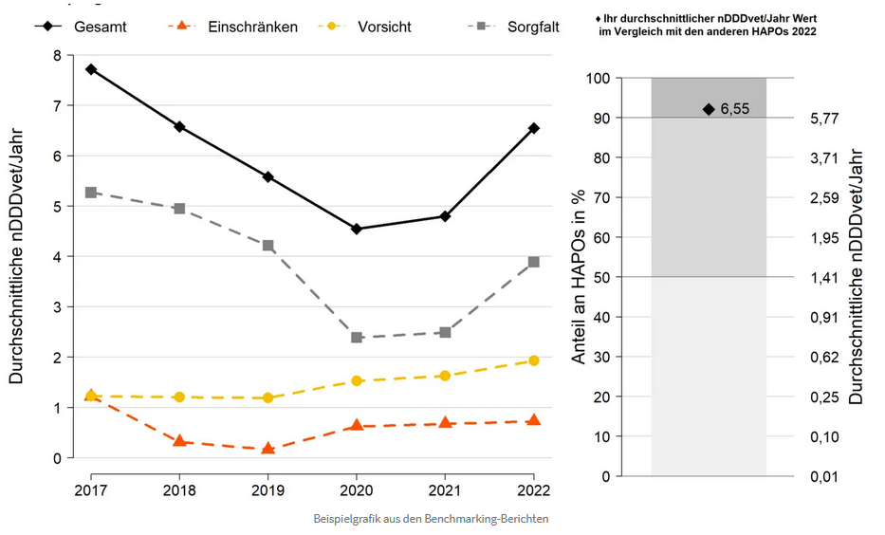
Application of veterinary medicines
Example graphic benchmark
Source: https://www.ages.at/tier/tierarzneimittel-hormone/antibiotika-vertriebsmengen-in-der-veterinaermedizin
Notes:
WENN DIE ZEIT KNAPP WIRD, KANN DIESE FOLIE AUSGEBLENDET WERDEN

Slide 25
AB Use – Antibiogram
§ 61 Use of antibiotics
On the one hand, implementation of EU law:
Regulations for prophylaxis, metaphylaxis
Prohibiting the routine use of AB to mask poor hygiene, inadequate housing conditions or care, or inadequate farm management to promote growth or increase yield.
On the other hand, there are clear guidelines as to when the veterinarian must carry out pathogen detection and a sensitivity test (antibiogram) as part of the diagnosis process ➔ applies to all animal species
  ➔ see also antibiotic guidelines (RIS - AVN_20240228_AVN_2024_2_2 - Amtliche Veterinärnachrichten (AVN) ab 15.09.2004 (bka.gv.at))
Notes:
WENN DIE ZEIT KNAPP WIRD, KANN DIESE FOLIE AUSGEBLENDET WERDEN

Slide 26
AB Use – Antibiogram
§ 61 Use of antibiotics - Key Facts
It is clear that veterinarians are responsible for the use of antibiotics based on their training and knowledge
According to TAMG § 54 (2): In accordance with Article 105 paragraph 2 of Regulation (EU) 2019/6, the veterinarian must be able to justify the veterinary prescription of antimicrobial veterinary drugs or antimicrobial drugs, in particular for meta- and prophylaxis.
The key word is DIAGNOSIS - if the decision is made to use/dispense an antibiotic as part of the diagnosis, further requirements must be adhered to under certain circumstances ➔ pathogen detection and sensitivity testing!
All approved ABs can still be used!
          Exception: if ONLY permitted for humans (EU Regulation)
Notes:
WENN DIE ZEIT KNAPP WIRD, KANN DIESE FOLIE AUSGEBLENDET WERDEN

Slide 27
AB Use – Antibiogram
§ 61 Diagnosis by veterinarians & corresponding exceptions
Pathogen detection and a susceptibility test (antibiogram) must be carried out if:
the use of third or fourth generation cephalosporins or fluoroquinolones could be indicated as the drug of choice, or the combined use of antimicrobial veterinary medicinal products or antimicrobial drugs that are not approved as combination preparations is indicated, or the use of an antimicrobial drug that is not approved for animals and has a systemic effect is indicated as the drug of choice (e.g. Human AB eye ointment can be used without an antibiogram).
In any case, an antibiogram must be created if:
When changing AB or with repeated or long-term use of AB in an epidemiological unit.
Exceptions:
➔ Danger to the animal regarding sampling or previous treatment or pathogen cannot be cultured or no method is available…
In the case of an acute illness, AB treatment can always be started!
Notes:
WENN DIE ZEIT KNAPP WIRD, KANN DIESE FOLIE AUSGEBLENDET WERDEN

