Slide 1
PRRS Status und Antibiotic consumption
Dr. Barbara Leeb Upper Austrian Animal Health Service
Salzburg, 27. Februar 2025

Slide 2
PRRS
Major viral disease in pigs occurring worldwide
Abbreviation for Porcine Reproductive and Respiratory Syndrome
Abortions at the end of gestation, birth of weak piglets, fever in sows
Respiratory diseases in weaner piglets and fattening pigs
Virus has immunosuppressive effect - promotes secondary bacterial infections
Increased use of antibiotics in PRRS positive farms

Slide 3
PRRS Strategies
Country-specific strategies to combat PRRS
  Eradication programs - Netherlands, Denmark, Hungary
  Germany - individual solutions for farms, widespread use of vaccines
  Austria - Animal Health Service PRRS stabilization program
AHS program
  Voluntary - but the producer groups oblige their farms to participate
  Preventing the spread of PRRS field virus strains
🞏​ on farms
🞏​ in livestock trading
  Improving animal health on Austrian pig farms and reducing the use of antibiotics
  Marketing of healthy piglet batches for fattening, also originating from different farms

Slide 4
PRRS stabilization program
PRRS status for each participating farm based on test results
Measures dependent on PRRS status
  Improving biosecurity
  Testing
  Vaccination - stabilization
PRRS unsuspicious | PRRS AK negative in sows, gilts, piglets, sale animals
PRRS stable | PRRS AK negative in piglets > 10 weeks resp. in sale animals; PRRS AK positive in sows
PRRS positive | PRRS AK positive in piglets resp. in sale animals or virus detection
Sows and piglets vaccinated | No sampling, as sows and piglets are vaccinated against PRRSV
In organized production, marketing of piglets according to PRRS status
  When grouping piglets for fattening

Slide 5
Evaluation of the PRRS stabilization program
Does the program have an impact on animal health and antibiotic consumption in Upper Austria?
Analysis by AGES DSR
PRRS status of program farms that market piglets
  262 breeding farms
  164 farrow to finish farms with piglet sale
Antibiotic index - nDDDvet
  Annual reporting of antibiotics dispensed per LFBIS
  Conversion into daily doses
  standardized by animal production per farm

Slide 6


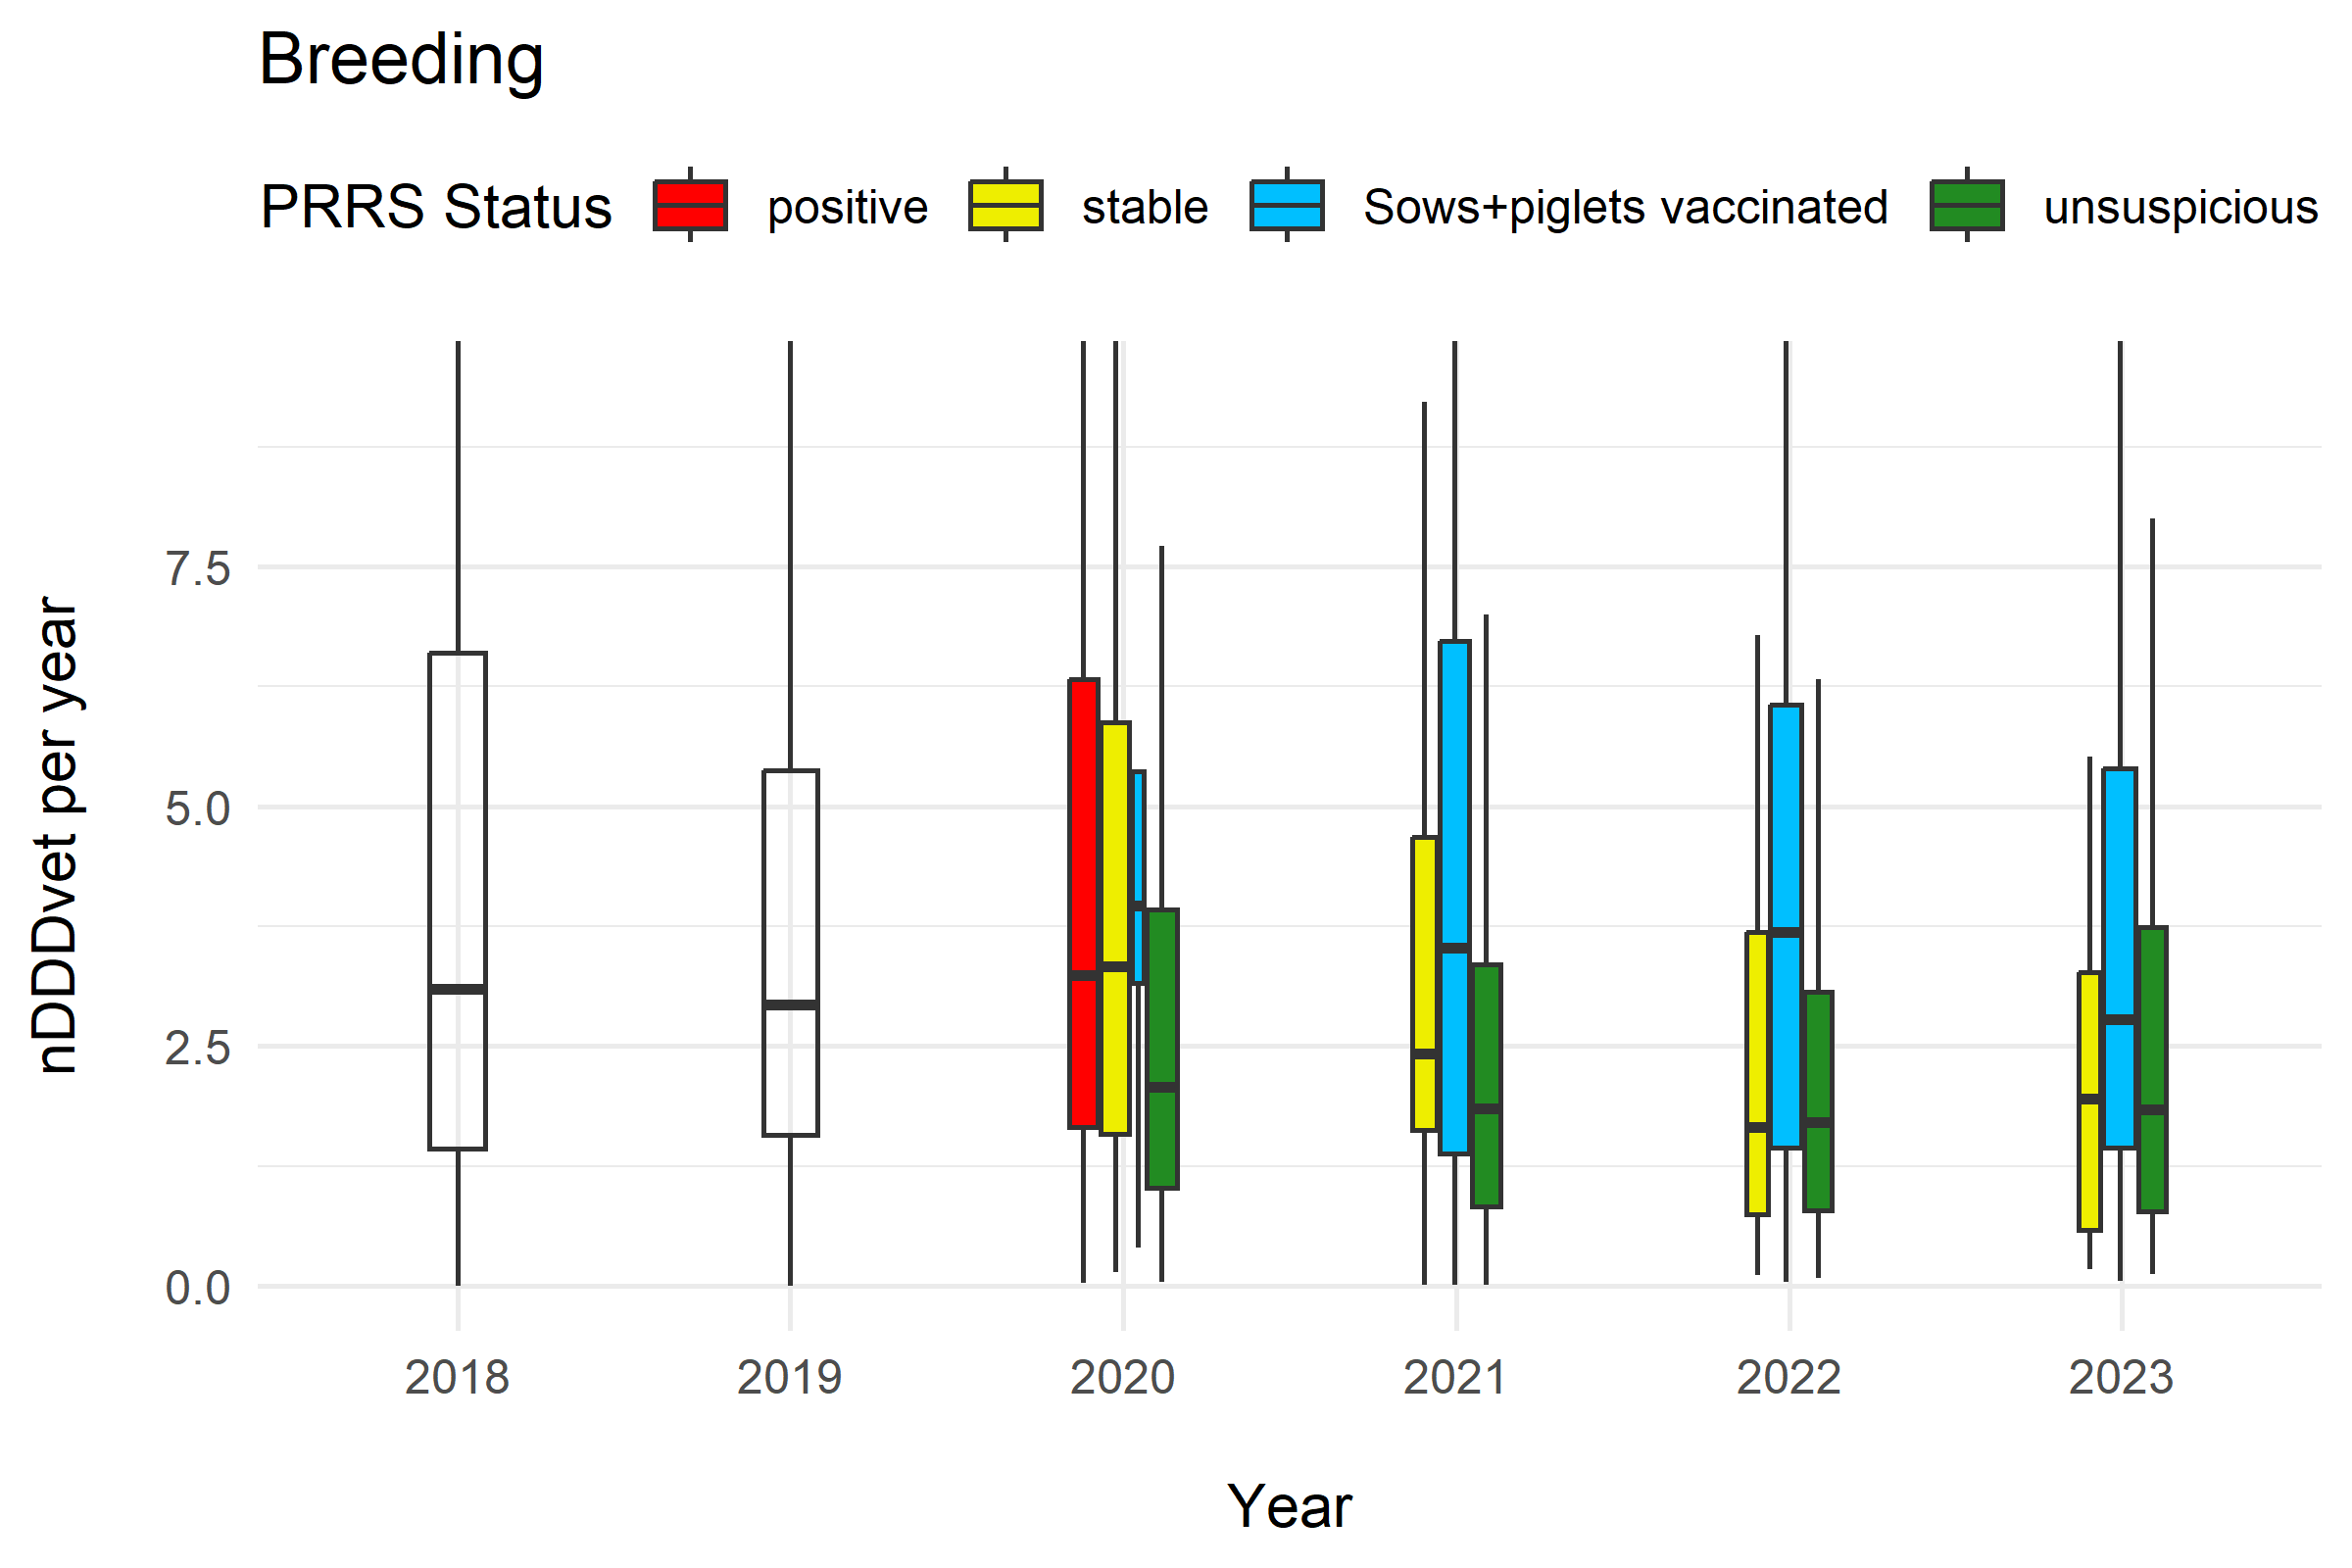
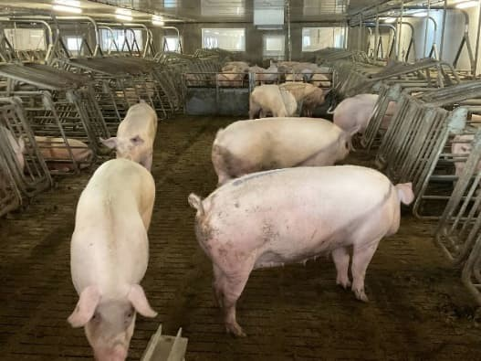
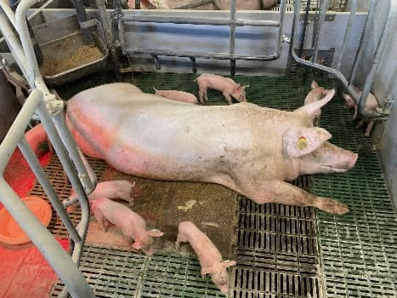
Antibiotic consumption in breeding farms
R. Fuchs, AGES DSR
In 2021 and 2022, farms with the status “sows and piglets vaccinated” had twice as high AB consumption, in 2023 1.5 times as high, compared to farms with the status “PRRS unsuspected” in these years (based on the median value).
Folie 6

Slide 7
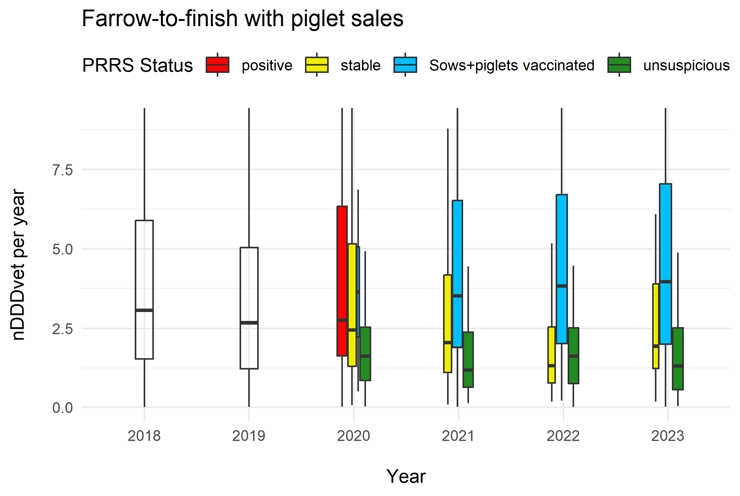
Antibiotic consumption in farrow to finish farms with piglet sale
R. Fuchs, AGES DSR
In 2021 and 2023, farms with the status “sows and piglets vaccinated” had three times as high AB consumption, in 2022 slightly more than
double, compared to farms with the status “PRRS unsuspected” in these years (based on the median value).
Folie 7

Slide 8
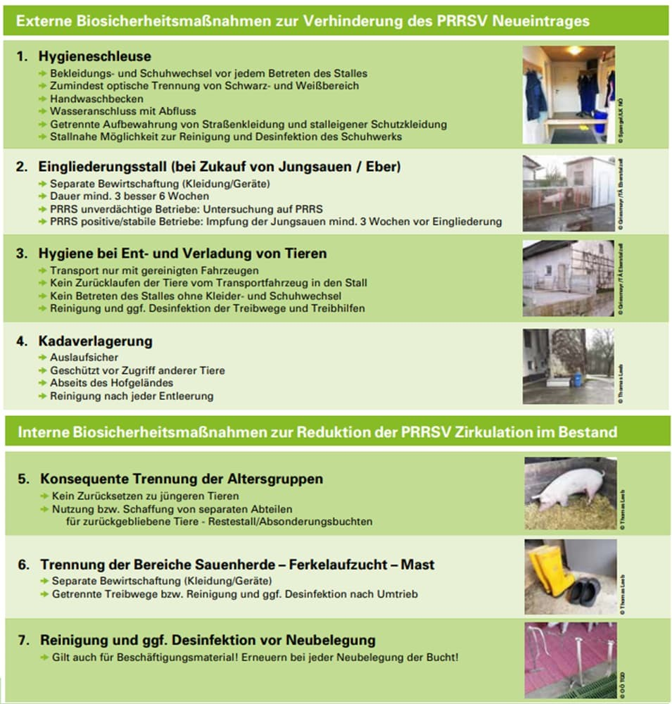
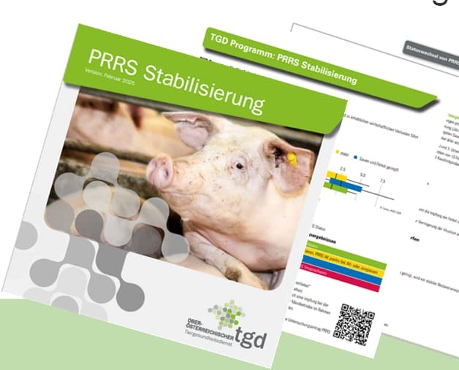
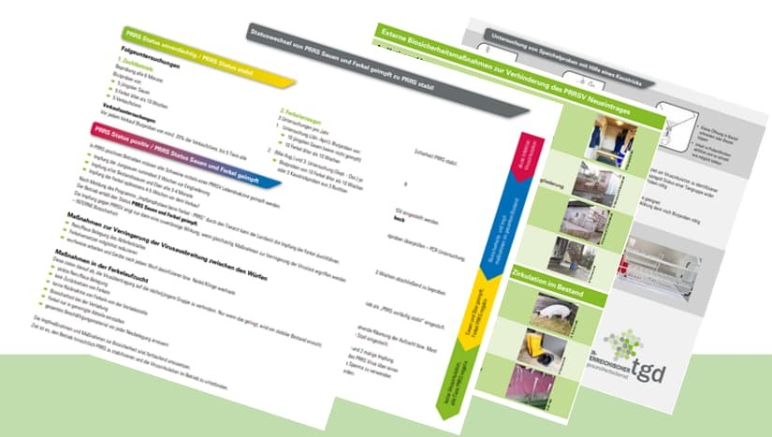
PRRS Status und Antibiotic consumption
PRRS status has a major influence on AB consumption
Avoid PRRS entry!!! – External biosecurity
Stabilizing PRRS positive farms
  Vaccination alone is usually not sufficient
  Improve internal biosecurity
🞏​ Viral load reduction necessary
🞏​ Interruption of virus circulation
  Know-how and diagnostic tools available for stabilization

Slide 9
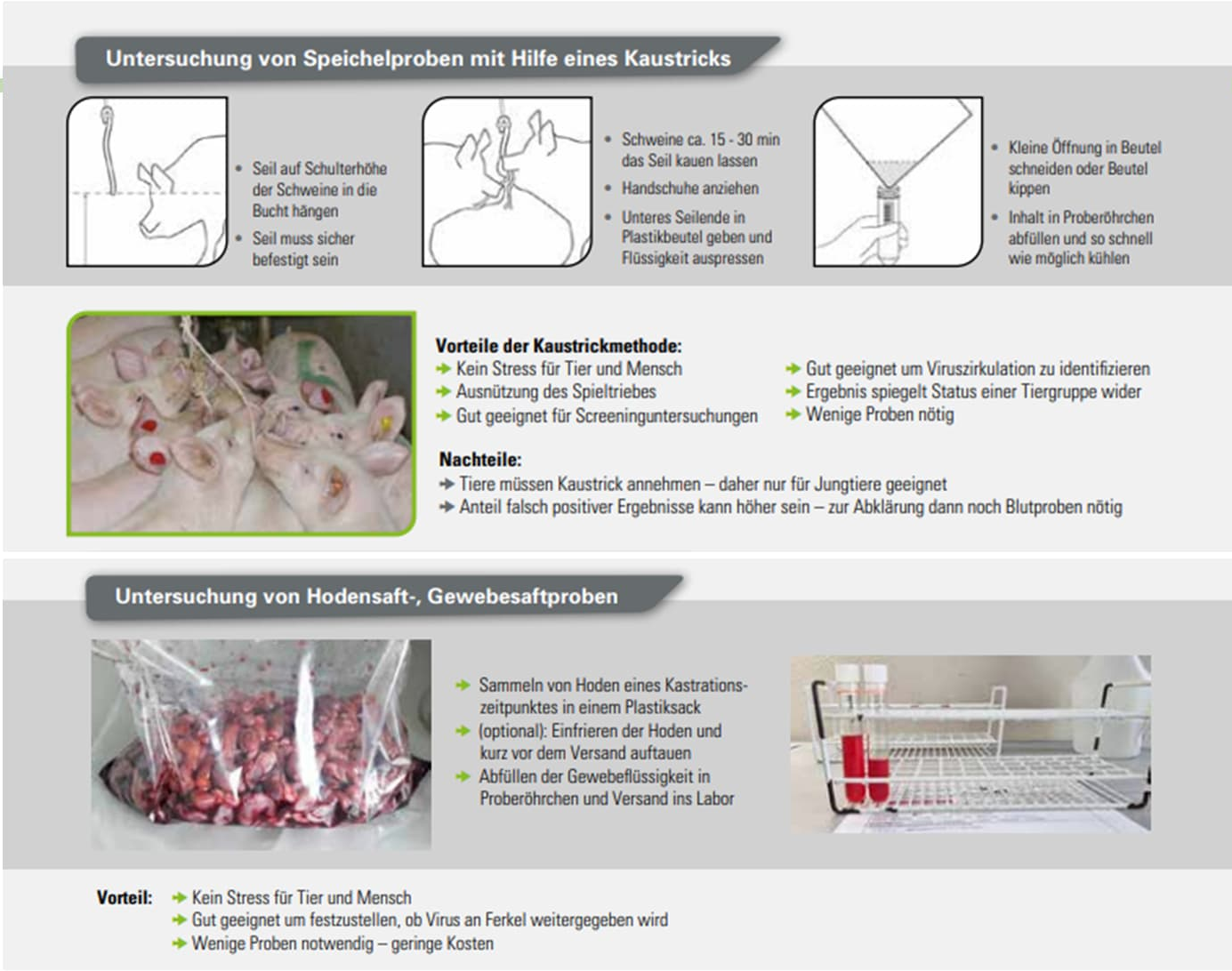

Slide 10
PRRS Status Changes
PRRS Status changes per Follow-up test
50
45
40
35
30
25
Number of farms
20
19
17
15
10
10
4
5
1
8
8
4
5
8
6
5
7
6
7
0
4
3
0
FU1-22 | FU2-22 | FU3-22 | FU1-23 | FU2-23 | FU3-23 | FU1-24 | FU2-24 | FU3-24
 | 2022 |  |  | 2023 |  |  | 2024
Summe Statusverschlechterung
Summe Statusverbesserung
Status Deterioration
Status Improvement

Slide 11
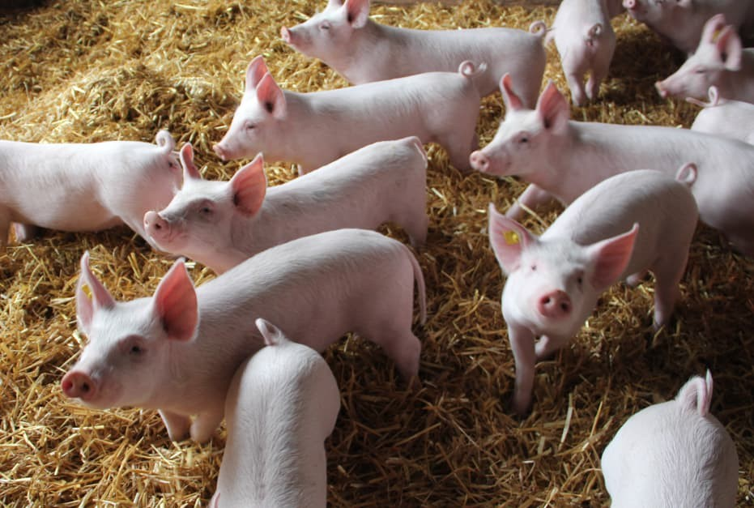
Fazit
PRRS has a strong trigger function for secondary bacterial infections
PRRS stabilization = contribution to the reduction of AB consumption
The separation of animal groups is essential to interrupt the circulation of the virus in PRRS-positive farms
PRRSV does not forgive biosecurity errors
Every single farm can improve!
Preventing new PRRSV infections

Slide 12
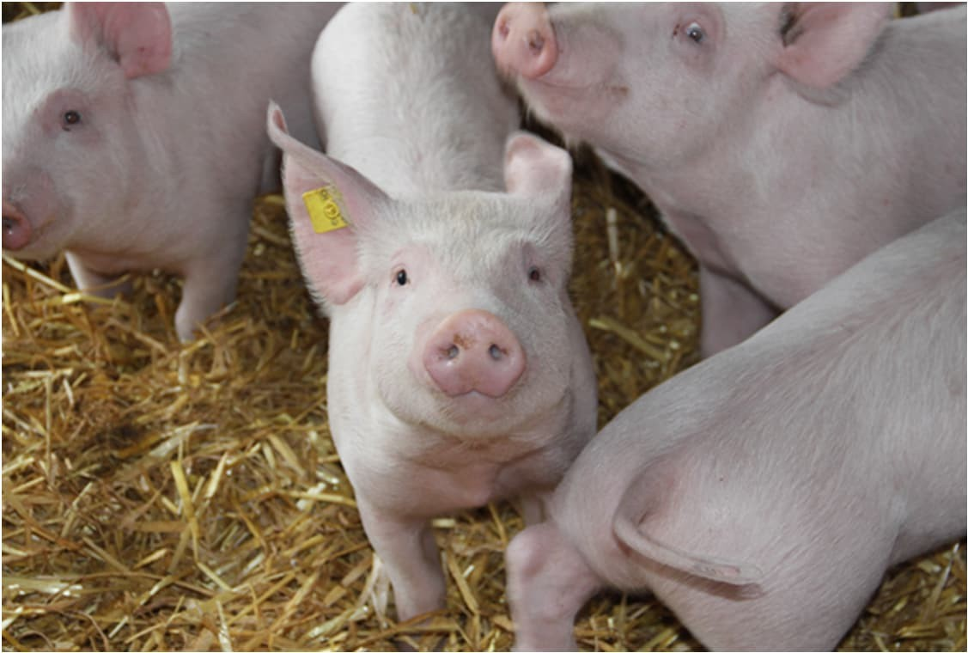
Thank you for your
attention!

